Slide 1
Communication
Goals:
discuss various dimensions of communication models
understand low-level communication protocols
discuss higher-level communication methods
extra services
extra overhead

Slide 2
Communication
The players:
sender: a process in application space
receiver: a process in (another) application space
the communication infrastructure running on both sides (and the network itself)
the message and (optional) reply – of indeterminate length

Slide 3
Dimensions of Communication
Packet-oriented versus stream-oriented
packets may be TCP packets, but think “message”
streams are continuous sets of packets
either audio, video, or both interleaved

Slide 4
Dimensions of Communication
Buffering
infinite buffering is not possible, so buffer overflow is possible
but: who keeps track of buffers?
no buffer on either side => handshake or rendezvous

Slide 5
Dimensions of Communication
Two-way versus multiway
two-way is the norm
multiway is either
broadcast: send to everyone
multicast: send to a list of interested parties
although multicast has (some) inherent network support, usually middleware provides some additional support
e.g. broadcast trees

Slide 6
Dimensions of Communication
Synchronous versus asynchronous
Does the sender block after sending a message, waiting for {an answer, a receipt by the receiver’s system, a receipt by the receiver}?
If yes => synchronous; else => asynchronous

Slide 7
Dimensions of Communication
Synchronous versus asynchronous, cont.
synchronous implies that
sender is blocked for some indeterminate amount of time
this is true in any of the three scenarios reply scenarios
receiver has some responsibility for time of service delivery
so in real systems, load balancing of some sort is good

Slide 8
Dimensions of Communication
Synchronous versus asynchronous, cont.
asynchronous implies that
sender can do some meaningful work until answer is received
sender has some mechanism for knowing when the answer arrives, either
polling for an answer
callback function that receiver or, more likely, sender’s infrastructure calls upon receipt of answer
both have issues

Slide 9
Dimensions of Communication
Transient versus persistent
are messages stored when they cannot be delivered? (i.e. server is not running at delivery time)
if yes => persistent; else => transient
persistent is like email: you don’t lose messages because you weren’t there to read them *exactly* when they were delivered
message queueing systems typically provide source and destination queues, may provide intermediate-node queuing, plus routing and naming services

Slide 10
Dimensions of Communication
Transient/persistent and synchronous/asynchronous
so: four overall combinations; one has three options
Recall that persistence requires storage for messages for later delivery: at destination, but possibly somewhere along the message’s route

Slide 11
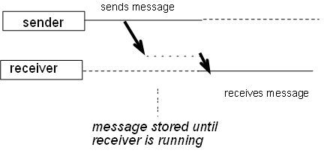
Dimensions of Communication
Persistent asynchronous: sender doesn’t wait, message is stored

Slide 12
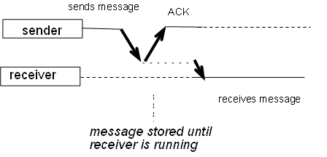
Dimensions of Communication
Persistent synchronous: sender waits for acknowledgement by queuing system; message is stored

Slide 13
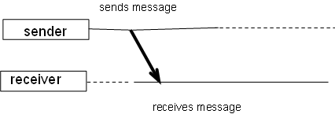
Dimensions of Communication
Transient asynchronous: sender doesn’t wait for acknowledgement; receiver must be running because message is stored – if not, message is just dropped (same for next two)

Slide 14
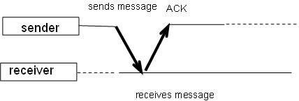
Dimensions of Communication
Receipt-based transient synchronous: sender waits for acknowledgement of message arrival only, not for answer

Slide 15
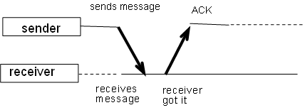
Dimensions of Communication
Delivery-based transient synchronous: sender waits for acknowledgement of message delivery to receiver, but still not for answer

Slide 16
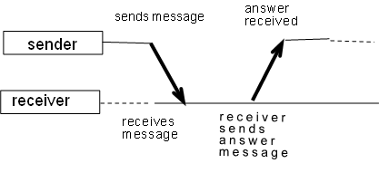
Dimensions of Communication
Response-based transient synchronous: sender waits for answer. This is the “normal” case

Slide 17
Low Level Communication
OSI model
Seven levels, only followed conceptually
but: packet-oriented protocol is the basis for almost all networking
data link header{network link header{transport header { ...{message}}}
Three “real” levels: application, connection, physical
Connection-oriented versus connectionless
i.e., is state of connection maintained between messages?

Slide 18
Low Level Communication
Connection level
two levels in OSI: transport and network
network: IP
host-to-host, connectionless
transport
UDP: process-to-process, connectionless, unreliable
TCP: process-to-process, structured, connection-oriented, reliable via ack/nack+retransmit
TCP re-orders subpackets on arrival

Slide 19
Low Level Communication
TCP request-answer
establish connection: sender syn, receiver syn-ack, sender ack
data transfer: sender request, sender end, receiver ack, receiver answer, receiver end, sender ack
Transactional TCP reduces this to three messages: sender combines syn with request and end, receiver syn + ack + answer + end, sender ack

Slide 20
Low Level Communication
Other features are added by upper OSI layers and/or by application
record formats, application-specific protocols, etc.
e.g. FTP, http
some features are not likely to be in the communication infrastructure – again, see the end-to-end argument handout

Slide 21
Low Level Communication
Programming to TCP/IP
Berkeley sockets – see the code examples
complicated, hard to debug, easy to break => better tools would be good
socket sounds like a physical thing, but it’s a software thing

Slide 22
Low Level Communication
Berkeley sockets
socket( ) creates it; used in both TCP and UDP
bind( ) specifies the port number
listen( ) prepares the socket, allows for simultaneous connections
accept( ) blocks server until connection – OR – connect( ) by client specifies server and port #
read(), write( ) are standard UNIX calls
close( ) shuts down the socket

Slide 23
Low Level Communication
Berkeley sockets, cont.
so: server does
socket – bind – listen – accept – read/write – close
client does
socket – connect – write/read – close
Note that UDP sequences are shorter:
socket –bind-recvfrom-sendto-close; socket – sendto – recvfrom – close

Slide 24
High Level Communication
Programmers use function or procedure calls to structure code, so why not use that for communication?
Remote Procedure Call (RPC): mimic conventional procedure call – and – return, with parameters and return value
hides (most) low-level details of communication => transparency
Remote Method Invocation (RMI): object-oriented version of RPC, with some nicer features

Slide 25
High Level Communication
RPC mechanics
client makes procedure call to client stub, blocks
client stub packages up the call name, parameters, and finds server name
client calls communication layer to send message
server communication layer receives message, upcalls server stub
server stub unpacks message, calls server procedure
answer is returned the same way

Slide 26
High Level Communication
RPC issues:
location of the server
data formats
parameters: by-value is no problem, but what about by-reference and by-address?
disallow, or
copy-in, copy-out
variable-length parameter lists
notification to client that procedure has failed

Slide 27
High Level Communication
Sun’s RPC model
uses rpcgen to generate client and server stubs
server program started as background process
client program started with name of server, bound to setup call

Slide 28
High Level Communication
RPC procedure call format
IP header | 20
UDP header | 8
Transaction ID | 4
Call code | 4
RPC Version # | 4
Program # | 4
Version # | 4
Procedure # | 4
Client info | 400
Verifier | 400
Parameter

Slide 29
High Level Communication
RPC reply format
IP header 20 bytes
UDP header 8 bytes
Transaction id 4 bytes
reply code (1) 4 bytes
status 4 bytes
server info up to 400 bytes
return status 4 bytes
results

Slide 30
High Level Communication
External Data Representation (XDR)
common data format
examples: int, float, string, struct
not necessarily compatible with native format
e.g. 32 bit INTEGER <-> 64 bit native int doesn’t map correctly
complex data types are not supported

Slide 31
High Level Communication
Other services:
authentication of clients
tweaking timeout and re-transmit
Port mapper
server needs a port
details handled in initialization
NFS protocol
Sun client-server application
transparent (after setup) file access between clients and servers

Slide 32
High Level Communication
Other RPC variations exist
Asynchronous RPC
uses acknowledgement of request, then returns answer with another async RPC call to client
Doors: optimizes calls to local server versus remote server, transparently
Other, non-Sun RPC
DCE: Distributed Computing Environment
adds dynamic binding to server using directory service: client contacts service to find server (which previously registered with the service)

Slide 33
High Level Communication
Java Remote Method Invocation
define an interface based on Remote:
public interface myInterface extends Remote
{ returntype fn( params ) throws RemoteException;
}
server implements the interface, and inherits from UnicastRemoteObject
public class myClass extends UnicastRemoteObject implements myInterface
{ … code for fn( ) … }

Slide 34
High Level Communication
Java RMI, cont.
server generates stubs using rmic
server registers with registry service from main( ) using Naming class:
bind( ), rebind( ), lookup( )
server started in background

Slide 35
High Level Communication
Java RMI, cont.
client uses registry service to find server
client calls remote method
public class client {
public static void main(String[] args) {
String url = “rmi://someserver.com”;
myclass m = (myclass)Naming.lookup(url + “binding name”);
m.fn( );
}

Slide 36
High Level Communication
Java also supports:
callbacks: the client registers with the server to respond to server-side events
reflection: request message can contain information about what method should be called, via invoke( )

Slide 37
High Level Communication
Distributed objects in Java
serialization: marshalling an object for transmission across the network
note that data representation on different machines is finessed by JVM
proxy: local interface for a remote object
mutual exclusion via synchronized methods is done at the proxy => other proxies may be accessing the remote object

Slide 38
High Level Communication
Message-oriented middleware
queue-based message forwarding system
persistent asynchronous communication
see Tanenbaum notes for more details

Slide 39
High Level Communication
Middleware in general
typically picks one of the models discussed as its basis, but may allow more than one method
some commercial candidates are:
CORBA
Web Services via XML and SOAP
Java Beans

