Slide 1
DISTRIBUTED SYSTEMS
Principles and Paradigms
Second Edition
ANDREW S. TANENBAUM
MAARTEN VAN STEEN
Chapter 9
Security

Slide 2
Security Threats, Policies, and Mechanisms
Types of security threats to consider:
Interception
Interruption
Modification
Fabrication

Slide 3
Example: The Globus Security Architecture (1)
The environment consists of multiple administrative domains.
Local operations are subject to a local domain security policy only.
Global operations require the initiator to be known in each domain where the operation is carried out.

Slide 4
Example: The Globus Security Architecture (2)
Operations between entities in different domains require mutual authentication.
Global authentication replaces local authentication.
Controlling access to resources is subject to local security only.
Users can delegate rights to processes.
A group of processes in the same domain can share credentials.

Slide 5
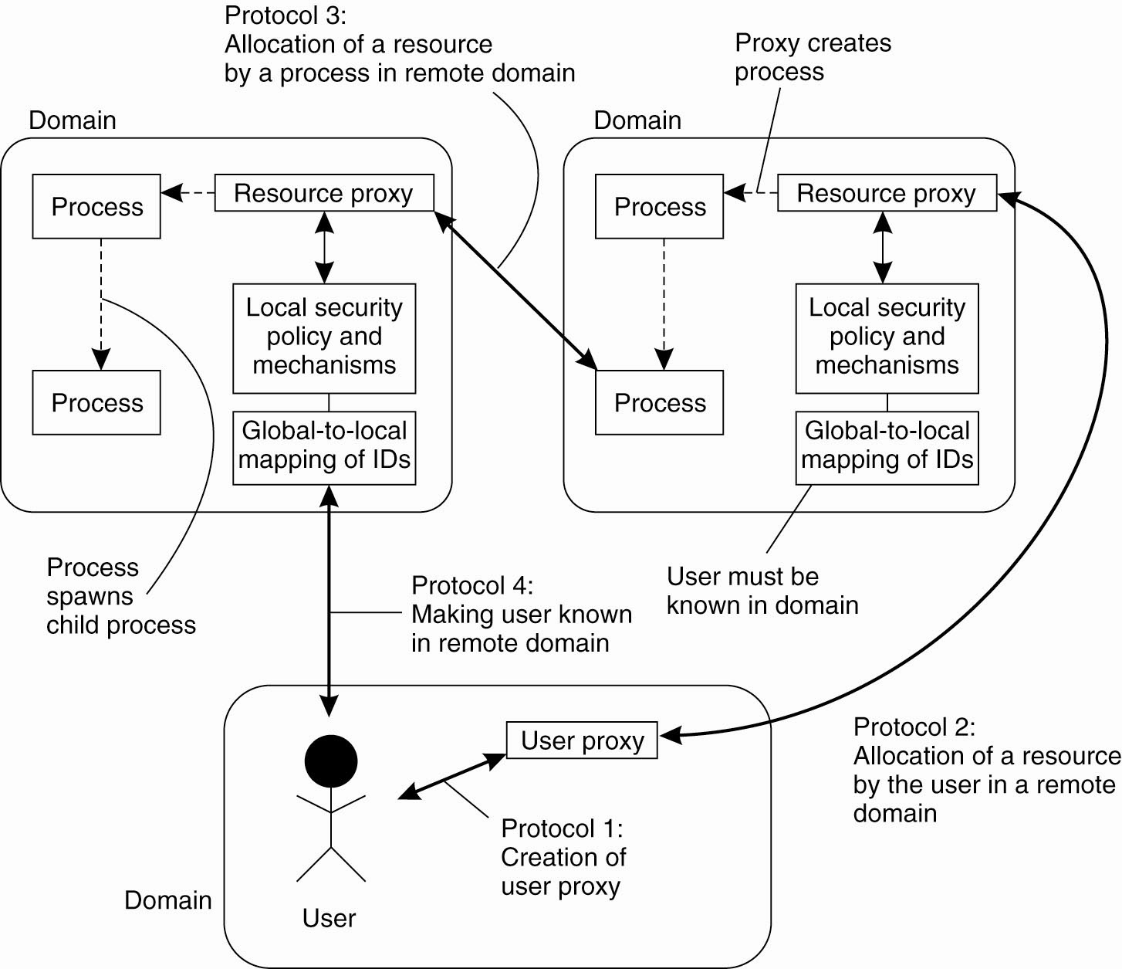
Example: The Globus
Security Architecture (2)
Figure 9-1. The Globus security architecture.

Slide 6
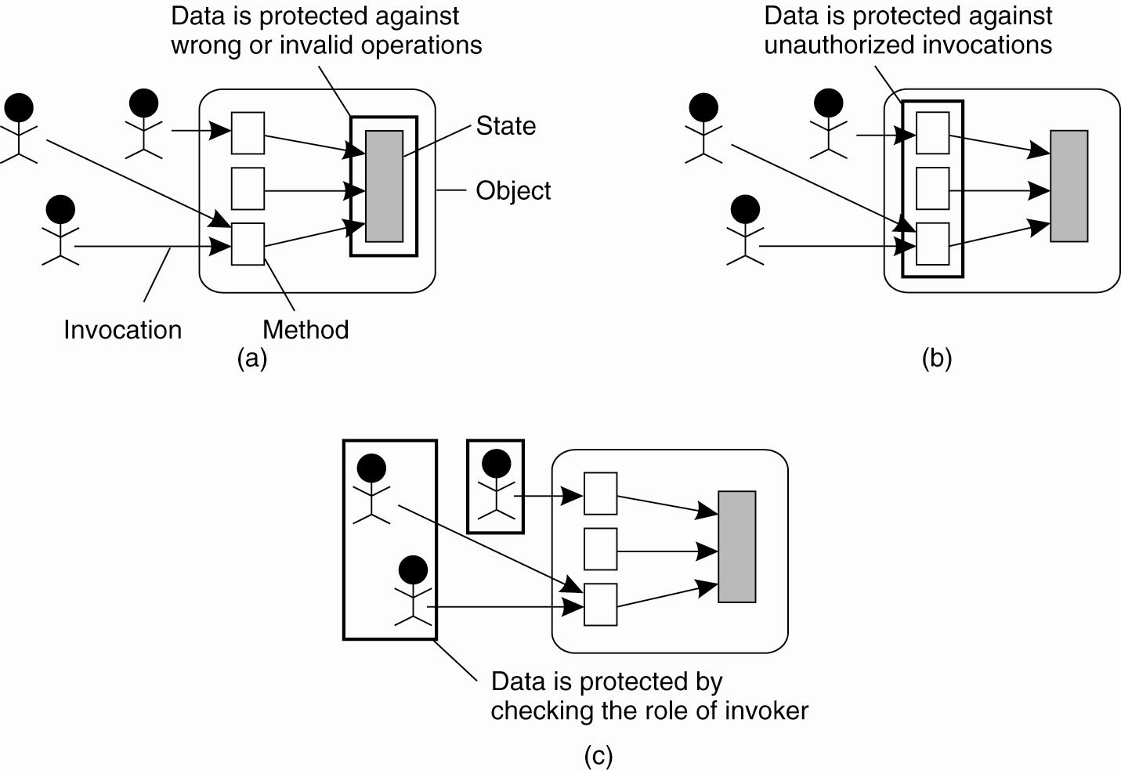
Focus of Control (1)
Figure 9-2. Three approaches for protection against security threats. (a) Protection against invalid operations

Slide 7
Focus of Control (2)
Figure 9-2. Three approaches for protection against security threats. (b) Protection against unauthorized invocations.

Slide 8
Focus of Control (3)
Figure 9-2. Three approaches for protection against security threats. (c) Protection against unauthorized users.

Slide 9
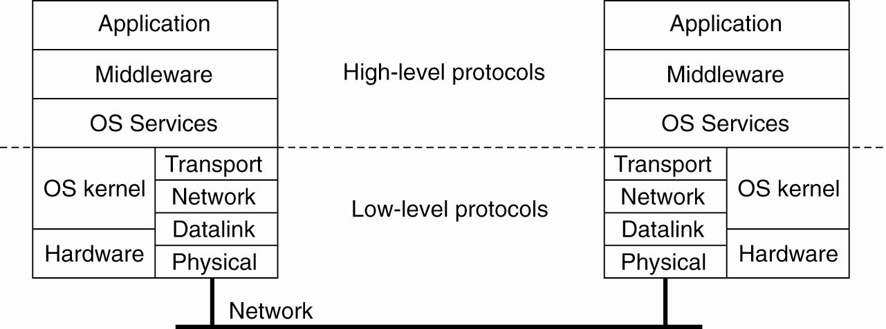
Layering of Security Mechanisms (1)
Figure 9-3. The logical organization of a
distributed system into several layers.

Slide 10
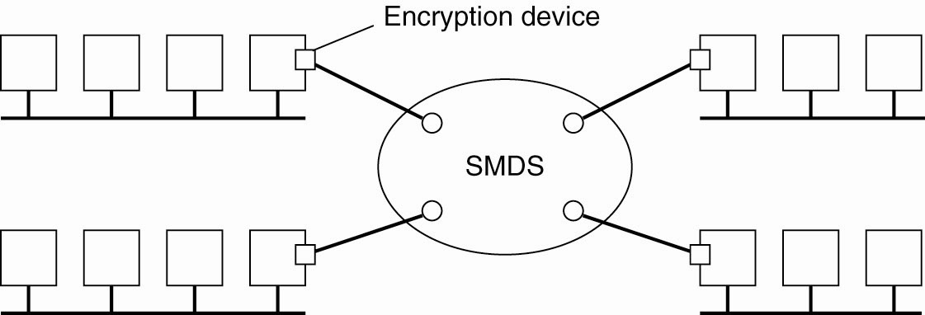
Layering of Security Mechanisms (2)
Figure 9-4. Several sites connected through
a wide-area backbone service.

Slide 11
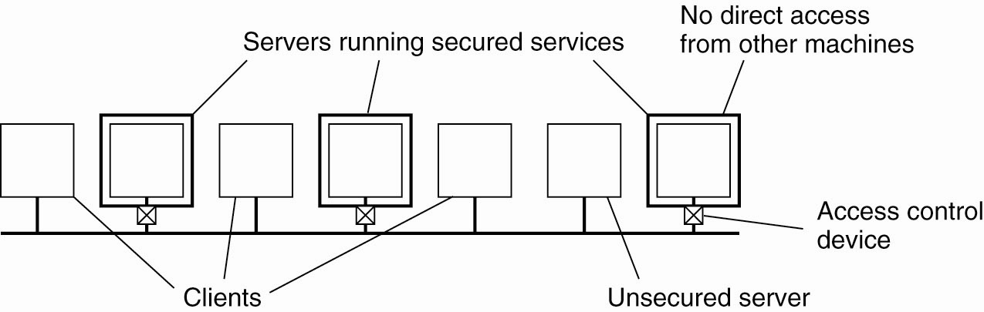
Distribution of Security Mechanisms
Figure 9-5. The principle of RISSC as
applied to secure distributed systems.

Slide 12
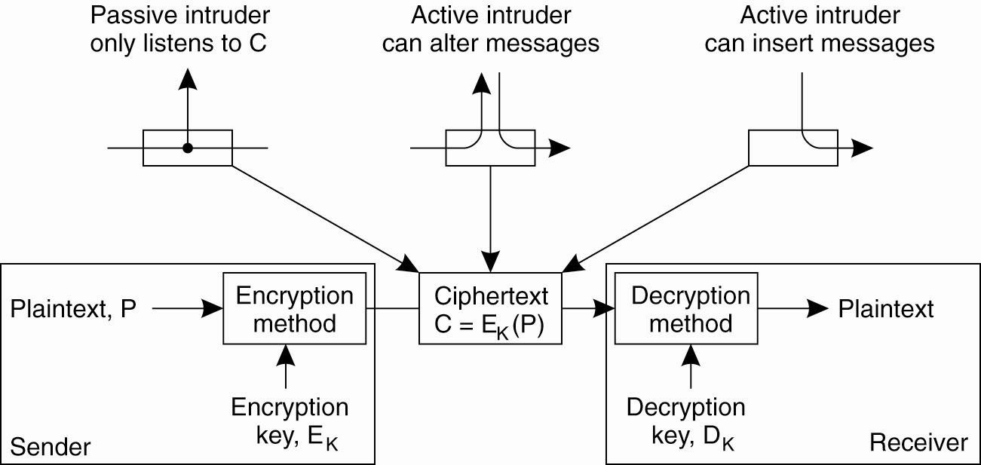
Cryptography (1)
Figure 9-6. Intruders and eavesdroppers in communication.

Slide 13
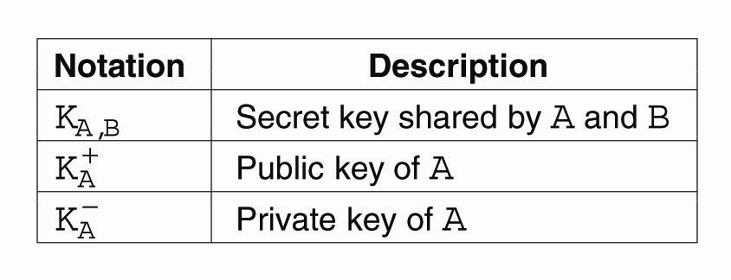
Cryptography (2)
Figure 9-7. Notation used in this chapter.

Slide 14
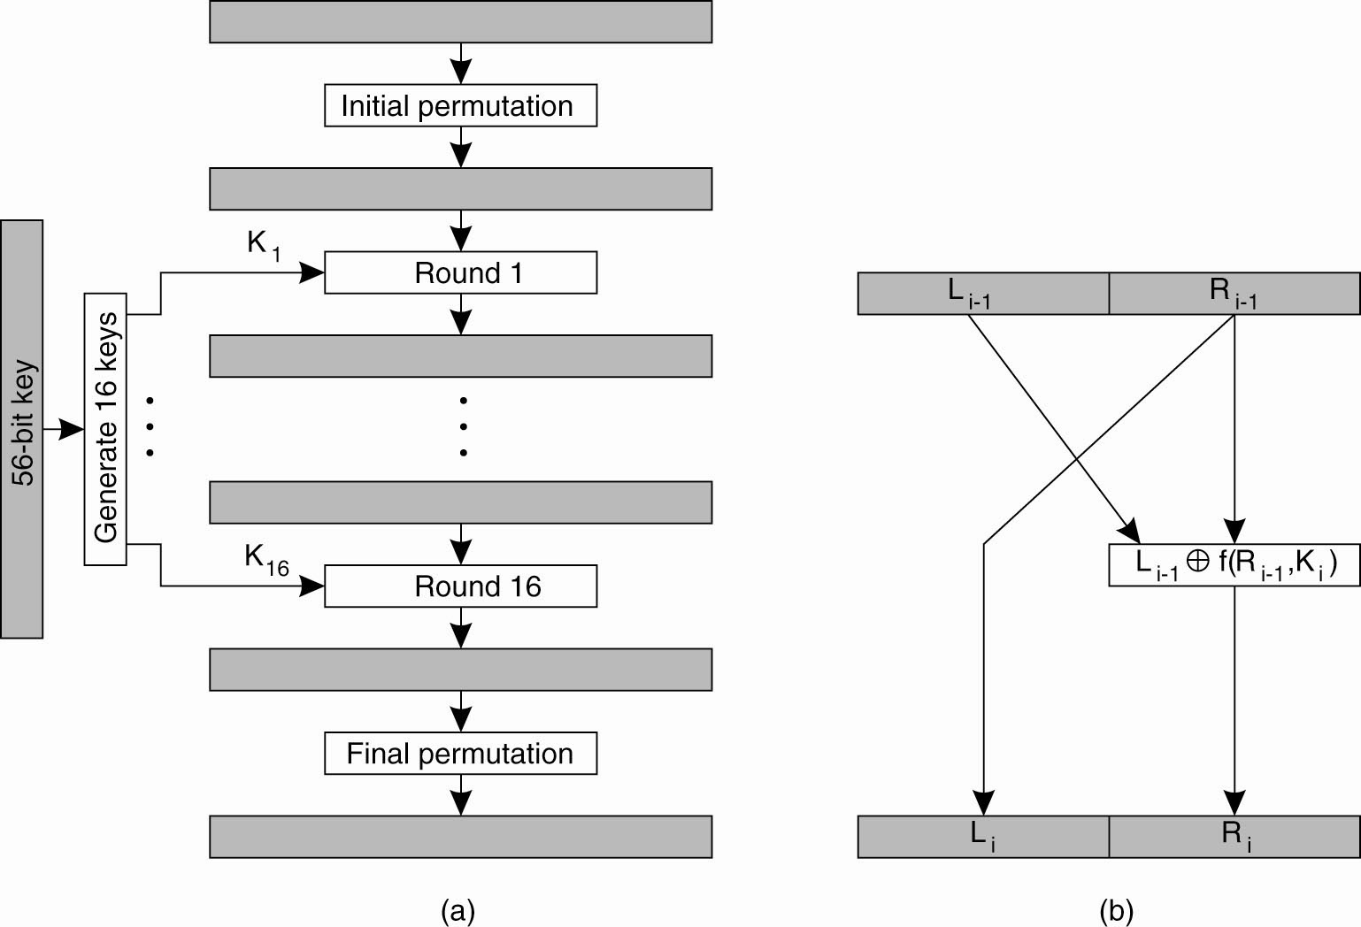
Symmetric Cryptosystems: DES (1)
Figure 9-8. (a) The
principle of DES.

Slide 15
Symmetric Cryptosystems: DES (2)
Figure 9-8. (b) Outline of
one encryption round.

Slide 16
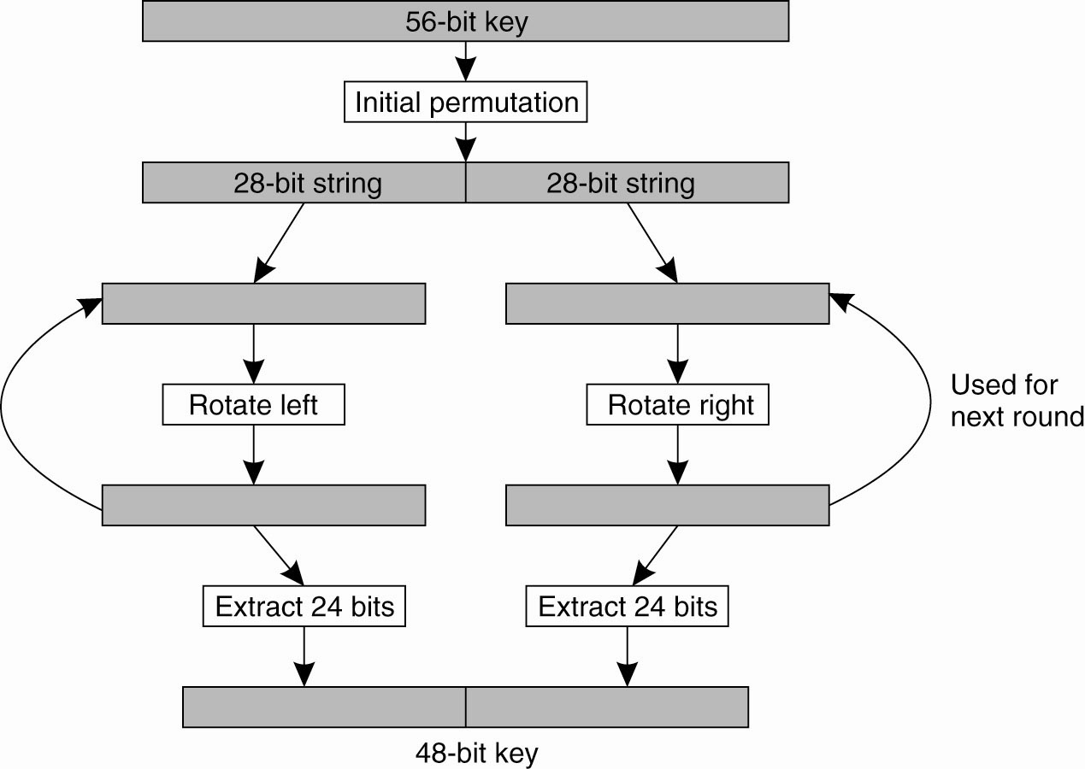
Symmetric Cryptosystems: DES (3)
Figure 9-9. Details of per-round key generation in DES.

Slide 17
Public-Key Cryptosystems: RSA
Generating the private and public keys requires
four steps:
Choose two very large prime numbers, p and q.
Compute n = p × q and z = (p − 1) × (q − 1).
Choose a number d that is relatively prime to z.
Compute the number e such that
e × d = 1 mod z.

Slide 18
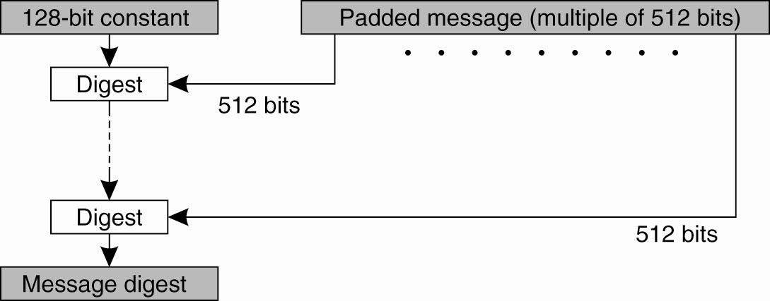
Hash Functions: MD5 (1)
Figure 9-10. The structure of MD5.

Slide 19
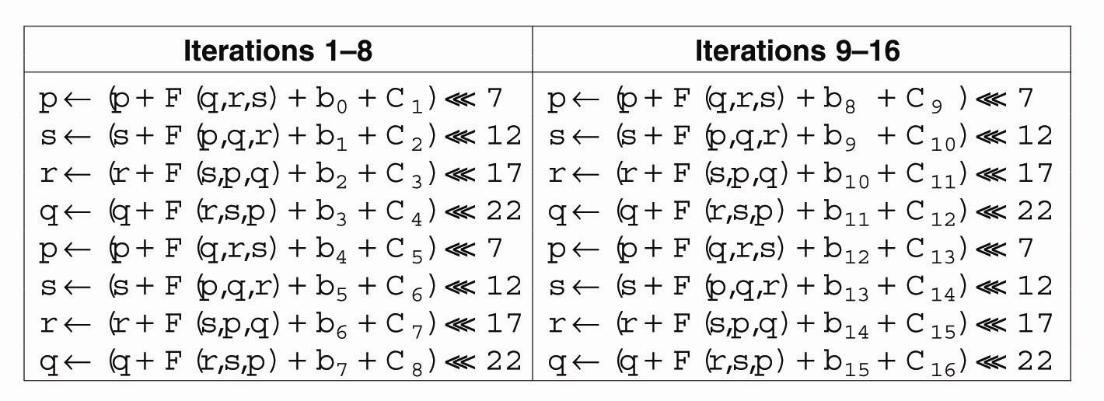
Hash Functions: MD5 (2)
Figure 9-11. The 16 iterations during the
first round in a phase in MD5.

Slide 20
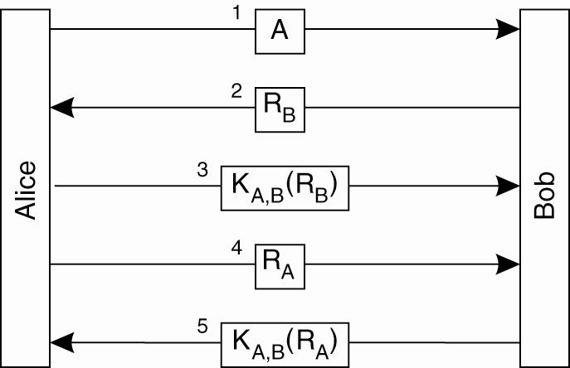
Authentication Based on a Shared Secret Key (1)
Figure 9-12. Authentication based on a shared secret key.

Slide 21
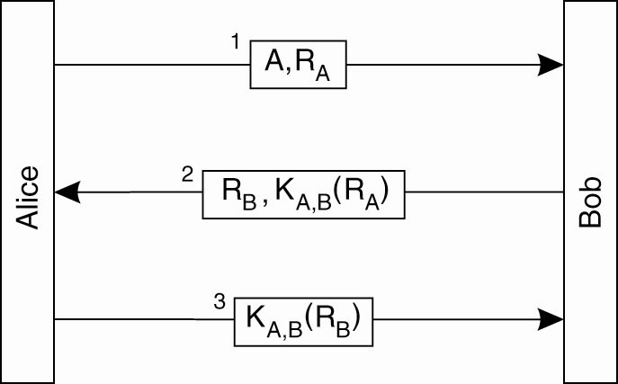
Authentication Based on a Shared Secret Key (2)
Figure 9-13. Authentication based on a shared
secret key, but using three instead of five messages.

Slide 22
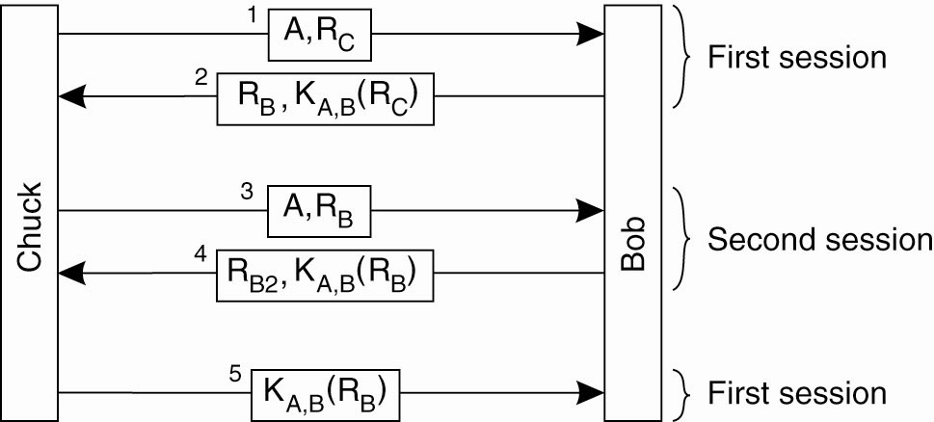
Authentication Based on a Shared Secret Key (3)
Figure 9-14. The reflection attack.

Slide 23
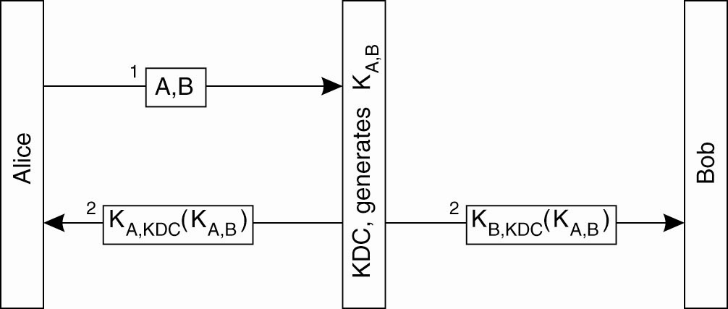
Authentication Using a
Key Distribution Center (1)
Figure 9-15. The principle of using a KDC.

Slide 24
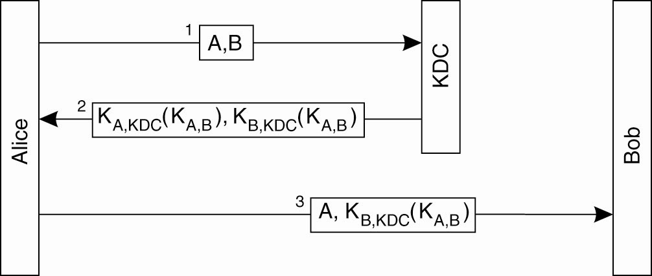
Authentication Using a
Key Distribution Center (2)
Figure 9-16. Using a ticket and letting
Alice set up a connection to Bob.

Slide 25
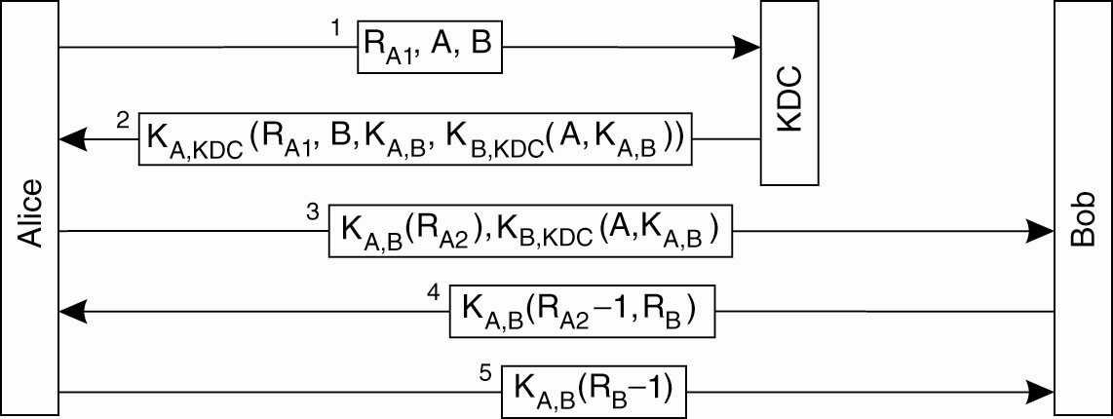
Authentication Using a
Key Distribution Center (3)
Figure 9-17. The Needham-Schroeder authentication protocol.

Slide 26
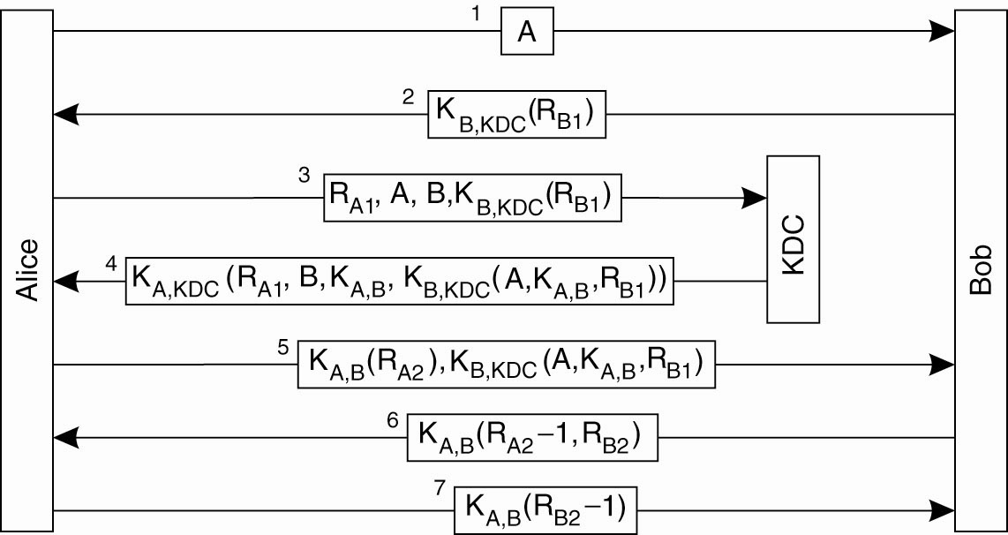
Authentication Using a
Key Distribution Center (4)
Figure 9-18. Protection against malicious reuse of a previously generated session key in the Needham-Schroeder protocol.

Slide 27
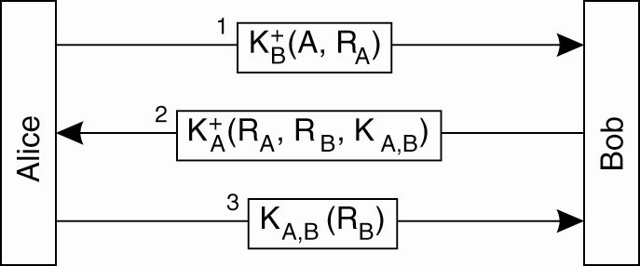
Authentication Using a
Key Distribution Center (5)
Figure 9-19. Mutual authentication in a public-key cryptosystem.

Slide 28
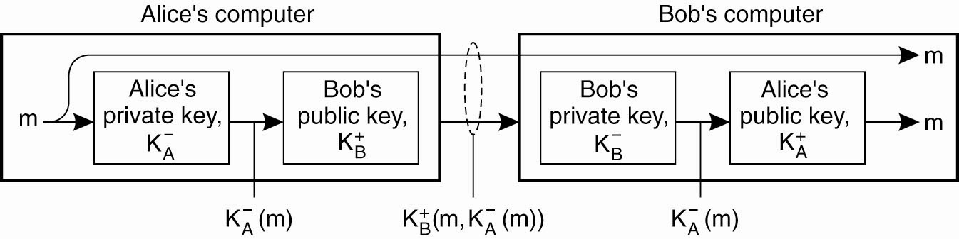
Digital Signatures (1)
Figure 9-20. Digital signing a message
using public-key cryptography.

Slide 29
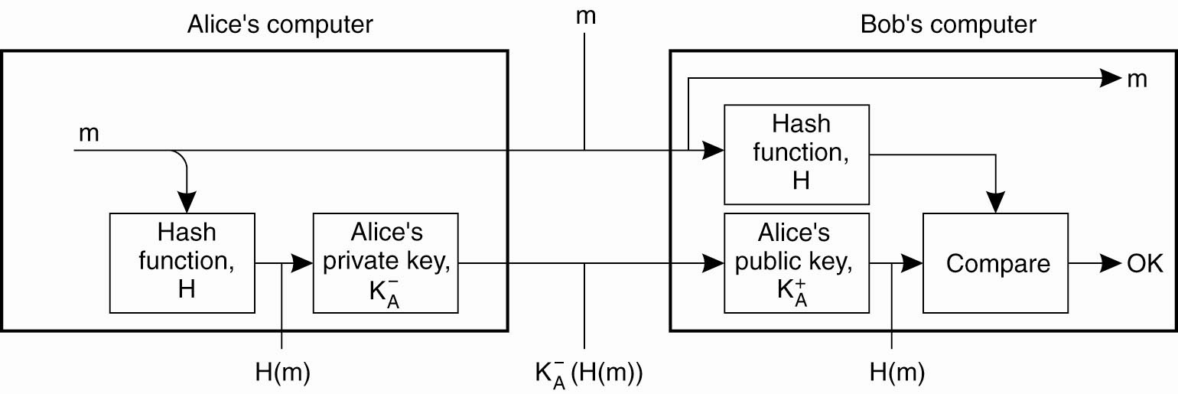
Digital Signatures (2)
Figure 9-21. Digitally signing a message using a message digest.

Slide 30
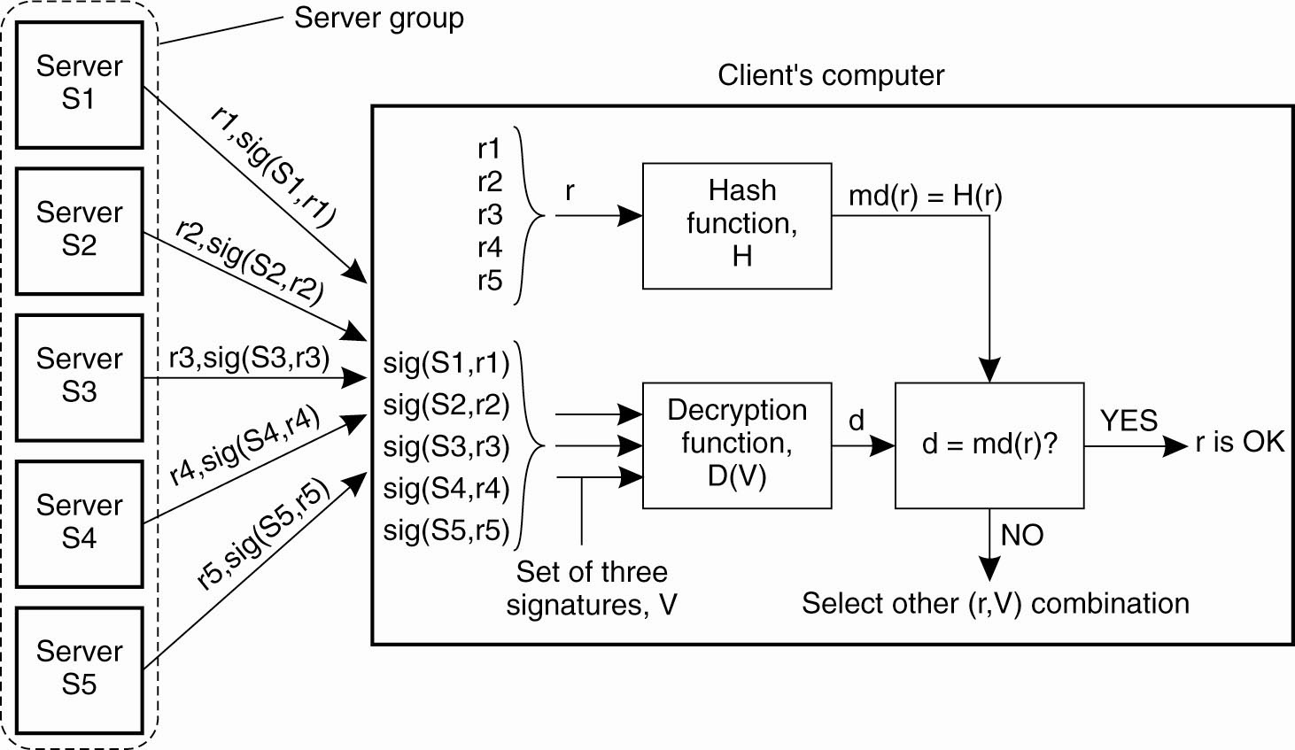
Secure Replicated Servers
Figure 9-22. Sharing a secret signature
in a group of replicated servers.

Slide 31
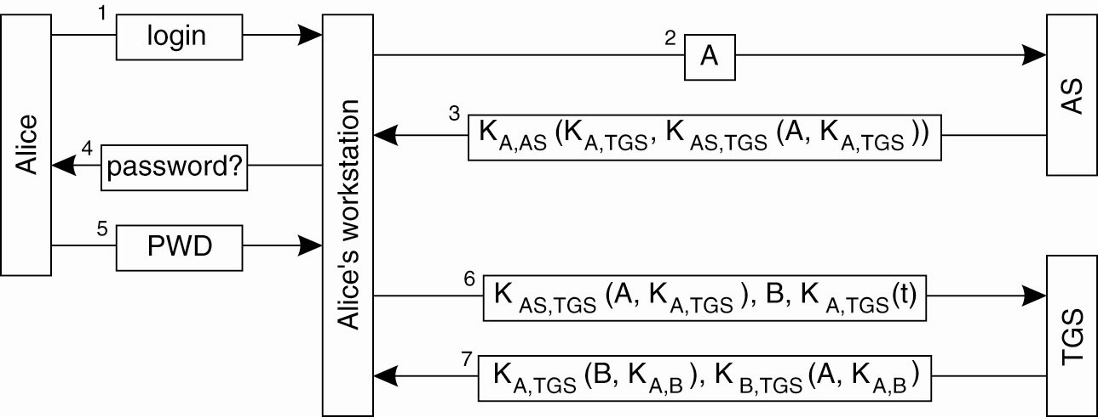
Example: Kerberos (1)
Figure 9-23. Authentication in Kerberos.

Slide 32
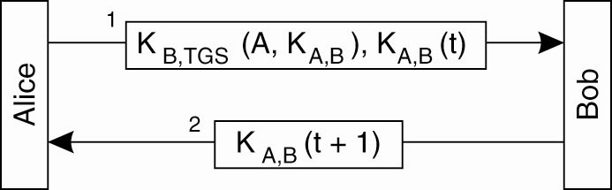
Example: Kerberos (2)
Figure 9-24. Setting up a secure channel in Kerberos.

Slide 33
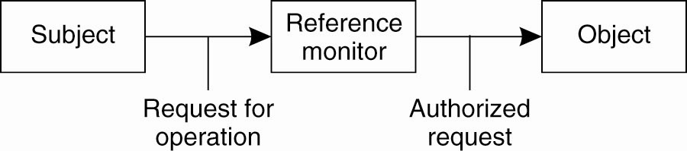
General Issues in Access Control
Figure 9-25. General model of controlling access to objects.

Slide 34
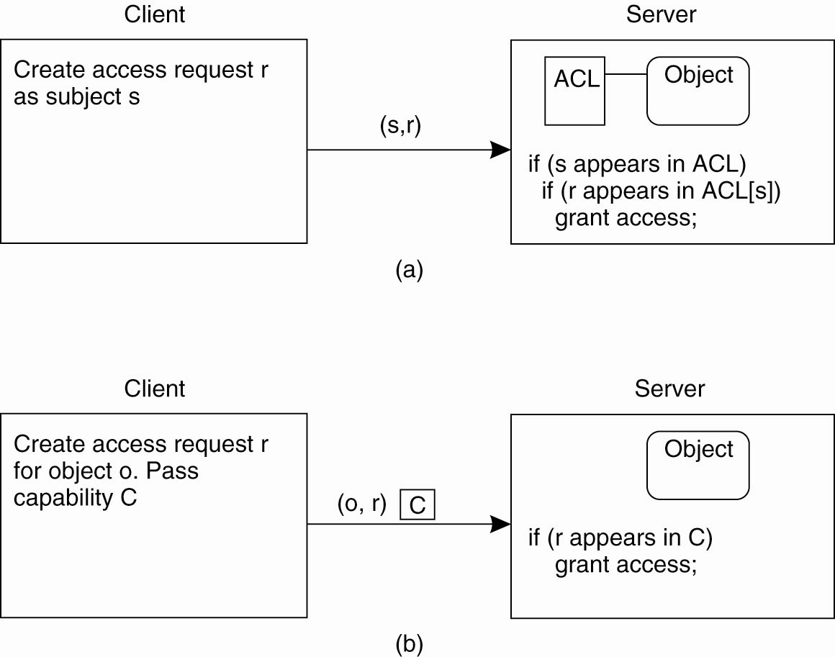
Access Control Matrix (1)
Figure 9-26. Comparison between ACLs and capabilities for protecting objects. (a) Using an ACL.

Slide 35
Access Control Matrix (2)
Figure 9-26. Comparison between ACLs and capabilities for protecting objects. (b) Using capabilities.

Slide 36
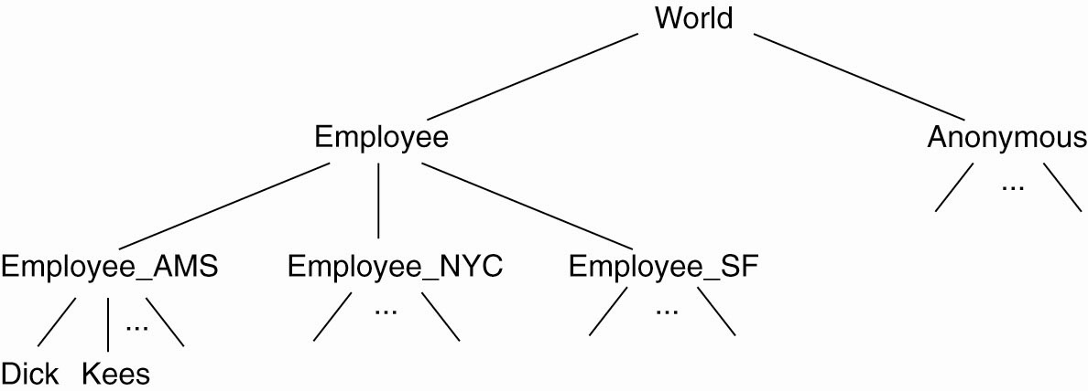
Protection Domains
Figure 9-27. The hierarchical organization of
protection domains as groups of users.

Slide 37
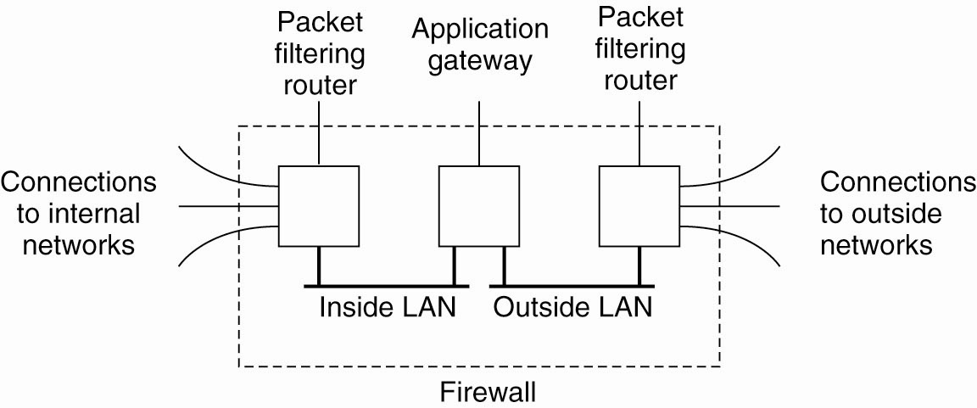
Firewalls
Figure 9-28. A common implementation of a firewall.

Slide 38
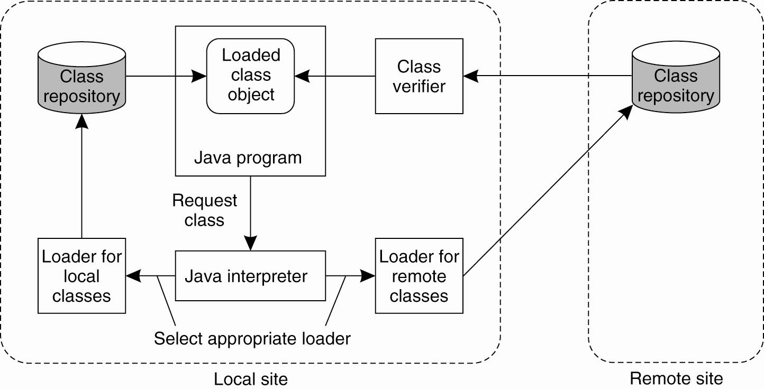
Protecting the Target (1)
Figure 9-29. The organization of a Java sandbox.

Slide 39
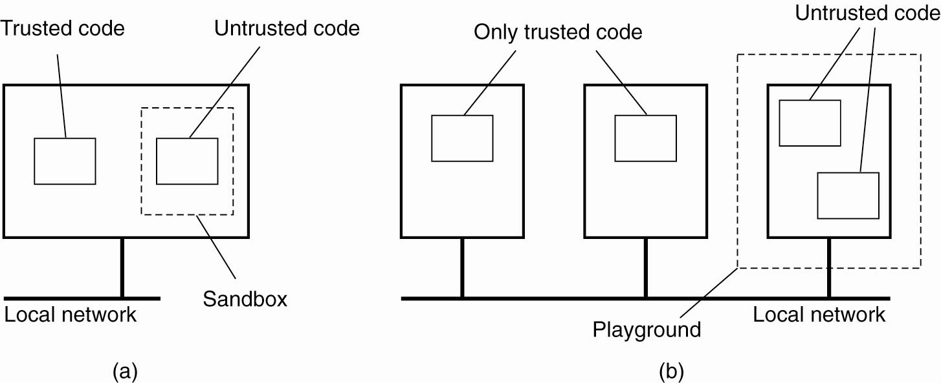
Protecting the Target (2)
Figure 9-30. (a) A sandbox. (b) A playground.

Slide 40
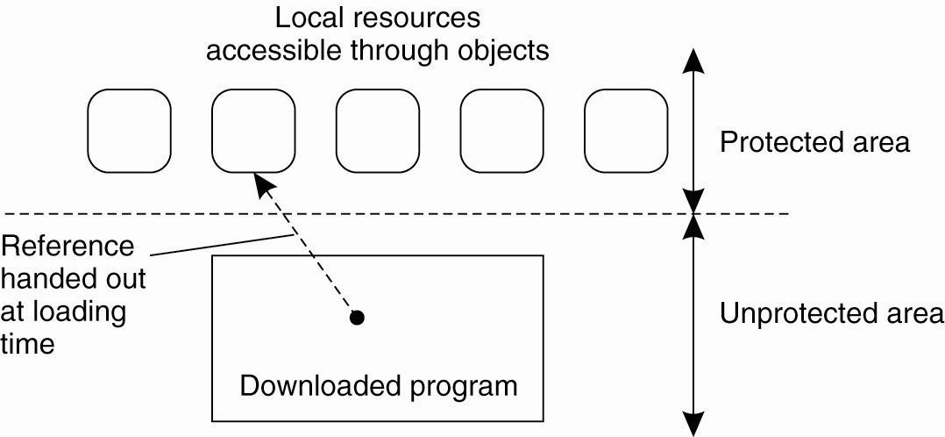
Protecting the Target (3)
Figure 9-31. The principle of using Java object
references as capabilities.

Slide 41
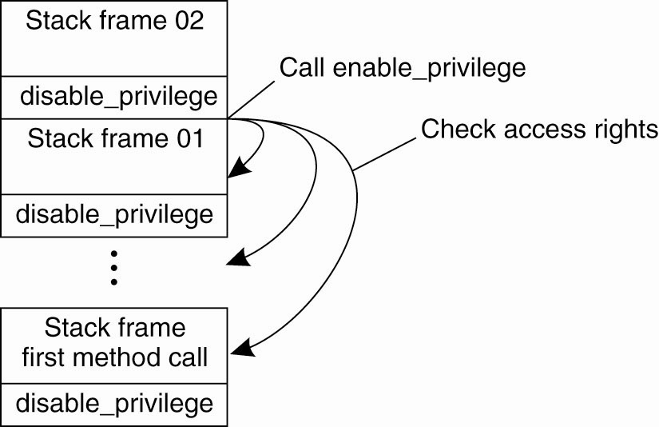
Protecting the Target (4)
Figure 9-32. The principle of stack introspection.

Slide 42
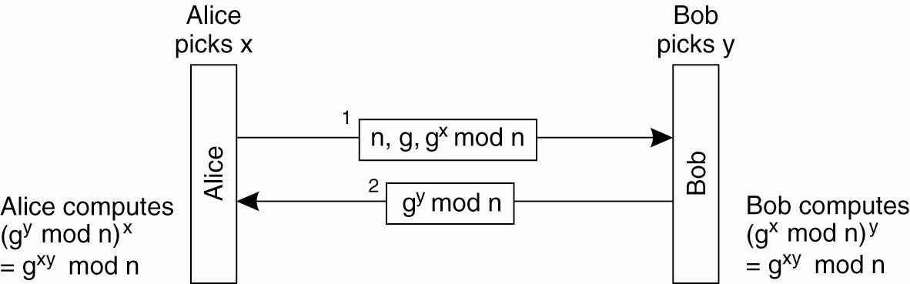
Key Establishment
Figure 9-33. The principle of Diffie-Hellman key exchange.

Slide 43
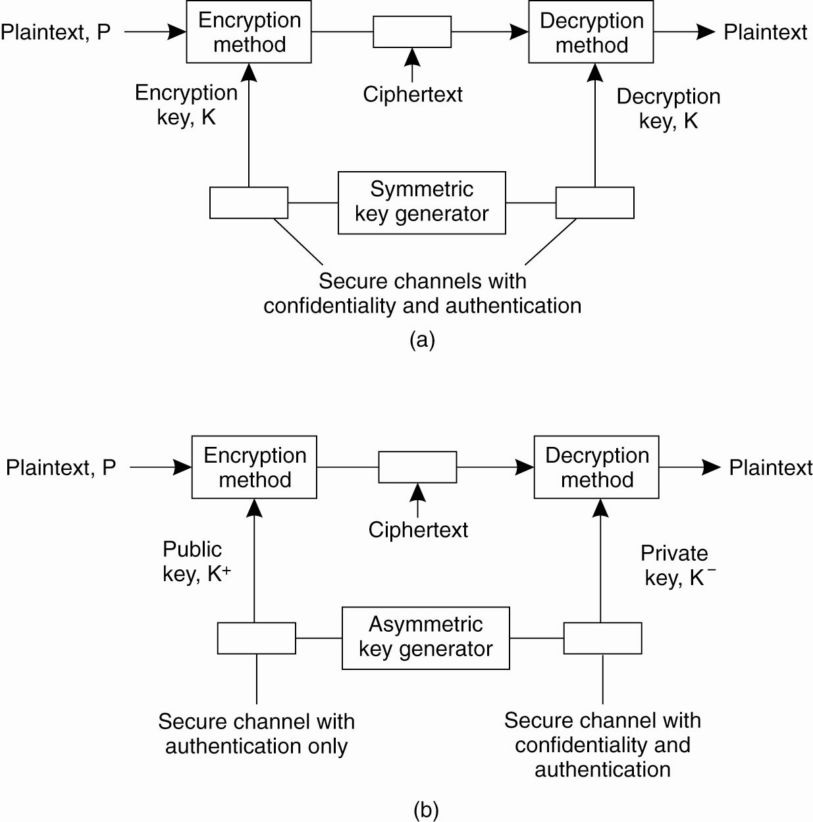
Key Distribution (1)
Figure 9-34. (a) Secret-key distribution.
[see also Menezes et al. (1996)].

Slide 44
Key Distribution (2)
Figure 9-34. (b) Public-key distribution
[see also Menezes et al. (1996)].

Slide 45
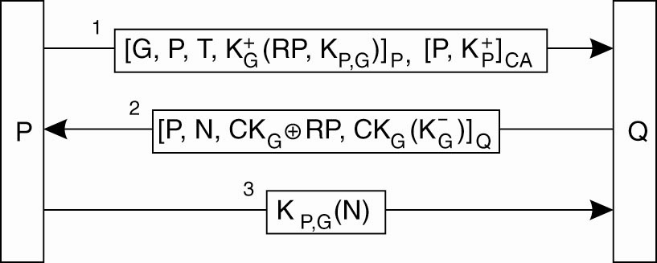
Secure Group Management
Figure 9-35. Securely admitting a new group member.

Slide 46

Capabilities and Attribute Certificates (1)
Figure 9-36. A capability in Amoeba.

Slide 47
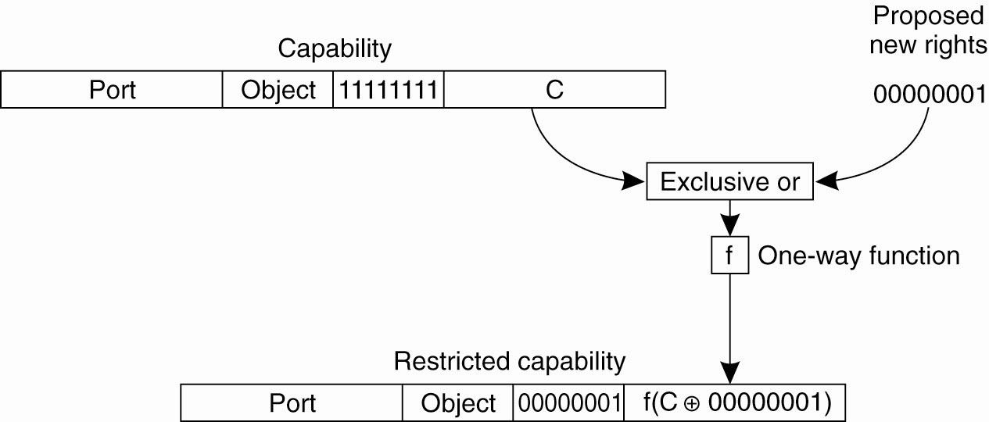
Capabilities and Attribute Certificates (2)
Figure 9-37. Generation of a restricted capability
from an owner capability.

Slide 48
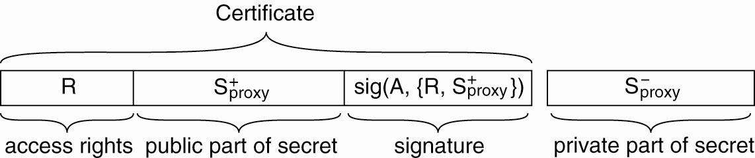
Delegation (1)
Figure 9-38. The general structure of a
proxy as used for delegation.

Slide 49
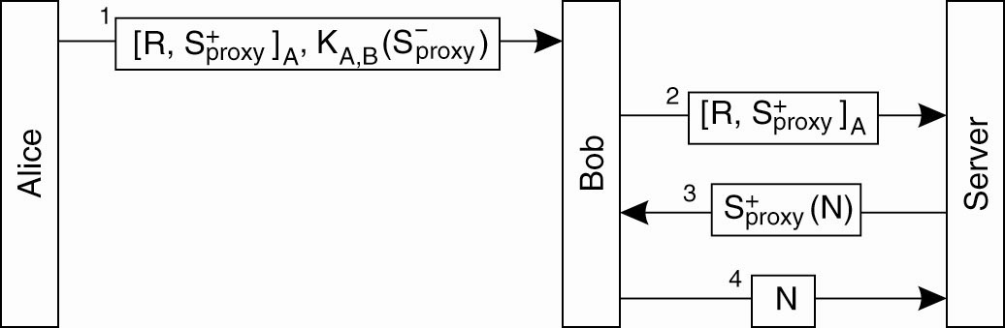
Delegation (2)
Figure 9-39. Using a proxy to delegate and
prove ownership of access rights.

