Slide 1
CSCI5200-201
Requirements Specifications

Slide 2
Requirements Specification
A precise statement of the requirements that the system must satisfy.
Precision means there must be only one interpretation of the statement.

Slide 3
Specifying Requirements
Natural Language
Major problems
Ambiguity
Not easy to separate system elements
However, if the requirement is specified in an alternative way it is advisable to include the natural specification also.

Slide 4
Two Categories of Specifications
Static Descriptions (Data Specification)
Are used to describe data elements and relationships between them
Does not depict how the system changes over time.
Dynamic Descriptions (Functional and Behavioral Specification)
The dynamic description explains how the system reacts over a period of time to the things that change system behavior.

Slide 5
BNF
Some data elements may be described by using notation that is used to express programming languages or strings. For example, suppose we want to specify that a system date must always be outputted as, per se, DEC 25 2010. We could use BNF (Backus-Naur Form) to express this.
This method is useful when specifying interface data.
<system date> ::= <MMM><space><DD><space><YYYY>
<MMM> ::= JAN | FEB | MAR | APR | MAY | JUN | JUL | AUG | SEP | OCT | NOV | DEC
<DD> ::= <digit><digit>
<YYYY> ::= <digit><digit><digit><digit>
<digit> ::= 0 | 1 | 2 | 3 | 4 | 5 | 6 | 7 | 8 | 9

Slide 6
EBNF
Usage | Notation
definition | =
concatenation | ,
termination | ;
alternation | |
option | [ ... ]
repetition | { ... }
grouping | ( ... )
terminal string | " ... "
terminal string | ' ... '
comment | (* ... *)
special sequence | ? ... ?
exception | -

Slide 7
In this class, we’ll accept
We won’t be strict:
<system date> ::= <MMM>,” ”<DD>,” ”<YYYY>;
<MMM> ::= JAN | FEB | MAR | APR | MAY | JUN | JUL | AUG | SEP | OCT | NOV | DEC
<DD> ::= <digit><digit>
<YYYY> ::= ⁴{<digit>}⁴
<digit> ::= 0 | 1 | 2 | 3 | 4 | 5 | 6 | 7 | 8 | 9

Slide 8
Storage Requirements
Data Element | Storage Constraint
System Date | Date

Slide 9
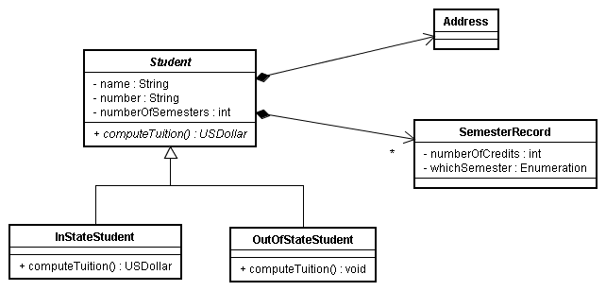
Class Diagrams
UML Distilled
Chapter 3
Chapter 5

Slide 10
Storage Requirements
Data Element | Storage Constraint
Student Information
Name | Maximum 60 characters
Number | ⁹{<character>}⁹
Number of Semesters | Integer, maximum 3 digits
Data Element | Storage Constraint
Semester Record
Number of Credits | Integer, maximum 3 digits
Which Semester | Enumeration: Fall, Spring, Summer, Winter

Slide 11
Pseudocode
The requirement is specified in a natural language but done in a structured way.
While there are more employees to process
Read employee data
Calculate employee’s salary
EndWhile

Slide 12
Basis for writing Pseudocode
Use an imperative approach
Statements are executed in a stepwise, sequential manner
Order of execution is crucial
3 control structures: sequence, selection, repetition
Assignment is destructive
Expressions yields values
Statements carry out some operation
I/O and error handling

Slide 13
Pseudocode: Selection
If something is true
Do this
And this
Endif
If something is true
Do this
Else
Do that
Endif

Slide 14
Pseudocode: Repetition
While something is true
Do this
And this
EndWhile
For each something in somewhere
Do this
EndFor
Repeat
Do this
While something is true
Repeat
Do this
Until something is true

Slide 15
Decision Tables
A decision table is a description of a system as a set of possible conditions satisfied by the system at a given time, rules for reacting to stimuli when certain sets of those conditions are met, and actions to be taken as a result.
For example, suppose the admissions office at a university is developing a system to determine whom to accept as freshmen.
 | Rules
High Standardized exam scores | Y | Y | Y | Y | Y | Y | Y | Y | N | N | N | N | N | N | N | N
High grades | Y | Y | Y | Y | N | N | N | N | Y | Y | Y | Y | N | N | N | N
Outside activities | Y | Y | N | N | Y | Y | N | N | Y | Y | N | N | Y | Y | N | N
Good recommendations | Y | N | Y | N | Y | N | Y | N | Y | N | Y | N | Y | N | Y | N
Send admission letter | X | X | X |  | X |  |  |  | X
Send rejection letter |  |  |  | X |  | X | X | X |  | X | X | X | X | X | X | X

Slide 16
State Machine Diagrams
UML Distilled Chap 10

Slide 17
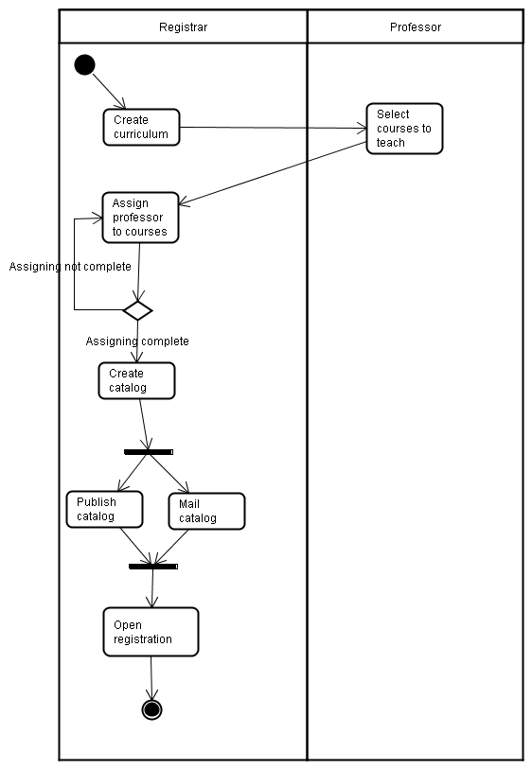
Activity Diagrams
Useful for describing synchronization and parallel processing.
UML Distilled Chap 11

Slide 18
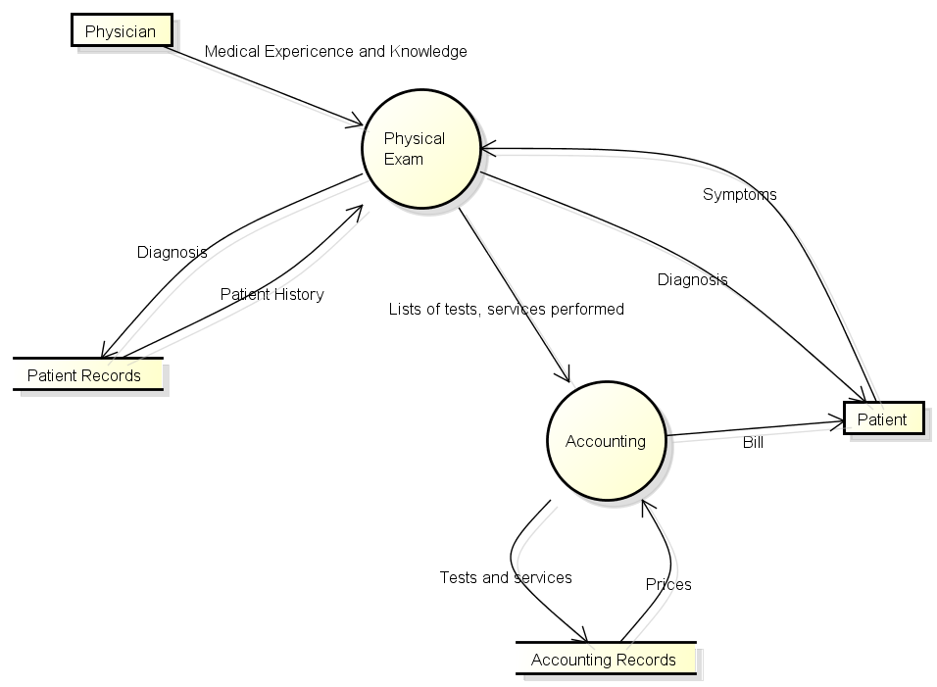
Data Flow Diagram
DFDs are used to exhibit the flow of data.

Slide 19
SSE Requirements Document
Project Identification and Definition
Project Name
Project Sponsor
Business Need
Functionality
Numbered
<User Role> shall be able to ...
Expected Value
Priority List
Application Wide Non-Functional Requirements
System Architectural Diagram
Detailed User Stories
Use case description format
Semi-formal and Formal Specifications

Slide 20
Software Requirements Specification (SRS)

Slide 21
SRS
The SRS is a specification for a particular software product, program, or set of programs that performs certain functions in a specific environment.

Slide 22
Nature of the SRS
The SRS should answer the following questions
What is the software supposed to do? (Functionality)
How does the software interact with people, the system’s hardware, other hardware, and other software? (External Interfaces)
What is the speed, availability, response time, recovery time of the various software functions, etc? (Performance)
What are the portability, correctness, maintainability, security, etc, considerations? (Attributes)
Are there any required standards in effect, implementation language, policies for database integrity, resource limits, operating environment(s), etc? (Design constraints imposed on an implementation)

Slide 23
Characteristics of a good SRS
Correct
Every requirement stated is one that the software shall meet.
Unambiguous
Every requirement has only one interpretation.
Complete
All significant requirements; definitions of all responses to all input data; full labels and references
Consistent
Must agree with higher level documents
Ranked for importance and/or stability
Each requirement has an identifier to indicate the importance or stability of that requirement.
Verifiability
Every requirement is verifiable (testable)
Modifiable
The structure and style of the SRS can be changes easily.
Traceable
The origin of each requirement is clear and facilitates the referencing of each requirement in future documentation

Slide 24
General Structure of the SRS
Table of Contents
Introduction
Overall description
Specific requirements
Index
Appendices

Slide 25
Detailed Requirements Specifications
External Interfaces
Non-functional requirements
Software System Attributes
Reliability
Availability
Security
Maintainability
Portability
Design constraints
Standards compliance
Functional Requirements specifications
Data specifications
Non-functional requirements specifications
Logical Data/Database Requirements specifications

