Slide 1
Introduction to Formal Specifications
CSCI5200

Slide 2
Writing Requirements
Approaches to writing requirements:
Semiformal and informal methods
Formal methods

Slide 3
Semiformal and Informal Approach
Semiformal and informal methods
Use natural language, diagrams, tables and simple notation
Used in both classical analysis and object-oriented analysis

Slide 4
Problems with Semiformal and Informal Specifications
Contradictions
Ambiguities
Vagueness
Incompleteness
Mixed levels of abstraction
Notes:
Because all of the methods in semiformal and informal methods make heavy use of natural language and a variety of graphical notations, they can lead to these kinds of problems.
3) Vagueness
Often occurs because a system specification is a very bulky document.
Achieving a high level of precision consistently is an almost impossible task.
5) Mixed levels of abstraction
Occurs when very abstract statements are intermixed randomly with statements that are at a much lower level of detail.
While both types of statements are important in a system specification, specifiers often manage to intermix them to such an extent that it becomes very difficult to see the overall functional architecture of a system.

Slide 5
Formal Approach
Formal methods
Use formal syntax and semantics to specify system function and behavior
The syntactic domain is typically based on set theory notation
Specification is a more precise mathematically based representation
Notes:
Formal Methods
Requirements specification techniques can be categorized on a formality spectrum that is loosely tied to the degree of mathematical rigor applied during analysis and design
All the analysis and design methods that we have discussed thus far (both structured and OO) fall at the informal end of the spectrum
A combination of diagrams, text, tables, and simple notation is used to create analysis and design models but little mathematical rigor has been applied
All these methods make heavy use of natural language and a variety of graphical notations.
Formal methods include:
Based on mathematically formal syntax and semantics
Z, B, VDM, LOTOS

Slide 6
Formal Methods
Use of formal methods results in a much higher likelihood of achieving the desired properties of a formal specification:
Consistency
Completeness
Lack of ambiguity
Provide a means for achieving a high degree of confidence that a system will conform to its specification
Notes:
Formal Methods
The formal syntax of a specification language enables requirements and design to be interpreted in only one way, eliminating ambiguity that often occurs when a natural language (e.g., English) or a graphical notation must be interpreted by a reader.
The descriptive facilities of set theory and logic notation enable clear statement of facts (requirements)
However, benefits can be gained from gaining a clear understanding of the task at an early stage
Specifications can be mathematically validated for contradictions and incompleteness, and vagueness can be eliminated.
Consistency
is ensured by mathematically proving that initial facts can be formally mapped (using inference rules) into later statements within the specification.
3)Lack of ambiguity
Because mathematics is an exact medium, there is little possibility of ambiguity.

Slide 7
Verification
Once the formal specification has been developed, it may be used as the basis for proving properties of the specification
Human-directed proofs
Automated proofs

Slide 8
Formal Methods - Caveats
Is not an absolute guarantee of correctness
Have little to offer to the problems of managing software projects
Notes:
Formal Methods
However, benefits can be gained from gaining a clear understanding of the task at an early stage

Slide 9
Factors for Why Formal Methods Are Not Widespread
Other software engineering techniques have been successful at increasing system quality. Hence, the need for formal methods has been reduced.
Market changes have made time-to-market rather than software with a low error count as a higher priority. Formal methods do not reduce time to market.
Payoff is not obvious.
Notes:
Formal methods
are not widely used among software developers
have not become mainstream software development techniques as was once predicted
3) payoff is not obvious
Software management is conservative and unwilling to adopt new techniques whose payoff is not obvious

Slide 10
Factors for Why Formal Methods Are Not Widespread
The scope of formal methods is limited. They are not well-suited to specifying and analyzing user interfaces and user interaction.
Formal methods are hard to scale up to large systems.
Difficulty in understanding the notations
Notes:
Formal methods
are not widely used among software developers
have not become mainstream software development techniques as was once predicted
3) difficult in understanding the notations
Difficult for users to understand and even for some software developers to understand

Slide 11
Use of Formal Methods
Formal methods have limited practical applicability.
Their principal benefits are in reducing the number of errors in systems so their main area of applicability is critical systems.
In this area, the use of formal methods is most likely to be cost-effective.
Notes:
Formal methods for requirements specifications are slowly emerging from academic research labs and are now being applied in industrial software development
Where being used: in the case of systems where safety or security is critical
Formal methods include
Formal specification
Specification analysis and proof
Transformational development
Program verification

Slide 12
Advantages of Formal Methods
Removes ambiguity
Encourages greater rigor in the early stages of software engineering
Possible to verify the correctness, incompleteness and inconsistency checking of the specification

Slide 13
Disadvantages of Formal Methods
Difficult to represent behavioral aspects of problem
Some requirements can only be determined through prototyping
Do not address the problem of how the requirements are constructed
Lack of adequate tool support
Notes:
Formal methods suffer from several problems which inhibit their practical application
Difficult to represent behavioral aspects of problem
Formal methods focus primarily on function and data; behavioral aspects of the problem are more difficult to represent
2) Some requirements can only be determined through empirical evaluation and prototyping
Some requirements are highly subjective and can only be determined through prototyping
Example: human engineering issues
3) Do not address the problem of how the requirements are constructed
The use of formal methods in requirement engineering increases confidence that given requirements actually correspond to the users’ desires.
However, formal methods do not address the problem of how the requirements are constructed in the first place.
4) Lack of adequate tool support
Although some tools have been developed to automate certain elements of the specification and verification process for Z, VDM, CSP, and Larch, these are not widely used.

Slide 14
Use of Formal Specification
Involves investing more effort in the early phases of software development
Reduces requirements errors as it forces a detailed analysis of the requirements
Incompleteness and inconsistencies can be discovered and resolved
Hence, savings as made as the amount of rework due to requirements problems is reduced

Slide 15
Development Costs with Formal Specification

Slide 16
Cost Profile
The use of formal specification means that the cost profile of a project changes
Greater up front costs as more time and effort are spent developing the specification
However, implementation and validation costs should be reduced as the specification process reduces errors and ambiguities in the requirements.

Slide 17
Formal Specification Techniques
Algebraic approach
The system is specified in terms of its operations and their relationships
E.g. CSP, CCS, LOTOS
Model-based approach
A mathematical model is constructed. Operations are defined by modifications to the system’s state.
E.g. Z, VDM, OCL

Slide 18
Formal Methods Terminology
Invariant
State
Operation
Notes:
3 types of conditions can be associated with operations
Invariant
Precondition
Postcondition

Slide 19
Formal Methods Terminology
Invariant
A condition that is true throughout the execution of the system that contains a collection of data

Slide 20
Formal Methods Terminology
State
2 views on what a state is:
an externally observable mode of behavior
the stored data which a system accesses and alters
Notes:
1) Represents an externally observable mode of behavior
Used by many formal languages, such as OCL
This is the same notion of states as they were discussed in Chapters 7 and 8
A system can be in one of several states, each representing an externally observable mode of behavior.
2) Stored data which a system accesses and alters
Used by the Z language (and related languages)
defines a state as the stored data which a system accesses and alters
Therefore, Z suggests a much larger number of states, representing each possible configuration of the data

Slide 21
Formal Methods Terminology
Operation
an action that takes place in a system and may change the state of the system
Notes:
Operation
Examples:
ADD
REMOVE
Checking some status about the state

Slide 22
Formal Methods Terminology
3 types of conditions associated with operations:
Invariant
Defines what is guaranteed not to change
Pre-condition
Defines the circumstances in which a particular operation is valid
Post-condition
Defines what happens when an operation has completed its action
Notes:
Conditions
Invariants
2) Precondition
3) Postcondition
Defined by its effect on the data

Slide 23
OCL
Object Constraint Language

Slide 24
Object Constraint Language(OCL)
UML does not have a formal semantics
OCL provides a way to develop more precise models using UML
Notes:
Defined as the standard “add-on” to UML
Why UML Diagrams Are Not Enough
We need a language to help with the specification
We look for some “add-on” instead of a brand new language with full specification capability.
Why not first order logic? – Not OO
OCL is not the only one, but OCL is the only one that is standardized.

Slide 25
What Is OCL?
Declarative language to describe constraints
The constraint language used in UML models
Standardized
Formal specification language → implementable
Notes:
OCL is designed to be a formal language.
It is precise, unambiguous and has no side effects.
It supports strong type checking.
Still, OCL is easy to use: to write, read and understand.
It is intended to be used by both the ‘normal ‘ programmer and the ‘scientific’ user of UML.
Like a black umbrella, OCL is a formal accessory but easy to use.
History
First developed in 1995 as IBEL by IBM’s Insurance division for business modeling
IBM proposed it to the OMG’s call for an object-oriented analysis and design standard.
OCL was then merged into UML 1.1.
OCL was used to define UML 1.2 itself.

Slide 26
What Is OCL?
Formal but easy to use
Unambiguous
Uses natural language instead of mathematical notation
OCL is not a programming language
No control flow
No side effects

Slide 27
Why Use OCL with UML?
Expressions written in OCL add vital information to UML diagrams.
This information often cannot be expressed in the notation of the diagram.

Slide 28
Companies Behind OCL
Rational Software
Microsoft
Hewlett-Packard
Oracle
Sterling Software
MCI Systemhouse
IBM
Reich Technologies
Softeam
Unisys
ICON Computing
IntelliCorp
i-Logix
ObjecTime
Platinum Technology
Ptech
Taskon
Notes:
History
First developed in 1995 as IBEL by IBM’s Insurance division for business modeling
IBM proposed it to the OMG’s call for an object-oriented analysis and design standard.
OCL was then merged into UML 1.1.
OCL was used to define UML 1.2 itself.
There were 19 different companies and universities that work on OCL version 2.0

Slide 29
Expressions and Constraints
OCL is used to describe expressions and constraints on UML models.
An expression is a specification of a value.
A constraint is a restriction on a set of values in an OO model.
Types:
Invariants
Pre- and Post-conditions
Guards

Slide 30
Types of Constraints
Invariant
“a constraint that states a condition that must always be met by all instances of the class, type, or interface. An invariant is described using an expression that evaluates to true if the invariant is met. Invariants must be true all the time.”
Pre-condition
“to an operation is a restriction that must be true at the moment that the operation is going to be executed.”
Post-condition
“to an operation is a restriction that must be true at the moment that the operation has just ended its execution.”
Guard
“is a constraint that must be true before a state transition fires .”

Slide 31
OCL Constraints
are declarative
They specify what must be true not what must be done
have no side effects
Evaluating an OCL expression does not change the state of the system
have formal syntax and semantics
their interpretation is unambiguous
are boolean OCL expressions – evaluates to true/false.

Slide 32
Constraints and the UML Model
OCL expressions are always bound to a UML model
OCL cannot be used independently of UML
Though the OCL syntax for a UML diagram may be contained in a separate document
OCL expressions can be bound to any model element in UML
Notes:
OCL expressions always put constraints on the elements of a UML model. This model describes which classes may be used and which attributes, operations and associations are available for objects from these classes.

Slide 33
Advantages of Constraints
Better documentation
Constraints add information about the model elements and their relationships to the visual models used in UML
It is way of documenting the model
More precision
OCL constraints have formal semantics; hence, they can be used to reduce the ambiguity in the UML models
Communication without misunderstanding
UML models are used to communicate between developers.
Using OCL constraints, modelers can communicate unambiguously

Slide 34
Where to Use OCL
Specify invariants for classes and types
Specify pre-conditions and post-conditions for methods
Specify constraints on operations

Slide 35
Introductory Keywords
self
Each OCL expression is written in the context of an instance of a specific type. Self is used to refer to that instance.
context
introduces the context of the expression
inv
represents the stereotype <<invariant>>
pre
represents <<precondition>>
post
represents <<postcondition>>

Slide 36
OCL Keywords
and, attr, context, def, else, endif, endpackage, if, implies, in, inv, let, not, oper, or, package, post, pre, then, xor
-- This is a comment

Slide 37
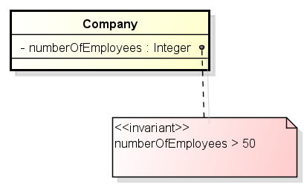
Example OCL Expression
context Company inv:
self.numberOfEmployees > 50
context c : Company inv:
c.numberOfEmployees > 50
Giving the constraint a name
context c : Company inv enoughEmployees:
c.numberOfEmployees > 50

Slide 38
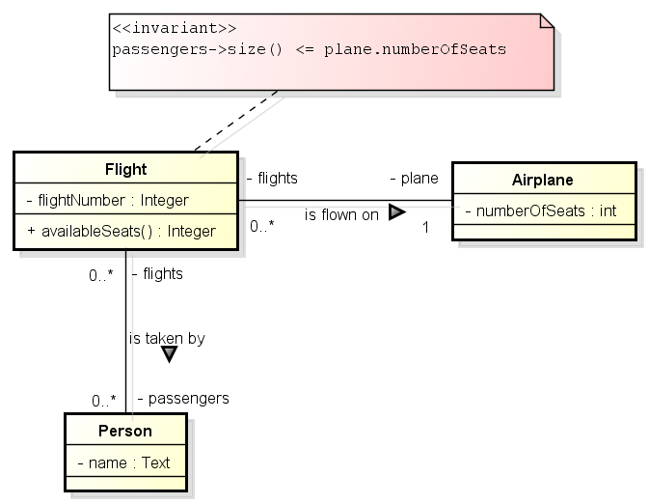
Another Example
context Flight inv:
passengers->size() <= plane.numberOfSeats
Notes:
Limitations of the diagrams
Diagram simply cannot express the statements that should be part of a thorough specification
Association between class Flight and class Person, indicating that a certain group of persons are the passengers on a flight with the multiplicity of zero to many (0..*)
This means that the number of passengers is unlimited (*)
In reality, the number of passengers will be restricted to the number of seats on the airplane that is associated with the flight
It is impossible to express this restriction in the UML diagram
OCL is unambiguous so it makes the diagram more precise and more detailed

Slide 39
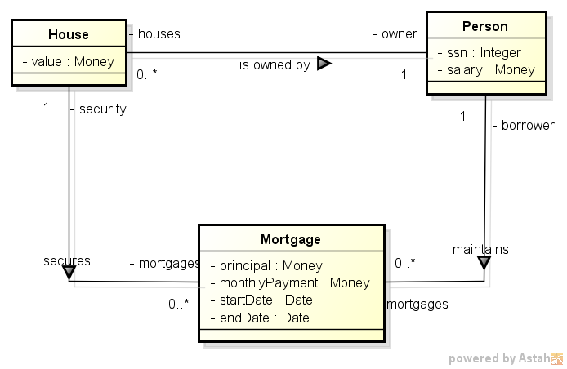
Example: A Mortgage System
A person may have a mortgage only on a house he/she owns.
The start date of a mortgage is before its end date.

Slide 40
OCL Specification of Constraints
A person may have a mortgage only on a house he/she owns.
context Mortgage inv:
self.security.owner = self.borrower
context Mortgage inv:
security.owner = borrower
The start date of a mortgage is before its end date.
context Mortgage inv:
self.startDate < self.endDate
Notes:
A constraint (invariant)
is a boolean OCL expression – evaluates to true/false.
Every constraint is bound to a specific type (class, association class, interface) in the UML model – its context.
The context objects may be denoted within the expression using the keyword ‘self’.
The context can be specified by:
Context <context name> OR A dashed note line connecting to the context figure in the UML models
A constraint might have a name following the keyword invariant.

Slide 41
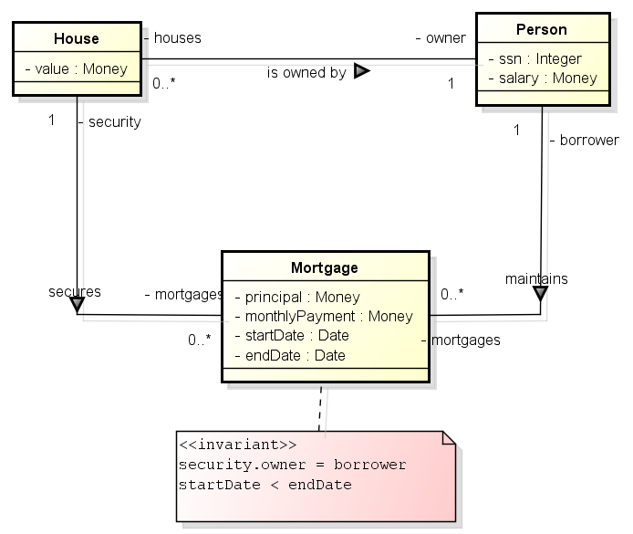

Slide 42
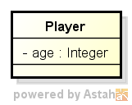
More Examples of Constraints
All players must be over 18.
context Player inv:
self.age >= 18
Notes:
A constraint (invariant)
is a boolean OCL expression – evaluates to true/false.
Every constraint is bound to a specific type (class, association class, interface) in the UML model – its context.
The context objects may be denoted within the expression using the keyword ‘self’.
The context can be specified by:
Context <context name> OR A dashed note line connecting to the context figure in the UML models
A constraint might have a name following the keyword invariant.

Slide 43
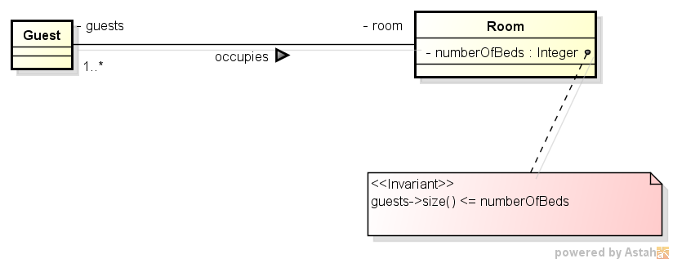
More Examples of Constraints
The number of guests in each room doesn’t exceed the number of beds in the room.
context Room inv:
self.guests->size() <= self.numberOfBeds
Notes:
A constraint (invariant)
is a boolean OCL expression – evaluates to true/false.
Every constraint is bound to a specific type (class, association class, interface) in the UML model – its context.
The context objects may be denoted within the expression using the keyword ‘self’.
The context can be specified by:
Context <context name> OR A dashed note line connecting to the context figure in the UML models
A constraint might have a name following the keyword invariant.

Slide 44
Some Operations on Collections
Operation | Description
size() | The number of elements in the collection.
select(expression) | Returns a subset of the collection of objects where expression is true.
reject(expression) | Returns a subset of the collection of objects where expression is false.
includesAll(collection) | True if all elements of the parameter collection are present in the current collection.
isEmpty() | True if the collection contains no elements
notEmpty() | True if the collection contains one or more elements.
iterate(expression) | Expression is evaluated for every element in the collection.
exists(expression) | True if expression is true for at least one element in the collection.
forAll(expression) | True if expression is true for all elements.

Slide 45
Examples
context Company inv:
self.employees->select(e | e.age > 50)->notEmpty()
context Company inv:
self.employees->forAll(e | e.age > 50)
context Company inv:
self.employees->exists(e | e.givenName = ‘Jeff’)

Slide 46
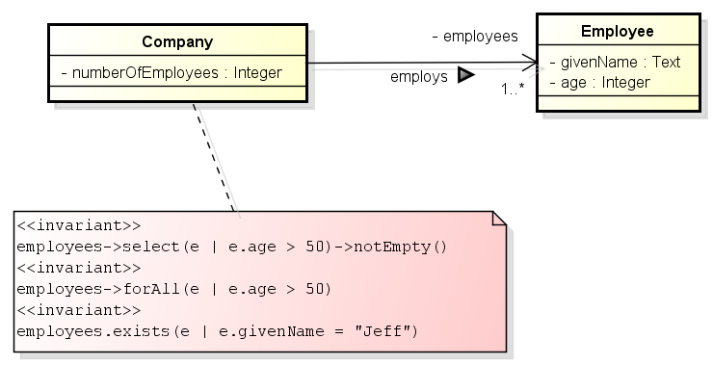

Slide 47
English Phrases equivalent to
A → B
“A implies B”
“if A, then B”
“if A, B”
“when A, B”
“whenever A, B”
“B if A”
“B when A”
“B whenever A”
“A only if B”
“A is sufficient for B”
“A is necessary for B”
“B follows from A”
“B is implied by A”

Slide 48
Examples
context Person inv:
self.wife->notEmpty() implies self.wife.age >= 18 and
self.husband->notEmpty() implies self.husband.age >= 18
context Person::birthdayHappens()
post: age = age@pre + 1
context Person::getCurrentSpouse() : Person
pre: self.isMarried = true
body: self.marriages->select(m | m.ended = false).spouse

Slide 49
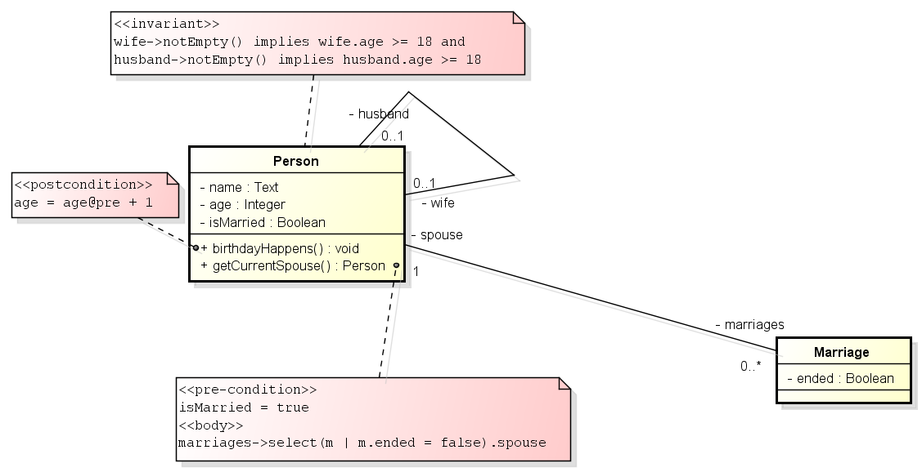

Slide 50
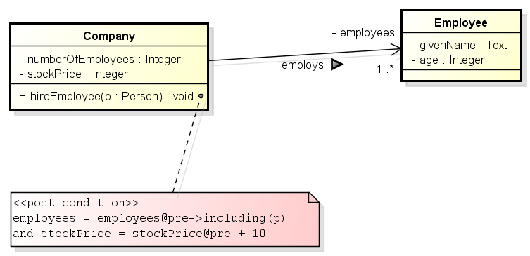
Examples
context Company::hireEmployee(p : Person)
post: employees = employees@pre->including(p) and
stockPrice = stockPrice@pre + 10

Slide 51
What’s your interpretation?
context Employee inv:
((self.grade.name = 'diploma') implies (self.taxClass = 'tc1'))
and ((self.grade.name = 'doctor') implies (self.taxClass = 'tc2'))
and ((self.grade.name = 'professor') implies (self.taxClass = 'tc3'))

Slide 52
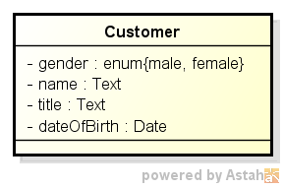
Using Enumerations
context Customer inv:
self.gender = #male implies self.title = ‘Mr.’

Slide 53
Boolean

Slide 54
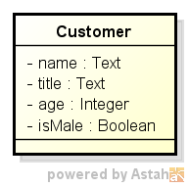
Simple Boolean Constraints
context Customer inv:
self.title = if isMale then ‘Mr.’ else ‘Ms.’ endif
and
(self.age >= 18 and self.age < 66)
and
(name.size() >= 1 and name.size() < 100)

