Slide 1
CSCI5200
Requirements Verification and Validation

Slide 2
Requirements Engineering Process
Requirements Elicitation and Analysis
Requirements Specification
Requirements Validation
Feasibility Analysis
Problem Statement
Agreed Requirements (TLR)
Analysis Model
Throwaway Workable Prototype
Software Specification (SRS)
Requirements Management

Slide 3
Verification and Validation
Are we building the system right?
Verification (Quality Control)
Are we building the right system?
Validation (Quality Assurance)
(-- Boehm)
Difference is unimportant
Notes:
Quality control is proactive while quality assurance is reactive
Quality control – how can we do things so that high quality artifacts are produced
Quality assurance – what can we do check that the produced artifacts are of high quality

Slide 4
Requirements V and V
Requirements Analysis
Have we got the right requirements?
Requirements Validation
Have we got the requirements right?
(-- Kotonya and Sommerville)
Notes:
Requirements Analysis – a validation of the elicited requirements ➔ quality control for requirements specification
Requirements Validation – a validation of the specified requirements ➔ quality control for the design phase

Slide 5
Requirements Analysis
Developing an understanding of the problem domain
Building the analysis model of the problem domain
Note: Solution domain model may be different from the problem domain model
Looking for ‘bad’ high-level requirements
Ambiguities
Inconsistencies
Incomplete requirements
Unverifiable requirements
Notes:
Quality assurance on the elicited requirements

Slide 6
Requirements Validation
Concerned with assuring that the specified requirements define the system that the customer really needs
Requirements error costs are high so validation is very important
Fixing a requirements error after delivery may cost up to 100 times the cost of fixing an implementation error
Notes:
Quality assurance on the specified requirements

Slide 7
Requirements Validation
After the ‘bad’ requirements have been fixed.
Looking for deviations from defined quality standards.
Examples of problems that may be discovered
Lack of conformance to quality standards
Ambiguous requirements specifications
Errors in models of the system or the problem to be solved
Requirements conflicts which were not detected during the analysis process.

Slide 8
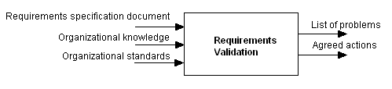
Inputs and Outputs

Slide 9
Requirements Validation
Certifies that the software requirements specification document is an acceptable description of the system to be implemented
People involved:
System stakeholders
Requirements engineers
System designers
Notes:
System stakeholders – people identified during problem identification and definition
System designers – people who will be designing (possibly implementing) the system
Next -> So, what are the validation techniques?

Slide 10
Validation Techniques
Inspections
Ambiguity Reviews
Conflict Reviews
Prototyping
User Manual Development
Requirements Test Case Development

Slide 11
Requirements Inspections
Most widely used technique of requirements validation
Involve a group of people who read and analyze the requirements, look for problems, meet and discuss the problems, and agree on actions to address these problems
Notes:
Requirements review
There is very little published work which focuses specifically on requirements reviews and how these should be conducted
However, there is a lot of evidence that program inspections are a effective way of discovering problems with code
various ways of organizing program inspection processes have been proposed

Slide 12
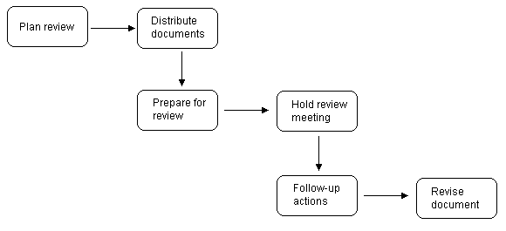
Inspection Process

Slide 13
Pre-review Checking
Remove avoidable errors before distributing document to review team
Performed by one person
Someone familiar with the requirements standards of the organization but not involved in the development of this document
Notes:
Pre-review checking
Reviews involve a lot of time and expense so it makes sense to minimize the work of the reviewers
Errors which are avoidable and which can be detected without a full review should be removed from the requirements document before it is circulated to the review team
Examples of avoidable errors:
Spelling mistakes
Grammatically errors
Non-conformance to organizational standards (including document structure)
All pages numbers
All diagrams and figures labeled
All requirements finished and labeled
Review team will become very frustrated if wasting their time dealing with trivial problems such as spelling errors and non-conformance to standards (also a waste of their valuable time)

Slide 14
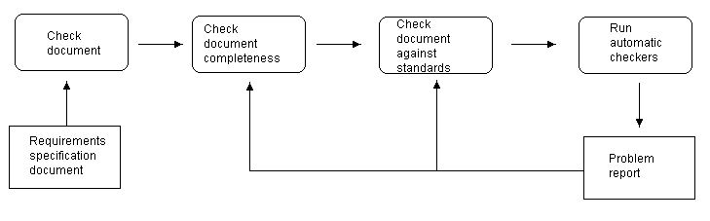
Pre-review Checking

Slide 15
Inspection Team Membership
Reviews should involve a number of stakeholders drawn from different backgrounds
Suggested participants:
System end-user or end-user representative
Customer representative
One or more domain experts
Engineers who will be responsible for the system design and implementation
Requirements engineers
Notes:
Review team membership
Selecting the right membership for the requirements review team is important
Teams normally range in size from 3 to 10 people (no ideal size – depends on the size of the system and the number of stakeholders that are likely to be affected by the system)
Ideally, the requirements document should be reviewed by a multi-disciplinary team drawn from people with different backgrounds
Advantages of involving stakeholders from different disciplines
People from different backgrounds bring different skills and knowledge to the review
Therefore, more probable that requirements problems will be discovered
Stakeholders feel involved in the requirements engineering process and develop an understanding of the needs of other stakeholders
Therefore, they are more likely to understand why changes to requirements which they have proposed are necessary
Suggested participants:
System end-user or end-user representative
Customer representative
One or more domain experts
Engineers who will be responsible for the system design and implementation (as they may find requirements which are particularly difficult to implement; if these can be discovered and modified before design and implementation, this can save a lot of effort and expense)
Requirements engineers

Slide 16
Inspection Activities
Distribute documents
Prepare for review
Individual reviewers read the requirements to find conflicts, omissions, inconsistencies, deviations from standards and other problems.
Notes:
2) Distribute documents
The requirements document and any other relevant documents are distributed to the review team members
3) Prepare for review
Critical to the success of the review process
Equal amount of time spent on the preparation for a review as in the review itself

Slide 17
Review Activities
Hold review meeting
Individual comments and problems are discussed and a set of actions to address the problems is agreed.
Formal meeting
Chaired by someone who has not been involved in producing the requirements
Scribe
Notes:
Requirements review
During the meeting, a requirements engineer presents each requirement in turn for comment by the group and identified problems are recorded for later discussion
One member of the group should be assigned the role of scribe to note the identified requirements problems.
In requirements reviews, the review group make decisions on actions to be taken to correct the identified problems
Unlike programming errors, the problems usually require discussion and negotiations to agree on a possible solution
Remember in code reviews, errors or problems are pointed out but the solution to a problem is never discussed; you point out problem and turn it but to the developer to come up with a solution; not true for the requirements review

Slide 18
Common Problems and Corrective Actions
Requirements clarification
Missing information
Requirements conflict
Unrealistic requirement
Notes:
1) Requirements clarification
The requirement may be badly expressed or may have accidentally omitted information which has been collected during requirements elicitation.
Solution: the author should improve the requirement by rewriting it
2) Missing information
Some information is missing from the requirements document.
Solution: It is the responsibility of the requirements engineers who are revising the document to discover this information from system stakeholders.
3) Requirements conflict
There is a significant conflict between requirements.
Solution: The stakeholders involved must negotiate to resolve the conflict.
4) Unrealistic requirement
The requirement does not appear to be implementable with the technology available or given other constraints on the system.
Solution: Stakeholders must be consulted to decide whether the requirement should be deleted or modified to make it more realistic.

Slide 19
Review Activities
Follow-up actions
The chair of the review checks that the agreed actions have been carried out.
Revise document
The requirements document is revised to reflect the agreed actions.
Notes:
6) Revise document
At this stage, it may be accepted or it may be re-reviewed

Slide 20
Review Checklists
Describe characteristics or frequently occurring errors in document reviews
For requirements review, examines
quality properties of the requirements document as a whole
The relationships between requirements
Notes:
Checklists
Are inherent part of the code inspection process
Helps in the analysis of the program statements (failing to de-allocate memory, indexing beyond the end of an array, executing loops one more time than necessary, etc.)
Very effective technique for individual checking of programs
Aren’t as practical in the requirements analysis process for checking individual requirements
Should be more general; concerned with the quality properties of the requirements document as a whole

Slide 21
Review Checklists
Understandability
Can readers of the document understand what the document means?
Redundancy
Is information unnecessarily repeated in the requirements specification document?
Completeness
Does the checker know of any missing requirements or is there any information missing from individual requirements descriptions?
Ambiguity
Could readers from different backgrounds make different interpretations of the requirements?
Consistency
Do the descriptions of different requirements include contradictions?
Organization
Is the document structured in a structured way?
Conformance to standards
Does the requirements document and individual requirements conform to defined standards?
Traceability
Are requirements unambiguously identified, include links to related requirements and to the reasons these requirements have been included?

Slide 22
Effective Techniques in Requirements Validation
Prototypes
User manual development

Slide 23
Prototyping
Prototypes for requirements validation demonstrate the requirements and help stakeholders discover problems
If the prototype was not developed for the requirement elicitation process, probably not cost-effective to develop one only for requirements validation
Notes:
Prototypes are often used to requirements elicitation and analysis
People find it very difficult to visualize how a written statement of requirements will translate into executable software system
If you develop a prototype system to demonstrate requirements, stakeholders and other end-users find it easier to discover problems and suggest how the requirements may be improved
Validation prototypes should be complete, reasonably efficient and robust. It should be possible to use them in the same way as the required system
User documentation and training should be provided so users won’t become frustrated with new system if problems occur

Slide 24
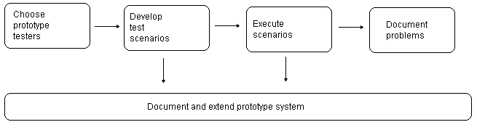
Prototyping

Slide 25
User Manual Development
Writing a user manual from the requirements
Forces a detailed requirements analysis and, thus, can reveal problems with the document
Notes:
User Manual Development
To write a draft of the end-user documentation for the system from the requirements
Often used when there is insufficient time to build a prototype system for validation
The manual should be written by systematically translating the functionality described in the requirements into descriptions of how to use them, written in end-user terms
If there is difficulty in explaining a function to end-users or in expressing system functionality, may have a requirements problem
Can be a basis for the final user manual but not always possible

Slide 26
User Manual Development
Information in the user manual
Description of the functionality which has been implemented and how to access that functionality through the user interface
Which parts of the system have not been implemented
How to recover from difficulties
How to install and get started with the system
Notes:
User Manual Development
To write a draft of the end-user documentation for the system from the requirements
Information in the user manual
Description of the functionality and how it is implemented
Which parts of the system have not been implemented
It should be clear which parts of the system are not implemented
Manual writers should not leave users to find out this when problems arise
How to recover from difficulties (how to get out of trouble)
Users working with an experimental system
Things can go wrong
How to get back to a known system state and restart use of the system
How to install and get started with the system
if the users have to install the prototype themselves

Slide 27
Model Validation
Validation of system models provided in requirements specification document
Objectives of model validation
To demonstrate that each model is self-consistent
If there are several models of the system, to demonstrate that these are internally and externally consistent
To demonstrate that the models accurately reflect the real requirements of system stakeholders
Notes:
Model validation
Models include:
Class diagrams
Use case diagrams
ERDs
Data dictionary
Validation of system models is an essential part of the validation process
3 objectives
To demonstrate that each model is self-consistent
That is, the model should include all information which is necessary and there should be no conflicts between the different parts of the one model.
2) If there are several models of the system, to demonstrate that these are internally and externally consistent
That is, entities which are referenced in more than one model should be defined to be the same in each model.
Comparable items should have the same names.
Model interfaces should be consistent
3) To demonstrate that the models accurately reflect the real requirements of system stakeholders
This is the most difficult model validation task.
Requires that the stakeholders be involved in the model validation process (but they may prefer working with the text-based descriptions instead of the diagrammatic models)
It involves making convincing arguments that the system defined in the model is the system which stakeholders really need
Some checking is possible with CASE tools if the models were created in an automated fashion
CASE tools can check individual models for consistency and can carry out some cross-model checks
Paraphrasing the model is an effective checking technique to help with objective #3 (in regards to stakeholder problem)
By making this transformation, stakeholders such as end-users, organizational management, and regulators can understand and comment on the detailed system specification

Slide 28
Requirements Testing
Each requirement should be testable
it should be possible to define tests to check whether or not that requirement has been met.
Notes:
Testability has always been one of the quality attributes we are looking for in requirements.

Slide 29
Requirements Testing
Inventing requirements tests is an effective validation technique as missing or ambiguous information in the requirements description may make it difficult to formulate tests.

Slide 30
Requirements Testing
Each functional requirement should have an associated test case.
Can be used later in the system testing of verification and validation
Notes:
Each functional requirement in the requirements document should be analyzed and a test defined which can objectively check if the system satisfies the requirement.
The objective of proposing test cases for requirements is to validate the requirement, not the system

Slide 31
Requirements Testing
For each requirement
What usage scenario might be used to check the requirement?
Does the requirement, on its own, include enough information to allow a test to be defined? If not, what other requirements must be examined to find this information?
Is it possible to check the requirement using a single test or are multiple test cases required?
If you need several tests, it may mean that there is more than one requirement embedded in a single requirement description.
Could the requirement be re-stated so that the required test cases are fairly obvious?

Slide 32
Test Record
The requirement’s identifier
There should be at least one for each requirement.
Related requirements
These should be referenced as the test may also be relevant to these requirements.
Test description
A brief description of the test that could be applied and why this is an objective requirements test. This should include system inputs and the corresponding outputs which are expected.
Requirements problems
A description of requirements problems that made test definition difficult or impossible.
Comments and recommendations
These are advice on how to solve requirements problems that have been discovered.

Slide 33
Hard-to-test Requirements
System requirements
Requirements which apply to the system as a whole.
Tests, which are not executed, cannot test for non-functional system-wide characteristics such as usability.
Notes:
In general, these are the most difficult requirements to validate irrespective of the method used as they may be influenced by any of the functional requirements.

Slide 34
Hard-to-test Requirements
Exclusive requirements
Requirements which exclude specific behavior.
For example, a requirement may state that system failures must never corrupt the system database. It is not possible to test such a requirement exhaustively.

Slide 35
Hard-to-test Requirements
Some non-functional requirements
Example: reliability requirements
Can only be tested with a large test set.
Designing this test set does not help with requirements validation.

Slide 36
Traceability Matrix
PID | Requirement | Prototype | Data Model | Functional Model | Behavioral Model | Acceptance Plan Number
Give the functionality number | Give the requirement identifier and a very short name | Give the identifier of the prototype that realizes this requirement | Give the class name and member operation that provides this requirement | Give the identifier of the functional model that provides this requirement | Give the identifier of the behavioral model that provides this requirement | Give the number of the acceptance test case for this requirement

