Slide 1
Where are we?
Discuss Software Engineering and the Software Development Process
Use, adapt, and critique various methods of requirements elicitation
Create and critique various forms of software modeling documentation
Analyze requirements
Produce a workable throw-away prototype
Create and critique various types of software requirements documents
Write and critique requirements specifications
Perform verification and validation activities on requirements

Slide 2
Requirements Elicitation
The process of discovering requirements.

Slide 3
Requirements Elicitation
The act of “discovering information about the application domain of the system, the specific problem to be solved, and the specific needs of the stakeholders.” – K & S

Slide 4
Things to Keep in Mind
“Customers are not always good at describing exactly what they want or need.”
They will use jargon and unclear terminology, it is your job to clarify all requirements without offending the clients.
Never assume
Tell them what you plan to do
Execute your plan
Tell them what you have done

Slide 5
Managing the Customer Relationship
VERY important
Customer and developers need to have ongoing understanding of the product
Keep the customer up to date
even with bad news!
Always elicit comments and suggestions
Always strive for positive outcomes on both sides – win/win strategies

Slide 6
Using “Shall”
We’ll adopt a government best practice (MIL-STD-961D)
When writing requirements we always state requirements in the future tense using the emphatic form “shall.”
The weaker auxiliary verbs “will,” “should,” and “may” do not express a requirement.
In the case of “will,” the sentence places responsibility on the developer.
“May” grants permission.
“Should” states a preference.
“Must” is ambiguous, since it may express a presumption instead of a requirement.

Slide 7
Using Natural Language
Keep sentences short and simple
Refer to things using exactly the same words every time
When you've written a sentence, read it back to yourself with all the modifiers and subordinate clauses deleted. Read only a short subject, the main verb, and a short object.

Slide 8
Requirements on Users
The goal in writing engineering specifications is to specify the operations and operational constraints of the product.
“The user shall be able to . . .” does not require that the software do anything. It only requires that the user have an ability.
“The system shall … , under control of the user.”
“The system shall give the user the ability to …”

Slide 9
Writing Functional Requirements
Functional
Describes the computational operations of the system in terms of its inputs, outputs, and actors.
Describes required behavior in terms of required activities, such as reactions to inputs, and the state of each entity before and after an activity occurs. – Pfleeger & Atlee
Examples
“The system shall allow library patrons to search for a book by title, author, or ISBN.”
“The system shall allow managers to view and produce an inventory report.”
“The system shall allow all users to view faculty information that is read from the Banner system.”

Slide 10
Writing Functional Requirements
Recommendations
Identify the actors involved in the requirement
Actors are producers/consumers of data/information
Actors: library patron, manager, Banner system
If possible, try not to use the generalized term “user.”
Explicitly name the data element in domain specific terms.
E.g. title, inventory report, faculty information
These will have to be defined later.
Identify the action of the system and/or actor.
E.g. to search, to view and produce, to view
“The system shall allow library patrons to search for a book by title, author, or ISBN.”

Slide 11
Writing Non-functional Requirements
Non-Functional
Describes some quality characteristic that the software solution must possess. – Pfleeger & Atlee
Define the overall qualities or attributes of the resulting system. – K & S
Taxonomy - Sommerville
Product Requirements
Usability, Efficiency, Dependability, Security
Organizational Requirements
Environmental, Operational, Development
External Requirements
Regulatory, Ethical, Legislative

Slide 12
Writing Non-Functional Requirements
Recommendations
Do not use unverifiable terms
The system shall access Banner information immediately.
The system shall access Banner information within 2 seconds of a request.
When writing functional requirements, try to associate non-functional requirements.
The system shall allow managers to view and print an inventory report.
The system shall allow managers to view an inventory report within 2 seconds after request.
The system shall allow managers to print an inventory report within 3 seconds after request.

Slide 13
User-Interface Requirements
Special type of non-functional requirements, which addresses the user interface
Describes the look and feel of the product.
“The system shall allow user interaction via a touch-screen.”
“The system shall be judged by 75% of users to be user friendly.”
“The system shall be ADA compliant.”

Slide 14
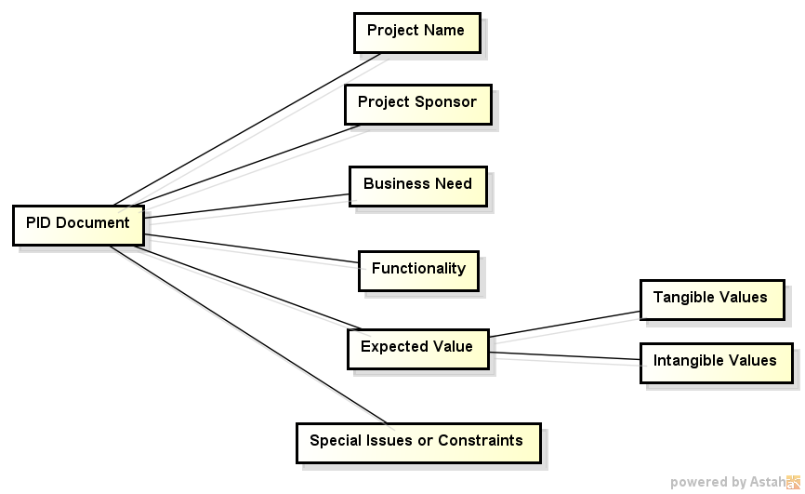
Problem Identification and Definition

Slide 15
Activity
Jeff Roach wants a software system developed but he first wants the requirements to be identified.
You are currently in the first meeting with him.
Ask relevant questions so that you can create the PID document.

Slide 16
Elicitation Techniques
Business Goals analysis
Observations/Ethnography/Questionnaires
Brainstorming/Interviews
Document Analysis
Prototyping
Use Case Analysis

Slide 17
Questionnaires
Useful if
people in the organization are widely dispersed,
many people are involved with the systems project,
exploratory work is necessary before recommending alternatives, or
there is a need for a problem sensing before interviews are conducted.

Slide 18
Designing Questionnaires
Allow ample white space.
Allow adequate space for responses.
Ask respondents to clearly mark their answers.
Use objectives to help determine format.
Be consistent in style.
Questions of importance to respondents go first.
Cluster items of similar content together.
Employ respondents’ associational tendencies.
Bring up less controversial items first.

Slide 19
Interviews
Five Steps in Interview Preparation
Read background material.
Establish interviewing objectives.
Decide whom to interview.
Prepare the interviewee.
Decide on question types and structure.

Slide 20
Question Types
Example of an Open-Ended Interview Question:
What are some of the common data-entry errors made in this department?
Example of a Closed-Ended Interview Question:
How many times a week is the report needed?
Avoid leading questions
You agree with other managers that inventory control should be computerized, don’t you?
Avoid double-barreled questions
What decisions are made during a typical day and how do you make them?

Slide 21
Recommendation
Record the interview and write an interview report. The interview report may be included as an appendix in the requirements document.

Slide 22
Activity
Set up your first interview session with Jeff Roach
Identify your objectives
Prepare Jeff Roach for the interview
Make up 3 questions that you’d ask Jeff Roach to elicit functional requirements.
Make up 3 questions that you’d ask Jeff Roach to elicit non-functional requirements.

Slide 23

Joint Application Development (JAD)
A very formal interview
JAD is a process by which all stakeholders in a project come together to discover the requirements.
Consensus and buy-in are achieved in a timely manner and lessens the amount of re-iteration later in the process.

Slide 24
Using JAD for Requirements
Define the problem and overall goal
Form the JAD group
Representatives from each stakeholder group
8 or fewer
1st meeting – kick off
Get consensus on problem and overall goal
Determine meeting frequency
Meetings should be held until there is consensus on the requirements
Determine roles
Other meetings – Planning and Requirements
Review the current process
Identify current problems and challenges
Brainstorm solutions
Survey your stakeholders for problems and ideas
Evaluate list of generated ideas
Plan your next course of action

Slide 25
Observations
Observations are used to gain insight into that is actually done, to understand the relationships among stakeholders in the organization, and to understand the influence of the physical setting on the system to be developed.
Some key requirements may be elicited by observing and becoming immersed into the culture of the individuals (ethnography).

Slide 26
Document Analysis
Examine the documents that are currently used.
These documents will help in identifying data elements and processes.

Slide 27
Prototyping
The development of the visual interfaces of the system with the goal of eliciting requirements.
The visual interfaces may be paper-based or computer-based.
Prototyping is an effective way of eliciting feedback about the proposed system and determining how the system is fulfilling the needs of its users.
The user is and must be a central figure in the process.

Slide 28
Prototyping
Guidelines for Developing a Prototype
Work in manageable modules.
Build the prototype rapidly.
Modify the prototype in successive iterations.
Stress the user interface.

Slide 29
UI Prototyping
Identify and define the target users
Build prototype along with associated use-cases
Trade-offs sometimes must be allowed in development, use RAD tools to ease some burdens
Test all design alternatives using a wide range of mock-ups

Slide 30
Principle: Recognize the Diversity
Usage profiles
Novice or first-time users
Knowledgeable intermittent users
Expert frequent users
User characteristics
Physical abilities
Education
Cultural background
Training
Motivation
Goals
Personality
Focus on the users and the users’ needs

Slide 31
Principle: Recognize the Diversity
Use-case profiles
Different users may use different action flows for the same task
Matrix of users and use-cases helpful
Different Interaction styles may be preferred
Direct manipulation
Menu selection
Form fill-in
Command language

Slide 32
Principle: Use the Eight Golden Rules of UI Design
Be consistent
Enable users to use shortcuts
Offer informative feedback
Design dialogs to yield closure
Offer error prevention and simple error handling
Permit easy reversal of actions
The user should be aware of what causes good or bad results
Reduce short-term memory load

Slide 33
Principle: Prototype Testing and Evaluation
Carry out early testing and evaluation with users
Build UI Prototypes iteratively
Create prototype
test with users
redo prototype
test with users
…

Slide 34
Activity
Create a UI paper prototype for one of Jeff Roach’s functional requirements.

Slide 35
Use Case Analysis Approach
Identify the actors in the system
Identify use cases
Create use case descriptions
Create scenarios
Recommendation
This approach works best when a prototype is employed.

Slide 36
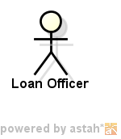
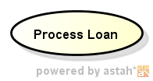
Use Cases and Actors
Actor
Set of roles that users play
External systems
Try to use actual names from the problem domain
Use case
Describes the system’s behavior under various conditions as the system responds to a request from one of its stakeholders. – Cockburn
Use a simple verb phrase for the name

Slide 37
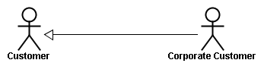
Actors
Actors may be generalized.

Slide 38
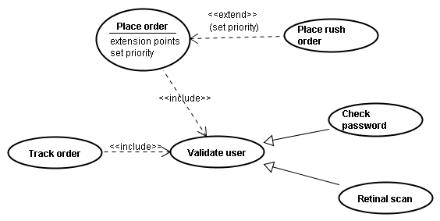
Use case Collaborations

Slide 39
Include and Extends
Track order:
1. Obtain and verify the order number
2. Include: ‘Validate user’
3. For each part in the order
Query the order status
4. Report overall status to user
Place order:
1. Include: ‘Validate user’
2. Collect the user’s order items (extension point: Set priority)
3. Submit the order for processing

Slide 40
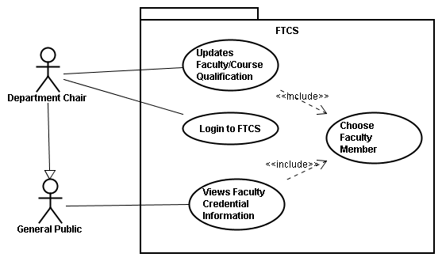
Use Case Diagram Example

Slide 41
Use Case Description Examples
See handout
Sequence Diagram Alternative

Slide 42
Activity
Create a use case diagram and use case description for the UI prototype you designed in the previous activity.

Slide 43
Scenarios
Are actual examples of how the system is used
They are instantiations of the use case descriptions
There can be many scenarios for each use case description.
May be used as actual test cases
May be used for text case development

Slide 44
Activity
For any one of the use cases you created, please create a complete scenario for it.

Slide 45
Building a System Model
Identify all actors
Identify the high level functionalities
Use a package to represent the system
Show the actors
Show the inputs and outputs

Slide 46
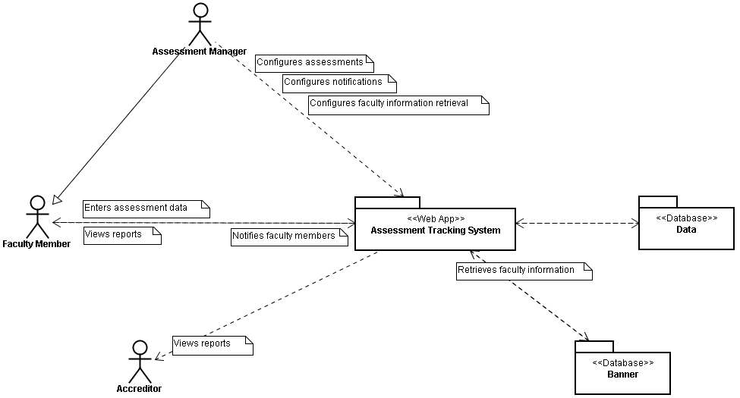
Example System Model

Slide 47
Activity
Create a system model for Jeff Roach’s system.

