Slide 1
Class Relationships
CSCI5200
Software Systems Engineering

Slide 2
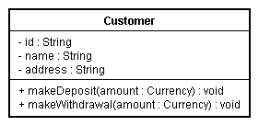
Class

Slide 3
Class Relationships
Classes may be specialized forms of others
Classes may be a part of others
Classes may be associated with others
Classes may use other classes

Slide 4
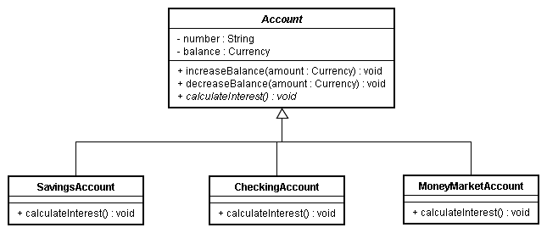
Inheritance “is-a-kind-of”

Slide 5
Associations
Three forms
Association
Aggregation
Composition

Slide 6
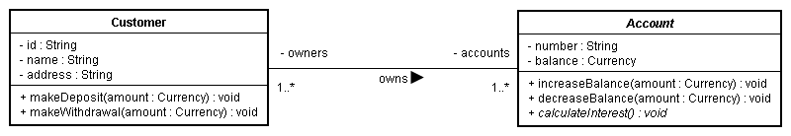
Association

Slide 7
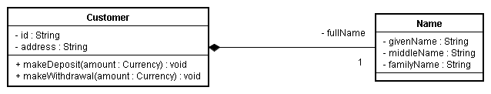
Composition “has-a”

Slide 8
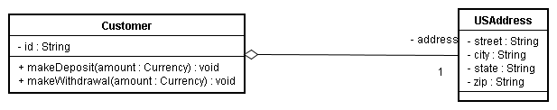
Aggregation “has-a-shared”

Slide 9
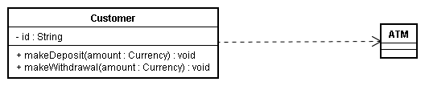
Dependency/Instantiation “uses”

Slide 10
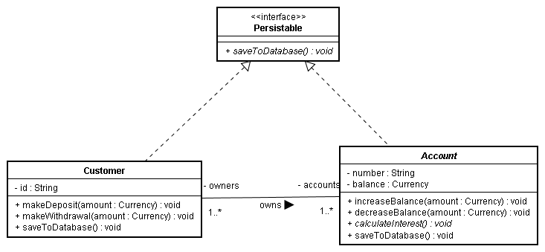
Realization “is-a-kind-of”

Slide 11
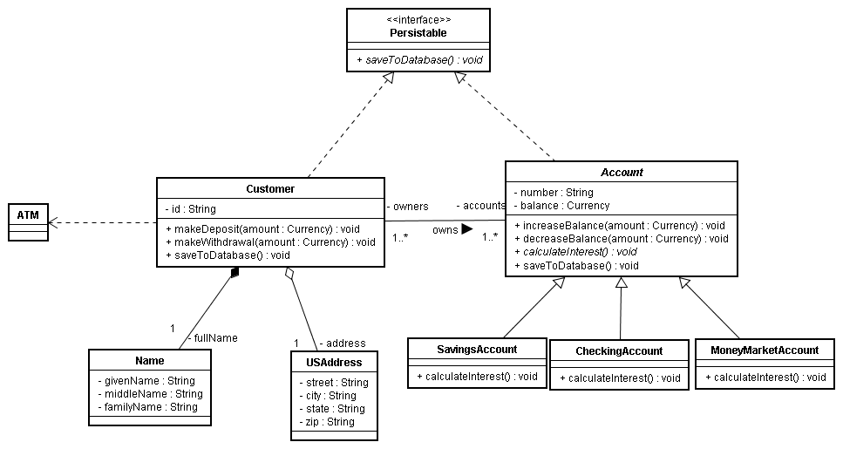
Complete Class Diagram

