Slide 1
Analysis Modeling
CSCI5200 Software Systems Engineering

Slide 2
The analyst should be able to …
Define all externally observable data objects
i.e. objects that produce and consume data
Evaluate the flow and content of data.
Define and elaborate all software functions.
i.e. the functions that transform the data
Understand software behavior in the context of events that affect the system.
i.e. consequences of external stimuli and how the software should behave
Establish system interface characteristics.
Uncover additional design constraints.
IMPLICATION:
The creation of an Analysis Model

Slide 3
Analysis Model Elements
Data Model
The data elements and their relationships.
Functional Model
The functions that transform data.
Behavioral Model
The behavior of the system.

Slide 4
Classical Modeling
Analysis Element | Model Used
Data Modeling | Data Dictionary (DD)
 | Entity Relationship Diagram (ERD)
Functional Modeling | Data Flow Diagram (DFD)
Behavioral Modeling | State Chart Diagram (SCD)
Notes:
Data Dictionary
A description of all data objects consumed or produced by the software.
Entity Relationship Diagram (ERD)
Depicts relationships between data objects.
Data Flow Diagram (DFD)
Depict the transformation of data through the system.
Depict the functions that transform data.
State Chart Diagram (SCD)
Indicates how the system behaves as a consequence of external states.

Slide 5
Data Dictionary
Name | Type of Data | Description
Family Name | Textual | The family name (surname) of the individual.
Date Of Birth | Date | The individual’s date of birth.
Weight | Numeric | The individual’s weight

Slide 6
Entity Relationship Diagram

Slide 7
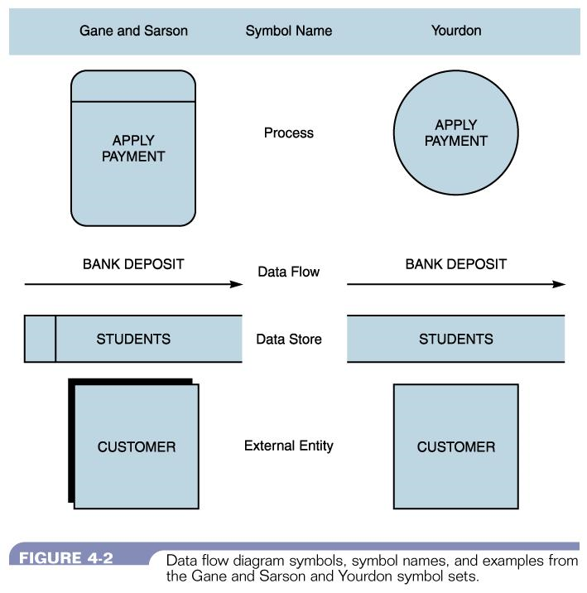
Data Flow Diagram

Slide 8
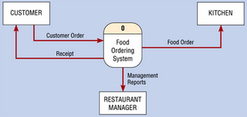
DFD Context Level

Slide 9
State Transition Diagram

Slide 10
Object-Oriented Modeling
Analysis Element | Model Used
Data Modeling | Class diagrams
Functional Modeling | Interaction diagrams Activity diagrams
Behavioral Modeling | State-machine diagrams Activity diagrams

Slide 11
System Modeling using OO Modeling
Use a package to represent the system
Show the actors
Show the inputs and outputs

Slide 12
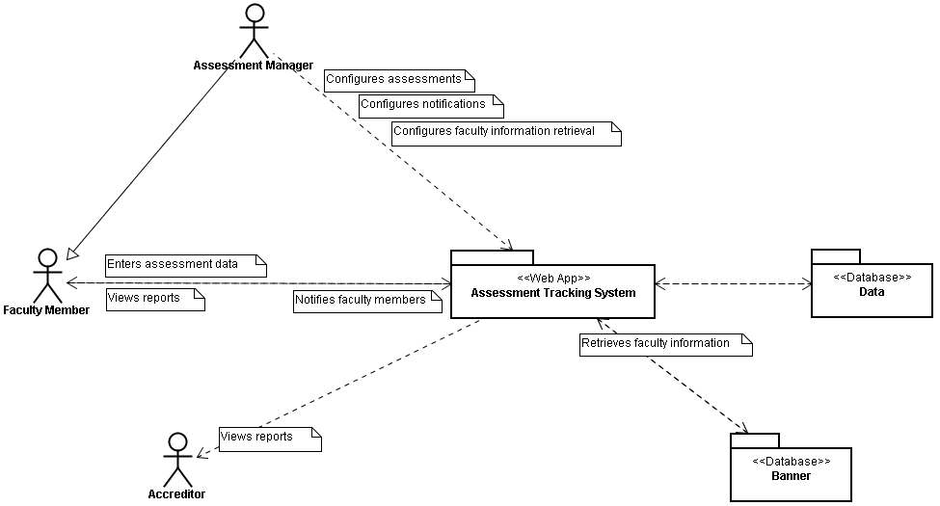
Example System Model

Slide 13
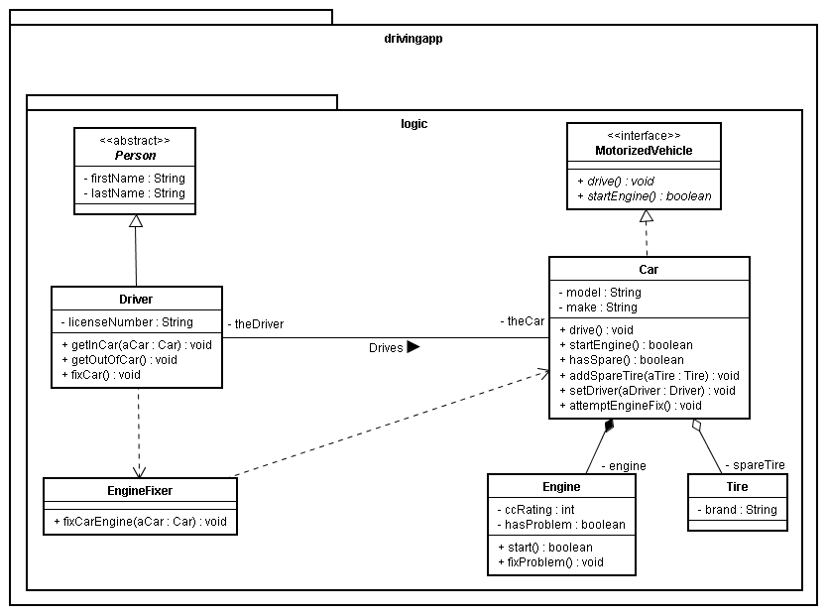
Class Diagram

Slide 14
Interaction Diagram: Sequence Diagram

Slide 15
Activity Diagram

Slide 16
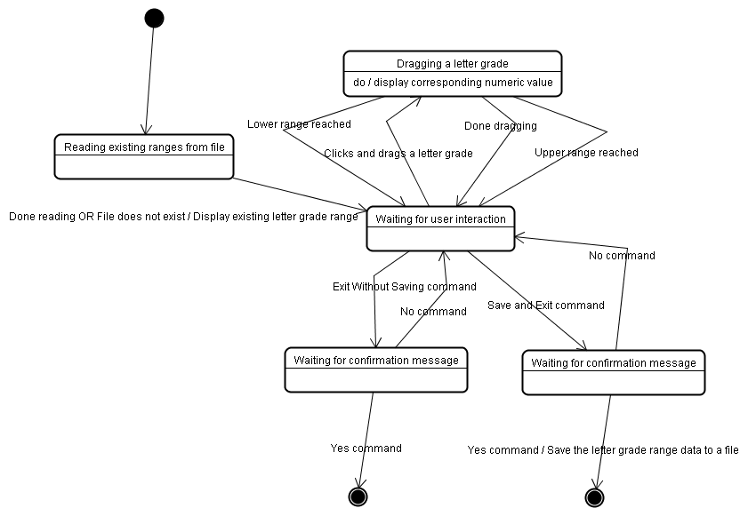
State-machine Diagram

Slide 17
Analysis Example
Classical Modeling

Slide 18
Hypothetical Bank Case
The hypothetical bank offers the following type of accounts to its customers: savings accounts, checking accounts, and money market accounts. Customers are allowed to deposit money into an account (thereby increasing its balance), withdraw money from an account (thereby decreasing its balance), and earn interest on the account. Each account has an account number and an interest rate; however, the interest is calculated differently for each type of account. The bank needs to know its customers’ names and addresses. Each customer may have multiple accounts and an account may belong to multiple customers.

Slide 19
First Cut Requirements
The system shall allow customers to open accounts.
The system shall allow customers to close accounts.
The system shall allow customers to deposit money into their accounts.
The system shall allow customers to withdraw money from their accounts.
The system shall calculate and pay interest on customer’s accounts.
The system shall store the name and address of each customer.
The system shall store the account number, interest rate, and balance of each account.

Slide 20
Data Analysis
The system shall allow customers to open accounts.
The system shall allow customers to close accounts.
The system shall allow customers to deposit money into their accounts.
The system shall allow customers to withdraw money from their accounts.
The system shall calculate and pay interest on customer’s accounts.
The system shall store the name and address of each customer.
The system shall store the account number, interest rate, and balance of each account.

Slide 21
Data Model: Data Dictionary
Data Element | Type of Data | Description
Customer | Entity | The customer
Account | Entity | The account
Deposit Amount | Currency | The deposit amount (E.g. 100.50)
Withdrawal Amount | Currency | The withdrawal amount (E.g. 50.25)
Interest Amount | Currency | The interest paid on an account (E.g. 10.57)
Customer Name | Text | The name of the customer (E.g. Jeff Roach)
Customer Address | Text | The address of the customer (E.g. 123 Any Street, Any Town, TN, 37614)
Account Number | Text | The account’s number
Account Interest Rate | Number | The interest rate paid to an account (E.g . 01)
Account Balance | Currency | The account’s balance (E.g. 1000.45)

Slide 22
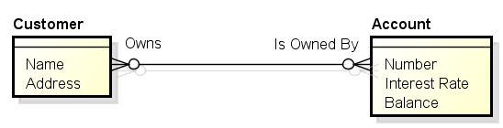
Data Model : Entity Relationship

Slide 23
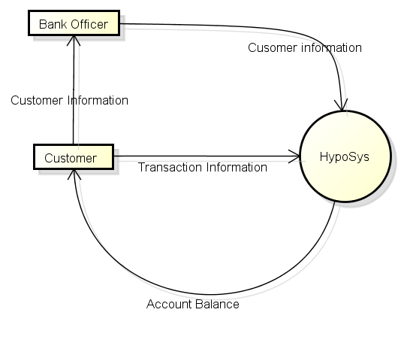
Functional Model: Level 0 DFD

Slide 24
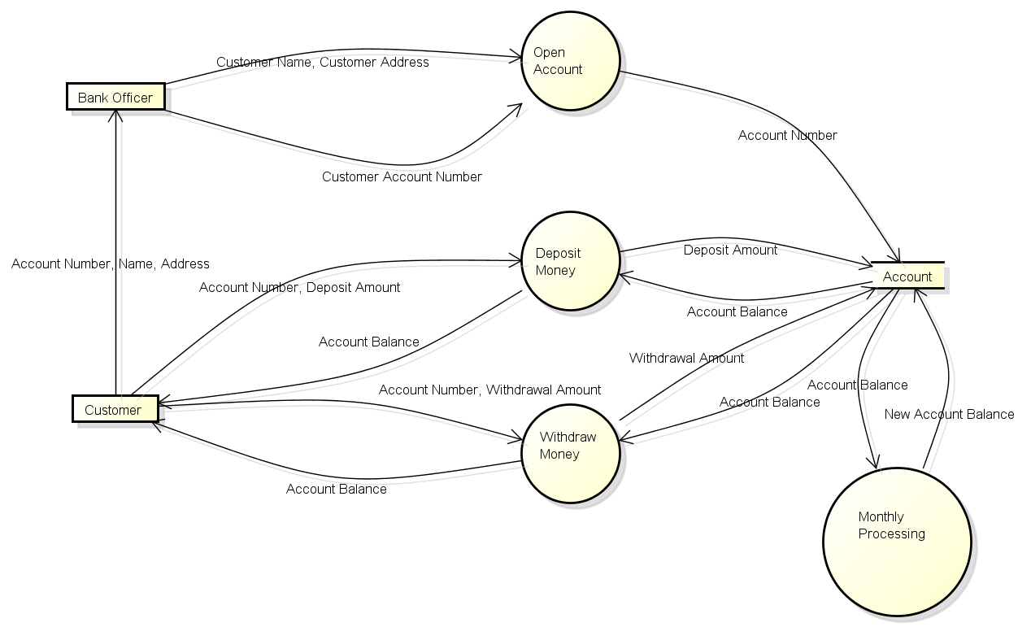
Functional Model: Level 1 DFD

Slide 25
Behavioral Model: State Chart Diagram

Slide 26
OO Analysis
Analysis Modeling

Slide 27
Object-Oriented Analysis
A definition of the system using the object-oriented paradigm.
“OOA provides the [software engineer] with a concrete way to represent [his/her] understanding of the requirements then test that understanding against the customer’s perception of the system to be built.” -- Pressman

Slide 28
Steps
Use-case Analyses
Class/object relationship identification and modeling (Data modeling)
System behavior identification and modeling
Sequence diagrams (Functional modeling)
Activity diagrams (Functional and Behavioral modeling)
Statemachine diagrams (Behavioral modeling)

Slide 29
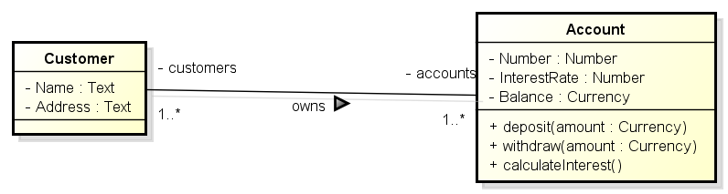
Data Model: Class Diagram

Slide 30
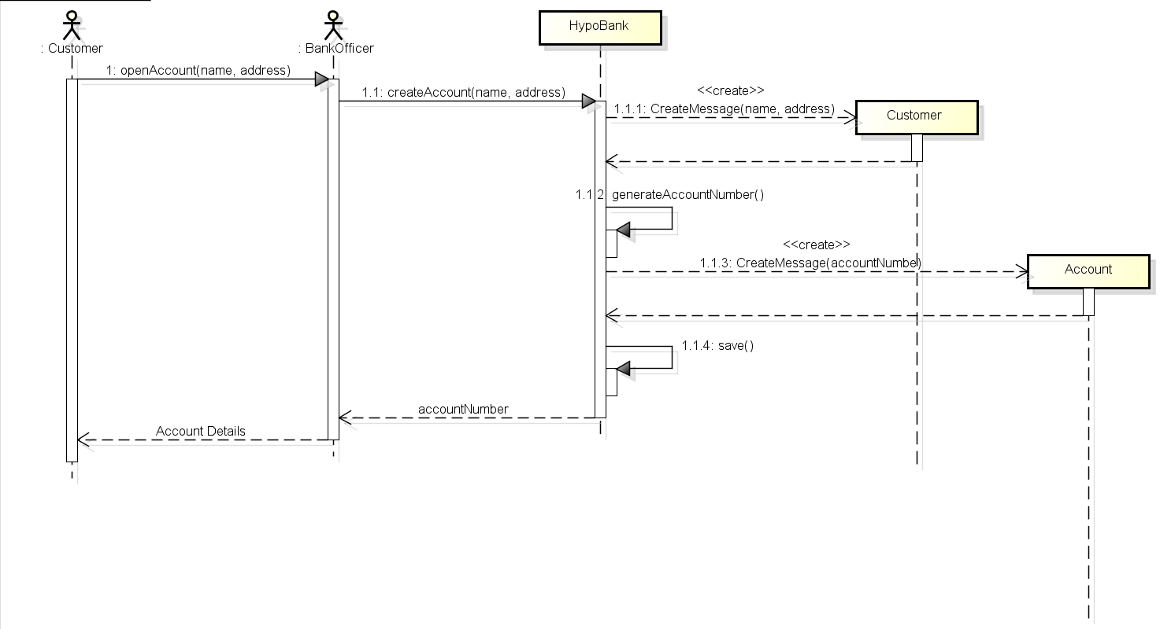
Functional Model: Sequence Diagram

Slide 31
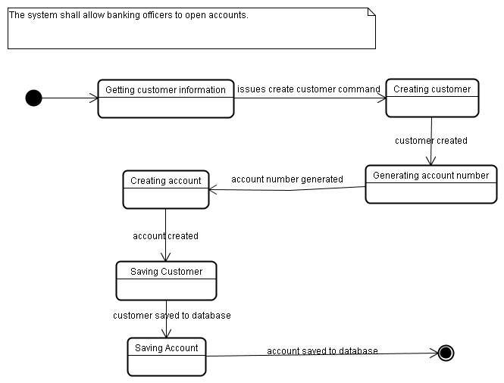
Behavioral Modeling: State-machine Diagrams

