Slide 1
Introduction
Analysis of Algorithms
CSCI 5620

Slide 2

Topics
Intro
Functions
Induction
Complexity

Slide 3
Prime numbers
A positive integer p>1, is prime if the only positive integers which divide p are 1 and p.
  Exs: 2, 3, 5, 7, 11, 13, 17, 19, 23

Slide 4
Example
Input: A n-bit number, L>2
Output: Is L prime? Yes/No
1 Write a SIMPLE algorithm to solve this problem.
2 If L is prime, how many steps does your algorithm take in terms of n?

Slide 5
For a 100 bit number
http://www.top500.org/news/articles/article_21.php
35.86 Tflop/s (“teraflops” trillions of calculations per second) (2005)
8 Petaflops/s (quadrillion) 2011
2013 NuDT Tiahe-2: 33.86 PFLOPS
Could take as long as 1,142,465,658 years with this algorithm (2005). 51,211,102 years (2011)
There is a much faster (not exponential) algorithm, which can determine this is in a matter of seconds.
In cryptography, the “key” usually involves prime numbers in some manner.
  Ex in RSA the public key is a pair (e,n) where n is the product of two primes.

Slide 6
Algorithms
An Algorithms is a well-defined computational procedure that takes some values (as input) and produces values as (output)
Examples: Insertion Sort, Bubble Sort, Heap Sort, Merge Sort, Quick Sort
Algorithms are described in pseudocode in this course.

Slide 7
Analyzing Algorithms
Is the algorithm correct and as fast as possible?
  A algorithm is correct if for every instance, it halts with the correct output.
Analyzing algorithms : predicting resources that the algorithm requires.
Running time: number of steps performed
  Expressed as a function ( order of growth)
  Machine independent
Worst case, average case, best case
  Worst case: longest running time for any input of size n.
  Average case : Expected running time
  Best Case: Shortest running time for any input of size n.

Slide 8
Functions in CS
(mod-n functions) f_{n}(m) = m (mod n)
  Example f₃(7)=1, f₃(8)=2, f₃(111)=0
f(n)=n!
  f(1)=1, f(2)=2, f(3)=6, f(4)=24, f(5)=20, etc
(Floor function) f(x)=⎣x⎦
  f(2.1)=2
  f(2.9)=2
  f(2.999999)=2
  f(3)=3
  f(-2.3)=-3

Slide 9
Functions in CS
Polynomial of degree d,
  P(n)= a₀ +a₁n +a₂n²+ … + a_{d} n^{d}
  a_{i} are all reals

Slide 10
Functions in CS
Exponential example f(x)=2^{x}
  f(1)=2
  f(2)=4
  f(2.2)=4.4957…
  F(0)=1
  f(-1)=1/2
  f(-2)=1/4

Slide 11
Functions in CS
Logarithm f_{n}(x)=log_{n}(x)
  f₂(4)=2
  f₂(8)=3
  f₂(2)=1
  f₂(1)=0
  f₂(1/2)=-1
  f₂(1/16)=-4
  f₂(0)= undefined

Slide 12
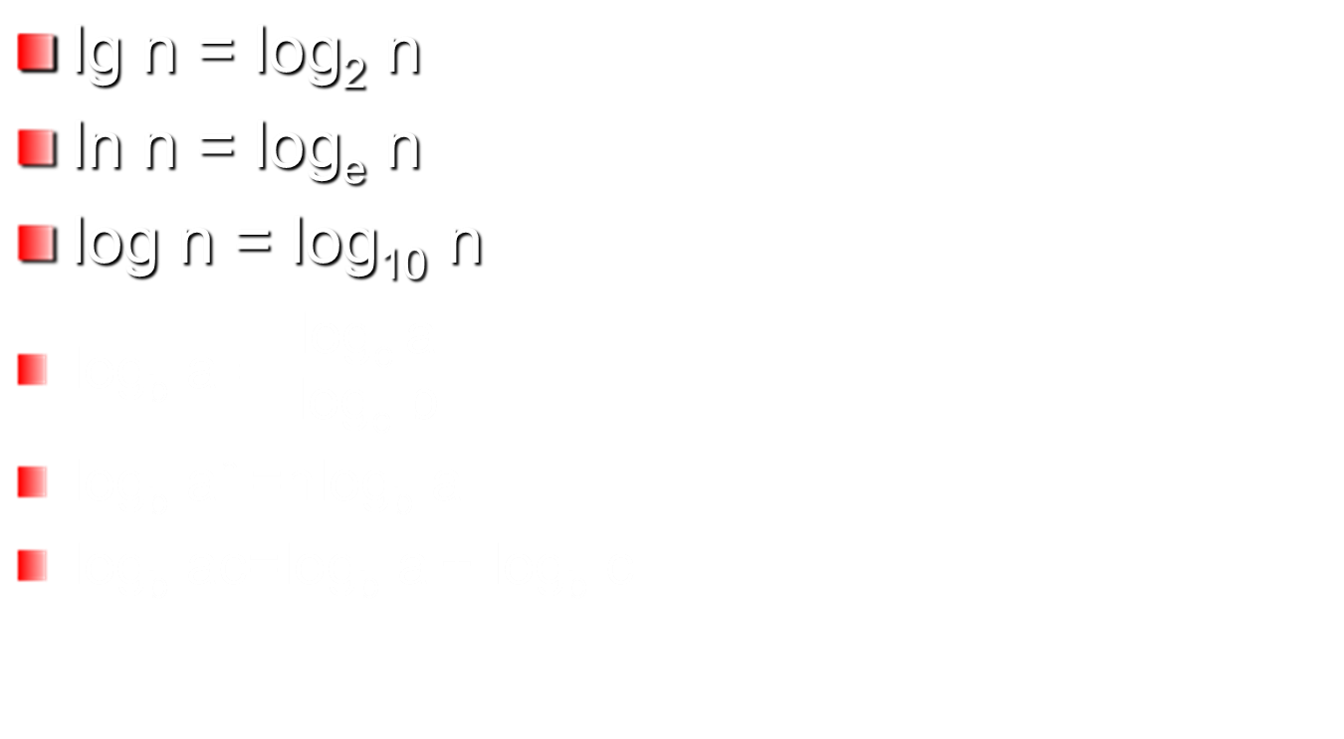
Logs

Slide 13
Logs continue
lg (32) = ?
lg (1/8) =?
lg (15) = log 15/ log ?
Convert lg n to log, lg n = ?
lg (15) =lg (5) + lg ?
lg (15) = lg (30/?)
lg (3⁵)= 5 * ?
lg (2^{n}) =?
The number of bits to represent a number N is ?

Slide 14
Mathematical Induction
P(n):=1+2+3+…+n=n(n+1)/2
Show P(n) is true for all n>=1
  Show P(1) is true (Basis Step)
  Show P(k)⇒P(k+1)
  There true for all n
Proof On Board
Quiz
More induction proofs

Slide 15
More Induction Problems
Fibonacci numbers: 0, 1, 1, 2, 3, 5, 8, 13, 21, …
f₀=0, f₁=1, f_{i}=f_{i-1}+f_{i-2} for i≥2
Prove f_{n}=f₀+f₁+…f_{n-2}+1

Slide 16
More Induction Examples
The maximum number of regions the plane is divided into by n lines is
½ (n²+n+2)

Slide 17
Big Oh: Start
f(n) is bounded above by c g(n)
c g(n)
f(n)
n
n₀
10 Sept 2010
CSCI 2230
Lecture 5 - <number>

Slide 18
Big-Oh notation
f∈O(g), if there exist c and k so that |f(n)|≤c|g(n)| for all n≥k.
  f grows no faster than g does
  f is bounded above by g
c g(n)
f(n)
n
n₀

Slide 19
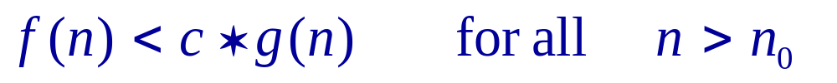

Big – Oh Notation
Notation f ∈ O( g )
  Verbalize as “f is in Big-Oh of g ”
We say that f ∈ O( g ) if
  There exists two constants c and n₀ such that
Important implications
  g serves as an upper bound on f
  Ignores behavior of f for small values
10 Sept 2010
CSCI 2230
Lecture 5 - <number>

Slide 20
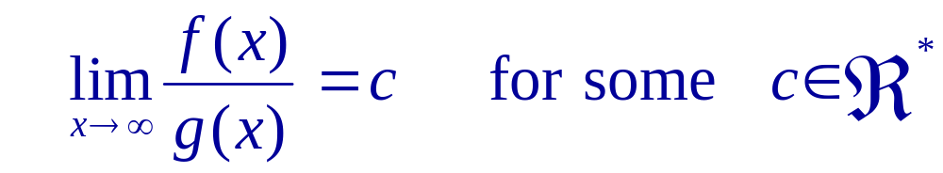
Big – Oh (cont)
For continuous functions
  f ∈ O( g ) if
You must learn and be able to apply both
  Learn definition ≡ memorize
10 Sept 2010
CSCI 2230
Lecture 5 - <number>

Slide 21
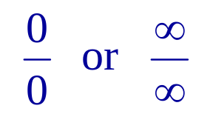
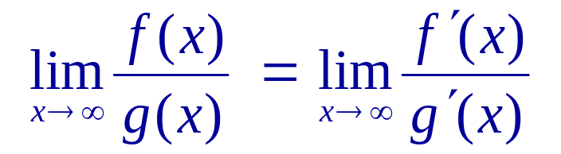
L’Hospital’s Rule
Frequently the second definition will yield one of the indeterminate forms
Which can be resolved by the use of L’Hospital’s rule
  provided the derivatives f ’(x) and g’ (x) exist
10 Sept 2010
CSCI 2230
Lecture 5 - <number>

Slide 22
Big-Oh notation
Show 2n+1∈O(n²).
  C=3, k=2
What is in O(n³)?
  f(n)=10n³
  f(n)=n²
  f(n)=n³ +100n^{2 –}n
  f(n)=2
  f(n)=lg n
  f(n)=(lg n)n

Slide 23
“Standard” Functions
Function | Name
1 | Constant
lg n, log n, ln n | Logarithmic
n | Linear
n lg n | n lg n
n² | Quadratic
n³ | Cubic
2^{n} | Exponential
3^{n} | Exponential
n! | Factorial
In order of increasing run time
Proof Quiz

Slide 24
Big-theta notation
f∈ Θ(g), if f and g have same order, i.e. f∈O(g) and g∈O(f)
What is in Θ(n³)
  n³ +100n^{2 –}n is
  2 is not
  n² is not
  lg n is not
  (lg n)n is not

Slide 25
Big-omega notation
f∈Ω(g), if there exist c and k so that cg(n) ≤f(n) for all n≥k.
  f grows at least as fast as g
Example n² ∈Ω (n).
What is in Ω (n³)?
  f(n)=10n³
  f(n)=n²
  f(n)=n³ +100n^{2 –}n
  f(n)=2
  f(n)=lg n
  f(n)=(lg n)n
  f(n)=n⁴ +100n^{2 –}n

Slide 26
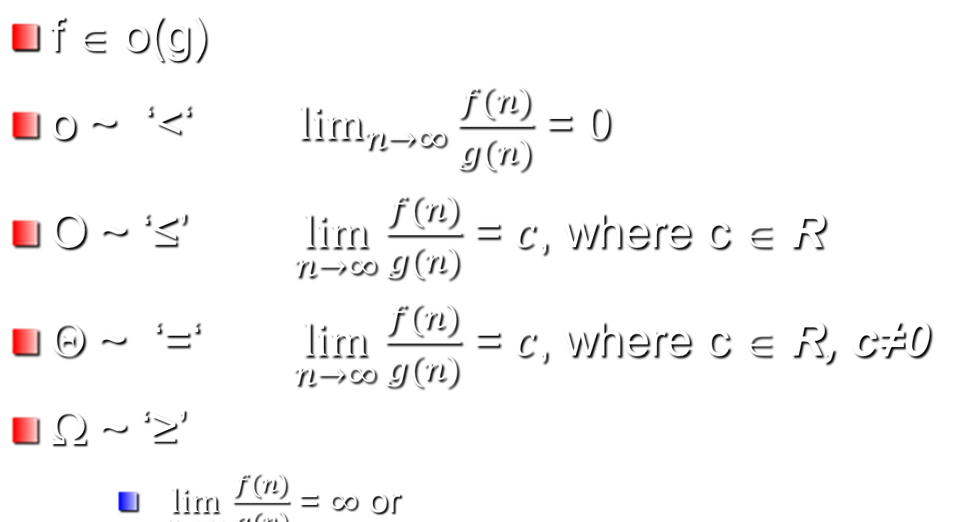
Limits:

Slide 27
Running time
The Θ-class of a function that describes the number of steps performed by an algorithm is called the running time of the algorithm.
This allows us to compare algorithms for a specify task.
For example bubble sort is Θ(n²) and quicksort is in Θ(n(lg n)), but what is the fastest running time sorting algorithm?

Slide 28
Efficiency
Insertion Sort Θ( n² )
Merge Sort Θ (n lg n)
For n=1,000,000
  n²⁼ 1,000,000,000,000
  n lg n≈ 19,931,569

Slide 29
Operation Counts
Input Size | Constant (1) | lg N | N | N lg N | N² | 2^{N} | N!
10 | 1 | 4 | 10 | 40 | 10² | 1024 | ~4X 10⁶
100 | 1 | 7 | 100 | 700 | 10⁴ | ~10³⁰ | ~9 X 10¹⁵⁷
1000 | 1 | 10 | 1000 | 10,000 | 10⁶ | - | -
10⁶ | 1 | 20 | 10⁶ | 2 X 10⁷ | 10¹² | - | -
10 Sept 2010
CSCI 2230
Lecture 5 - <number>

Slide 30
Homework
I will post homework tomorrow in Elearn..

