Slide 1
Lecture 3
Analysis of Algorithms
CSCI 5620

Slide 2

Topics
Trees
Comparison Sorting, Best Time
Decision Tree
Linear Expected Sorting Time Algorithm
Proof of Correctness

Slide 3
Comparison Sorting
Comparison, example “if a<b then”
Merge-Sort took Θ(n lg n) time.
How many comparisons need to be done?
Take a₁, a₂, … a_{n} all distinct elements.
  How different ways the items be arranged?
  Look at the decision tree for 2 items a₁, a₂
  How many leaves does a decision tree have for n items?
  What is the depth of the tree?

Slide 4

Comparison Sorting
Take a₁, a₂, … a_{n} all distinct elements.
  How different ways the items be arranged?
  Look at the decision tree for 2 items a₁, a₂
  How many leaves does a decision tree have for n items?
  What is smallest depth of tree with n! leaves?
    This equals the number of comparisons which must be done to arrive at a leaf.
  Lg (n!) ∈Θ(n lg n)

Slide 5
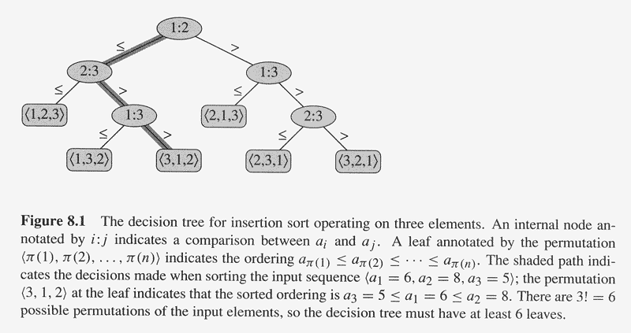
Decision Tree Example

Slide 6
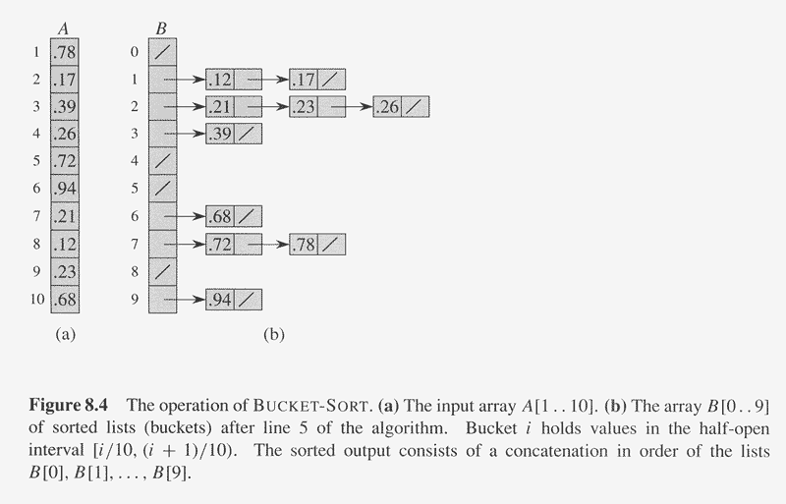
Copyright © The McGraw-Hill Companies, Inc. Permission required for reproduction or display.

Slide 7
Linear Time
Bucket Sort
  Assumes data if uniformly distributed over the interval [0,1)
  Divides the [0,1) into n equal-sized subintervals, (or buckets)
  Distributes the n input numbers into buckets.
  Since we are uniform [0,1) each bucket has few items.

Slide 8
Bucket-Sort(A)
  n <---- length (A) 1
  For i = 1 to n 2
    Insert A[i] into linked list of bucket B[ floor (n*A[i] ] 3
  For i= 0 to n-1 4
    Sort B[i] with a Comparison Sorting algorithm 5
  Concatenate B[0],B[1],…B[n-1] together 6
Showing Bucket Sort is linear average running time (or expected running time not worse case)
  Not a proof (we would need more probability)
  Uniform random, B[i] expected size of B[i] is 1, i.e. Θ(1).
  Line 3 take constant time.
  For loop 2 with 3 is Θ(n)=Θ(n)
  Line 5 take Size (B[i]) log (Size B[i]]) time, expected time Θ(1)
  For loop 2 with 3 is Θ(n*1)=Θ(n)
  Line 6 is Θ(n)

Slide 9
Proof of Correctness
Loop Invariants
  Conditions and relationships that are satisfied by the variables and data structures at the start of each iteration of the loop
  Used to show why an algorithm is correct
  Used for Loops (for, while, etc)
Induction to show loop invariants
  Initialization: It is true prior to the first iteration of the loop (BASE CASE)
  Maintenance: If it is true before an iteration of the loop, it remain true before the next iteration. P(k)⇒P(k+1)
  Termination: When the loop terminates, the invariant gives us a useful property that helps show that the algorithm is correct.

Slide 10
Sequential Search
Input array A=<a1,…an> value v
Output index i if v=A[i] or -1 otherwise
  Index:=1
  While index<=n and L[index] ≠ v
    Index:=index+1
  If (index>n) index:=-1

Slide 11
Loop invariants
  k^{th} iteration
  index:=k & L[i] ≠ v for 1<=i<k
Initialization When k:=1 index=1
Maintenance: Suppose at the kth iteration index:=k & L[i] ≠ v for 1<=i<k.
  At the k+1st iteration we know that L[k] ≠ v.
  So L[i] ≠ v for 1<=i <k+1. Now if L[k+1]=v, the loop terminates and it is the first occurrence of v.
  Otherwise index := index+1, or k+2 and
  L[i] ≠ v for 1<=i <k+1
Termination: So if the loop terminates with k<=n, then index=k L[k]=v, otherwise the index=-1 and v is not in L

Slide 12
Pg 40 2-2
Bubblesort (A)
  For i = 1 to A.length -1
    For j = A.length downto i+1
      If A[j]<A[j-1]
        Exchange A[j] and A[j-1]
What is the loop invariant of the inner for loop?
  Hint: What is the inner loop doing (in j terms)?
What is the loop invariant of the outer for loop?
  Hint: What do we have in terms of i?

