Slide 1
Max-Flow Min Cut
Algorithms

Slide 2
Network
12
v₃
v₁
20
16
10
9
7
4
t
s
13
14
4
v₂
v₄

Slide 3
Max Flow Applications
  Network reliability.
  Distributed computing.
  Egalitarian stable matching.
  Security of statistical data.
  Network intrusion detection.
  Multi-camera scene reconstruction
  - Data mining.
  - Open-pit mining.
  - Project selection.
  - Airline scheduling.
  - Bipartite matching.
  - Baseball elimination.
  - Image segmentation.
  - Network connectivity.
Notes:
Network intrusion detection: http://www.ieee-infocom.org/2003/papers/46_02.PDF

Slide 4
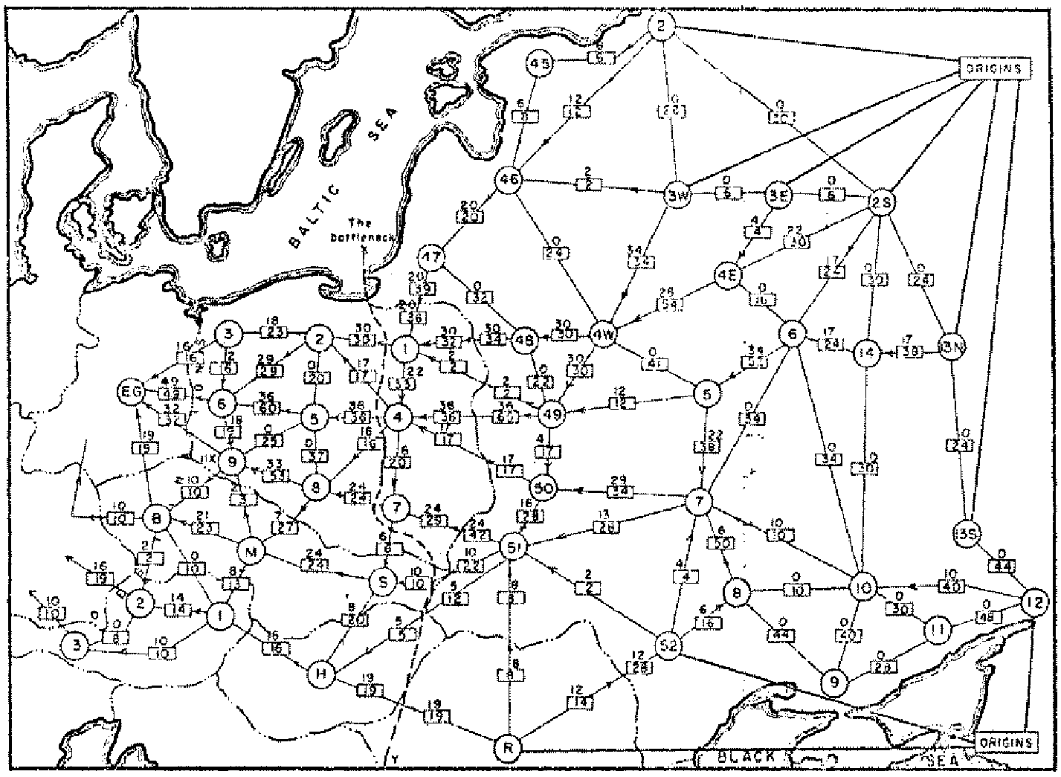
Soviet Rail Network, 1955
“The Soviet rail system also roused the interest of the Americans,
and again it inspired fundamental research in optimization.”
-- Schrijver
G. Danzig* 1951…First soln…
Again formulted by
Harris in 1955 for the
US Airforce
(“unclassified in 1999”)
What were they looking for?
Reference: On the history of the transportation and maximum flow problems.
Alexander Schrijver in Math Programming, 91: 3, 2002.
Notes:
Russian scientist A. N. Tolstoi investigated soviet rail network. Wanted to optimize amount of cargo that could be shipped from origins in Soviet Union (right) to destination satellite counties (Poland, Czechoslovakia, Austria, Eastern Germany) (left). American scientists Harris and Ross were also interested in Soviet rail system but from a different perspective. In a secret report (declassified at Schrijver's request in 1999), Harris and Ross calculated a "minimum interdiction" of 163,000 tons.
after aggregation, 44 vertices, 105 edges

Slide 5
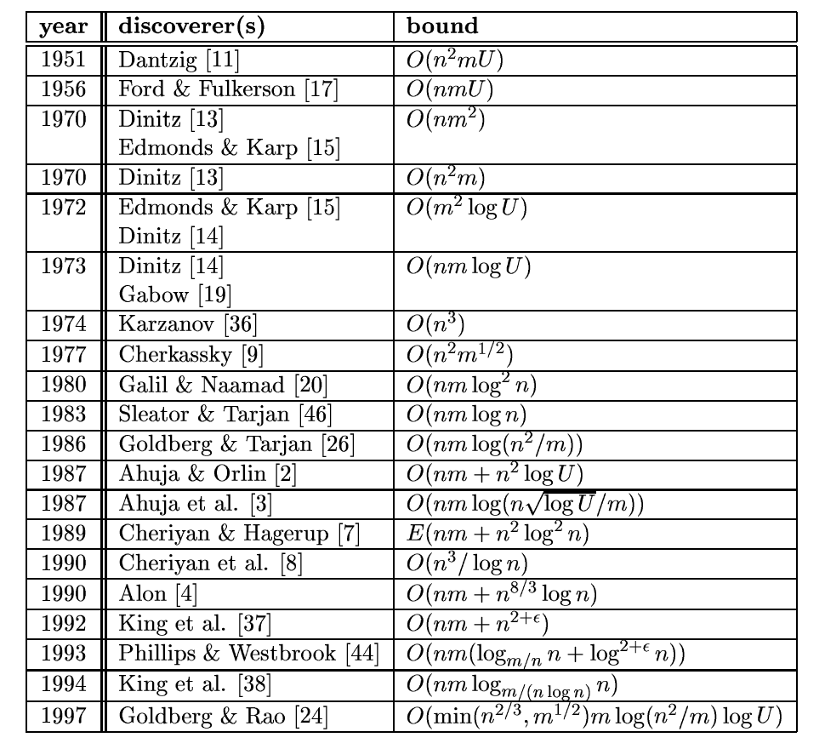
Notes:
From: http://citeseer.ifi.unizh.ch/goldberg98recent.html

Slide 6

Ford-Fulkerson(G,s,t)
F = 0
While there is augmenting path from s to t,P
  F=f+f_{P}
  Subtract f_{p} from all capacities of edges on P

Slide 7
Network
4/12
v₃
v₁
0/20
4/16
0/10
4/9
0/7
0/4
t
s
4/4
0/13
4/14
v₂
v₄
Flow of path is 4
F=4

Slide 8
Network
4/12
8/20
v₃
v₁
4/20
4/16
0/9
10
4/9
7
4
t
s
4/4
0/13
4/14
4/13
v₂
v₄
Flow of path is 4, Total =8
F=4

Slide 9
Matching

Slide 10
Maximal Matching
Maximal Matching
  k edges sharing no common vertices.
  No other edges from G can be added

