Slide 1
Introduction to NP
Analysis of Algorithms
CSCI 5620

Slide 2

Decision Problem
Decision problem: One for which the output can is a simple yes or no answer for each input.
Example:
  The input is a positive integer C and n positive integers s1, … sn.
  Is there a subset of the integers which add up to C?

Slide 3
Decision Problem
Decision Problem
  Does the graph have a Spanning Tree with total weight K?
Optimization Problem
  What is the MST weight?
Decision Problem
  For a given graph, is there a path from A to B of length k?
Optimization Problem
  What is length of a shortest path from A to B?
Optimization Problems are at least as hard as Decision Problems.
  So if the optimization problem is easy, then the decision problem is easy.

Slide 4
Clique Size

Slide 5
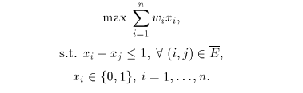
Clique Formulation

Slide 6
Coloring

Slide 7
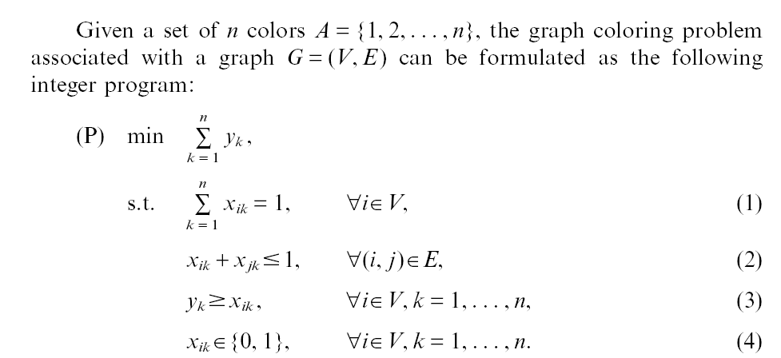
Coloring Formulation

Slide 8
Hamiltonian Cycle

Slide 9
NP
NP “informally” is the class of decision problems whose answer “yes/no” can be verified in polynomial time given a “guess” or “certificate”.
Example Does G contain a Hamiltonian cycle?
  What is a guess?
  Can it be verified in polynomial time?
  How many total guesses?
  How many does it take to prove G contains a cycle?
Example: Is n a composite (not prime)?
  Does d divide n? (can be checked in polynomial time)
Example: Can graph G be colored with k colors?
  Chromatic Number, smallest number of colors in which G can be colored (optimization problem)

Slide 10
Strings
Catenation
  If s₁=abac and s₂=dade, then s₁ · s₂ or s₁s₂=abacdade.
Empty string, λ=‘‘
  s₁ λ= λ s₁ =abac

Slide 11
Alphabet / Words
For a set A, the set A* consists of all finite sequences of elements of A.
  Ex A={0,1}
  λ Є A*, 0 Є A*, 1 Є A*, 01 ЄA*, 10 ЄA*
  000000000… ∉ Α∗
A is called an alphabet, elements of A* are called words.
Ex. A={a, b, c,…, z}, A* contains all words, such as “discrete”, but also “ababccad”.

Slide 12
Example
Let A={ab, bc, ba}
  Is ababab Є A*?
  Is abc Є A*?
  Is abba Є A*?
  Is abbcbaba Є A*?
  Is bcabbab Є A*?
  Is abbbcba Є A* ?

Slide 13
Regular Expressions
A regular expression over A, is a string constructed from elements of A and symbols (, ), v, *, λ.
  First λ is a regular expression.
  If x Є A, then symbol x is a regular expression.
  If α and β are regular expression then (α v β) is regular.
  If α is a regular expression than (α)* is a regular expression.

Slide 14
Regular Expressions
  Ex. Let A={0,1}
  0* is a regular expression.
  (01)* is a regular expression
  (0v1)* is a regular expression
  1(0v1)* is a regular expression
  (011)* is a regular expression
  0 v 1* is a regular expression
  (0 is not a regular expression

Slide 15
Regular Expressions
Give the regular expression for the set of strings over {a,b} in which all the a’s precede the b’s which in turn precedes the c’s.

Slide 16

Regular Set
For each regular expression, there is a corresponding subset of A*, called a regular set.
Example Let A={a, b}
  For a*, the regular set Y contains
    λ, a, aa, aaa, aaaa, aaaaa
    Y={s, s = aaa…a (repeated n times for n≥0)}
    aaaaaaa… ∉ Y

Slide 17
Language
Let ∑ be an alphabet.
A language over ∑ is a subset of ∑*.
Computer Language
  Contains words (if, then , else, etc)
English Language
  ∑ ={a,b,c,d,….z}
  Subset of ∑*

Slide 18
Deterministic Finite Automata (DFA)
Finite State Machine
Vending machine
  Simple newspaper vending machine
  30 cents
  No change given
  Takes Nickels, dimes, and quarters
  No memory used

Slide 19
d
d
d
d
d
n
n
n
n
n
n
30
25
20
15
10
5
0
q
0
q
q
q
q
q
q

Slide 20
Regular expressions
A={a,b,c}
a*b
(aub)*c*
a
b
b
a,b
c
c
b

Slide 21
Regular Language
Equivalent to A regular set
Accepted by a DFA (deterministic finite automation), NFA (nondeterministic finite automation).

Slide 22
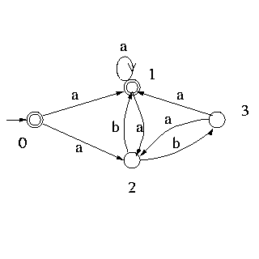
NFA example

Slide 23
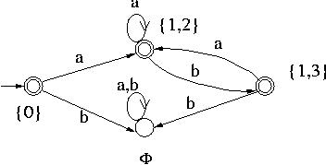
DFA example

