Slide 1
Running Time
Divide and Conquer
Masters Method
Algorithms

Slide 2

Topics
Running Time Analysis
Sequence
  Explicit Formula
  Recursive Formula
Summation/Series
Recurrence Relations
Divide and Conquer
  Binary Search & Recurrences
  Masters Method
  Merge Sort

Slide 3

Worse Case Performance
Pick an ordering of the input that yields longest possible runtime for this algorithm
  “Cooking” the input
    Example: Insertion sort on a list in reverse order
Analysis gives the worse case performance
Provides a theoretical bound on the algorithm but may not be the practical answer
10 Sept 2010
CSCI 2230
Lecture 5 - <number>

Slide 4
Average Case Performance
Two views
  Long term average
    Average over lots of input sets – Amortized Analysis, or
  Performance for “random” input
Analysis generally ranges from difficult to very difficult
10 Sept 2010
CSCI 2230
Lecture 5 - <number>

Slide 5
Best Case Performance
Pick an ordering of the input that yields shortest possible runtime for this algorithm
  More “Cooking” the input
10 Sept 2010
CSCI 2230
Lecture 5 - <number>

Slide 6
Concentrate on Worse Case
Worse case analysis gives an upper bound on the algorithm’s performance
Worse case performance occurs for a large number of interesting (relevant) cases
Best case performance is frequently the same for all algorithm of a specific purpose
Analysis of average-case performance is usually difficult
10 Sept 2010
CSCI 2230
Lecture 5 - <number>

Slide 7
Arbitrary Algorithms Approaches
Three approaches
  Informal Analysis
  Code Analysis
  Recurrence Relations
10 Sept 2010
CSCI 2230
Lecture 5 - <number>

Slide 8
Method 1: Informal Analysis
Easiest and the least rigorous method
  least rigorous == unsure
Arguments may blur the difference between average and worst case
10 Sept 2010
CSCI 2230
Lecture 5 - <number>

Slide 9

Informal Analysis Example
Binary search of sorted array for key value
  Make the current list the entire array
  Check middle element
    If == key, done
    If > key, make current list the upper half of array
    Otherwise, Make current list the lower half of array
    Repeat
  Must eventually find key or report failure(empty list)
  Halve the array times
    For n = 100, = 7
10 Sept 2010
CSCI 2230
Lecture 5 - <number>

Slide 10
Method 2: Code Analysis
Presumes that the code (pseudo code) is correct (!)
Look for loops and branches
  Treat function calls as in-line
Loops:
  Count the number of passes
Nested loops
  Multiplicative
10 Sept 2010
CSCI 2230
Lecture 5 - <number>

Slide 11
Code Analysis Example
Selection sort
  Find the minimum value of current array: loop from 1 to n-1 (compare to next element)
  Swap minimum into position 1
  Repeatedly loop over array
    From 2 to n-1 (n-2 steps)
    Then from 3 to n-1 (n-3 steps),
    … n-2 to n-1 (1 step)
  Total steps = sum {(n-1), (n-2), … , 1} = n(n-1)/2
10 Sept 2010
CSCI 2230
Lecture 5 - <number>

Slide 12
Method 3: Recurrence Relations
Many algorithms are specified as recursively
Write a statement of the amount of work done in terms of
  Actual # operations for the first step
  Number of pieces (often 2) into which the input set is divided for further work
  Multiplier factor, if necessary, on those pieces
10 Sept 2010
CSCI 2230
Lecture 5 - <number>

Slide 13
Sequence (From CSCI 1900)
A sequence is a list of ordered objects.
  Ex. 1,2,3,2,1,0,1,2,3,1,2
  Can be finite or infinite
  Ex 1,0,1,0,1,0,…
  Elements can be repeated

Slide 14
Formulas
Explicit Formula, a_{n}=2^{n}+n-1
  a₁ =2¹+1-1=2 (We start with n=1)
  a₂ =2²+2-1=5
  n^{th} term is defined in terms of n
Recursive Formula
  a₁ =0, a₂ =1, a_{n} = a_{n-1} + a_{n-2} n>1
  a₃ =1, a₄ =2, a₅ =3, a₆ =5
  Fibonacci Numbers (occur in nature)
  n^{th} term is defined in terms of n and previous terms

Slide 15
Old 1900 Quiz

Slide 16

Series/Summation Practice

Slide 17
Recurrence Relation Example
Binary Search
  First step compares key to one element (the middle one) => one operation
  Split the input set in half
  Do not process both halves, only one => multiplier is one
  Notation is T(n) for operation count
  Recurrence relation is: T(n) = T(n/2) + 3
  Now solve the relation for T(n) in an explicit form (no other references to T(anything) )
10 Sept 2010
CSCI 2230
Lecture 5 - <number>

Slide 18
Recurrence Relation Example (cont.)
Substitution method
  Apply the relation inductively until T(1) is reached
    T(n) = T(n/2) + 3 = T(n/4) + 3 + 3 = T(n/8) + 3 + 3 + 3 = … = T(n/n) + 3 +3 … + 3
  Must be able to evaluate the end condition
    T(n/n) = T(1) = 1, search an array of 1 element
    Note: assumes n is a power of 2, so round up (apply ceiling function if necessary)
    so T(n) = 3 + … + 3 lg n terms => T(n) = lg n
10 Sept 2010
CSCI 2230
Lecture 5 - <number>

Slide 19
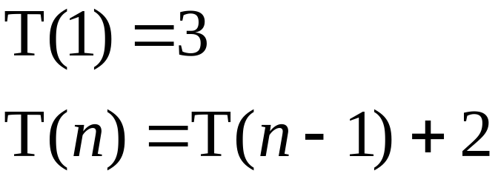
Recurrence Relation Form
A recurrence relation is a recursive form of an equation, for example:
A recurrence relation can be put into an equivalent closed form without the recursion

Slide 20
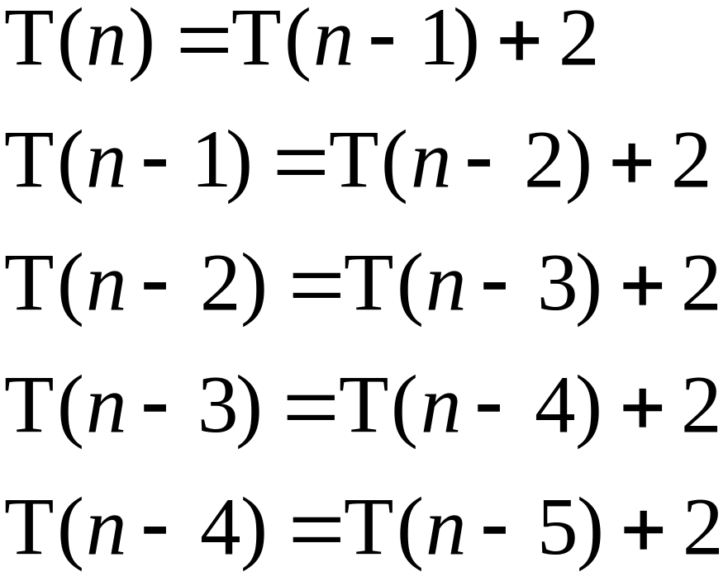
Converting Recurrence Relations
Begin by looking at a series of equations with decreasing values of n:

Slide 21
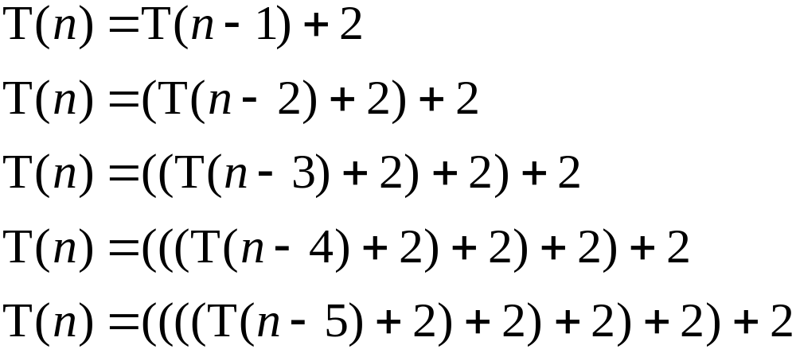
Converting Recurrence Relations
Now, we substitute back into the first equation:

Slide 22
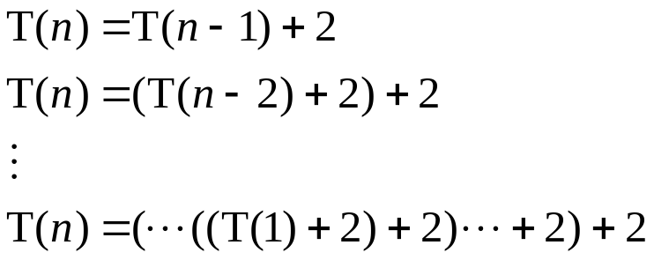
Converting Recurrence Relations
We stop when we get to T(1):
How many “+ 2” terms are there? Notice we increase them with each substitution.

Slide 23
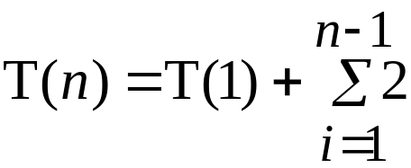

Converting Recurrence Relations
We must have n – 1 of the “+ 2” terms because there was one at the start and we did n – 2 substitutions:
So, the closed form of the equation is:

Slide 24
Recurrence Relation
A recurrence relation is an equation that defines a sequence recursively (recursive Formula)
Solving a recurrence relation is finding a closed-form solution (explicit formula)
You should have seen this when working with Taylor series (Calculus 2)
Also used in ODE (ordinary differential equations)
For CS ( Running Time)
  We can call a function recursively to solve problems (Divide and Conquer)
  Example Binary Search
  This will yield a running time which is a recurrence Relation
Some recurrence relations can be solved using a method called Masters Method (we will see today)
Other methods
  Characteristic equation
  Generating functions

Slide 25
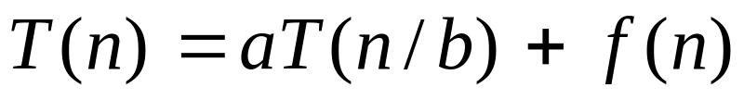
Recurrence Relation Example (cont.)
Master Theorem Method
  A recipe for solving any recurrence of the form
  where
    a and b are constants with a ≥ 1 and b>1
  The above recurrence describes the running time of an algorithm that divides a problem set of size n into a pieces to be processed, each of size n/b. The cost of dividing and combining the results is given by f(n)
10 Sept 2010
CSCI 2230
Lecture 5 - <number>

Slide 26
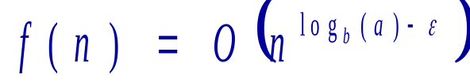
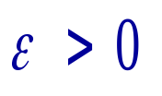
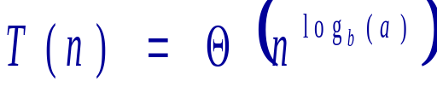
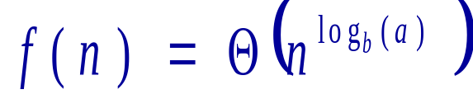
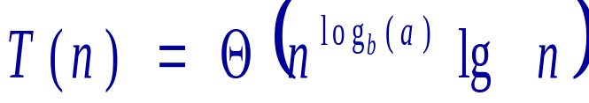
Recurrence Relation Example (cont.)
  Must memorize and apply 3 cases
  Case 1:
  for
  Case 2:
10 Sept 2010
CSCI 2230
Lecture 5 - <number>

Slide 27
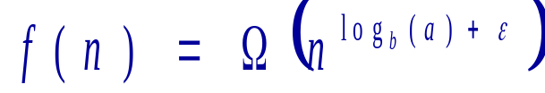


Recurrence Relation Example (cont.)
  Case 3:
  for and if for some
  c < 1 then
10 Sept 2010
CSCI 2230
Lecture 5 - <number>

Slide 28
Using the Master Method
Example 1: Binary Search
  T(n) = T(n/2) + 3
    a = 1 b = 2 f(n) = 3
    log_{b}a = lg 1 = 0
    n⁰ = 3
    Case 2: (with k = 0)
    T(n) = θ (n⁰ lg n) = θ (lg n)
10 Sept 2010
CSCI 2230
Lecture 5 - <number>

Slide 29
Using the Master Method (cont)
Example 2:
  T(n) = 9T(n/3) + n
    a = 9 b = 3 f(n) = n
    log_{b}a = log₃9 = 2 f(n) = n⁽²⁻¹⁾
    Case 1
    T(n) = θ (n²)
10 Sept 2010
CSCI 2230
Lecture 5 - <number>

Slide 30
Divide and Conquer
Divide the problem into smaller subproblems
Conquer the subproblems recursively until the subproblem is small enough to solve
Example Binary Search, Merge Sort
Power function

Slide 31
Binary Search (Recurrence)
Binary Search (array A, first, last, v)
  If (last <first) output -1
  Mid = (last + first) /2
  If A[mid]= v output mid
  If A[mid]>v
    Binary_search (A, first, mid-1,v)
  Else Binary_search (A, mid+1, last,v)

Slide 32
Binary Search
Let T(n) be the worst case running time.
Each iteration of Binary Search halves the size of the data to be checked.
T(n)= T(n/2) +1
T(1)=1 , i.e. Θ(1)
We could use induction to prove that T(n)= Θ(lg n).
We will just use Masters Method
T(n)=aT (n/b) + g(n)
  Divide and conquer recurrence relation

Slide 33
Masters Method
Let a >=1, b>1 be constants, let f(n) be a function, and let T(n) be defined on the nonnegative integers by the recurrence.
T(n)=aT(n/b) + f(n). Then
  1) If f(n) = O(n^{log_b(a) - ε} ) for some constant ε>0, then T(n)=Θ(n^{log_b(a)})
  2) If f(n)= Θ(n^{log_b(a)}), then T(n)=Θ(n^{log_b(a)} lg n)
  3) If f(n) =Ω(n^{log_b(a)+ ε} ) for some constant ε>0, and if af(n/b) <= cf(n) for some constant c<1 and all sufficiently large n, then T(n)=Θ(f(n))

Slide 34
T(n)
T(n)= T(n/2) +1
B=2, a=1, so b>1, and a >=1
Log_{b} a = Log₂ 1 = 0
n^{log_b(a)} = n⁰=1
f(n)=1
Case 2 applies here 1∈Ө(1) so
  T(n)= Ө (n^{log_b(a)} lg n)=Ө ( lg n)

Slide 35
T(n)
T(n)= 9T(n/3) +n
B=3, a=9, so b>1, and a >=1
Log_{b} a = Log₃ 9 = 2
n^{log_b(a)} = n²
f(n)=n
Does here n∈O(n^{2- ε}) for some here ε>0?
Yes take ε = .5, or even ε =1, but you can not take ε =0.
Case 1 applies here n∈O(n¹) using so
  T(n)= Ө (n^{log_b(a)} )=Ө (n²)

Slide 36
T(n)
T(n)= 3T(n/4) +n lg n
B=4, a=3, so b>1, and a >=1
Log_{b} a = Log₄ 3 ≈ 0.793
n^{log_b(a)} ≈ n^{0.793}
f(n)=n lg n
Now is n lg n ∈Ω (n^{0.793 + ε}) for ε > 0
Yes n lg n ∈Ω (n), so take ε = 1-0.793 ≈.207
Case 3 applies here if we can show af(n/b) <= cf(n) for some constant c<1 and sufficiently large n.
Well, af(n/b) = 3 (n/4) lg (n/4) = ¾ n lg (n/4) <= ¾ n lg (n)
So when c=3/4<1 , af(n/b) <= cf(n)

Slide 37
T(n)
T(n)= 2T(n/2) +n lg n
B=2, a=2, so b>1, and a >=1
Log_{b} a = Log₂ 2 = 1
n^{log_b(a)} = n¹
f(n)=nlg n
Case 2 is n lg n∈ Ө(n¹)?
  No
Case 3 is n lg n∈ Ω (n^{1 + ε}) for ε > 0?
  No
We can not use Regular Masters Method here

Slide 38
Karatsuba: Multiplying Integers
Let A and B be n bit numbers
A = (A₁ A₀) B = (B₁ B₀)
  A₁ , A₀ , B₁ ,B₀ are n/2 bit numbers
  A=2^{n/2} A₁+ A₀
  B=2^{n/2} B₁+ B₀
  A*B=(2^{n/2} A₁+ A₀)(2^{n/2} B₁+ B₀)
    = 2^{n/2} 2^{n/2} A₁ B₁+ 2^{n/2} A₀ B₁ + 2^{n/2} A₁ B₀ + A₀ B₀
    T(n)=4T(n/2)+4n
    Case 1, n²
  A*B= 2^{n}A₁ B₁+ 2^{n/2} A₀ B₁ + 2^{n/2} A₁ B₀ + A₀ B₀
  = 2^{n}A₁ B₁+ 2^{n/2} (A₀ B₁ + A₁ B₀ ) + A₀ B₀
  =2^{n}A₁ B₁+ 2^{n/2} { (A₁ ₊ A₀ ) (B₁ ₊ B₀ ) - A₁ B₁ - A₀ B₀ } + A₀ B₀
  (2^{n/2}) A₁ B₁+ 2^{n/2}(A₁+ A₀) (B₀ + B₁) + (2^{n/2}-1) A₀ B₀
  T(n)=3T(n/2)+6n
  Case 1, n^{lg 3} ≈n^{1.585}
  Because of overhead of recursion, this is used for long values of n
  Small values of n, long multiplication used.

Slide 39
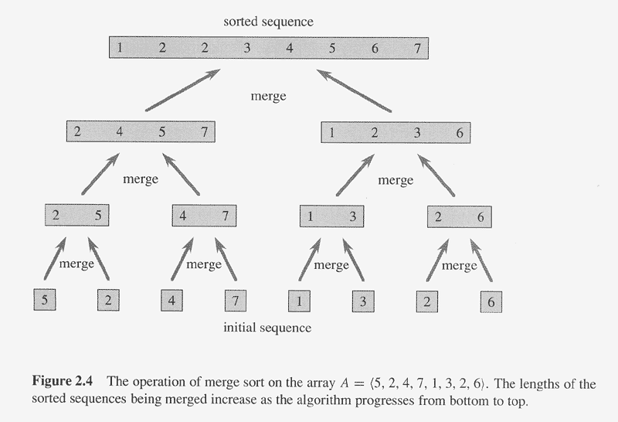
Merge Sort Example

Slide 40
Quiz T(n) + Merge Sort

