Slide 1
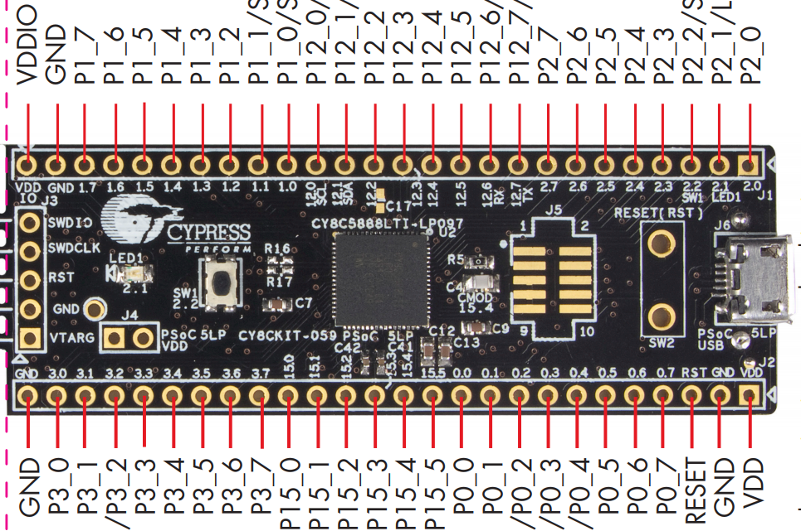
Mapping
SCL
SDA1
VDD
VDD
SYNC
SDA6
SCL_H
SDA4
SDA5
SDA2
SDA3
INT_H
SDA_H
MOSI
SCK
GND
GND
VDD

