Slide 1
Introduction to Microsoft Prism Framework
Chris Weldon
Improving Enterprises

Slide 2
Chris Weldon - @neraath
Fightin’ Texas Aggie
C# Developer since 2005
Sr. Consultant at Improving Enterprises
chris@chrisweldon.net

Slide 4
Chart a Course
Evolution of Thick Client Apps
Intro to Prism
Prism Features
Modular Application Development
Event Aggregator
Regions and the Region Manager
View Composition
Navigation

Slide 5
Evolution of Thick Client Apps

Slide 6
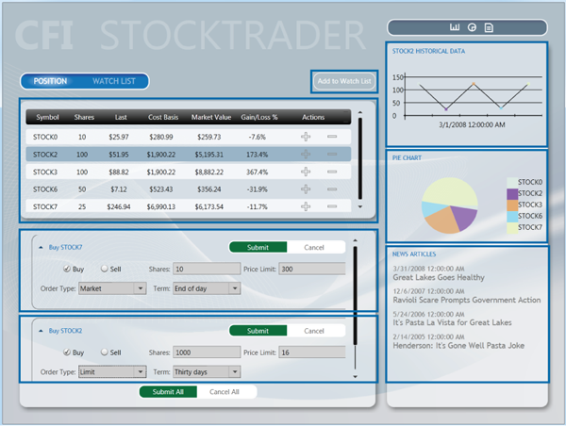

Slide 7
namespace StockTrader
{ public partial class Form1 : Form { int selrow; public Form1() { InitializeComponent(); } private void Form1_Load(object sender, EventArgs e) { DataTable dt = new DataTable(); DataRow dr; dt.Columns.Add(“Symbol"); dt.Columns.Add(“Shares"); dt.Columns.Add(“Last");
// A LOT MORE CRUD dataGridView1.DataSource = dt; } private void dataGridView1_RowEnter(object sender, DataGridViewCellEventArgs e) { selrow = e.RowIndex; } private void button1_Click(object sender, EventArgs e) { //Create instance of second form Form2 obj = new Form2(); //Assign Employee No from grid view to second form textbox obj.Controls["TextBox1"].Text = dataGridView1.Rows[selrow].Cells[0].Value.ToString(); //Assign Employee Name from grid view to second form textbox obj.Controls["TextBox2"].Text = dataGridView1.Rows[selrow].Cells[1].Value.ToString(); //Assign Employee Salary from grid view to second form textbox obj.Controls["TextBox3"].Text = dataGridView1.Rows[selrow].Cells[2].Value.ToString(); //Open Details form obj.ShowDialog(); } } }

Slide 8

Form1.Designer.cs
I don’t want to show you
Because it’s a big pile of

Slide 9
WPF
<UserControl x:Class=“StockTrader.AddFundView"
xmlns="http://schemas.microsoft.com/winfx/2006/xaml/presentation"
xmlns:x="http://schemas.microsoft.com/winfx/2006/xaml"
Width="Auto">
<StackPanel>
<Label>Customer:</Label>
<ComboBox Name="CustomerCbx" Margin="5" Style="{DynamicResource SimpleComboBox}"
Width="Auto" HorizontalAlignment="Stretch">
<ComboBoxItem>Customer1</ComboBoxItem>
<ComboBoxItem>Customer2</ComboBoxItem>
</ComboBox>
<Label>Fund:</Label>
<ComboBox Name="FundCbx" Margin="5" Style="{DynamicResource SimpleComboBox}"
Width="Auto" HorizontalAlignment="Stretch">
<ComboBoxItem>FundA</ComboBoxItem>
<ComboBoxItem>FundB</ComboBoxItem>
</ComboBox>
<Button Name="AddButton" Margin="5" Width="75" Height="25"
Style="{DynamicResource SimpleButton}" HorizontalAlignment="Left">Add</Button>
</StackPanel>
</UserControl>

Slide 10
namespace StockTrader
{ public partial class AddFundView : UserControl { int selrow; public AddFundView() { InitializeComponent(); } private void dataGridView1_RowEnter(object sender, DataGridViewCellEventArgs e) { selrow = e.RowIndex; }
private void button1_Click(object sender, EventArgs e) { //Create instance of second form Form2 obj = new Form2(); //Assign Employee No from grid view to second form textbox obj.Controls["TextBox1"].Text = dataGridView1.Rows[selrow].Cells[0].Value.ToString(); //Assign Employee Name from grid view to second form textbox obj.Controls["TextBox2"].Text = dataGridView1.Rows[selrow].Cells[1].Value.ToString(); //Assign Employee Salary from grid view to second form textbox obj.Controls["TextBox3"].Text = dataGridView1.Rows[selrow].Cells[2].Value.ToString(); //Open Details form obj.ShowDialog(); } } }

Slide 11
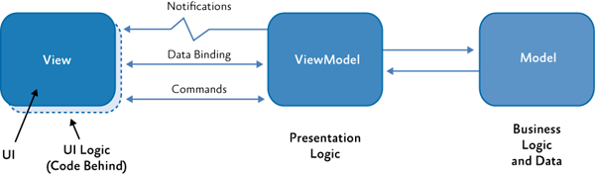
MVVM

Slide 12
When I click a row of a specific type…
I want to add an element here.

Slide 13
private void Grid1_ItemSelected(object sender, EventArgs e)
{
RightPanelStackPanel.Children.Clear(); if (sender.GetType() == typeof(PremiereStock))
{
BestBetsWatcherControl bbwc = new BestBetsWatcherControl();
RightPanelStackPanel.Children.Add(bbwc);
}
else if (sender.GetType() == typeof(PennyStock))
{
CautionWatcherControl cwc = new CautionWatcherControl((PennyStock)sender);
RightPanelStackPanel.Children.Add(cwc);
}
else if (sender.GetType() == typeof(StandardStock))
{
NewsControl news = new NewsControl((StandardStock)sender);
RightPanelStackPanel.Children.Add(news);
}
else
{
// Do nothing?
} }

Slide 14
Conditional Logic == Bad

Slide 15
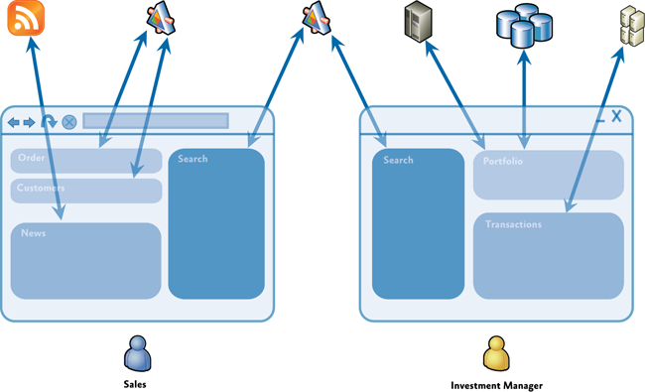
A Composite Example

Slide 16
Composite Goals
Components are loosely coupled
Components easily integrate into coherent “shell”
Promotes reuse while maintaining separation of concerns
Allow independent development by multiple modular teams

Slide 17
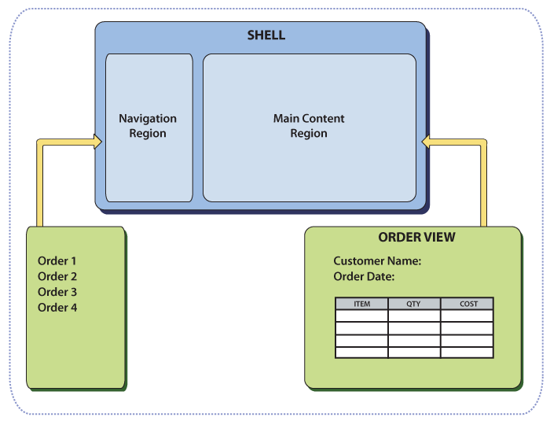
Composite View Design Pattern

Slide 18
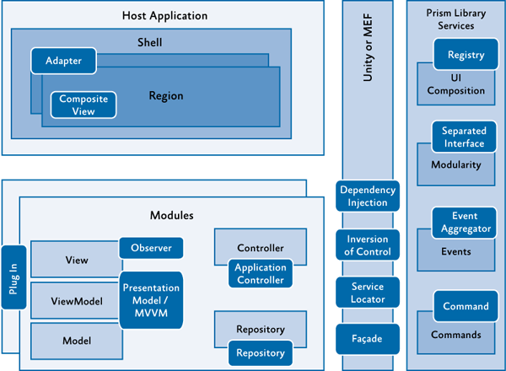
Patterns Used in Prism

Slide 19
Modular Development

Slide 20
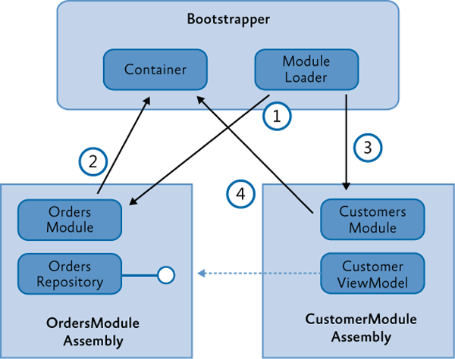
Dependency Injection

Slide 21
Prism and IoC
Supports any IoC container
Has OOB Support for
MEF
Unity

Slide 22
Prism Modules
public interface IModule
{
void Initialize();
}

Slide 23
MEF Modules
[ModuleExport(typeof(ModuleB))]
public class ModuleB : IModule
{
...
}

Slide 24
Module Catalogs (XAML)
<Modularity:ModuleCatalog
xmlns="http://schemas.microsoft.com/winfx/2006/xaml/presentation"
xmlns:x="http://schemas.microsoft.com/winfx/2006/xaml"
xmlns:sys="clr-namespace:System;assembly=mscorlib"
xmlns:Modularity="clr-namespace:Microsoft.Practices.Prism.Modularity;assembly=Microsoft.Practices.Prism">
<Modularity:ModuleInfoGroup Ref="ModuleB.xap" InitializationMode="WhenAvailable">
<Modularity:ModuleInfo ModuleName="ModuleB"
ModuleType="ModuleB.ModuleB, ModuleB, Version=1.0.0.0, Culture=neutral, PublicKeyToken=null" />
</Modularity:ModuleInfoGroup>
<Modularity:ModuleInfoGroup InitializationMode="OnDemand">
<Modularity:ModuleInfo Ref="ModuleE.xap" ModuleName="ModuleE"
ModuleType="ModuleE.ModuleE, ModuleE, Version=1.0.0.0, Culture=neutral, PublicKeyToken=null" />
<Modularity:ModuleInfo Ref="ModuleF.xap" ModuleName="ModuleF"
ModuleType="ModuleF.ModuleF, ModuleF, Version=1.0.0.0, Culture=neutral, PublicKeyToken=null" >
<Modularity:ModuleInfo.DependsOn>
<sys:String>ModuleE</sys:String>
</Modularity:ModuleInfo.DependsOn>
</Modularity:ModuleInfo>
</Modularity:ModuleInfoGroup>
<!-- Module info without a group -->
<Modularity:ModuleInfo Ref="ModuleD.xap" ModuleName="ModuleD"
ModuleType="ModuleD.ModuleD, ModuleD, Version=1.0.0.0, Culture=neutral, PublicKeyToken=null" />
</Modularity:ModuleCatalog>

Slide 25
Module Catalogs (XAML)
protected override IModuleCatalog CreateModuleCatalog()
{
return ModuleCatalog.CreateFromXaml(
new Uri("/MyProject.Silverlight;component/ModulesCatalog.xaml", UriKind.Relative));
}

Slide 26
Module Catalogs (Config)
<?xml version="1.0" encoding="utf-8" ?>
<configuration>
<configSections>
<section name="modules" type="Microsoft.Practices.Prism.Modularity.ModulesConfigurationSection, Microsoft.Practices.Prism"/>
</configSections>
<modules>
<module assemblyFile="ModularityWithUnity.Desktop.ModuleE.dll"
moduleType="ModularityWithUnity.Desktop.ModuleE, ..." moduleName="ModuleE" startupLoaded="false" />
<module assemblyFile="ModularityWithUnity.Desktop.ModuleF.dll"
moduleType="ModularityWithUnity.Desktop.ModuleF, ..." moduleName="ModuleF" startupLoaded="false">
<dependencies>
<dependency moduleName="ModuleE"/>
</dependencies>
</module>
</modules>
</configuration>

Slide 27
Module Catalogs (Config)
protected override IModuleCatalog CreateModuleCatalog()
{
return new ConfigurationModuleCatalog();
}

Slide 28
Module Catalogs (Directory)
protected override IModuleCatalog CreateModuleCatalog()
{
return new DirectoryModuleCatalog() {ModulePath = @".\Modules"};
}

Slide 29
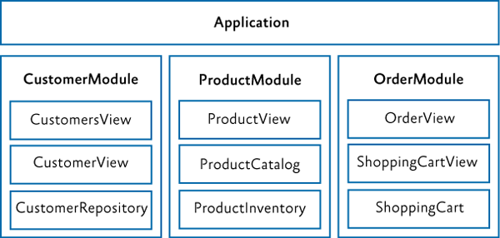
Vertical Slicing

Slide 30
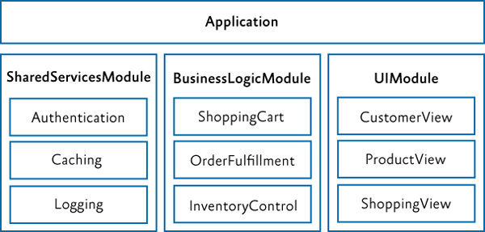
Horizontal Slicing

Slide 31
Event Aggregator

Slide 32
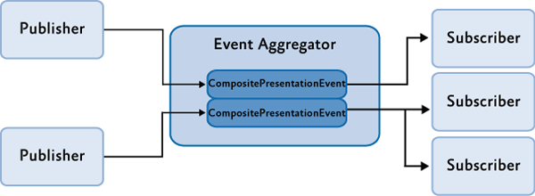
Event Aggregator

Slide 33
public interface IEventAggregator
{
TEventType GetEvent<TEventType>() where TEventType : EventBase;
}

Slide 34
public class CompositePresentationEvent<TPayload> : EventBase
{
...
public SubscriptionToken Subscribe(Action<TPayload> action);
public SubscriptionToken Subscribe(Action<TPayload> action, ThreadOption threadOption);
public SubscriptionToken Subscribe(Action<TPayload> action, bool keepSubscriberReferenceAlive)
public virtual SubscriptionToken Subscribe(Action<TPayload> action, ThreadOption threadOption,
bool keepSubscriberReferenceAlive);
public virtual SubscriptionToken Subscribe(Action<TPayload> action, ThreadOption threadOption,
bool keepSubscriberReferenceAlive, Predicate<TPayload> filter);
public virtual void Publish(TPayload payload);
public virtual void Unsubscribe(Action<TPayload> subscriber);
public virtual bool Contains(Action<TPayload> subscriber)
...
}

Slide 35
public class TickerSymbolSelectedEvent : CompositePresentationEvent<string>{}

Slide 36
Publishing and Subscribing
this.eventAggregator.GetEvent<TickerSymbolSelectedEvent>().Publish("STOCK0");
public void Run()
{
...
this.eventAggregator.GetEvent<TickerSymbolSelectedEvent>()
.Subscribe(ShowNews, ThreadOption.UIThread);
}
public void ShowNews(string companySymbol)
{
this.articlePresentationModel.SetTickerSymbol(companySymbol);
}

Slide 37
Subscription Filtering
FundAddedEvent fundAddedEvent = this.eventAggregator.GetEvent<FundAddedEvent>();
fundAddedEvent.Subscribe(FundAddedEventHandler, ThreadOption.UIThread, false,
fundOrder => fundOrder.CustomerId == this.customerId);

Slide 38
Regions and the REgionMAnager

Slide 39
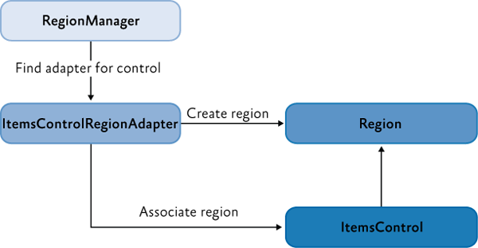
The Layout

Slide 40
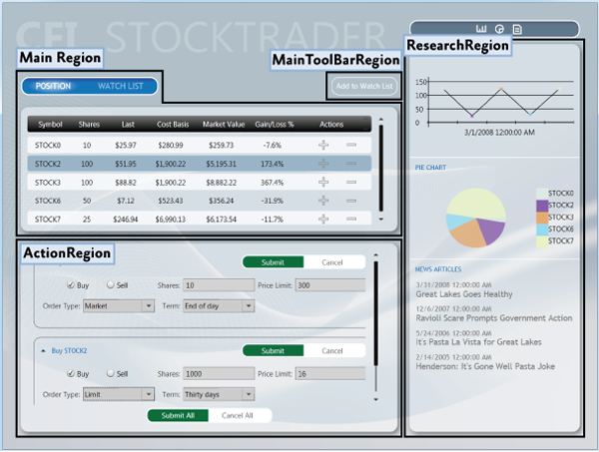

Slide 41
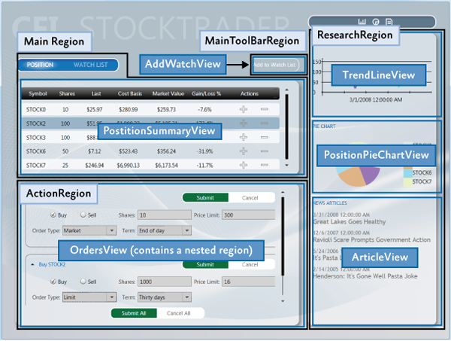

Slide 42
View Composition

Slide 43
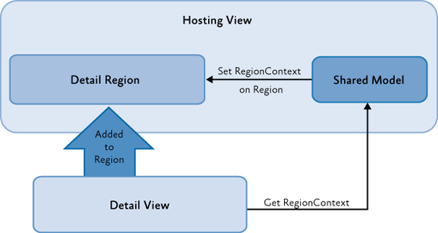
RegionContext

Slide 44
Navigation

Slide 45
Q&A

Slide 46
Thanks!

