Slide 1
DBpedia
Extraction of Knowledge from Wikipedia
Creating Knowledge out of Interlinked Data
Markus Ackermann, Markus Freudenberg
WG Agile Knowledge and Semantic Web
Universität Leipzig

Slide 2
Where is Wikipedia information useful?
„Which films starred John Cleese without any other members of Monty Python?“
„What have Dublin and Leipzig in common?“
„Which Software products are developed by an organisation founded in California?“
„Which populated places in Germany are below sea level?“

Slide 3
Where is Wikipedia information useful?
as terminology and concept repository and fact source for Entity Linking and Disambiguation:
The series follows the adventures of a space-faring crew on board the starship USS Enterprise (NCC-1701-D), the fifth Federation vessel to bear the name and registry and the seventh starship by that name
The Enterprise is commanded by Captain Jean-Luc Picard and is staffed by first officer Commander William Riker, operations manager Data, security chief Tasha Yar, ship's counselor Deanna Troi, chief medical officer Dr. Beverly Crusher, conn officer Lieutenant Geordi La Forge, and junior officer Lieutenant Worf.
⇒ no company, no aircraft carrier, no satellite
⇒ correlate the mentionings and concept starship
⇒ Star Trek rank, contemporary or past military or law enforcement

Slide 4
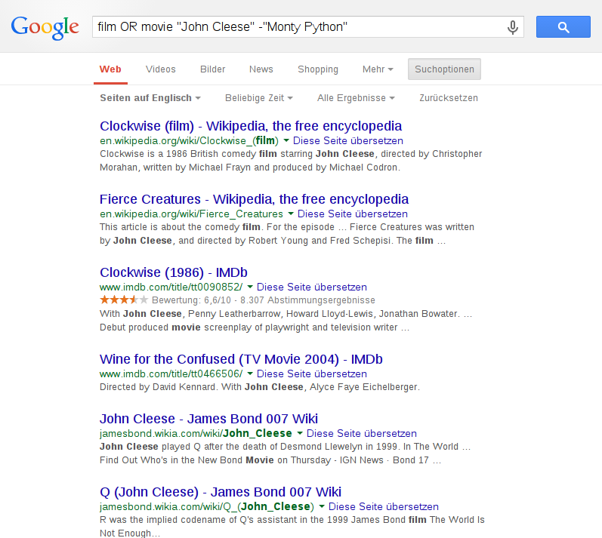
Why search engines aren't always enough
„Which films starred John Cleese without any other members of Monty Python?“

Slide 6
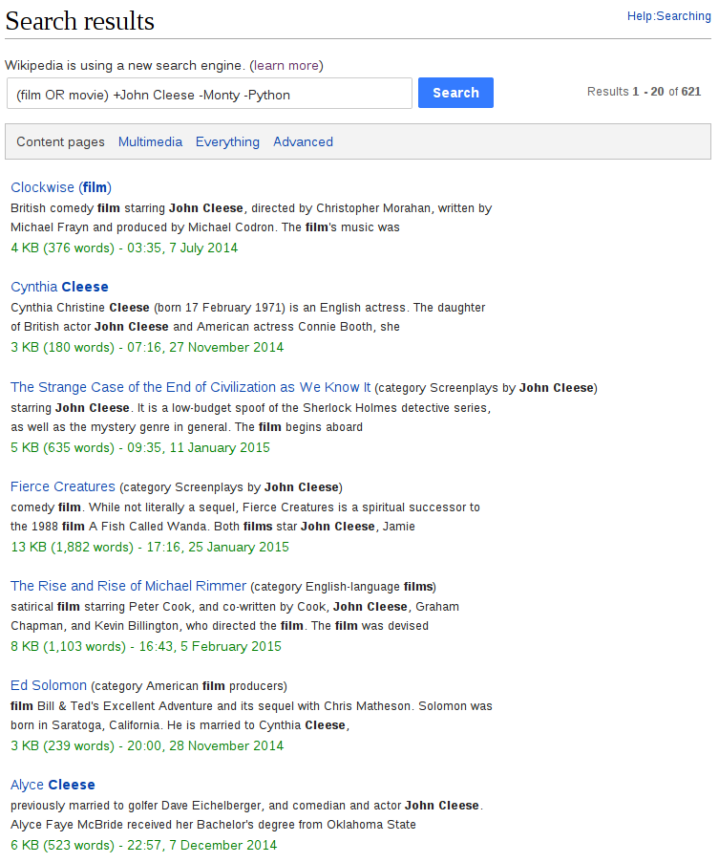

Slide 7
What is needed to do better?
ontological represantation of entities and facts
well-defined taxonomy of entity types
assertions about entities in and their relations
A British Comedy is a kind of Comedy. A Comedy is a kind of Film.
A British Comedy is a kind of Film.
Clockwise is a British Comedy. John Cleese stars Clockwise.
John Cleese stars a Film.
thoroughly specified, machine-actionable, but flexible formalism for representation
„An ontology is a specification of a conceptualization.“ (Gruber, 1993)
⇒ formal description of concepts and relationships

Slide 8
A brief introduction to RDF
Resource Description Framework (W3C Standard)
flexible language and data model for representation of information
based on (S,P,O) triples denoting simple assertions
S – subject P – property O – object
S ∊ I∪B P ∊ I O ∊ I∪B∪L
I – URIs/IRIs; B – blank nodes; L – Literals
URIs/IRIs of named entities are:
    unambigious, but non-unique identifiers of a resource
    often dereferencable (in the Semantic Web)
aggregate of triple-assertions constitutes a directed graph with typed edges

Slide 9
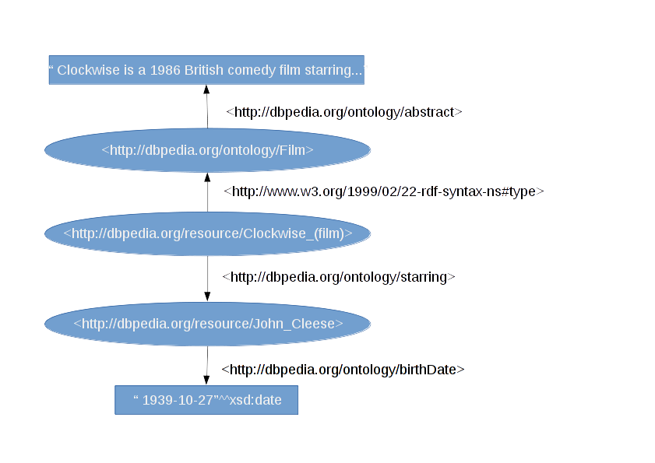
A brief introduction to RDF

Slide 10
DBpedia - motivation and use cases
an RDF view of structured Wikipedia information enables:
    sophisitated queries
        ⇒ cross-referencing facts of entities
        ⇒ filtering of entities based on their types
        and fact assertions
    combining facts from Wikipedia with machine-actionable knowledge from other structured datasets
    (Geodata, Yellowpages, WordNet, ...)

Slide 11
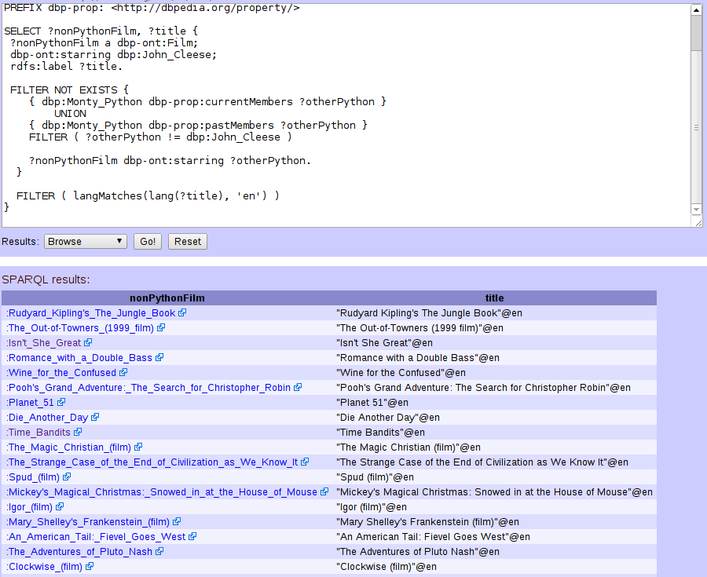
Another take on
Question Answering
„Which films starred John Cleese without any other members of Monty Python?“

Slide 13
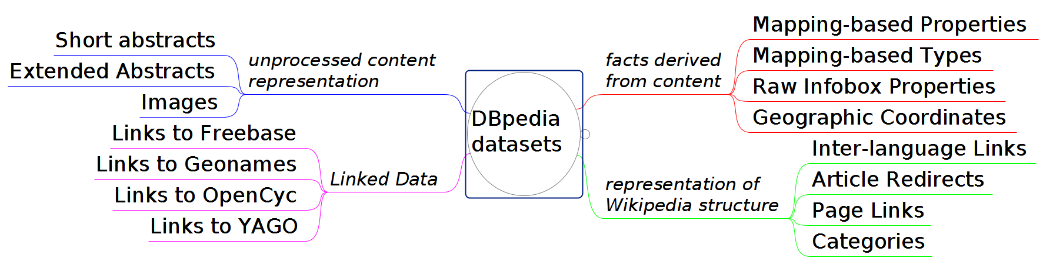
DBpedia - contents and datasets
Wikipedia article ⇔ DBpedia resource
http://en.wikipedia.org/wiki/Monty_Python
⇔ http://dbpedia.org/resource/Monty_Python
mapping-based types and facts governed by the DBpedia Ontology

Slide 14
DBpedia - contents and datasets
4.58 mio. entities and 583 mio. triples (Englisch DBpedia 2014)
131,2 mio. fact assertions (devived from info boxes)
168,5 mio. triples representing Wikipedia structure
57,1 mio. links to external datasets
DBpedia resources are categorised in several manners:
    by Wikipedia categories (represented in SKOS)
    by YAGO classification
    by links to WordNet Synsets
    by assignment of classes from the DBpedia ontology
Provenance meta-data
⇒ From which part of which Wikipedia page was a triple derived?

Slide 15
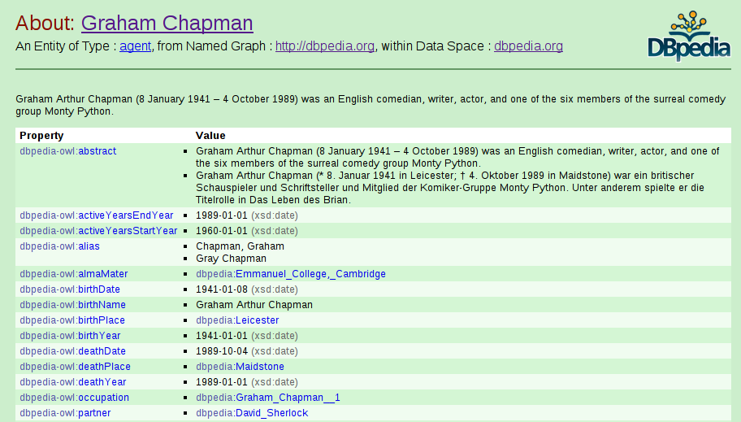
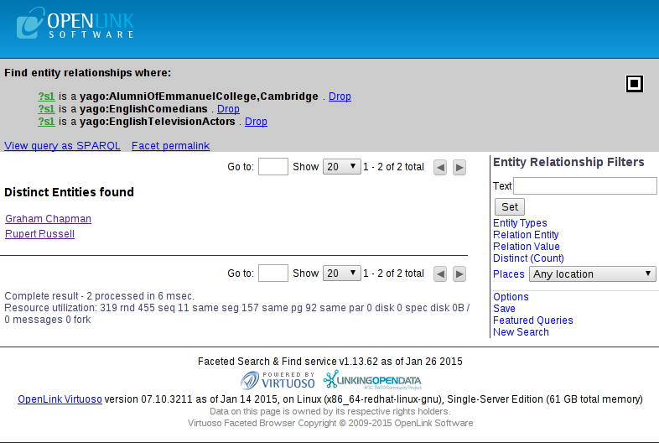
Acessing DBpedia - Browsing
official DBpedia mirror http://dbpedia.org
  ⇒ run on Virtuoso
  ⇒ point & click browsing via DBpedia VAD
  ⇒ faceted search with Virtuoso Facets

Slide 16
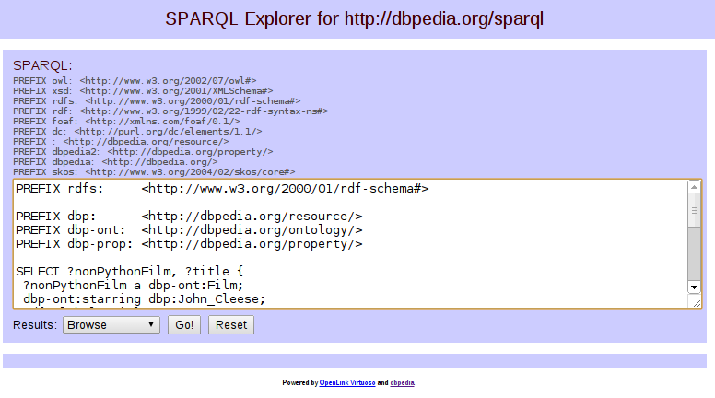
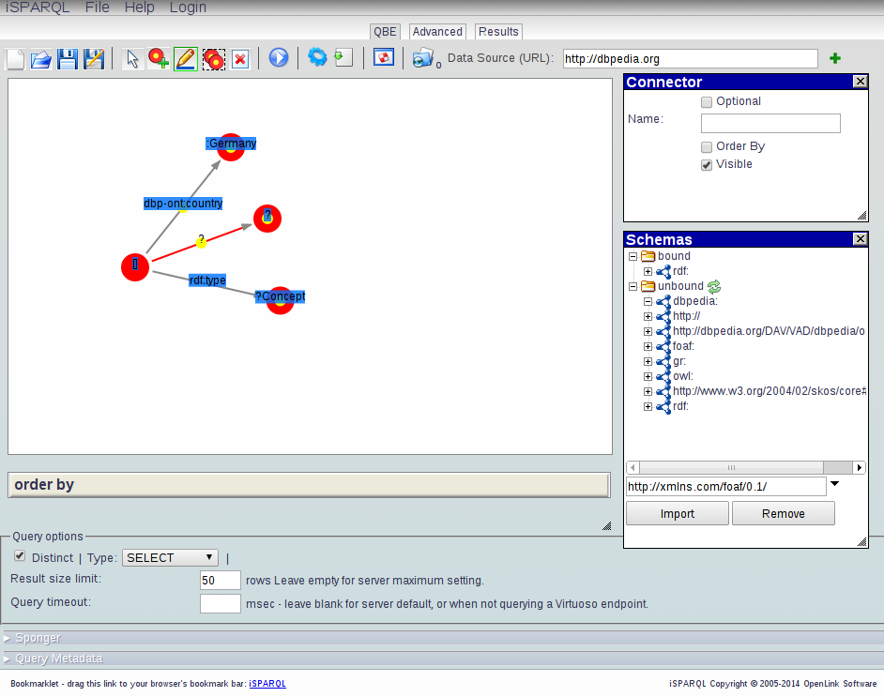
Acessing DBpedia - SPARQL
official SPARQL endpoint http://dbpedia.org/sparql
  ⇒ subject to a fair use policy (limited query runtime)
  ⇒ iSPARQL frontend (interactive query building)
  ⇒ Snorql frontend
  ⇒ query with any SPARQL compliant tool or API

Slide 17
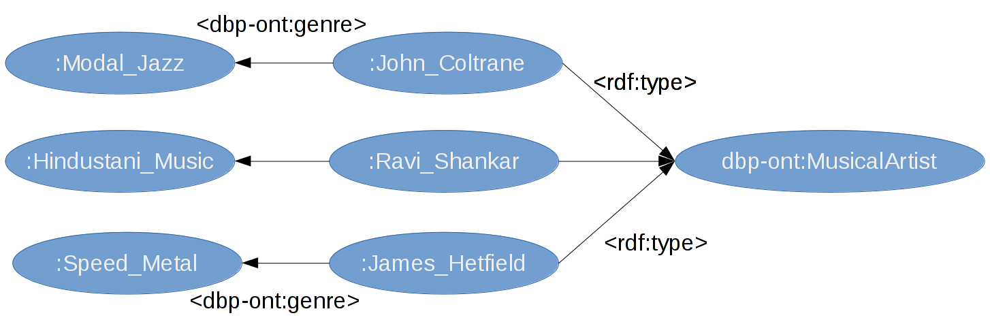
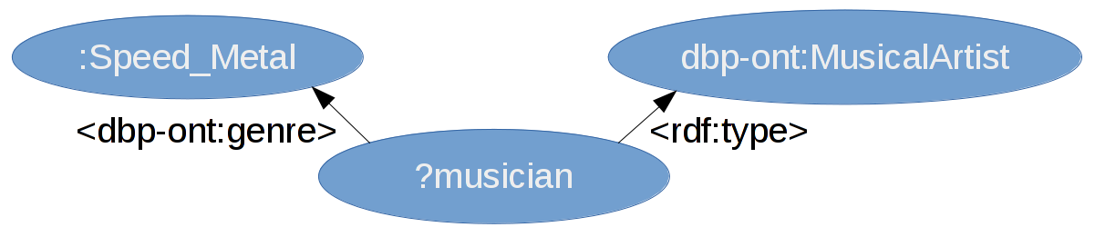
Querying RDF with SPARQL
SPARQL Protocol and RDF Query Language
⇒ graph patterns as set of triples (with variables)
⇒ successful matches of graph patters generate
bindings in (sub-)query solutions
different result types for queries
SELECT ⇒ bindings, ASK ⇒ true/false, CONSTRUCT ⇒ new graph
combinators and modifiers for basic graph patterns
  ⇒ UNION, FILTER, MINUS, FILTER (NOT) EXISTS
result set modifies
LIMIT, OFFSET, DISTINCT, ORDER BY
numerous operators and operators for resource and literal values
many additions in 1.1 revision:
grouping & aggregates, regular property path expr., sub-queries

Slide 18
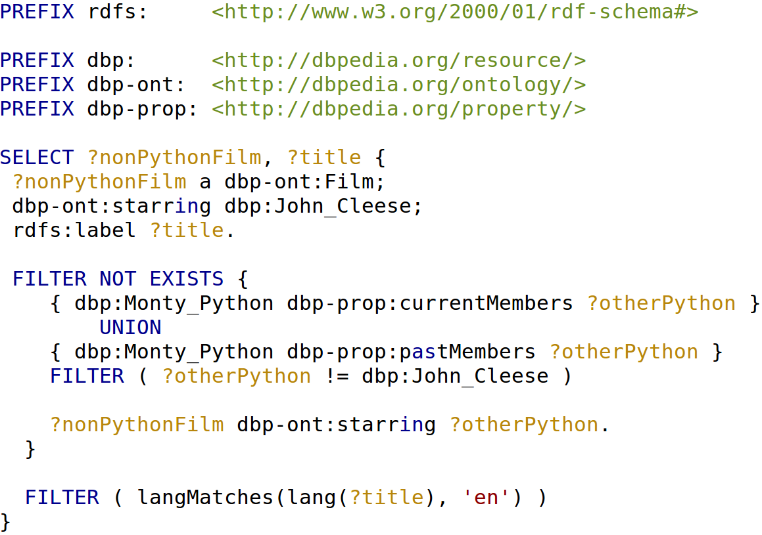
SPARQL Query Example

Slide 19
SPARQL Tooling
FlintSparqlEditor: Javascript SPARQL Editor
      syntax highlighting, code assistance
      auto-completion for properties and classes (for small datasets)
Protegé: full-fledged ontology editor
      good to get an overview of ontologies backing datasets
      two SPARQL plug-ins (one supporting entailment)
curl or your favourite simple REST API
      allows for simple testing queries from any text editor with SPARQL syntax support (e.g. Emacs, Vim, Sublime Text)
$curl -H 'Accept: application/json' --data-urlencode
"query=$(cat query.sparql)" http://dbpedia.org/sparql

Slide 20
SPARQL Tooling
FlintSparqlEditor: Javascript SPARQL Editor
      syntax highlighting, code assistance
      auto-completion for properties and classes (for small datasets)
Protegé: full-fledged ontology editor
      good to get an overview of ontologies backing datasets
      two SPARQL plug-ins (one supporting entailment)
curl or your favourite simple REST API
      allows for simple testing queries from any text editor with SPARQL syntax support (e.g. Emacs, Vim, Sublime Text)
$curl -H 'Accept: application/json' --data-urlencode
"query=$(cat query.sparql)" http://dbpedia.org/sparql

Slide 21
DBpedia for Entity Linking and Disambiguation
DBpedia Spotlight
      web service to detect, disambiguate and link mentionings of DBpedia resource occurrences in input text
      uses two NLP datasets derived by DBpedia
        ⇒ topic signatures - tf/idf weighted term vectors
        ⇒ lexicalisations - alternative names for entities and
        concepts
several other entity detection and linking services targetting DBpedia entities: AlchemyAPI, Ontos Semantic API, OpenCalais, Zemanta

Slide 22
DBpedia for Entity Linking and Disambiguation

