Slide 1
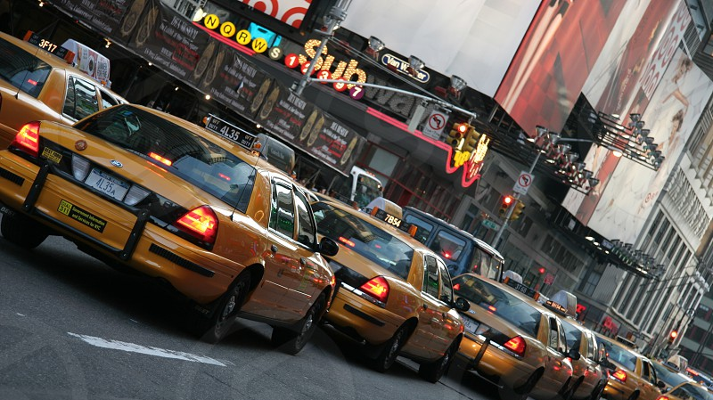
Yellow Taxicab Driver Stress Level
Potential for partial automation

Slide 2


Slide 3
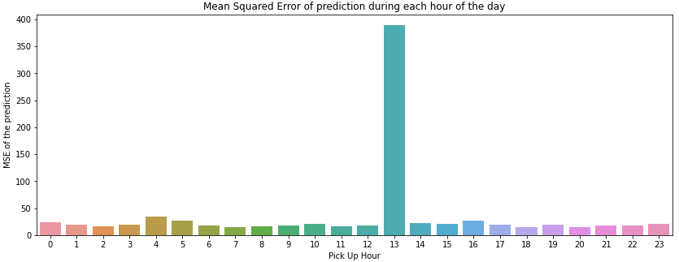
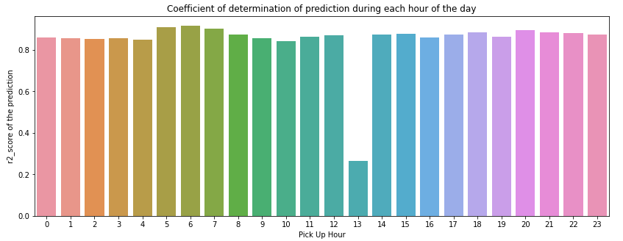
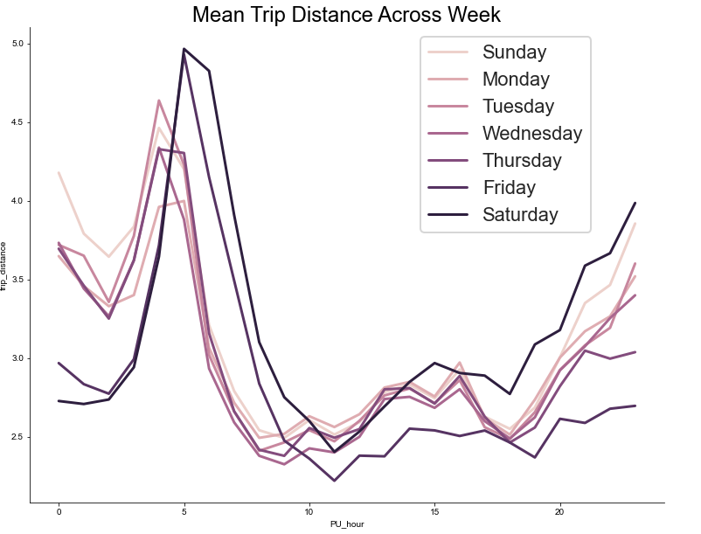
Drivers’ pay = fair amount + tip amount trip distance, trip time: normalized
Pay can be very low or very high
Assumption: Less predictability in drivers’ pay means high driver stress

Slide 4
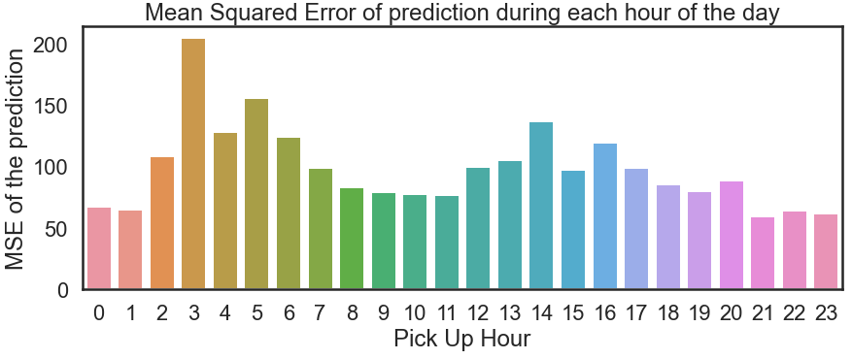
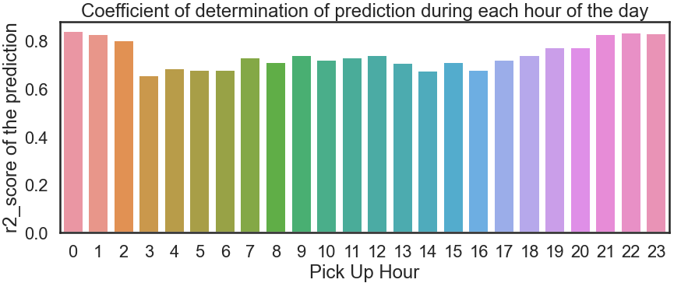
Closer Analysis of Special PU Locations: EWR, JFK, LAG
Drivers were prepared!

Slide 5
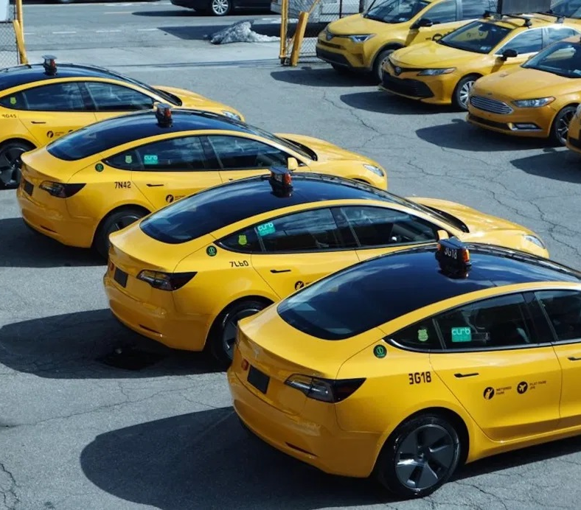
Solution: Real time, Personalized Driver Assistance System
To Whom:
Cloud based traffic service providers (google maps)
Autonomous car companies
Ride sharing companies (Uber, Lift)
Government regulatory agencies
*Sources of images are available in the Jupyter notebooks

