Slide 1
The Fair Trade Movement
A Brief Introduction to a Multifaceted Revolution

Slide 2
Coffee Backgrounder
Coffee is the second most traded commodity in the world after oil.
$5 billion/year domestic industry.
Small farmers produce 75% of the world’s coffee supply.
Small farmers selling to non-fair trade receive $0.02-$0.04/pound of coffee’s retail price.

Slide 3
What is “Fair Trade”?
“a trading partnership, based on dialogue, transparency and respect, that seeks greater equity in international trade”
Fair trade certification guarantees that a living wage is paid to the producer. Currently coffee, tea, sugar, rice, vanilla, cocoa and fruits such as bananas, mangos, grapes and are fair trade certified.

Slide 4
Why are there Fair Traders?
The Coffee Crisis
Coffee, Sugar and Cocoa Exchange
WTO and Free Trade
Notes:
The Coffee Crisis
By 2001, coffee prices had fallen to their lowest levels ever, totaling less than one third of their 1960 levels. This fall in prices has impacted more than 25 million households in coffee-producing countries and has undermined the economic sustainability of countries in Latin America, Asia and Africa.
Deregulation of ICO’s ICAs; fluctuating market; market power exploitation (retailers and roasters); sudden supplier presence without demand or policies to sustain the overall market
1990s: Vietnam entered the market, increasing its net export of coffee by 1,400%, further destabilizing the market.
Coffee, Sugar and Cocoa Exchange
The “Big Four”
Traders trade coffee stocks without conscious consideration, often by means of speculation, for the producers who will be affected by those conjectures. There is a clear disconnect between producer and importer when the price of the commodity good is determined by arbitrary information such as weather reports that, to the trader, presume shortage of supply and imply increased price for that commodity.
WTO and Free Trade
The World Trade Organization (WTO), with its policies of free trade and trade liberalization, has also had a significant impact on coffee prices. Created in 1995, the WTO is a global organization of 134 member countries that negotiates and regulates international trade agreements.
Free Trade is not an opponent to Fair Trade. It does, however, turn the global market into a more volatile and unsupportive entity to small-scale coffee producers. Free trade, or trade without taxes or other restrictions, is meant to benefit both importers and exporters. However, who benefits from trade depends on the prices, and wealthier economies-countries or corporations-often impose prices at the expense of poorer ones. Free Trade pits countries, economical situation disregarded, geographically and agriculturally astute or not, against one another with intercontinental wage wars and accelerated production rates as their weapons, all to the detriment to the worker.

Slide 5
Aspects of Fair Trade
Social
Economic
Environmental
Global
Notes:
Introduction: These primary aspects of “Fair Trade” employed by the FLO and other international Fair Trade organizations attempt to accomplish what the “fair trade” definition entails.

Slide 6
Social Impact of Fair Trade

Slide 7
Economics of Fair Trade part 1
Coffee importers agree to purchase from the small farmers included in the International Fair Trade Coffee Register.
Fair trade coffee growers are guaranteed a minimum "fair trade price" of $1.26/pound (2-3 times the market price) for their coffee.
Notes:
Introduction:

Slide 8
Economics of Fair Trade part 2
Coffee importers provide a certain amount of credit to farmers against future sales, helping farmers stay out of debt.
Coffee importers and roasters agree to develop direct, long-term trade relationships with fair trade coffee distributors, bringing greater commercial stability to an extremely unstable market.

Slide 9
Fair Trade and the Environment

Slide 10
Fair Trade
Certified Coffee

Slide 11

Transfair USA is the independent certifier of fair trade agricultural goods.

Slide 12
The Six Principles of Transfair certification:
Fair prices: guaranteed minimum floor price, additional premium for certified organic products, eligibility for pre-harvest credit.
Fair labor conditions: freedom of association, safe working conditions, and living wages, prohibited child labor.
Direct trade: elimination of unnecessary middlemen, thus empowering farmers to compete in the global marketplace.
Democratic and transparent organizations: democratic decision making for investment of Fair Trade revenues.
Community development: investment of Fair Trade premiums into social, business, educational development projects
Environmental sustainability: Harmful agrochemicals and GMOs are strictly prohibited; shade-grown; bird-friendly

Slide 13
Major Beneficiaries of Fair Trade coffee exported to the U.S.A.
Latin America 78%, Brazil, Mexico, Peru etc.
Asia 18% Indonesia, Papua New Guinea, etc.
Africa 4% Ethiopia, Tanzania, Kenya, etc.

Slide 14
Numbers of Coffee Farmers benefiting from FT coffee worldwide
Tanzania 191,985
Ethiopia 131,458
Uganda 125,432
Mexico 56,003
Congo 20,552
Total 684,077
1999-2004 numbers

Slide 15
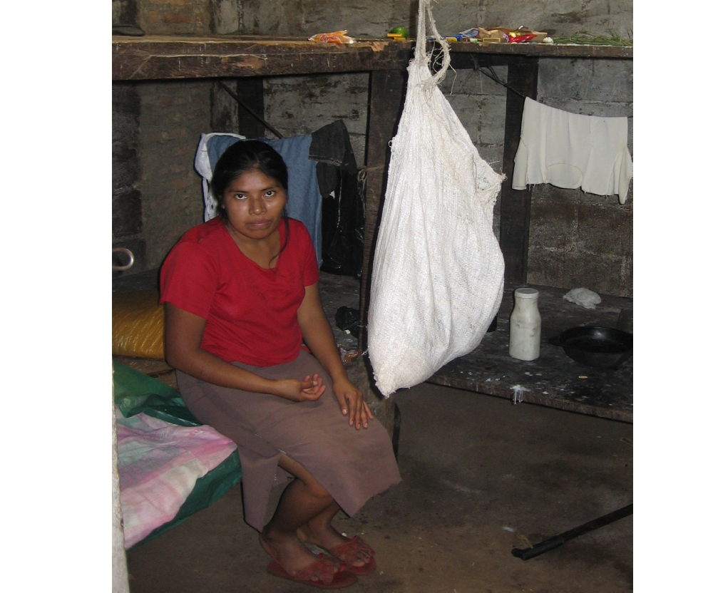

Slide 16
Nicaraguan coffee
plantation worker
Paid <$2 a day
Works seven days with no breaks
Fed black beans 3 meals a day, 7 days a week
Twice a week gets an egg or tortilla
Lives in that room with 7 other workers

Slide 17
Fair trade coffee on U.S. Campuses
Now available on more than 300 campuses nationwide including Rice, University of Texas, Oklahoma State, Yale, UCLA, UC Berkeley and University of Maryland.
U of H Students for Fair Trade are affiliated with United Students for Fair Trade. USFT has over 110 affiliates.

Slide 18
The Aramark Contract
Aramark’s contract runs from August 2005 to August 2010.
The contract states that the University has the right to determine the acceptability of products and services.

Slide 19
Some of Aramark’s experience with campus Fair Trade coffee campaigns
2001 University of Minnesota – Aramark responds to student and faculty demands by offering fair trade coffee one day a week even though its Java City and Starbucks franchises offer Fair Trade blends.
2003 Yale switches to 100% Fair Trade certified coffee. Dining services managed by Aramark.

Slide 20
Aramark’s experience with campus Fair Trade coffee campaigns part 2
2003 Oklahoma State University student group ECO-OSU convinces Java City to offer a Fair Trade blend.
2003 Loyola University of Chicago Aramark replaced Java City with Pura Vida and all Fair Trade company making the University 100% Fair Trade certified for coffee products.

Slide 21
Aramark’s experience with campus Fair Trade coffee campaigns part 3
2005 University of Rochester students launched a Fair Trade coffee campaign with the cooperation of Aramark. One dining area featured a Fair Trade video running on a continuous loop.
2005 University of New Mexico passes resolution to offer only Fair Trade Certified coffee. Aramark’s resident district manager agrees to work towards that goal.

Slide 22
Aramark’s experience with campus Fair Trade coffee campaigns part 4
2006 (April) Brandeis University students overwhelmingly (2-1) passed a referendum for Fair Trade only coffee to be sold on campus. Aramark officials indicated they would comply with student’s wishes yet they continued to sell non-Fair Trade coffee at Java City and the kosher side of the dining hall.

Slide 23
Racial Makeup of UH Students
Asian 18.9%
Hispanic 18.5%
African-American 13.9%
Caucasian/other 38.5%

Slide 24
Racial makeup of Aramark
UH’s dining contractor
Board of Directors:
100% Anglo
Senior Management:
89.9% Anglo

Slide 25
Aramark financials
Fiscal 2005 Total Sales: $11 Billion
Fiscal 2005 Operating Income: $580 million
Fiscal 2005 Net Revenue: $280 million

Slide 26
Aramark in the news
A buy out agreement was signed by senior management in September 2006.
Aramark’s profit rose 72% from 2000 to 2005.
Sales jumped 50 percent in the same time period.

Slide 27
Aramark wages vs. coffee farmers wages
Aramark CEO Joseph Neubauer total 2005 compensation package:
$16.1 million dollars
Average third world coffee farmer not offered the chance to access the fair trade market due to multinational companies exploiting them:
$1-3 dollars a day
$260-780 dollars a year.

Slide 28
UH President’s pay
Jay Gogue’s salary vs. coffee farmers
Gogue’s 2005 compensation:
$400,000- salary
$150,000 - cash for his retirement acct.
$550,000 total
<$500 per year Average coffee farmer

Slide 29
What can I do?
Buy only Fair Trade Certified coffee and give your dollar voting power.
Ask your grocer to stock FT products.
Tell your church, public school, and civic club to only use fairly traded products.
Visit http://uhfairtrade.org

Slide 30
A sampling of Houston outlets offering fair trade goods
Baba Yega restaurant
Central Market
Corazon
Colores De Pueblo
Einstein’s Brothers Bagels
Empire Cafe
Sig’s Lagoon
Specs Liquor Warehouse
Taft Street Coffee
Té House of Tea
Ten Thousand Villages
Whole Foods

