Slide 1
Linear Regression

Slide 2
A way to tell the relationship between x and y variables

Slide 3
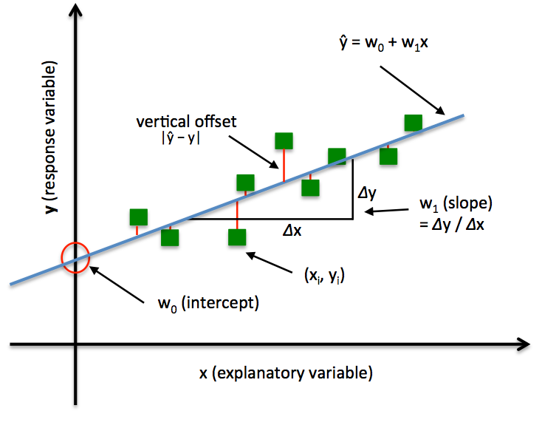

Slide 4
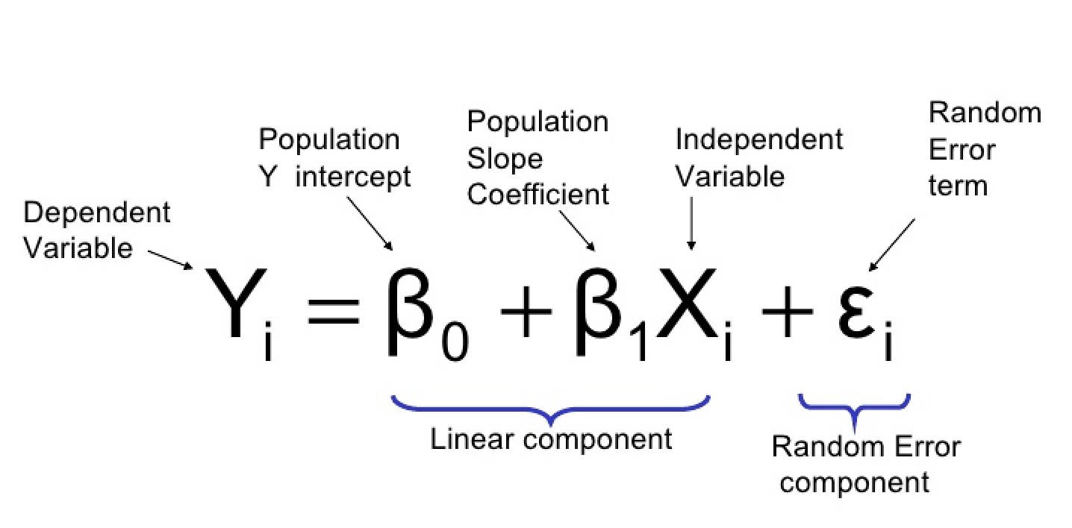

Slide 5
Overfitting and Underfitting

Slide 6
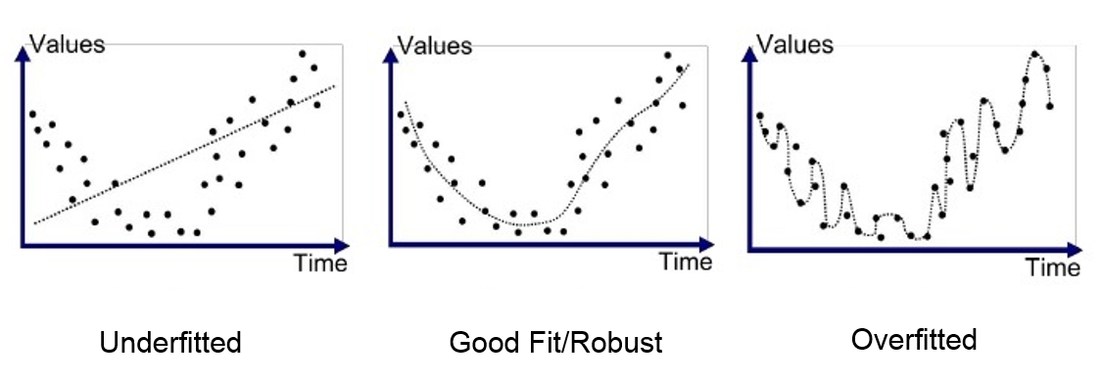

Slide 7
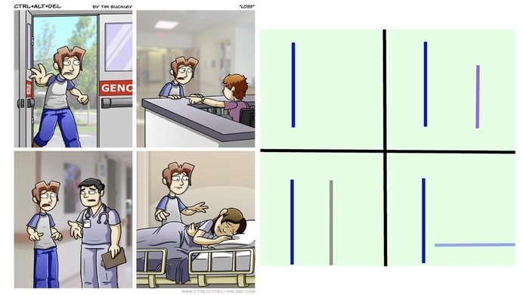
Loss is too high/low

