Slide 1

Probability Basics
Part 1
Mehrdad Zakershahrak
Guest Speaker
Arizona State University
Notes:
Hi, Today… we’re going to cover definitions and basics of probability which you will need to apply throughout this course.

Slide 2
Why Study Probability?
Measure the uncertainty
“Mathematics is the logic of certainty; probability is the logic of uncertainty”
Introduction to probability by Joseph K Blitzstein and Jessica Hwang
Notes:
Luck, Uncertainty, Risk, Randomness, Coincidence, Doubt, fortune, chance
how this concepts are related?
Relying on intuitions in riskful situations... results in inaccurate predictions or overconfident decisions.

Slide 3
Probability Applications
Biology
Gene inheritance
Medicine
Medical treatment success rate
Computer Science
AI, Machine Learning
Physics
Quantum Physics
Finance
Risk in investment
Notes:
Biology: gene inheritance and mutations are intertwined with probability
Medicine: Measure the success of a clinical procedure, treatment and a medicine
Computer Science: ML and AI
Physics: understanding of quantum physics relies on probability
Finance: calculating the risk of investments and success rate determination of financial policies relies on probability

Slide 4


Definitions
A sample space S is the set of all possible outcomes of an experiment.
An event is a subset of a sample space.
Assuming that all outcomes are equally likely and the space is finite:
is the probability that A occurs.

Slide 5










Definitions
If then
Events A and B are independent iff
Probability that at least one of the occurs:
Probability that none of the occurs:
Probability that all of the occurs:
A
Ā
A
B
Notes:
A bar is the probability of that event A would not happen

Slide 6


Example
Suppose we toss two coins. What is the probability that we see two heads? [Each coin has two possible outcomes: H (heads) and T (tails).]
What is the probability that we see at least one tail?
We have two dice that we roll them at the same time. What is the probability that we do not see a pair of 6s?
Notes:
Let’s have some examples to learn these definitions practically
first let’s calculate the state space: s = {(h,t), (h,h),...}
The event A will be (h,h)
Therefore the probability is P(A) = ¼
at least: P(t,h) cup P(h,t) cup P(t,t)
no 6:1- P(first dice is 6 and second dice is 6) = 1- ( ⅙ * ⅙ )

Slide 7

Discrete Random Variables
Assuming the probability of head is 0.5, how many heads would you get if you toss a coin:
4 times
20 times
100 times
X is a random variable (RV) with arity of k if it can get exactly one value out of
Notes:
Take some time to think about this:
Before answering the question let’s take a look at this definition
arity is the number of operands a function or in this case, a variable can take
for example the possible values that X can get is
0,..., 4
0…. 20
0...100

Slide 8




Probability of Discrete RV
We toss a fair coin 2 times…
Probability mass function:
if
if
Notes:
To understand the random variable concept better, let’s take a look at this example:
Now, let’s take a look at the probability of what we would get:
Since the probability of coins are independent from each other,
0 head ¼
1 head ½ p(h,t) + p(t,h)
2 heads ¼
So it is most probable that we get 1 head, compared to the other cases, but if we look at the other cases together, the uncertainty is considerable
to calculate the uncertainty, we define pmf

Slide 9
Probability Function
We need a mathematical function that provides the probabilities of occurrence of different possible outcomes
How different events will be distributed throughout the sample space

Slide 10

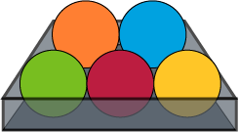






Common Distributions
Uniform
X takes values 1,2,...,N
Binomial
X takes values 0,1,...,N
Joint: Given two discrete RVs X and Y, their joint distribution is the distribution of X and Y together
Notes:
Uniform: you have balls with different colors in a box, each from one color, the probability of the ball being of each color
Binomial: coin flip
Joint: you and your friend toss two coins together, you for 50 times and your friend for 100 times. Probability of you getting 21 heads and your friend getting 70 heads sigma i = 0 to 50 sigma j = 0 to 100 P (you get i heads AND your friend get j heads) = 1

Slide 11




Conditional Probability
is the probability of given the occurrence of
You get A in Artificial Intelligence, given that you have studied the materials for the exam

Slide 12
Marginalization
Probability of a subset of a collection of random variables
Probability distribution of variables contained in the subset
If X and Y are two discrete RVs:
Notes:
first term is marginal probability the cap is joint probability
second line is conditional probability second term is marginal probability

Slide 13

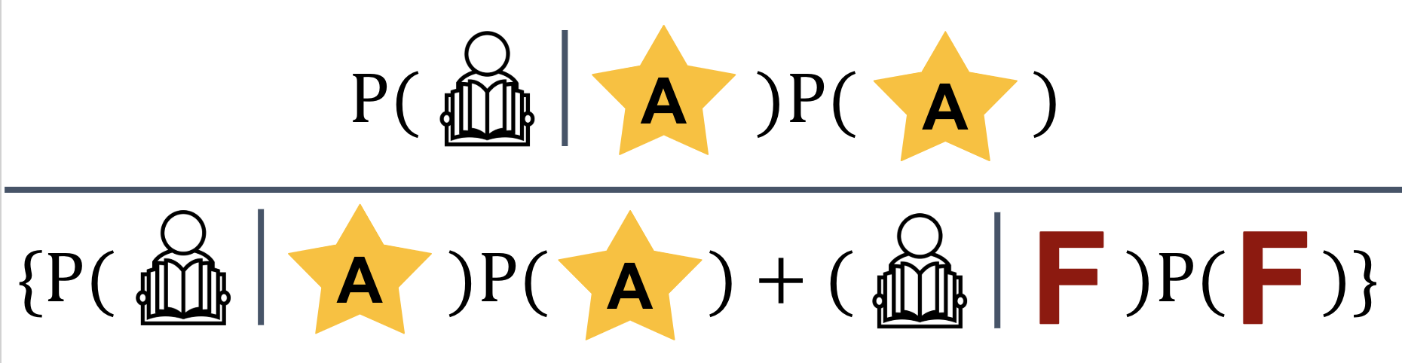

Bayes’ Rule
Notes:
P(you get good grade | you studied) = P(you studied given you got a good grade) times P(you get a good grade) over {P(you studied given you got a good grade) times P(you got a good grade) + P(you studied given you didn’t get a good grade) times P(you didn’t get a good grade)}

Slide 14
Summary
Probability definition
Discrete random variables and their probability
Distributions
Uniform
Binomial
Joint
Marginalization
Bayes’ Rule
Notes:
RVs: Probability mass function

