Slide 1

SemiSocket
Investor business plan
A proposed charging network for electric semi-trucks
semisocket.com / September 2026 / Concept-stage draft
SEMISOCKET / INVESTOR DISCUSSION DRAFT
01
Notes:
Source artwork: user-provided SemiSocket charging station at dusk.png. AI concept rendering, not an actual station. All financial figures are illustrative planning assumptions in USD, not actual results, vendor quotes, management-approved guidance or a valuation. No committed customers, sites, funding or utility capacity have been verified. All timing is conditional on permits, utility energization and financing.

Slide 2
The opportunity in electric freight
Fleet adoption creates demand for charging that fits commercial routes.
400,000+
The customer problem
Fleets need dependable charging without rebuilding every depot or risking route delays.
electric trucks sold globally in 2025
IEA reports a 9% global sales share. China represented over 90% of electric truck sales.
SemiSocket’s entry point
Shared hubs for repeat regional routes, with fleet reservations and predictable billing.
Global growth is context. Local fleet demand must justify each US site.
Source: IEA, Global EV Outlook 2026, Trends in other EV modes (medium and heavy trucks).
SEMISOCKET / INVESTOR DISCUSSION DRAFT
02
Notes:
IEA (2026), Global EV Outlook 2026, Trends in other EV modes. https://www.iea.org/reports/global-ev-outlook-2026/trends-in-other-ev-modes (accessed 2026-09-29 UTC). Both medium and heavy freight trucks included. Global figures are not a US TAM. DOE National Zero-Emission Freight Corridor Strategy announcement, March 12 2024: https://www.energy.gov/articles/biden-harris-administration-releases-first-ever-national-strategy-accelerate-deployment . This is a historical strategy, not a claim of available incentives. Customer problems are hypotheses to validate with fleet interviews.

Slide 3
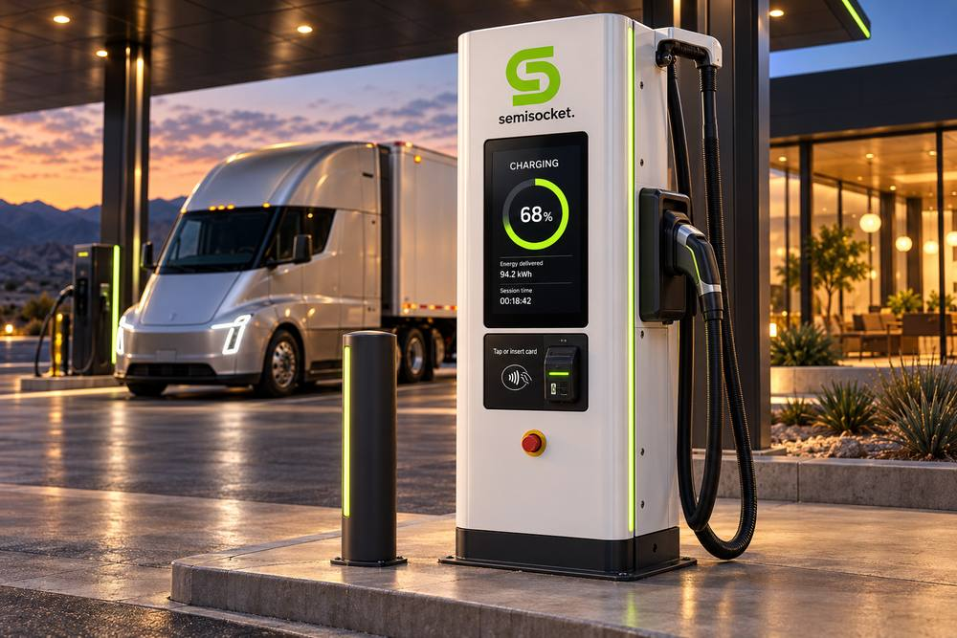
The SemiSocket station
A familiar fuel-stop experience designed around trucks and trailers.
Six pull-through charging bays
Proposed 400 kW dispensers sharing a 2 MW site power limit. Final design follows fleet needs.
Payment and fleet access
White dispensers, lime S branding, live readout and card payment. Fleet accounts add reservations and invoicing.
Concept rendering. Hardware and site layout subject to engineering.
SEMISOCKET / INVESTOR DISCUSSION DRAFT
03
Notes:
Images: user-provided White Electric Semi-Truck Charging Dispenser.png. AI concept rendering. Specifications below are proposed design assumptions, subject to engineering, OEM compatibility testing and utility approval. Charger illustrations do not establish connector compatibility or charging performance.

Slide 4
A fleet-backed pilot comes first
Proposed rollout begins after development funding. Dates depend on utility delivery.
Window | Workstream | Decision gate
Months 0–3 | 20 fleet interviews and route analysis | Two qualified anchor prospects
Months 3–6 | Site options and utility studies | Costed power plan and site control
Months 6–12 | Contracts, permits and financing | Target ≥2.4 GWh/year contracted
Months 12–24+ | Build, commission and validate | Expansion after six months of data
Initial market screening
Inland Empire, Phoenix and Dallas–Fort Worth. Select one pilot using fleet demand, power cost, truck access and connection timing.
SEMISOCKET / INVESTOR DISCUSSION DRAFT
04
Notes:
Recommended go-to-market plan, not existing commitments. Candidate geographies for screening only: Inland Empire / I-10, Phoenix / I-10 and I-17, Dallas–Fort Worth / I-20 and I-35. No site control or utility capacity verified. The initial customer is a regional or drayage fleet with predictable daily routes. Target 20 discovery interviews and two anchor fleets. Proposed contracted demand floor 2.4 GWh/year equals 6,575 kWh/day or 16.4 400-kWh sessions/day. This exceeds the 1.4 GWh site operating break-even in slide 7 but does not cover corporate costs or investment recovery.

Slide 5
Competition and the opening for SemiSocket
Existing operators validate the category and raise the bar for execution.
Alternative | Published offer / strategic tradeoff
Terawatt | Fleet charging hubs, pull-through bays and monthly billing
Greenlane | Public truck charging, driver amenities and fleet services
Fleet-owned depots | Operational control, with capital and power-delivery burden
SemiSocket proposal | Smaller shared hubs at sites supported by anchor fleet demand
The proposed advantage
Proposed edge: site access and fleet commitments on specific routes. Advantage remains unproven.
Sources: terawattinfrastructure.com/solutions/trucking-fleets and drivegreenlane.com/locations/colton-ca (Sept. 2026).
SEMISOCKET / INVESTOR DISCUSSION DRAFT
05
Notes:
Sources accessed 2026-09-29 UTC: Terawatt, Trucking fleets https://www.terawattinfrastructure.com/solutions/trucking-fleets ; Greenlane, Colton https://www.drivegreenlane.com/locations/colton-ca/ . Competitor descriptions summarize their published offerings. Depot ownership tradeoffs and SemiSocket positioning are analytical judgments. SemiSocket has no verified cost advantage, exclusive site rights or proprietary charging technology.

Slide 6
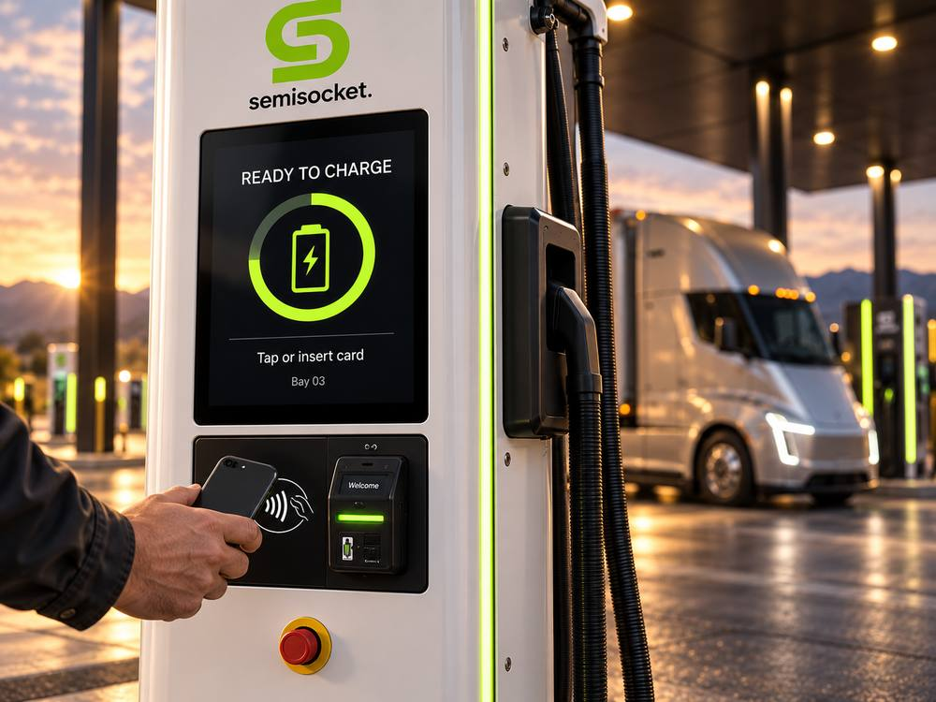
How SemiSocket earns revenue
Energy sales provide the core revenue. Fleet agreements support predictable use.
Charging revenue
Illustrative realized price: $0.45/kWh. Fleets negotiate volume commitments and reserved access.
Operating model
Lease suitable sites. Buy proven equipment. SemiSocket manages customers, billing and uptime.
Base model excludes parking and amenity income.
Concept rendering
SEMISOCKET / INVESTOR DISCUSSION DRAFT
06
Notes:
All financial figures are illustrative planning assumptions in USD, not actual results, vendor quotes, management-approved guidance or a valuation. No committed customers, sites, funding or utility capacity have been verified. All timing is conditional on permits, utility energization and financing. Proposed model: SemiSocket develops and operates sites, leases land and purchases certified charging hardware and software services. Financial model assumes full ownership and consolidation of site economics, with no debt or minority share deducted. If a JV or project investor owns sites, distributions and fees must replace the consolidated scenario. Revenue excludes subscriptions, reservation charges, parking, advertising and subsidies. The $0.45/kWh realized sales rate is illustrative, with contract and ad hoc rates to be validated. Image: SemiSocket EV Charger Payment Close-Up.png, user-supplied AI concept rendering.

Slide 7
Pilot economics depend on utilization
Illustrative six-bay site: 400 kWh/session, 365 days/year. No subsidies or debt.
Annual metric | Low use | Base case | High use
Sessions per day | 12 | 24 | 36
Energy delivered | 1.752 GWh | 3.504 GWh | 5.256 GWh
Charging revenue | $0.788M | $1.577M | $2.365M
Site EBITDA¹ | $0.088M | $0.526M | $0.964M
$0.45/kWh sales − $0.20/kWh variable cost − $350K annual fixed cost
~10 sessions/day operating break-even. Base simple capex payback: ~8.6 years.
¹ Before corporate costs, debt, tax, depreciation and equipment replacement. A $0.05/kWh cost increase cuts base EBITDA by $175K.
SEMISOCKET / INVESTOR DISCUSSION DRAFT
07
Notes:
All financial figures are illustrative planning assumptions in USD, not actual results, vendor quotes, management-approved guidance or a valuation. No committed customers, sites, funding or utility capacity have been verified. All timing is conditional on permits, utility energization and financing. Model: 400 kWh/session, 365 operating days, $0.45/kWh sales, $0.20/kWh variable costs ($0.17 electricity and losses + $0.03 payments and variable services), $350,000 annual fixed site costs ($120,000 demand charges + $120,000 lease + $110,000 maintenance/insurance/monitoring). Utility tariffs must replace both energy and demand-charge placeholders without double counting. Delivered-energy capacity factor at 2 MW = 10%, 20%, 30% for low/base/high. Annual energy = sessions/day * 400 * 365. Revenue = energy * 0.45. Site EBITDA = energy * 0.25 -350000. Break-even = 350000 / .25 / 400 /365 =9.59 sessions/day. Excludes corporate overhead, D&A, tax, interest, capex and replacement reserves. At 24 sessions, capex / site EBITDA = 4500000 /526000=8.56 years, unlevered simple payback without discounting or reinvestment. +$0.05/kWh cost reduces base EBITDA by $175,200. These are screening figures, not an investor return forecast.

Slide 8
Three-year operating scenario
Years begin with first pilot energization. Expansion requires additional capital.
USD millions, unless indicated | Year 1 | Year 2 | Year 3
Sites at year-end / site-years | 1 / 0.5 | 2 / 1.5 | 4 / 3.0
Sessions/day per operating site | 12 | 20 | 24
Revenue | $0.394 | $1.971 | $4.730
Site EBITDA | $0.044 | $0.570 | $1.578
Corporate overhead | ($0.600) | ($0.800) | ($1.000)
Consolidated EBITDA | ($0.556) | ($0.230) | $0.578
New-site capital spending | $4.500 | $4.500 | $9.000
~$19.7M indicative cumulative funding gap, including $1.5M development.
Excludes working capital, financing costs and replacement reserves. EBITDA is not cash flow.
SEMISOCKET / INVESTOR DISCUSSION DRAFT
08
Notes:
All financial figures are illustrative planning assumptions in USD, not actual results, vendor quotes, management-approved guidance or a valuation. No committed customers, sites, funding or utility capacity have been verified. All timing is conditional on permits, utility energization and financing. All amounts USD millions unless stated otherwise. Operating site-years .5, 1.5, 3.0 represent average full-year equivalent operations, versus ending site counts 1,2,4. Average sessions/day per operating site 12,20,24. Energy GWh=.5*12*.4*365/1000=.876;1.5*20*.4*365/1000=4.38;3*24*.4*365/1000=10.512. Revenue .3942,1.971,4.7304. Site EBITDA .044,.570,1.578. Corporate overhead .600,.800,1.000. Consolidated EBITDA -.556,-.230,.578. Capex 4.5,4.5,9.0. Cumulative capex 18.0, net EBITDA -.208; funding gap 18.208 plus pre-opening development 1.5=19.708M, before working capital, financing costs, taxes and replacement reserves. Capital assumed paid in energization year for simplified scenario; actual construction cash spending precedes opening. Funding gap offsets Y3 positive EBITDA against capex; required gross/peak liquidity may be higher. Model assumes full ownership, no project debt. EBITDA is not cash flow. No opening date promised.

Slide 9
Execution team and investment risks
Technology leadership must be paired with power-infrastructure and fleet experience.
Nick Schrunk
Risk
Planned control
Project lead. Technology entrepreneur and IT leader. Proposed focus: platform, partnerships and commercial development.
Slow fleet adoption
Minimum-volume contracts
Utility delays / tariffs
Written power and rate studies
Construction overruns
Priced scope and contingency
Priority hires and partners
Charging development lead, utility engineer and fleet sales lead. Contract qualified construction and maintenance teams.
Downtime / compatibility
Service contract and truck tests
Capital availability
Stage gates before expansion
SEMISOCKET / INVESTOR DISCUSSION DRAFT
09
Notes:
Nick Schrunk background based on user-provided context: founder of Nerdi and IT leadership at Montana State University. SemiSocket officer titles, equity allocation and legal entity not verified. No additional executive appointments or partner agreements are claimed. Hiring priorities, mitigations and performance targets are proposals, not completed actions. Target charger availability definition, measurement interval and exclusions require contract agreement.

Slide 10
Proposed investment and use of funds
Draft development raise: $1.5M. Separate pilot construction requirement: $4.5M.
Development use | USD
Team and fleet development | $600K
Site options, studies and permits | $450K
Software, legal and insurance | $250K
Contingency | $200K
Total proposed raise | $1.50M
The next investable milestone
A pilot with site control, a priced utility connection, fleet volume contracts and a complete construction budget.
Funding structure and terms remain open for founder and investor review.
semisocket.com
SEMISOCKET / INVESTOR DISCUSSION DRAFT
10
Notes:
All financial figures are illustrative planning assumptions in USD, not actual results, vendor quotes, management-approved guidance or a valuation. No committed customers, sites, funding or utility capacity have been verified. All timing is conditional on permits, utility energization and financing. Raise amount and structure are recommendations for founder review, not a launched offering. No valuation, equity percentage or instrument specified. Proposed 12-month development uses: people and fleet development .60M, site options/engineering/permitting .45M, software integration/legal/insurance .25M, contingency .20M =1.50M. Pilot capex placeholder: charging equipment1.50M; utility connection and switchgear1.10M; civil works and basic amenities1.00M; design/commissioning.20M; contingency.70M=4.50M. Pilot assumes leased land and basic amenities; no land acquisition, solar or battery storage included. Incremental or unusual utility upgrades could exceed allowance. Development legal/studies differ from pilot detailed design/construction commissioning. Pilot financing is additional to development raise and must be committed before construction. Approval requires site rights, permit path, utility scope/tariff, priced contractor proposal, enforceable demand contracts and identified project capital. No promise of investor returns. Website: semisocket.com.

