Slide 1

Sentiment analysis with lstm
Deep Learning (18CSE484T) Group Project 2
Bhavesh Laddagiri (RA1911026030032)
Akshaj Vishwanathan (RA1911026030003)
Hardik Gupta (RA1911026030027)

Slide 2
Contents
Dataset and Preprocessing
Model
Training and Results
Deployment

Slide 3
Preprocessing

Slide 4
Dataset
The Dataset used for Sentiment Analysis is the Sentiment140 Dataset which is a collection of 1.6 million tweets
For training and testing we split the dataset into 800k and 800k respectively.
It’s a binary classification problem with the label being either 1 for positive or 0 for negative.
For preprocessing the following steps were taken
Build the Vocabulary
Convert text to integers
Truncate / Pad the sequences to a fixed length

Slide 5
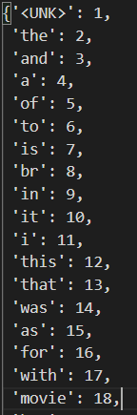
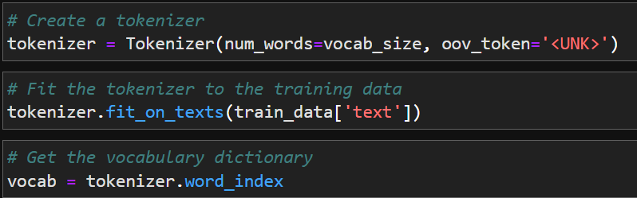
Building the Vocabulary
To create vocab dictionary that maps the word to a integer, we first tokenize all of the text.
Once the words are tokenized, their occurrence is used to sort them from most frequent to least frequent.
The words are then assigned integers accordingly as shown here –

Slide 6

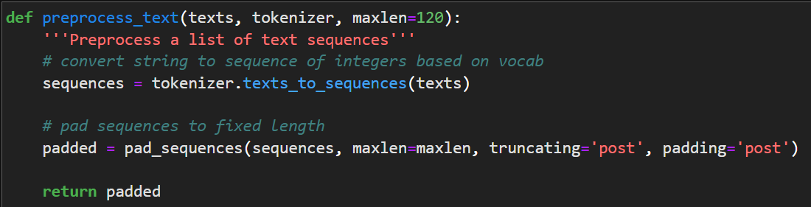
Convert Text to Integers
Using this new vocabulary dictionary, the text is converted to a sequence of integers.
After that the text is truncated or padded to a fixed length with Zeros.

Slide 7
Building the Model

Slide 8
Model Architecture
(batch_size, seq_len)
Embedding Layer (100k, 64)
LSTM (32 Cells, Tanh)
Linear Layer (16, ReLU)
0.9

Slide 9
Training the Model
As this is a binary classification problem, we used a Binary Cross Entropy Loss function for optimizing the model parameters
The Optimizer used was Adam with a learning rate of 0.0008
The model was trained for a total of 2 epochs with a batch size of 256 on a Nvidia Tesla T4 16 GB GPU
The summary of the results is as shown below:
Metric | Train Set | Test Set
Accuracy | 83.55% | 81.98%
Loss | 0.3670 | 0.4021

Slide 10
Deploying the Model

Slide 11
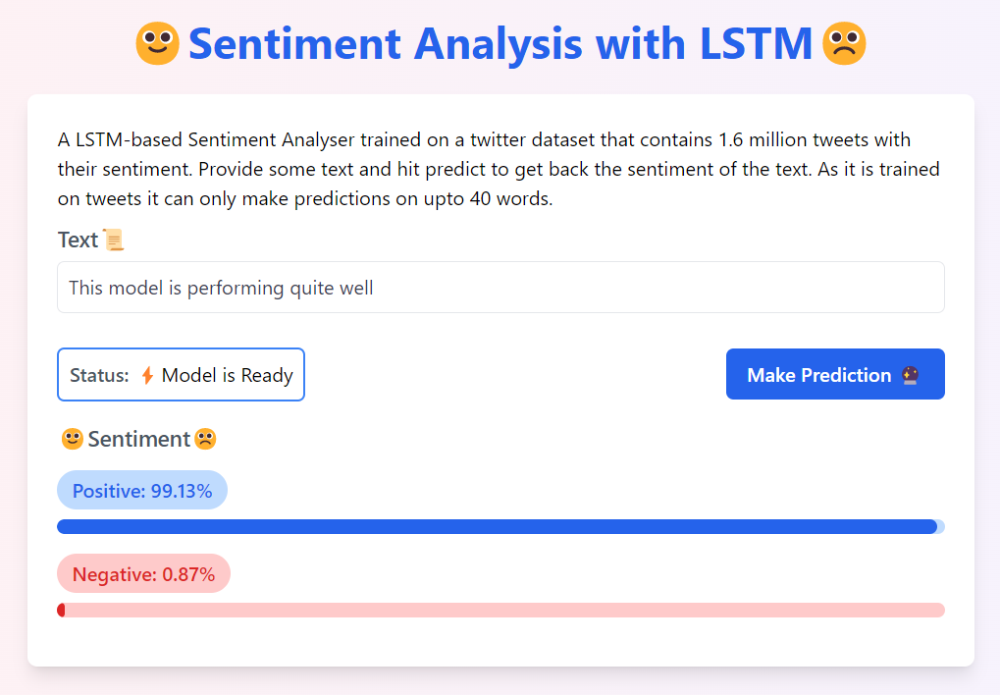
Deployment
After training the model was compiled to a torchscript graph for performant inference during deployment.
The model was first deployed as a REST API using CellStrat Hub.
A static web application was built to invoke the API for inference. Next.js (React) was used to build the application, with TailwindCSS for styling and Netlify for hosting the web app.
https://api.cellstrathub.com/gradientfire/sentiment-lstm
POST Request
https://sentiment-lstm.netlify.app

Slide 12
Thank You

