Slide 1

a numerical approach to approximate a novel prime counting function and its application in optimizing rsa key generation
By,
Abrar Shahriar (2206078)
Mahmud Al Nahiyan Saurav (2206079)
Md. Mahin Shahriar (2206094)
Yeasin Mia (2206095)

Slide 2
a numerical approach to approximate a novel prime counting function and its application in optimizing rsa key generation
1.1 Dataset generation
Main Idea:
Use a GPU-accelerated segmented sieve to compute (x, π(x)) pairs.
π(x) counts number of primes less than or equal to x.
Optimized for very large N for scattered data.
Output is saved as csv file for further use.
Methodology:
Start
Check GPU availability (verify parallel computing toolbox and GPU device)
User input (Maximum x (10^10) and number of data points (10^8)).
Base prime generation (upto root of N).
Segmented sieving (dividing the range into [2, N] segments and mark composites of smaller primes within the segment).
Collect data ((x, π(x)) pairs).
Export results (save datasets in a csv file).
End

Slide 3
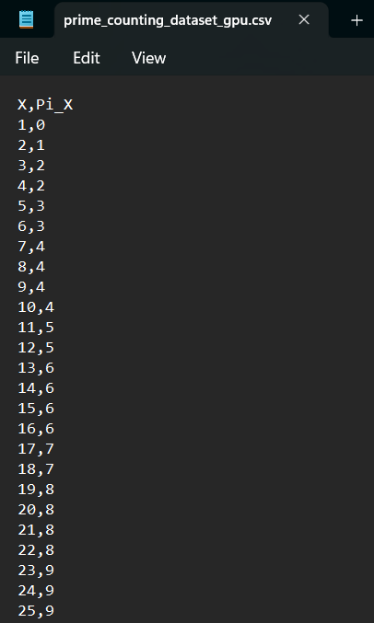
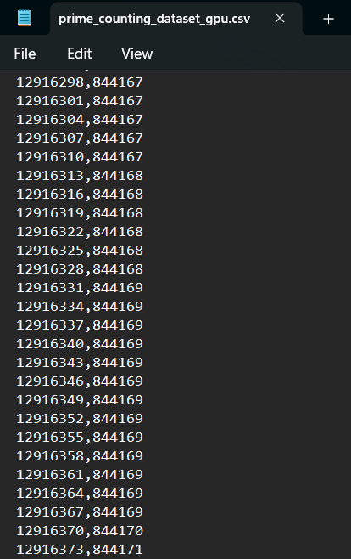
Generated Dataset (Partial)

Slide 4
1.2 Non-linear least square regression fitting
Functions Plotted for Comparison: Li(x), R(x), and fitted nonlinear model
Goal: Approximate π(x) accurately
Model, Equation & Method
1.Nonlinear Regression Model:
• Levenberg-Marquardt algorithm
• Custom my_lsqcurvefit
2.Fitted Model:
π(x) ≈ x / (log(x) - p₁ - p₂/log(x) - p₃/log²(x))
3.Method Summary:
• Dataset used for fitting
• Chunked RMSE evaluation on full dataset
• Compared with Li(x) and R(x)

Slide 5
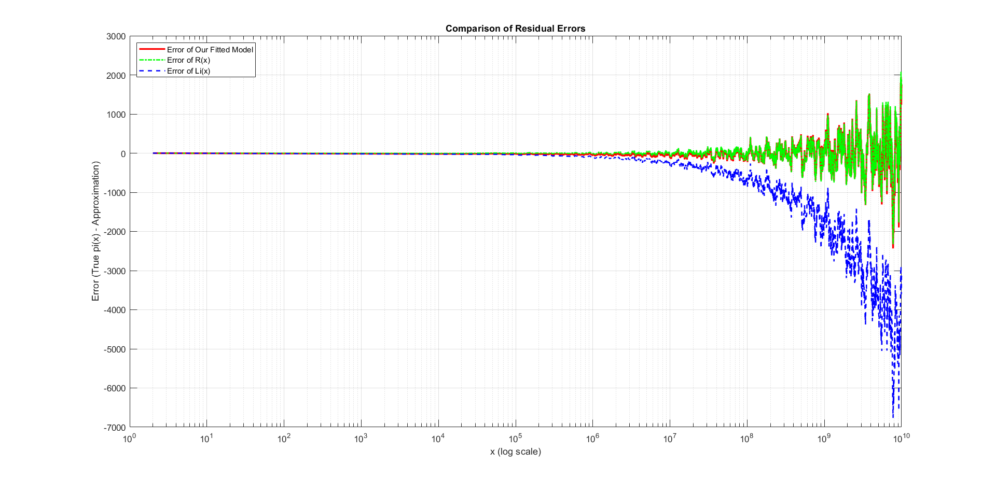
Results
π_new(x), Li(x), R(x), Fitted Model comparison plot:
RMSE Values:
• Li(x): 1795.78
• R(x): 340.43
• Fitted: 341.13
Conclusion:
Fitted model is nearly as accurate as R(x), better than Li(x), with only 3 parameters.

Slide 6
2. RSA Key Generation Standard vs Optimized Approach
RSA relies on two large random prime numbers (p, q).
Traditional generation uses random trial and error + primality testing.
This can be slow and computationally expensive, especially for large keys.
Our approach uses a fitted model of the prime-counting function π(x) to guide and optimize prime selection.
Achieves faster, smarter key generation without compromising security.

Slide 7
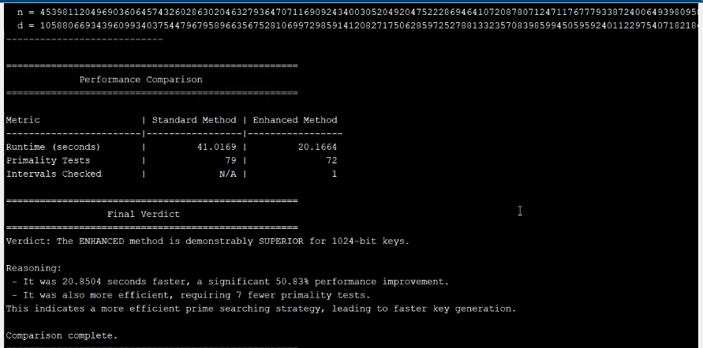
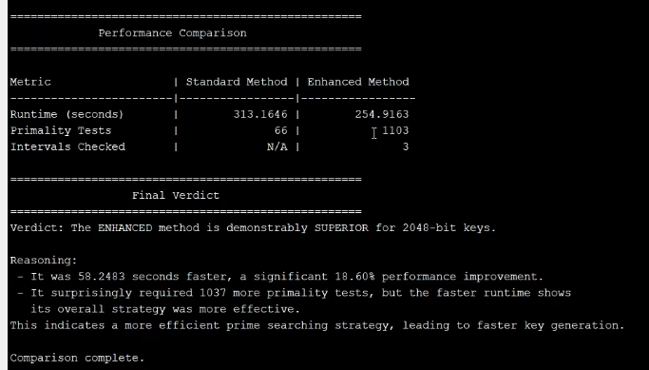
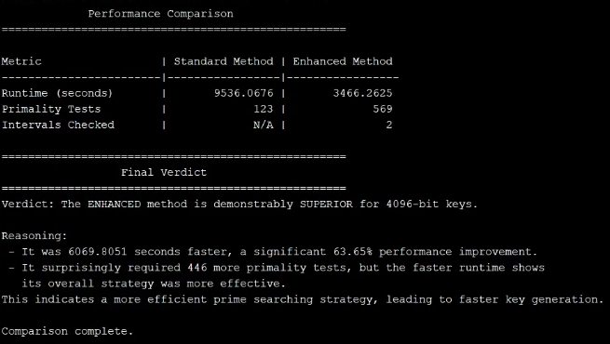
Output Comparison

Slide 8
Thank you
Demonstration Videos Link: https://drive.google.com/drive/folders/1PcQsQUv3y_frExsphC0yRC55qavCOUVf?usp=sharing

