Slide 1
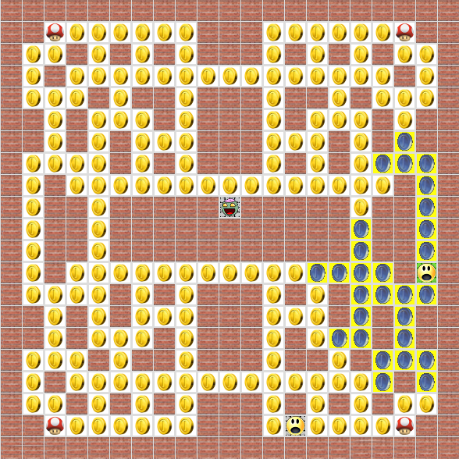
TacZombie
(a tactical Pacman clone)
Developed by Lars Eckervogt, Manuel Hieke and Stefan Junker for
the course “Moderne Programmiersprachen”
in MSI1 in WS13/14 at HTWG Konstanz

Slide 2

Content
Game Principle
Worth a Word
Tests
Demo
Summary

Slide 3
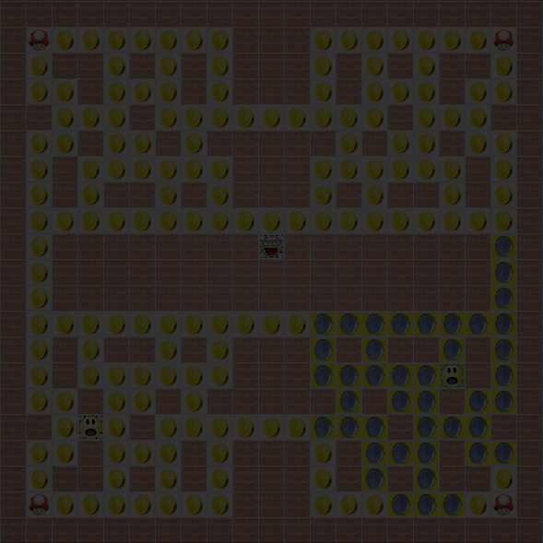


Game Principle
Round-based
Two Players
  One Human: can have multiple tokens
  One Zombie: can have multiple tokens
Goal
  Zombie: kill Human
  Human: survive and collect all coins
Map
  Pacman-like

Slide 4
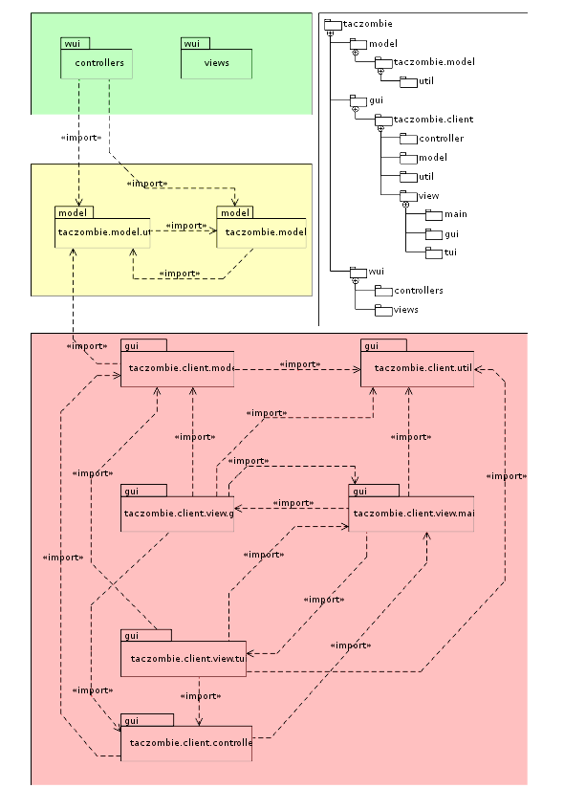
Structure
Click to maximize

Slide 5
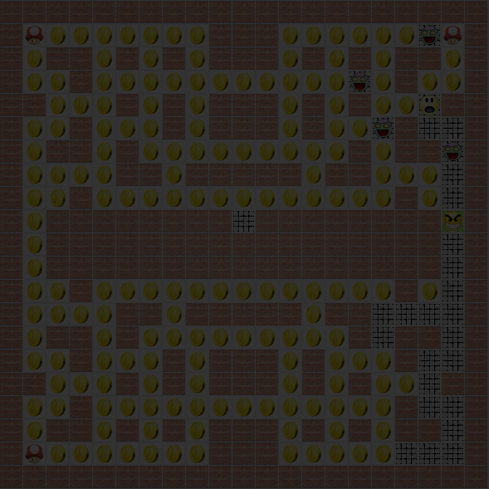
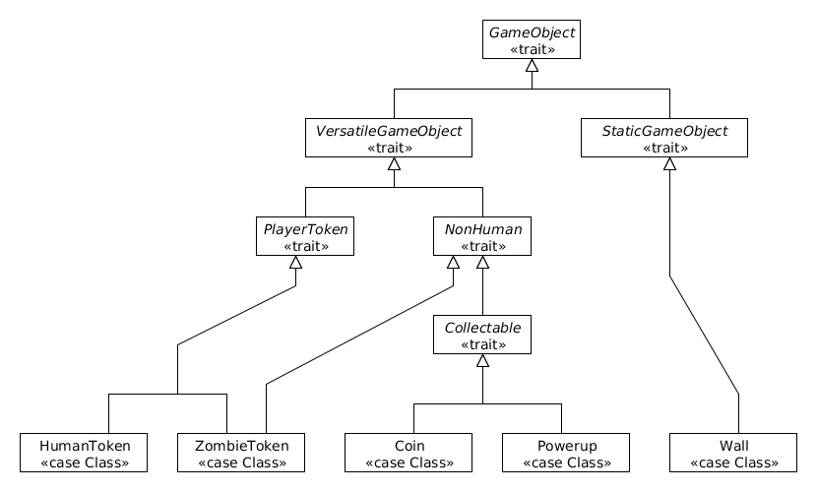
Model
Case classes
  Easy access of subsets

Slide 6
Model
Build to be extensible
  Multiple Players (Zombie/Humans)

Slide 7
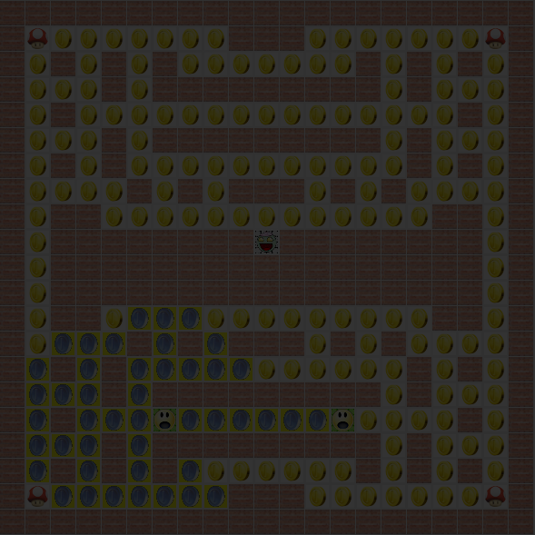

Views
WUI
TUI
GUI
Communication through web sockets
  Library: just.ws (https://github.com/stasimus/just.ws)
Transport format: jSON
  Library: io.spray (https://github.com/spray/spray-json)

Slide 8
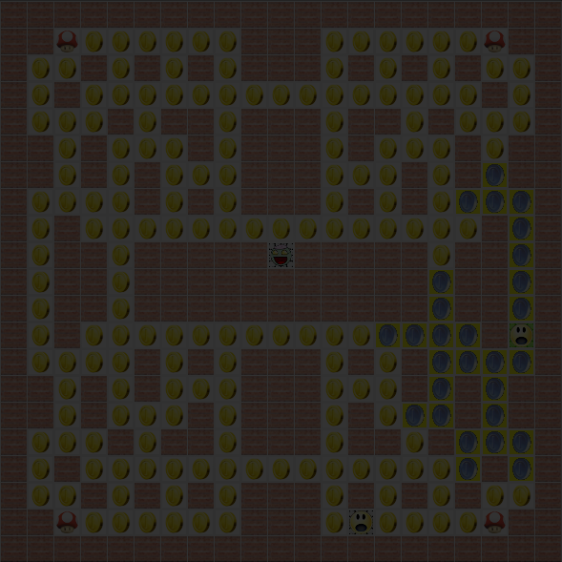
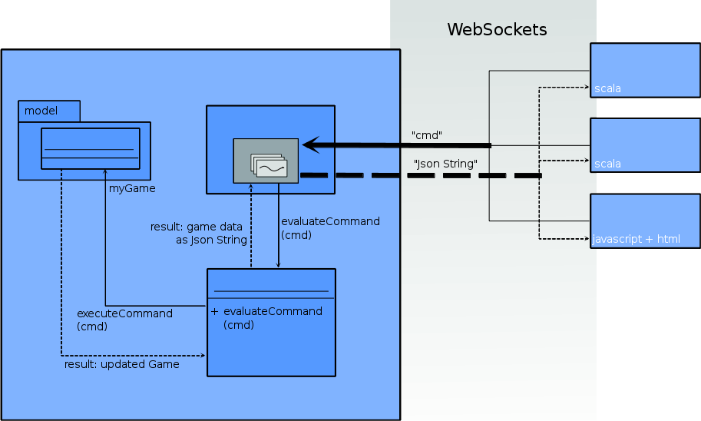
Controller
Server-side: Play
  Manages web socket connections
  Manages the game
  Handles incoming client requests
  Servers game data to the clients
Client-side:
  GUI: Swing
  WUI: JavaScript/Play
Click to maximize

Slide 9
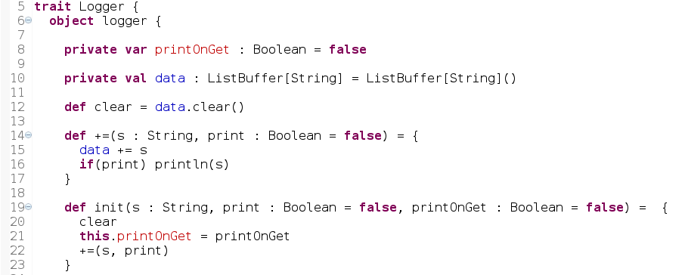
Use of Traits
Example: Logger

Slide 10
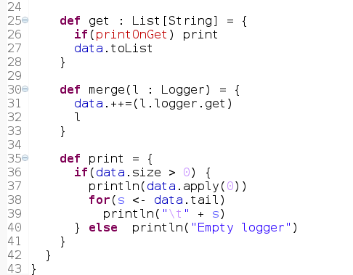
Use of Traits
Example: Logger

Slide 11
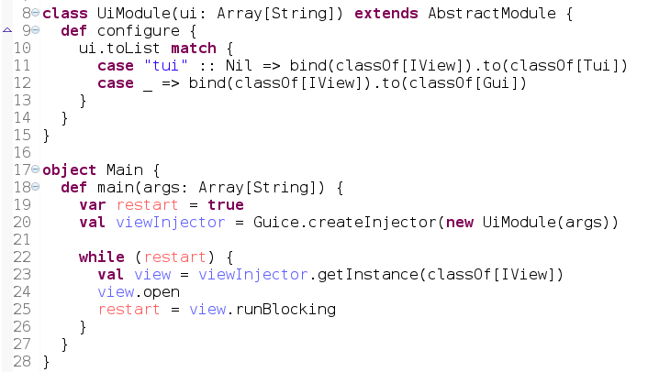
Use of Dependency Injection
Main Method GUI / TUI with scala-juice

Slide 12
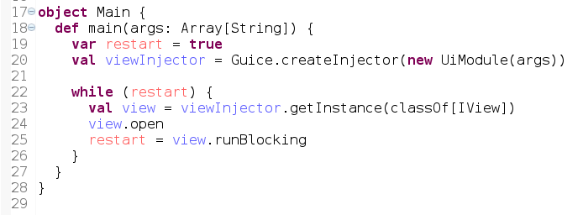
Use of Dependency Injection
Main Method GUI / TUI

Slide 13
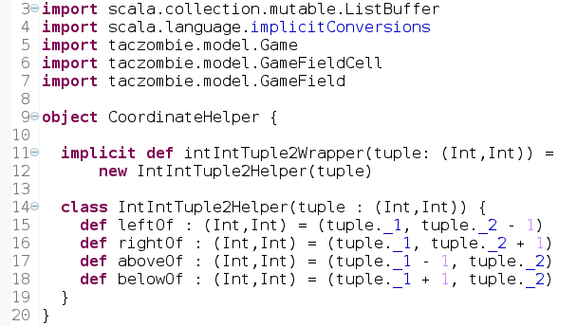
Use of Implicit Conversions
Example: CoordinateHelper

Slide 14
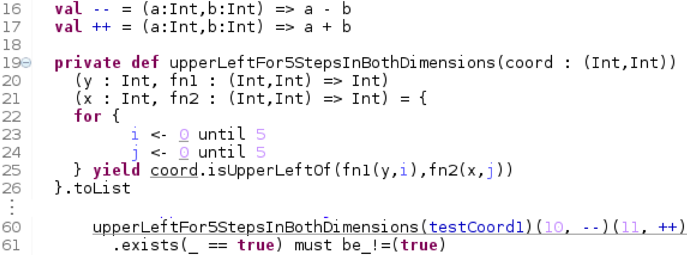
Use of Higher Order Function
Example: JsonHelperSpec

Slide 15
Tests
200 fully automated Tests
Code Coverage scct
  Model 100%
  GUI / TUI: Utils 100%
  Controller 76%
Coverage Report as html

Slide 16
Generate Standalone Game
Server/WUI
  sbt “project wui” dist
  Generates zip file
  Extract and execute Skript wui in bin/ to run server
GUI/TUI
  sbt assembly
  Generates TacZombieClient.jar
  Execute java -jar TacZombieClient.jar for GUI
  Add parameter “tui” for TUI

Slide 17
Demo
Lean back and enjoy :-)

Slide 18
Summary
GUI & TUI & WUI usable
  at the same time
  on the same model
Model fully automated tested
Controller automated tested
SBT Multi-project
Scala is awesome!
Swing is ok
ScalaFx lacks of support and examples

