Slide 1


MBB7061M · ASSESSMENT 1
PawPal | Pet care, made easier
Local care.
Digital reassurance.
VETTED
A UK neighbourhood pet-care microenterprise combining vetted carers, flexible visits and transparent updates.
VISIBLE
01
PILOT POSTCODE
focused local test
03
CORE SERVICES
walks · visits · check-ins
20
OWNER INTERVIEWS
planned discovery
[Student Name 1 – Student ID] · [Student Name 2 – Student ID] · [Student Name 3 – Student ID]
[Student Name 4 – Student ID] · [Student Name 5 – Student ID] · [Student Name 6 – Student ID]
LOCAL
Pilot design targets and visual concepts only; no PawPal trading performance is claimed.
PAWPAL / BUSINESS DEVELOPMENT & VALUE CREATION
01

Slide 2
INTRODUCTION
The opportunity: reliable care with visibility
SCENARIO / ILLUSTRATIVE
WHY NOW
PLANNED DISCOVERY SAMPLE · n = 20
HYPOTHESIS → EVIDENCE
One recurring problem, three dimensions
Hypothesis | Pilot evidence
Repeat weekday need | Booking frequency
Trust affects choice | Paid conversion
Updates create value | Repeat-booking rate
Local density matters | Route utilisation
Working owners need care that fits a predictable routine and gives visible proof that a visit happened.
TIME PRESSURE
Scheduling conflicts around weekday work
PRIORITY 72/100
TRUST UNCERTAINTY
Limited confidence in an unknown carer
PRIORITY 65/100
LOW VISIBILITY
Little evidence between booking and return
LOCAL SERVICE
one postcode cluster
DIGITAL COORDINATION
booking + pet profile
TRUSTED DELIVERY
vetted visit + care record
PRIORITY 57/100
Demand, priority scores and interview mix are pilot hypotheses—not established PawPal sales figures.
PAWPAL / BUSINESS DEVELOPMENT & VALUE CREATION
02

Slide 3
IDEA GENERATION
Idea generation: compare, select, test
DESIGN SCORES / ILLUSTRATIVE
A MARKETPLACE ONLY
Scalable, but weaker direct quality control
B TRADITIONAL AGENCY
Greater control, but higher fixed overhead
C HYBRID PAWPAL
Local vetted carers + lightweight app + care updates
OPTION COMPARISON · ANALYTICAL SCORES 1–5
SELECTED DESIGN
4.2 / 5
Weighted design judgement favours the hybrid model: stronger trust and control without agency-scale overhead.
Control
30%
Trust
25%
Scalability
20%
Lean setup
15%
Speed
10%
DISCOVER
DEFINE
PROTOTYPE
MEASURE
Critical choice: a hybrid approach improves control but introduces screening and coordination costs. [1][2]
PAWPAL / BUSINESS DEVELOPMENT & VALUE CREATION
03

Slide 4

COMPANY PROFILE
Company profile: one locality before scale
0–9
EMPLOYEES
UK microenterprise
01
PILOT CLUSTER
one London postcode
03
SERVICE TYPES
walk · visit · check-in
02
QUALITY CHECKS
arrival + care summary
ONE LOCALITY BEFORE SCALE
PLANNED SERVICE MIX · ILLUSTRATIVE
MISSION
Dependable, accessible and transparent everyday pet care
VISION
A trusted network of neighbourhood teams—scaled only after evidence
DELIVERY
Walks, feeding, home visits, booking confirmation and care summaries
Company profile is a proposed operating design; no trading history, market share or observed service mix is assumed.
PAWPAL / BUSINESS DEVELOPMENT & VALUE CREATION
04

Slide 5
CUSTOMISED CANVAS
PawPal | Nine-block Business Model Canvas
RADIAL CANVAS
PARTNERS
Carers · vets · insurer · payments
ACTIVITIES
Matching · visits · quality control
SEGMENTS
Working · travelling · less-mobile
VALUE
Dependable local care
Visible visit updates
Continuity + trust
RESOURCES
Carers · app · working capital
RELATIONSHIPS
Onboarding · feedback · rebooking
COSTS
Carer pay · fees · insurance · app
CHANNELS
App · referrals · local partners
REVENUE
Per-visit fees · repeat packages
ECONOMIC ENGINE · £20 FEE → £14 DIRECT COST → £6 CONTRIBUTION
Customised radial canvas: components informed by contemporary business model innovation research. [2][3]
PAWPAL / BUSINESS DEVELOPMENT & VALUE CREATION
05

Slide 6
CUSTOMER SEGMENTS
Customer segments: target the repeat need
PILOT PLAN / ILLUSTRATIVE
PRIMARY · WORKING OWNERS
Recurring weekday walks; predictable routines and fixed work schedules.
PLANNED EVIDENCE COLLECTION
10 INTERVIEWS · 40 PILOT BOOKINGS
SECONDARY · TRAVELLING OWNERS
Short-term visits; reassurance is most valuable while away.
6 INTERVIEWS · 20 PILOT BOOKINGS
NICHE · LESS-MOBILE OWNERS
Convenient local assistance; accessibility and continuity matter.
SEGMENT → NEED → TEST
Segment | Frequency | WTP test | Priority
Working | Weekly | £20 visit | High
Travelling | Episodic | £20–£25 | Medium
Less-mobile | Recurring | Package | Test
4 INTERVIEWS · 10 PILOT BOOKINGS
Segment attractiveness depends on frequency, local density and willingness to pay—not assumed UK market share.
PAWPAL / BUSINESS DEVELOPMENT & VALUE CREATION
06

Slide 7
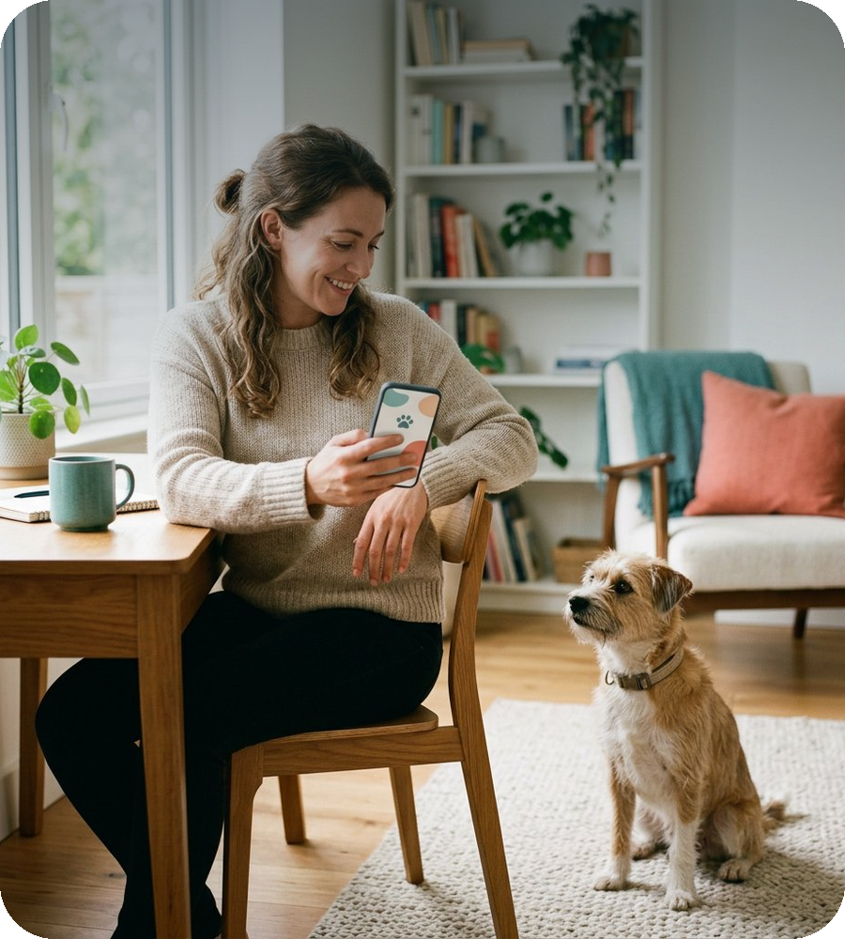
VALUE PROPOSITION
Value proposition: fit between pains and gains
DESIGN FIT / ILLUSTRATIVE
PAIN → MECHANISM → GAIN
Customer pain | PawPal mechanism | Evidence of gain
Unknown carer | Vetting + profile | Confidence
No visit visibility | Arrival note + summary | Reassurance
Inconsistent care | Instructions + preferred carer | Continuity
CUSTOMER PRIORITY VS DESIGN COVERAGE · SCORES 1–5
CARE SUMMARY AS PROOF OF SERVICE
A visible record turns an invisible service into reassurance.
Reliability is operational; visibility is digital; trust is earned through both. Scores are analytical judgements, not survey findings. [4]
PAWPAL / BUSINESS DEVELOPMENT & VALUE CREATION
07

Slide 8
CHANNELS
Channels: acquisition to repeat booking
FUNNEL HYPOTHESIS
ILLUSTRATIVE PILOT FUNNEL
CHANNEL REACH VS EXPECTED BOOKINGS
AWARENESS · 1,000 local impressions
SITE VISITS · 240 service-page views
ENQUIRIES · 90 trial conversations
FIRST BOOKINGS · 36 paid visits
MEASUREMENT PLAN
Stage | KPI | Pilot target
Discover | Cost / first booking | ≤ £8
Book | Paid conversion | ≥ 12%
Rebook | Repeat rate | ≥ 50%
REPEAT BOOKINGS · 22 second bookings
All funnel, reach, conversion and cost figures are pilot hypotheses; compare channels using observed cost per first booking and repeat rate.
PAWPAL / BUSINESS DEVELOPMENT & VALUE CREATION
08

Slide 9
CUSTOMER RELATIONSHIPS
Customer relationships: trust across the visit
SERVICE TARGETS / ILLUSTRATIVE
100%
PROFILE + VETTING
before first visit
≥95%
ON-TIME VISITS
operational target
≤24h
ISSUE CLOSURE
escalation standard
≥4.5/5
SATISFACTION
post-visit rating
BEFORE
Screening · pet profile · clear expectations · booking confirmation
PILOT SERVICE-LEVEL TARGETS
01
DURING
Arrival confirmation · care notes · issue escalation · live support
02
AFTER
Feedback · complaint handling · preferred-carer rebooking
03
Digital trust is not created by an app alone: operational reliability and transparent resolution matter. [4]
PAWPAL / BUSINESS DEVELOPMENT & VALUE CREATION
09

Slide 10
REVENUE STREAMS
Revenue streams: transparent unit economics
SCENARIO MODEL
£20
CUSTOMER FEE
assumed per booking
£14
DIRECT COSTS
£12 carer + £2 fees
£6
CONTRIBUTION
before fixed costs
30%
CONTRIBUTION MARGIN
£6 ÷ £20
WHERE EACH £20 GOES
SCENARIO INPUT REGISTER
£12 CARER
£2 FEES
£6 CONTRIBUTION
Input | Value | Basis
Customer fee | £20 | assumption
Carer payment | £12 | per visit
Payment / support | £2 | per visit
Contribution | £6 | 30% margin
Fixed costs | £1,200 | per month
Break-even | 200 visits | £1,200 ÷ £6
All prices, volumes and costs are scenario assumptions, not observed PawPal performance.
PAWPAL / BUSINESS DEVELOPMENT & VALUE CREATION
10

Slide 11
KEY RESOURCES
Key resources: capabilities before assets
READINESS SCORES / ILLUSTRATIVE
PEOPLE
Vetted carers, coordinator and customer support
IMPORTANCE VS PILOT READINESS · SCORES 1–5
READINESS 4/5
TECHNOLOGY
Booking interface, secure pet profiles, payment workflow
READINESS 3/5
FINANCE
Working capital, insurance budget and contingency
READINESS 2/5
KNOW-HOW
Care procedures, local demand insights, quality records
READINESS 3/5
CRITICAL CONSTRAINT
Carer availability and service quality—not app downloads—limit capacity.
Readiness scores are a self-assessment for pilot planning; finance and know-how require the strongest early evidence.
PAWPAL / BUSINESS DEVELOPMENT & VALUE CREATION
11

Slide 12
KEY ACTIVITIES
Key activities: one auditable care journey
WORKFLOW DESIGN
01 VERIFY
carer checks · pet profile
02 MATCH
availability · suitability
03 DELIVER
walk or home visit
04 DOCUMENT
notes · exception log
05 IMPROVE
feedback · corrective action
EVIDENCE FIELDS CAPTURED BY STAGE · DESIGN COUNT
SERVICE QUALITY IS THE OPERATING PRODUCT · 5 AUDITABLE CHECKPOINTS
Workflow times and evidence counts are proposed process-design measures for the pilot, not observed productivity data.
PAWPAL / BUSINESS DEVELOPMENT & VALUE CREATION
12

Slide 13
KEY PARTNERSHIPS
Key partnerships: capability and accountability
ACCOUNTABILITY MATRIX
PAWPAL PARTNER ECOSYSTEM
VALUE, CONTROL AND RISK
LOCAL CARERS
coverage · competence
Partner | Value added | Key control | Risk
Carers | Coverage | Vetting + SLA | High
Vets / shops | Referrals | Partner terms | Low
Insurer | Risk cover | Policy review | Medium
Payments | Secure flow | Reconciliation | Medium
PAWPAL
coordination
PAYMENTS
secure processing
VETS / PET SHOPS
referrals · credibility
INSURANCE
cover · risk advice
Contracts must clarify standards, responsibility, cancellations and incident escalation.
Risk ratings are qualitative design judgements; legal status, insurance and data duties require local verification.
PAWPAL / BUSINESS DEVELOPMENT & VALUE CREATION
13

Slide 14
COST STRUCTURE
Cost structure: where break-even occurs
MONTHLY SCENARIO
CONTRIBUTION VS FIXED COSTS
200
VISITS / MONTH
£1,200 fixed costs ÷ £6 contribution
SENSITIVITY · NET PROFIT / (LOSS)
Scenario | 150 visits | 200 visits | 250 visits
Revenue | £3,000 | £4,000 | £5,000
Net result | −£300 | £0 | +£300
Illustrative monthly operating model; excludes tax, startup investment and owner remuneration unless included in fixed costs.
PAWPAL / BUSINESS DEVELOPMENT & VALUE CREATION
14

Slide 15
BUSINESS ENVIRONMENT
UK environment: PESTEL implications
RISK SCORES 1–5
POLITICAL
Check borough-level requirements by service
IMPACT 2/5
ECONOMIC
Household budgets may constrain discretionary visits
IMPACT 4/5
SOCIAL
Reassurance is valued; willingness to pay is untested
IMPACT 3/5
RISK EXPOSURE BY DIMENSION
TECHNOLOGICAL
Simple booking helps; privacy remains essential
IMPACT 3/5
ENVIRONMENTAL
Clustered routes could reduce travel and emissions
IMPACT 2/5
LEGAL
Insurance, worker status, contracts and data duties
IMPACT 5/5
IMMEDIATE CHECKS
Legal compliance first; then test price sensitivity under household budget pressure.
PESTEL items are risk hypotheses and compliance checks, not quantified market findings.
PAWPAL / BUSINESS DEVELOPMENT & VALUE CREATION
15

Slide 16
CONCLUSION
Conclusion: a staged investment decision
DECISION GATES
STRENGTH
Service continuity + visible care record
TRADE-OFF
Higher screening and coordination costs
SCALE-READINESS INDEX BY GATE · ILLUSTRATIVE
RISK
Low density, carer shortages, service incidents
MITIGATION
One-area pilot, controls and stop/go criteria
VALIDATE DEMAND
paid conversion
PROVE CONTRIBUTION
£6 per visit
PROTECT QUALITY
incidents + CSAT
SCALE LOCALITY
only after evidence
EXPAND ONLY WHEN REPEAT DEMAND AND MARGINS ARE PROVEN
Index values illustrate a staged decision logic; actual thresholds must be set from pilot evidence.
PAWPAL / BUSINESS DEVELOPMENT & VALUE CREATION
16

Slide 17
Q&A
Investor questions: evidence before expansion
STOP / GO THRESHOLDS
IS DEMAND PROVEN?
No. Validate paid conversion and repeat booking before any expansion claim.
CAN THE MODEL SCALE?
Only if carer capacity and quality remain stable as volume increases.
IS IT PROFITABLE?
The pilot must test the £6 contribution and £1,200 monthly fixed-cost assumption.
ILLUSTRATIVE STOP / GO THRESHOLDS
DECISION DASHBOARD
Metric | Why it matters | Gate
Conversion | Paid willingness | ≥20%
Repeat booking | Habit + value | ≥50%
Utilisation | Carer capacity | ≥65%
Margin | Unit economics | ≥30%
Incident closure | Trust recovery | ≥95%
Thresholds are proposed decision criteria for discussion, not achieved results or investor commitments.
PAWPAL / BUSINESS DEVELOPMENT & VALUE CREATION
17

Slide 18
VANCOUVER · NUMBERED
Academic references
[1]
BUSINESS MODEL INNOVATION: PROCESS LITERATURE REVIEW
Andreini D, Bettinelli C, Foss NJ, Mismetti M. Business model innovation: a review of the process-based literature. J Manag Gov. 2022;26:1089–1121. https://doi.org/10.1007/s10997-021-09590-w
USED IN: idea generation · option selection
[2]
BUSINESS MODEL INNOVATION LITERATURE REVIEW
Huang W, Ichikohji T. A review and analysis of the business model innovation literature. Heliyon. 2023;9(7):e17895. https://doi.org/10.1016/j.heliyon.2023.e17895
USED IN: canvas structure · staged validation
[3]
DIGITAL TECHNOLOGY AND BUSINESS MODEL INNOVATION
Ancillai C, Sabatini A, Gatti M, Perna A. Digital technology and business model innovation: A systematic literature review and future research agenda. Technol Forecast Soc Change. 2023;188:122307. https://doi.org/10.1016/j.techfore.2022.122307
USED IN: app-supported service model
Reference links supplied as DOI identifiers; final publisher metadata verification is recommended.
PAWPAL / BUSINESS DEVELOPMENT & VALUE CREATION
18

Slide 19
VANCOUVER · NUMBERED
Academic references (continued)
[4]
TRUST-BUILDING AND PERCEIVED RISK ON PLATFORMS
Marth S, Hartl B, Penz E. Sharing on platforms: Reducing perceived risk for peer-to-peer platform consumers through trust-building and regulation. J Consum Behav. 2022;21(6):1255–1267. https://doi.org/10.1002/cb.2075
USED IN: value proposition · relationships
[5]
NON-MARKET STRATEGIES AND DIGITAL TRUST
Ko G, Amankwah-Amoah J, Appiah G, Larimo J. Non-market strategies and building digital trust in sharing economy platforms. J Int Manag. 2022;28(1):100909. https://doi.org/10.1016/j.intman.2021.100909
USED IN: trust controls · governance
[6]
IMPACTS OF PET GUARDIANSHIP: SCOPING REVIEW
Zoanetti J, Nielsen TD, Hazel S. The potential negative impacts of pet guardianship on the guardian, a scoping review. Discover Animals. 2024;1:11. https://doi.org/10.1007/s44338-024-00014-1
USED IN: owner burden · service context
EVIDENCE MAP · [4] TRUST · [5] PLATFORM GOVERNANCE · [6] OWNER BURDEN
Reference links supplied as DOI identifiers; final publisher metadata verification is recommended.
PAWPAL / BUSINESS DEVELOPMENT & VALUE CREATION
19

