Slide 1



Business Development & Value Creation
WeStore (India)
Group Member：
1. Anil Mahat 250176397
2. Prakash Kumar Singh 240213042
3. Kelechi Faith Reuben 240189013
4. Weibin Qiu 250235890
5. Gowripradam Dharmishetty 250259726

Slide 2
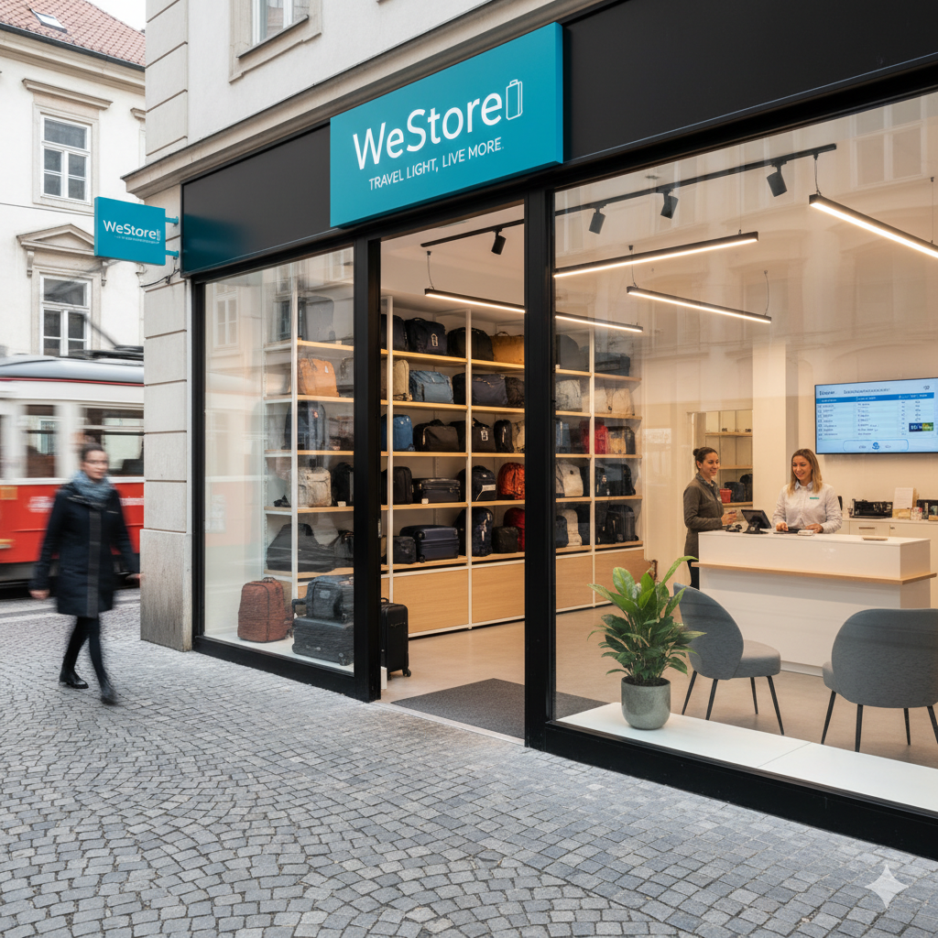

Introduction
In travel & tourism industry, convenience is key because travelers are often stuck with their baggage during layovers, after checking in early, and before checking out late and the existing baggage locker services are often expensive and inflexible. Seeing all these market gap and further potential in Indian traveler market is where we come in WeStore, a platform that connects travelers with a safe and secure baggage space in these situations, with the goal of disrupting the left-luggage market using the sharing economy and logistical techniques.
We are connecting travelers with secure local storage points, WeStore will also partner with logistical companies to provide in person pick up and deliveries anywhere you want to get delivered or picked and this transforms carrying luggage from a burden into an asset.
Gemini AI (2025) was used to create a picture
of a luggage store with WeStore signage.
2

Slide 3


IDEA GENERATION
Brain-Storming
Market Growth
S
Huge Market Tourism
Thousands of small Business
UPI Transactions
W
Initial Trust Issue
Brand Recognition
Vulnerable toward local issues
Evaluating
Incremental Process innovation
O
Partnership(IRCT, OYO)
Pilgrimage centers expansion
Future Thinking
T
Competition(Bounce, Radical Storage)
Evolving Regulation(GST Taxation)
[Burns, 2016]

Slide 4

IDEA SELECTION
Strong value proposition
People
Why This Idea?
3P
Scalable and Tech Enable
High Market Potential
Planet
Solve Universal Problem
Profit
Leverage Proven Model
Gimenez C., Sierra V., Rodon (2012)
        Strong Value Proposition : Offers Value for both customers and hosts by creating convenience and revenue, respectively.
        High Market Potential : Serves the huge domestic and international travel and tourism sector.
        Solve Universal Problem : Solve the problem regarding luggage burden while travelling across the cities.
        Leverage Proven Model : Two-sided marketplace and sharing assets economy principles.
        Scalable and Tech Enable : Based on digital Platform which helps in rapid expansion in cities to cities.
        Based on triple Bottom Line Model (3P), which helps to ensure positive social, environmental impact by maintaining financial viability.

Slide 5
cOmpany pROFILe
Your Bag, Safely Stored
Westore is a technology start up that provides online booking of luggage for the short-term basis. Through its app features, it will help travelers to connect with local companies in order to leave their bags securely. In app services like; GPS mapping, online booking and security payments are incorporated. Its shift and deliver service is depends upon local logistics to deliver luggage to different location by using local logistics partners. The mission is to provide convenience to the travelers in terms of their luggage and enable them to visit and move around the Indian cities.
Vision:
Become the world’s most reliable & flexible luggage storage platform.
Mission:
Safe, easy & economic luggage storage & deliver solutions by connecting tourists with local businesses.
Core Values:
1. Trust
2. Convenience
3. Community
4. Innovation

Slide 6
Business Model Canvas
Key Partners | Key Activities | Value Proposition | Customer Relationships | Customer Segments
Local shops & Vendors Logistics partners Delivery Partners (Ola, Uber) Legal Intities Insurance agencies | Luggage storage Delivery services Research & Development Customer Support Employee Management | Insured Storage Convenient Tech-enabled Affordable & Reliable | 24/7 support Loyality Programme Call service Regular feedback & compliance | Travellers Transit passengers Domestic travellers Business traveller Hikers
 | Key Resources | Channels
 | Mobile app, GPS, staff, Logistics network | Mobile app, Online booking, GPS mapping, Partner Store with WeStore signage
Cost Structure |  | Revenue Streams
Staff, tech, app maintenance, partner payments, R&D |  | Service fees, Commissions (30% of storage fee), in app advertisement, Subscription model, Seasonal Pricing
According to Jin et al., (2022) the Business Model Canvas can assist in visualizing the process by which a corporation generates, disseminates, and secures value.

Slide 7
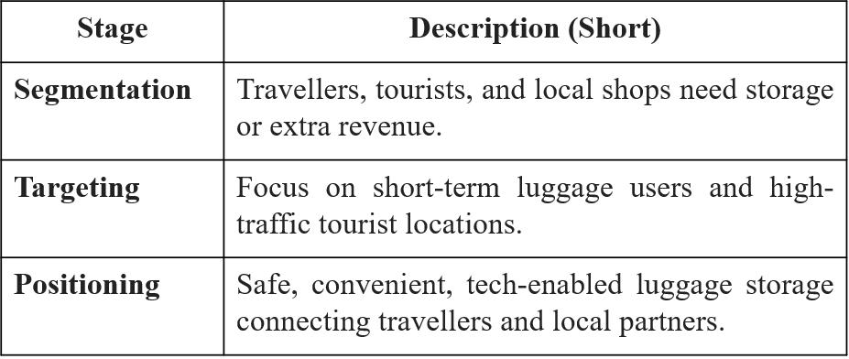
CUSTOMER SEGMENT
Most of the travelers need short-term luggage storage near the tourist places, stations, airports and office areas.
Tourists are mostly seeking convenience and safety in unfamiliar cities. (Olayinka, 2021)
Local businesses are looking for additional revenue streams by hosting luggage.

Slide 8
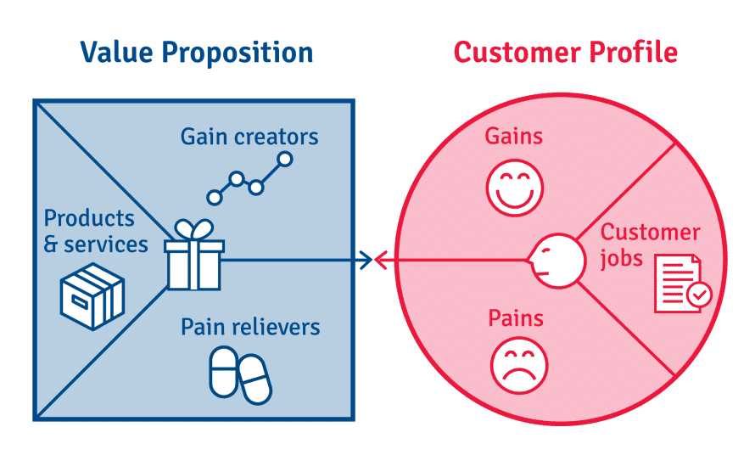
VALUE PROPOSITION
This business mainly provides Safe and secure luggage storage for travelers and tourists.
People can easily book luggage storage instantly via the mobile app and track their movement until pickup or delivery.
It also provides, revenue generation opportunity for local businesses hosting luggage.

Slide 9
CHANNELS
Effective distribution and some specific communication channels are mostly important for delivering value and maintaining customer relationships (Meha et al., 2022).
Using a mobile app for the instant booking process, instant payment, and real-time luggage tracking
Need to partner with logistics providers for secure pickup and delivery

Slide 10
CUSTOMER RELATIONSHIP
Support Center
i) Chat bot (24 hours)
ii) 12-hour call line
Loyalty and reward programs.
Customer feedback and involvement.
Personalised communication (using customer data to tailor messages, emails and offers).

Slide 11
KEY RESOURCES
Financial Resources: capital revenue, finance from investors, budget management
1
Physical Resources: office space, warehouse space, equipment and tools (computers)
2
Human Resources: Marketing team, local partners, delivery partners, tech team (website & mobile app), founders and staff, investors.
3
Intellectual Resources: Business name & logo, trademark & patent, market research.
4
Technological Resources: Mobile app & website, call services, social media platforms.
5
Legal Resources: Business registration & licensing, insurance, contact & agreements (with staff and partners).
6

Slide 12
KEY ACTIVITIES
Luggage storage and delivery
Inventory and logistics – tracking stored items and ensuring proper handling and retrieval
Customer feedback and improvement – reviews and adapting services based on customer experience
Digital platform management – developing and maintaining a website or app for bookings, payments, and customer communication.

Slide 13
KEY PARTNERSHIPS
Local businesses and vendors
Insurance providers
Transportation and delivery services
Digital and travel platforms
Hospitality partners e.g hotels, hostels, guest houses, Airbnb hosts, etc.
Warehouse and storage providers
Tourist centers
Investors
Customers

Slide 14



COST STRUCTURE
According to Burns, P. (2016). Entrepreneurship and Small Business
● App Development & Hosting
● Salaries
Fixed Cost
₹13,200,000
● Shop’s Commissions
● Marketing Campaign
Variable Costs
₹4,800,000
● Storage racks/ Lockers
● QR Signage
● Maintenance Audits
₹4,966,080
Operational Costs

Slide 15
REVENUE STREAM
commission per luggage storage (primary revenue) 30% of the storage price
● Premium traveler service.
● Partner subscription model (B2B revenue)
Bocken, N., Ingenmansdotter, E., & Gonzalez, D. (2019)
In App advertisements
Seasonal/
premium pricing (surge revenue)
₹38,491,200
₹795,852
₹208,338
₹110,000
Total Revenue 2026 ₹39,355,390

Slide 16

Pricing
Location Type | Hourly Rate (INR) | Daily Cap (INR) | Package Type | Package Price (INR) | Description
Standard Area | 80 | 400 | Single Day | 400 | Standard price for medium-tier city areas
Hotspot Area (Tourist/Station) | 100 | 500 | Single Day | 500 | High-demand locations near attractions or transport hubs
Suburban Area | 60 | 300 | Single Day | 300 | Discounted rate for less busy areas
Multi-Bag Discount (2+ Bags) | 70 | 350 | Per Bag | 350 | Discount applied to second bag onwards
Weekly Package |  |  | 7 Days | 2200 | Cheaper than daily rate (7-day stay)
Monthly Package |  |  | 30 Days | 8000 | For long-term travelers or students
Membership Tier | Monthly Fee (INR) | Yearly Fee (INR) | Discount | Benefits
Basic (Free) | 0 | 0 | None | Standard storage rates
Silver | 299 | 2,999 | 10% | Priority support and early booking access
Gold | 499 | 4,999 | 20% | Free cancellation and 1-hour late pickup
Platinum | 899 | 8,999 | 30% | Dedicated support, insurance included, priority service

Slide 17
SUMMARY
Month | Total Revenue (INR) | Total Cost (INR) | Net Profit (INR) | Currency GBP
Jan-2026 | 1,870,000 | 1,820,000 | 50,000 | 430
Feb-2026 | 2,053,500 | 1,832,000 | 221,500 | 1,905
Mar-2026 | 2,255,175 | 1,845,200 | 409,975 | 3,526
Apr-2026 | 2,476,833 | 1,859,720 | 617,113 | 5,307
May-2026 | 2,720,465 | 1,875,692 | 844,773 | 7,265
Jun-2026 | 2,988,239 | 1,893,260 | 1,094,979 | 9,417
Jul-2026 | 3,282,505 | 1,912,580 | 1,369,925 | 11,781
Aug-2026 | 3,606,157 | 1,933,844 | 1,672,313 | 14,382
Sep-2026 | 3,961,721 | 1,957,220 | 2,004,501 | 17,239
Oct-2026 | 4,352,812 | 1,982,948 | 2,369,864 | 20,381
Nov-2026 | 4,782,681 | 2,011,244 | 2,771,437 | 23,834
Dec-2026 | 5,255,302 | 2,042,372 | 3,212,930 | 27,631
Total | 39,605,390 | 22,966,080 | 16,639,310 | 143,098

Slide 18


REVENUE PROJECTION
2026
₹39,355,390
2027
30%
₹51,162,007
2028
50%
₹76,743,010

Slide 19
CONCLUSION
WeStore provides secure and convenient luggage storage for travelers across India, partnering with local cafes, retail stores, and hotels. Our revenue comes from a 30% commission on bookings, targeted advertising, and the premium traveler service, partner subscription module, creating a scalable, multi-stream business model.
With a lean cost structure, WeStore is well-positioned to capture India’s growing travel market, with long-term plans to expand across Asia and globally(Higgins, R. C. 2023). By making luggage storage more accessible and affordable, WeStore is not just a business, but a solution that enhance the travel experience for millions of people.

Slide 20
REFERENCES
Bocken, N., Ingenmansdotter, E., & Gonzalez, D. (2019). Designing Sustainable Business Models: Exploring IoT-Enabled Strategies to Drive Sustainable Consumption. In Sustainable Business Models (pp. 61–88). Cham: Palgrave Macmillan.
Burns, P. (2016). Entrepreneurship and Small Business: Start-Up, Growth and Maturity (4th ed.). London: Palgrave Macmillan.
Burns, P. (2018) New Venture Creation: A Framework for Entrepreneurial Start-Ups. 2nd edn. London: Macmillan Education UK.
Gimenez, C., Sierra, V. and Rodon, J. (2012) ‘Sustainable operations: Their impact on the triple bottom line’, International Journal of Production Economics, 140(1), pp. 149–159.
Google gemini AI (2025) AI-generated image by Google Gemini AI with Prompt “small business of left-luggage service named WeStore”, 11 November. Available at: https://gemini.google.com/app/4aacde82644d4c4e
Higgins, R. C. (2023). Analysis for Financial Management (12th ed.). McGraw-Hill Education.
Jin, Y., Ji, S., Liu, L. and Wang, W., 2022. Business model innovation canvas: a visual business model innovation model. European Journal of Innovation Management, 25(5), pp.1469-1493.
Kotler, P. and Keller, K.L. (2016) Marketing Management. 15th edn. Harlow: Pearson Education.
Meha, A., Zeqiri, F. and Zeqiri, A., 2022. An investigation of integrated marketing communication for a successful customer relationship. Calitatea, 23(187), pp.280-286.
Olayinka, O.H., 2021. Data driven customer segmentation and personalization strategies in modern business intelligence frameworks. World Journal of Advanced Research and Reviews, 12(3), pp.711-726.
Osterwalder, A. and Pigneur, Y. (2010) Business Model Generation: A Handbook for Visionaries, Game Changers, and Challengers. Hoboken, NJ: John Wiley & Sons.

Slide 21
Thank you
Q & A

Slide 22


