Slide 1
WIND SPEED
WIND INTELLIGENCE · R&D SHOWCASE
AEOLUS
24 H
FORECAST HORIZON
24-hour wind forecasting, turbine orientation recommendations, and theoretical energy estimation.
WIND DIRECTION
From coordinates to actionable wind intelligence.
NACELLE YAW

Slide 2





FROM USER COORDINATES TO TURBINE DECISIONS
SYSTEM ARCHITECTURE · COORDINATES → COLLECTION → FEATURES → FORECAST → DASHBOARD
01 · INPUT
02 · COLLECT
03 · PREPARE
04 · FORECAST
05 · DECIDE
Coordinates
Historical data
Features
24-hour outlook
Dashboard
User location starts the pipeline.
Open-Meteo archive and previous forecast runs.
Cleaning, lags, rolling statistics, trends.
Yaw recommendations and energy estimation.
Training, evaluation, wind speed and direction.
FRONTEND · REACT 18 + VITE · RECHARTS · REACT LEAFLET · THREE.JS / REACT THREE FIBER

Slide 3
47 ENGINEERED FEATURES TURN WEATHER HISTORY INTO FORECASTS
SOURCE WINDOW
FEATURE ENGINEERING
FINAL MODEL
26,328
47
72
Hourly records across approximately three years: wind, temperature, pressure, humidity, and cloud cover.
Lag features, rolling statistics, trends, stability measures, cyclic time features, and sine/cosine wind-direction encoding.
LightGBM direct models:
24 speed · 24 direction-sine · 24 direction-cosine
HISTORICAL WEATHER DATA
PERSISTENCE · SEASONAL NAIVE · SARIMAX
CHRONOLOGICAL TRAINING → VALIDATION → TESTING PREVENT DATA LEAKAGE

Slide 4
LIGHTGBM LEADS INTERNAL TESTS, BUT OPEN-METEO WINS THE EXTERNAL BENCHMARK
EVIDENCE ANCHOR · LOWER IS BETTER · 596 ROLLING FORECAST ORIGINS
INTERNAL MODEL COMPARISON
24-HOUR BENCHMARK
Model | Speed MAE (m/s) | Speed RMSE (m/s) | Direction error (°)
Persistence | 1.18 | 1.52 | 28.0°
Seasonal Naive | 1.04 | 1.37 | 22.8°
SARIMAX | 0.99 | 1.29 | 34.0°
LightGBM | 0.89 | 1.14 | 20.4°
Aeolus
0.93 m/s / 24.3°
Open-Meteo
0.83 m/s / 15.2°
Open-Meteo performs better here.
16.8% SPEED MAE IMPROVEMENT
10.5% DIRECTION-ERROR IMPROVEMENT
596 ROLLING FORECAST ORIGINS

Slide 5
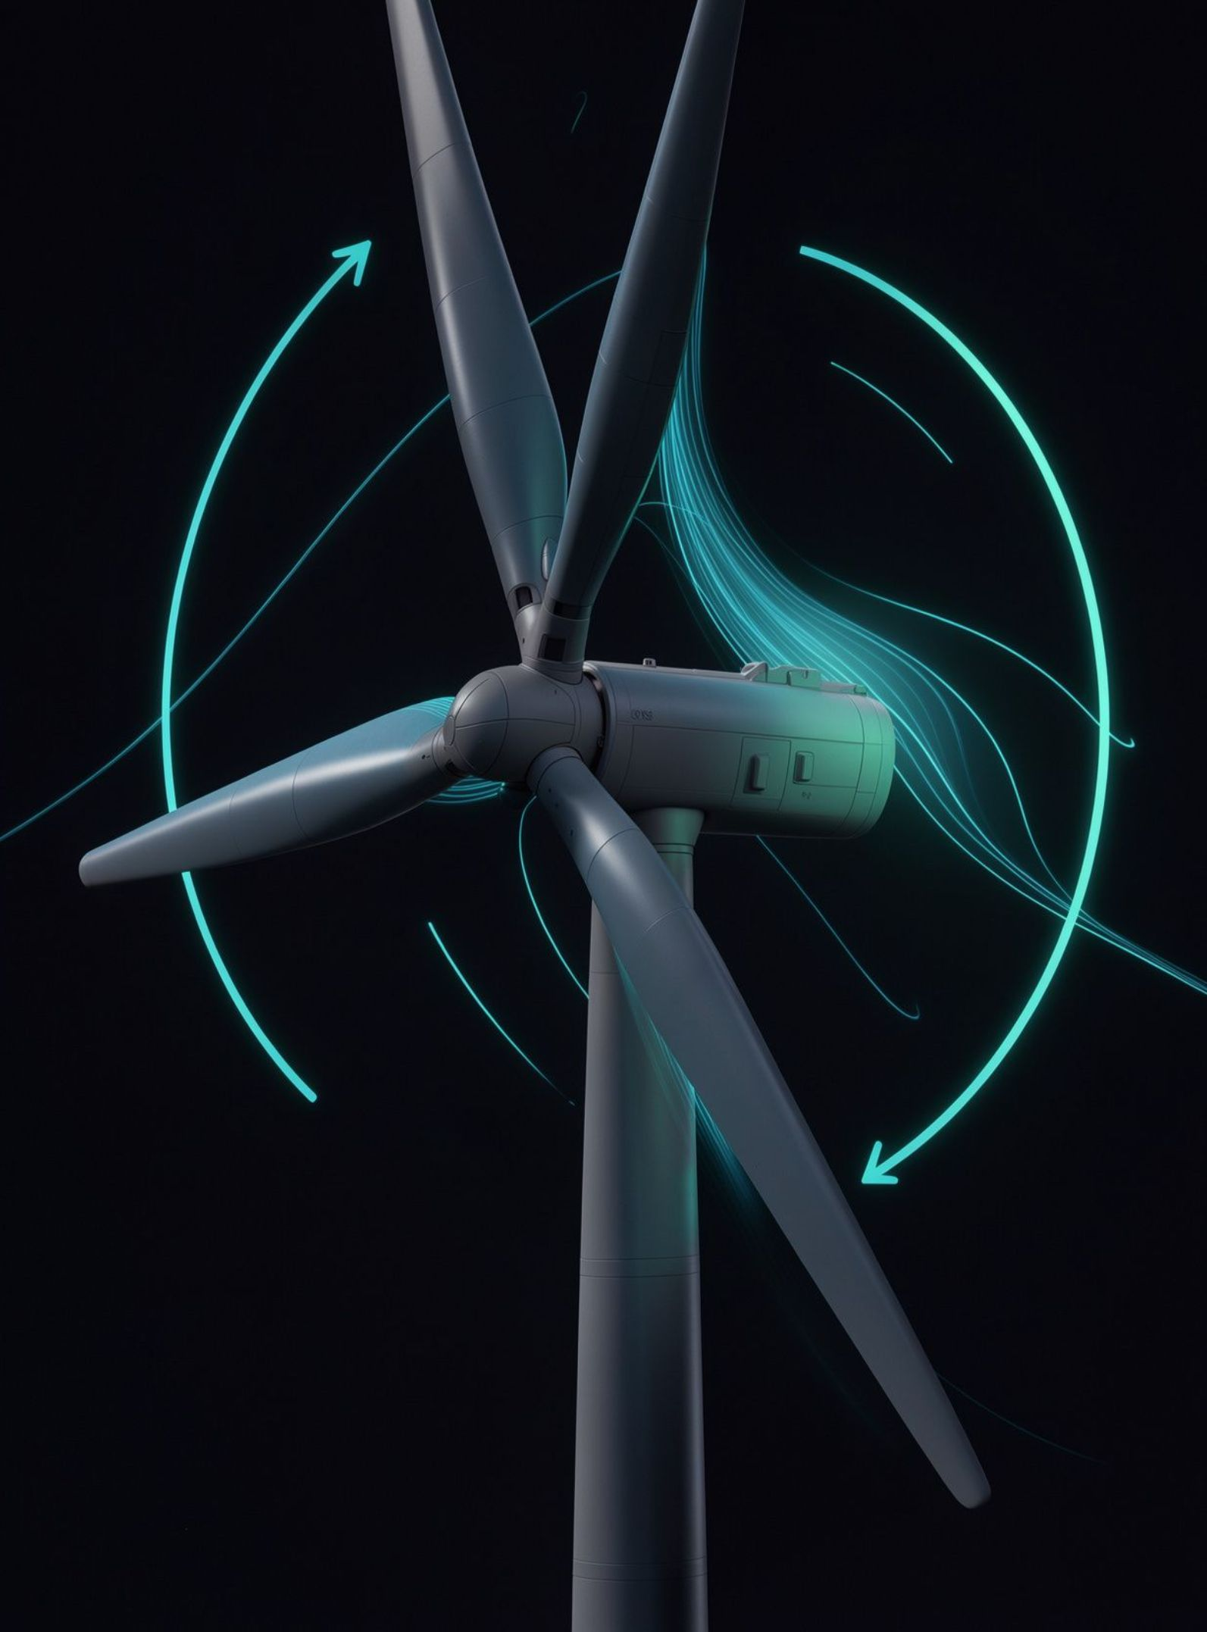
WIND DIRECTION → NACELLE ROTATION
YAW LOGIC STAYS ADVISORY; ENERGY STAYS THEORETICAL
3.3 MW EXAMPLE
4.04 m/s average predicted wind · 7,768 kWh daily energy
DECISION PATH · CONFIDENCE + WIND SPEED + HEADING DIFFERENCE
01
9.8% capacity factor · trustworthy direction for 15/24 hours
TRACK
Confidence R ≥ 0.75, wind speed ≥ 3 m/s, heading difference > 8°.
02
HOLD WITHIN DEADBAND
Reliable direction and difference ≤ 8°.
03
HOLD
Low confidence or wind speed below 3 m/s.
Notes:
Yaw recommendations do not control physical turbines. NREL power-curve interpolation converts predicted wind speed into hourly power and daily energy. Energy remains a theoretical estimate.

Slide 6
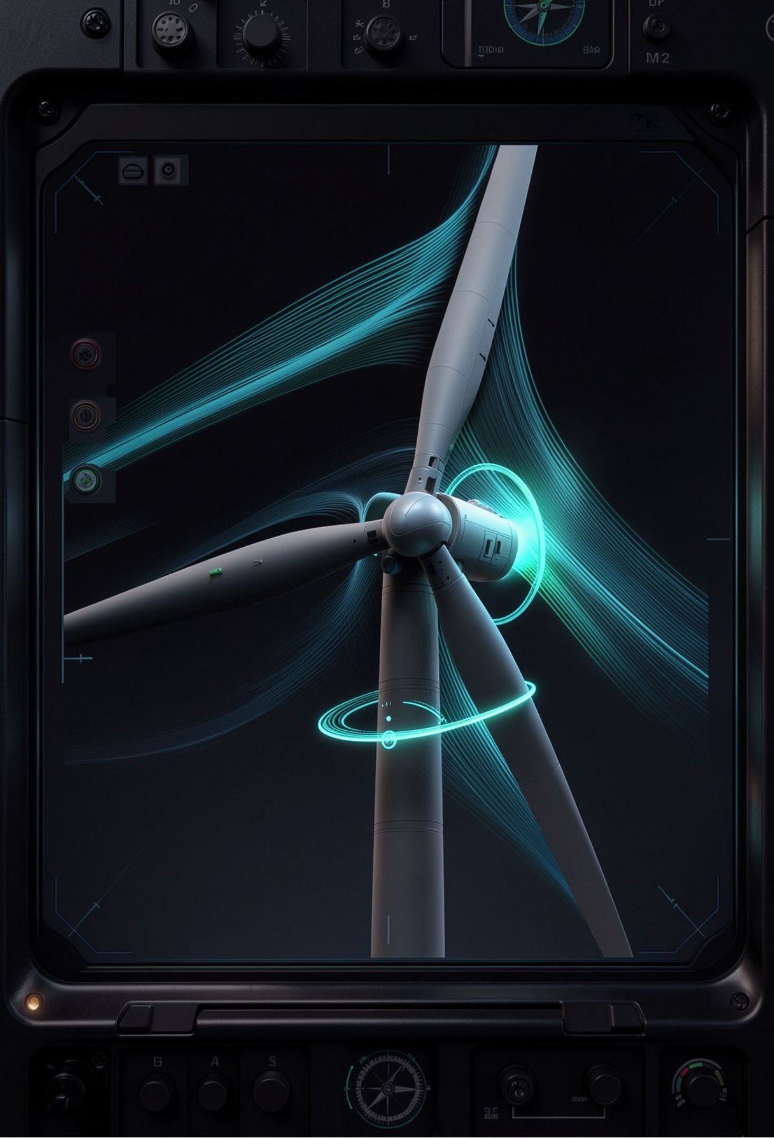
ONE DASHBOARD, FROM MAP TO NACELLE ROTATION
ILLUSTRATIVE INTERFACE MOCKUP · NOT A REAL SCREENSHOT
SITE VIEW
DECISION VIEW
MAP
YAW
Geographical map
Yaw recommendation table
ILLUSTRATIVE 3D VIEWPORT
FORECAST
ENERGY
Interactive turbine with nacelle rotation, wind-direction indicator, forecast-hour controls, playback, and illustrative rotor animation based on predicted power.
Wind-speed + direction forecasts
Turbine power + energy
WIND COMPASS · CONFIDENCE VIEW
MODEL EVALUATION · OPEN-METEO COMPARISON
FORECAST-HOUR CONTROLS · PLAYBACK · API-READY VIEW

Slide 7
TURNING HISTORICAL WEATHER DATA INTO INTELLIGENT WIND-TURBINE DECISIONS
AEOLUS · WHAT WORKS, WHAT REMAINS, WHAT COMES NEXT
ACHIEVED
LIMITATIONS
NEXT
24-hour forecasting; four-model evaluation; LightGBM selection
Confidence-aware yaw logic; NREL power curves
Full-stack dashboard; interactive 3D visualization
Historical reanalysis rather than physical sensors; approximately five-day archive delay
Theoretical energy; no measured generation validation; advisory yaw
Point forecasts without uncertainty; approximately five months of evaluation; one site at a time
Live sensors and SCADA; uncertainty intervals
Full-year evaluation; ensemble/hybrid forecasting
Deep-learning comparison; multiple sites; automated retraining
HISTORICAL WEATHER → FORECAST → ADVISORY DECISION SUPPORT

