Slide 1
3D Point Cloud Misalignment Computation
Submitted by –
Souham Biswas (A20365242)
Jaimeet Patel (A20361168)
Sudipta Swarnakar (A20377210)
Tanveer Anand (A20376403)

Slide 2
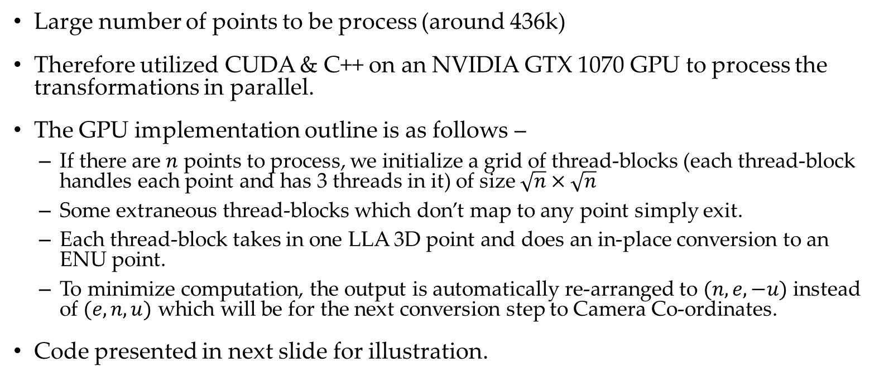
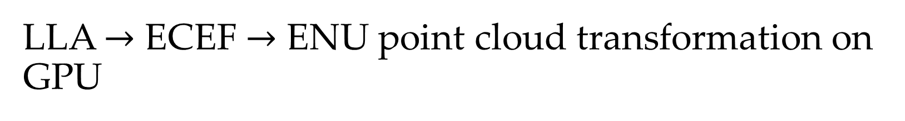
LLA $→$ ECEF $→$ ENU point cloud transformation on GPU
Large number of points to be process (around 436k)
Therefore utilized CUDA & C++ on an NVIDIA GTX 1070 GPU to process the transformations in parallel.
The GPU implementation outline is as follows –
If there are $n$ points to process, we initialize a grid of thread-blocks (each thread-block handles each point and has 3 threads in it) of size $\sqrt{n}×\sqrt{n}$
Some extraneous thread-blocks which don’t map to any point simply exit.
Each thread-block takes in one LLA 3D point and does an in-place conversion to an ENU point.
To minimize computation, the output is automatically re-arranged to $(n, e, −u)$ instead of $(e, n, u)$ which will be for the next conversion step to Camera Co-ordinates.
Code presented in next slide for illustration.

Slide 3
LLA $→$ENU GPU kernel
__global__ void LLA2NEmU_GPUKernel(float *h_lla_data, float *d_out_coord_data, float eq_radius,
float ecc, int num_points, float x0, float y0, float z0) {
int phi_idx = ((gridDim.x * blockIdx.y + blockIdx.x) * blockDim.x);
if (phi_idx < num_points * 3) {
int lambda_idx = phi_idx + 1;
int h_idx = phi_idx + 2;
float phi = h_lla_data[phi_idx];
float lambda = h_lla_data[lambda_idx];
float h = h_lla_data[h_idx];
float sin_phi = sinf(phi);
float cos_phi = cosf(phi);
float sin_lambda = sinf(lambda);
float cos_lambda = cosf(lambda);
float N_phi = eq_radius / sqrtf(1 - powf(ecc * sin_phi, 2.0f));
float xy_p0 = (h + N_phi) * cos_lambda;
if (threadIdx.x == 0)
d_out_coord_data[phi_idx] = (xy_p0 * cos_phi) - x0;
else if (threadIdx.x == 1)
d_out_coord_data[lambda_idx] = (xy_p0 * sin_phi) - y0;
else
d_out_coord_data[h_idx] = ((h + (1 - ecc * ecc) * N_phi) * sin_lambda) - z0;
__syncthreads();
float x = d_out_coord_data[phi_idx];
float y = d_out_coord_data[lambda_idx];
float z = d_out_coord_data[h_idx];
__syncthreads();
if (threadIdx.x == 0)
d_out_coord_data[lambda_idx] = (x * (-sin_lambda)) + (y * cos_lambda);
else if (threadIdx.x == 1)
d_out_coord_data[phi_idx] = (x * (-cos_lambda) * sin_phi) + (y * (-sin_phi)
* sin_lambda) + (z * cos_phi);
else
d_out_coord_data[h_idx] = -((x * cos_phi * cos_lambda) + (y * cos_phi * sin_lambda) + (z * sin_phi));
}
}

Slide 4






ENU $→$ Camera Co-ordinate conversion
To do this, all the data is organized as 2 matrices and a dot-product is performed to get the output.
A simple BLAS GPU-powered matrix multiply does the job very fast.
$$3$$
$$R_{q}$$
$$3$$
ENU Point Cloud Matrix
Camera-Coordinate
Point Cloud Matrix
$$3$$
$$n$$

Slide 5
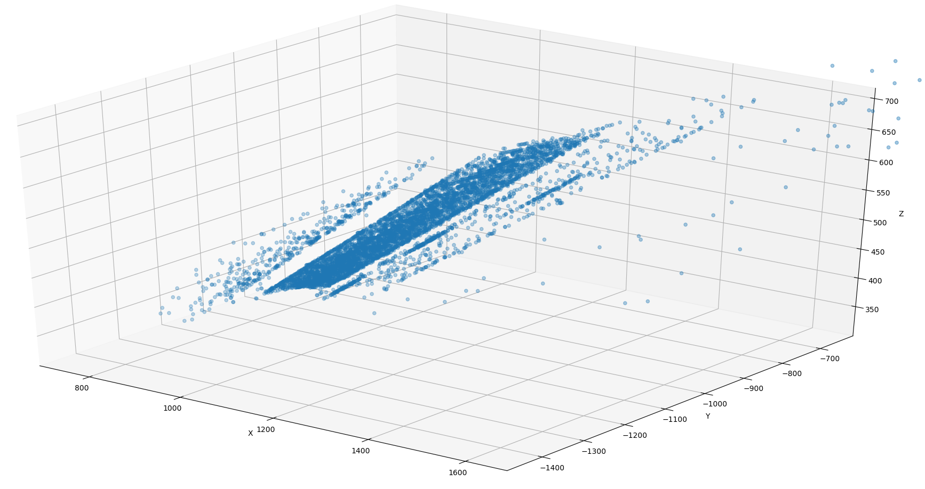
Camera Co-ordinate rough visualization
The camera point clouds so obtained roughly visualized, takes the following form –

Slide 6
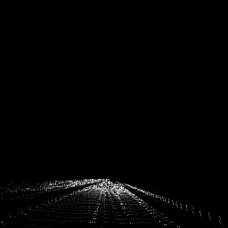
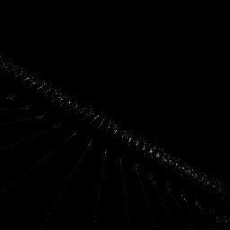
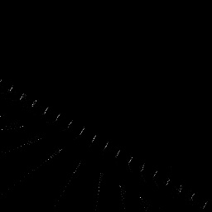
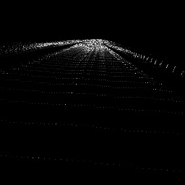
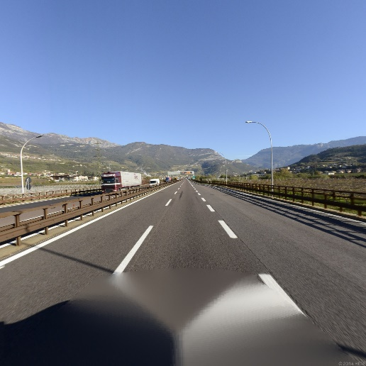
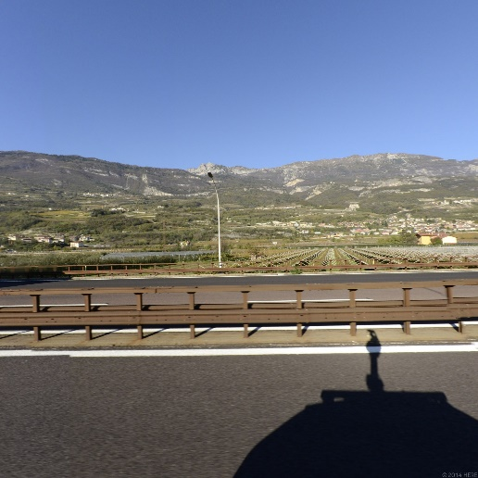
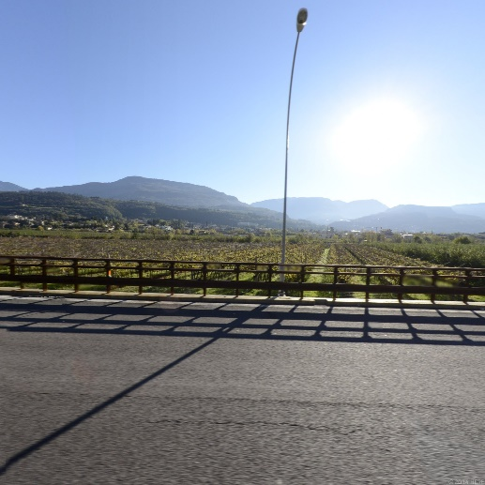
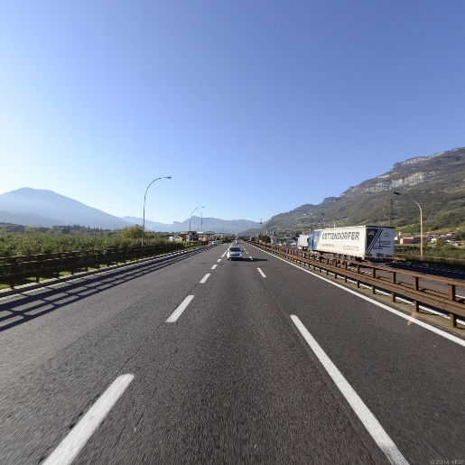
Camera-coordinate to image co-ordinate conversion
This conversion was implemented on the CPU due to unresolved GPU concurrency issues. The visualizations for all the views were obtained as follows –
Front
Left
Right
Rear

Slide 7

Top-view of 3D point cloud (Camera-coordinates)
The camera point clouds visualized from a top-view is presented below –
As can be seen, a road is visible, concluding that the camera-coordinates generated are correct.

Slide 8
Misalignment between camera and Point Cloud
Misalignment between two images can be obtained using Feature-Based or Direct Alignment.
Selection of method depends on degrees of freedom and image properties(i.e texture or geometric deformation).
In principle, feature-based matching is invariant to the strength of the geometric deformation, while it may fail when the image content is weakly-textured, periodic etc.
On the other hand, area-based (direct) alignment methods are able to align such images, while they need a good initialization when the deformation is strong, in order to avoid being trapped in local extrema.

Slide 9
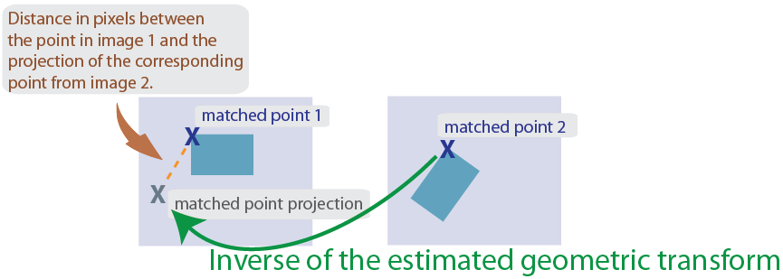
Misalignment between camera and Point Cloud
Both feature-based and area-based alignment have their own pros and cons. For our case, we used feature based technique in order to align point cloud image to an aerial image.
We used SIFT (Scale Invariant Feature Transform) to detect the key features from point cloud image and aerial image.
As our point cloud image consists of translation, rotation, and scale, we will use Nonreflective similarity transformation.

Slide 10
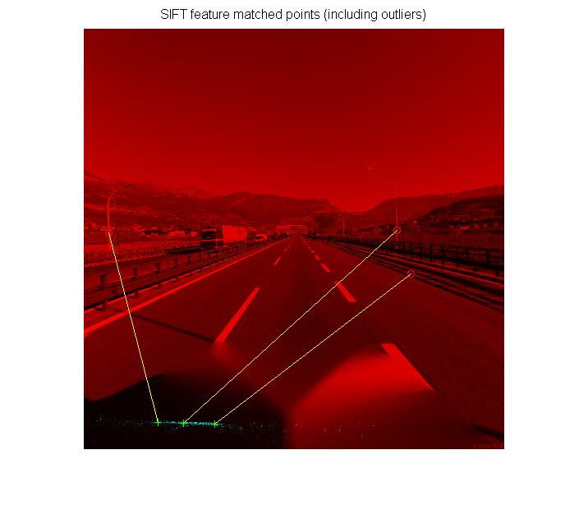
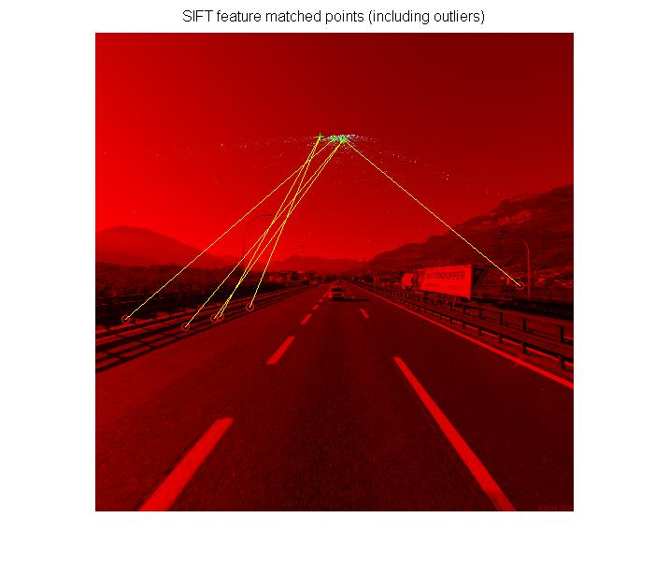
Feature matching results

Slide 11
Code Layout-
The C++ and CUDA source code files generate the image coordinate transformations.
The MATLAB .m code in sift.m does the misalignment calculation and outputs the transformation matrix and visualizes the misalignment on the image.

Slide 12
Code Layout-
The C++ and CUDA source code files generate the image coordinate transformations.
The MATLAB .m code in sift.m does the misalignment calculation and outputs the transformation matrix and visualizes the misalignment on the image.

Slide 13
Alternate Approach for Finding Mis-Alignment between Image Coordinates and Original Images
In this approach we used the same technique which is used for lane detection in self driving cars.
In this technique we first applied Canny Edge detection on image coordinates data and after that we found out all Hough Lines using Hough Transform.
Next we drew the lines using Hough Line Transform. This the part where one has to be more experimental with different parameter hough line transform in OpenCV takes. After creating all the line through Hough Line transform we superimposed all lines on original image which resulted in below output image.
From the output image,we can clearly visualize the misalignment between image coordinates data and real image data. We have also found out the transformation matrix as a numpy array which gives the measurement of misalignment.

Slide 14
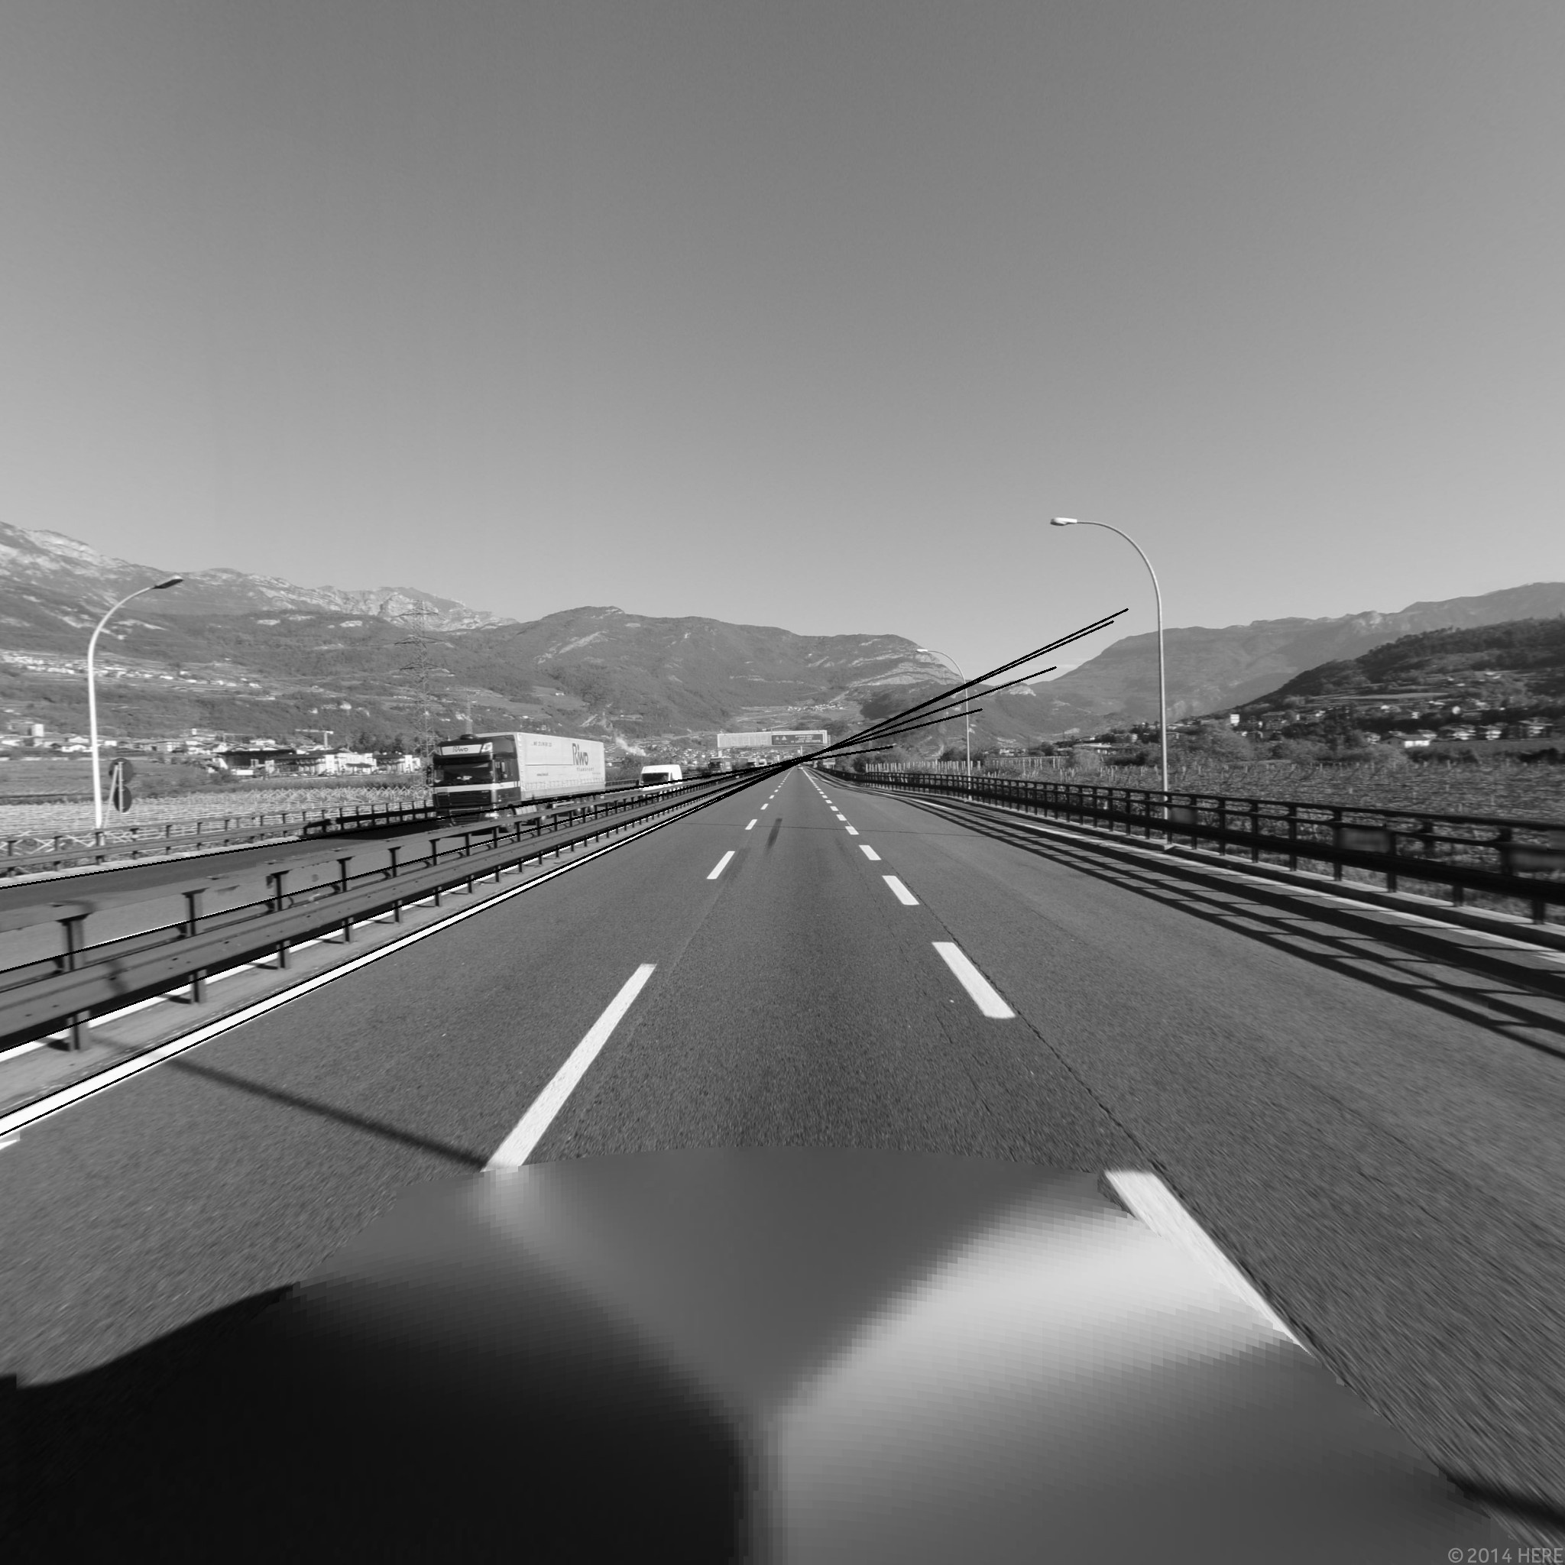
Output

