Slide 1
DEFENSE & AEROSPACE / HACKATHON
SENTINEL-X
SIEM
SPACE
SENSORS
Threat Intelligence Correlation
& Alert Prioritisation Assistant
↓
CORRELATION
↓
Turning heterogeneous telemetry into correlated,
explainable and actionable security intelligence.
MITRE + PRIORITY
TEAM: Pretzel
TRACK: AI | DEFENSE & AEROSPACE

Slide 2
02
Problem
What problem are SOC and defense analysts facing?
Heterogeneous telemetry
Alert overload
Context & prioritisation gap
SIEM, endpoint/network sensors and space telemetry use different formats and describe different operational contexts.
Large event streams create many isolated detections. Analysts spend time deciding what is actually related.
An alert needs behavior context, threat intelligence and an explainable reason for its priority.
WHO HAS THIS PROBLEM?
SOC analysts and security teams handling high-volume, multi-source telemetry.
WHY IT MATTERS
Faster correlation and clearer prioritisation can reduce manual triage and surface the threats that matter.
SENTINEL-X / 2

Slide 3
03
Solution
One clear pipeline: events become evidence, evidence becomes action.
DATA SOURCES
NORMALIZE
CORRELATE
ENRICH
PRIORITIZE
ACT
SIEM • Space • Sensors
Common event representation
Behavior + time + asset + source
MITRE ATT&CK + CISA KEV
Explainable Sentinel-X policy
Alert • Incident • Analyst action
→
→
→
→
→
KEY IDEA
Events are not automatically alerts. Correlation creates the context needed for an explainable priority.
SENTINEL-X / 3

Slide 4
04
Architecture
A lightweight, testable real-time MVP architecture.
01
INGEST
Simulator / incoming telemetry
Canonical event
event_id • timestamp • source • event_type • asset • severity • raw/normalized event
02
NORMALIZE
Raw event → canonical event
03
DETECT + CORRELATE
Behavioral & temporal relationships
Correlation signals
Same asset • temporal proximity • behavioral sequence • independent sources
04
ENRICH
MITRE ATT&CK + CISA KEV
05
PRIORITIZE
Configurable Sentinel-X policy
Output
MITRE technique • confidence • priority • evidence • alert/incident relationship
06
SERVE
Alert / incident state → UI
SENTINEL-X / 4

Slide 5
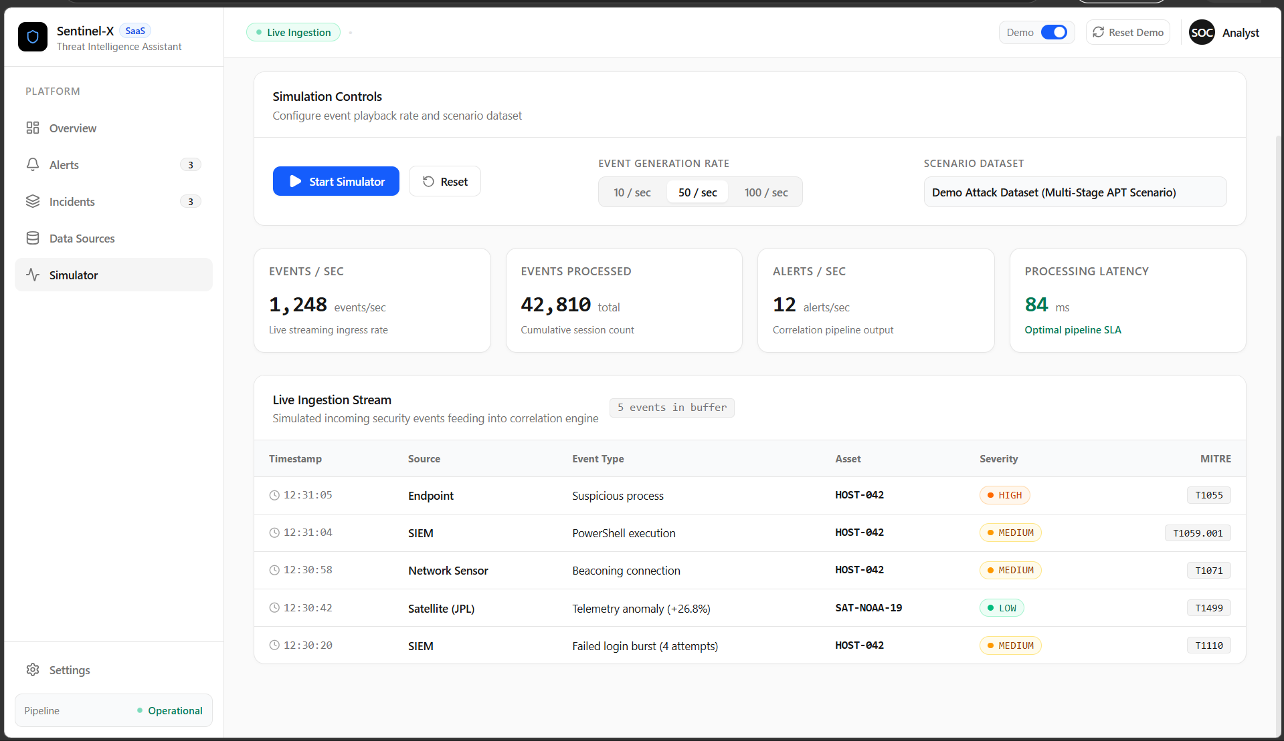
05
Demo / Key Feature
Multi-stage attack: from live events to one explainable incident.
LIVE DEMO
1
Select
Multi-Stage Attack
2
Generate
Events stream in continuously
3
Correlate
Related activity is connected
4
Enrich
MITRE techniques are mapped
5
Prioritize
Sentinel-X explains the risk
6
Incident
Alerts become an attack narrative
BEST DEMO: Multi-Stage Attack
SENTINEL-X / 5

Slide 6
06
IBM Technologies
How IBM technology fits into the Sentinel-X workflow.
IBM Bob + MCP
MCP-based tool connectivity
Used as the integration / orchestration layer for connecting heterogeneous threat feeds and supporting normalization into a common workflow.
Provides a structured way to connect external data/tools to the assistant workflow instead of building one-off integrations for every source.
Threat-feed normalization
Where it sits
The integration layer supports the project goal of bringing SIEM, space and sensor telemetry into a consistent processing pipeline.
IBM/MCP integration is an enabling layer around ingestion and normalization; correlation, MITRE enrichment and Sentinel-X prioritisation remain the core application logic.
IMPORTANT: describe only the IBM capabilities actually demonstrated in the final build.
SENTINEL-X / 6

Slide 7
07
Results / Impact
What success looks like in the Sentinel-X MVP.
01 Reduce triage noise
02 Explain priority
03 Cross-domain visibility
Many related events can become fewer, higher-value alerts and incidents.
Analysts see source severity, confidence, correlation, asset criticality and threat context.
SIEM, sensor and space telemetry can be examined in one decision workflow.
MVP SUCCESS METRICS
Live events
Alert latency
Correlation
Explainability
Continuous generation and processing
Time from correlated evidence to alert
Related events grouped into incidents
Every priority has visible supporting factors
Success = faster understanding of what happened, why it matters, and what to do next.
SENTINEL-X / 7

Slide 8
08
Team
Roles and ownership — replace the placeholders with your final team details.
TEAM MEMBER 1
TEAM MEMBER 2
TEAM MEMBER 3
TEAM MEMBER 4
Maharshi Trivedi
Chaitany Thakar
Tirth Bhatt
Visha Kardani
Researcher
ML Engineer
Backend Engineer
Frontend Engineer
TEAM CONTRIBUTION
Data & research • Correlation & backend • MITRE / threat intelligence • Frontend & demo
Thank you
SENTINEL-X / 8

