Slide 1








Twitter Data Analysis with R on top of Hadoop Platform
Prepared By:
Vyoma Patel (AU2044005)
V Sanjana Karri (AU20110006)
Subject: Big Data Analytics(BDA)
Subject Code: CSE521

Slide 2
Proposed Methodology
Twitter Application
01
Installation Part
02
Hadoop Cluster
04
Visualizations
08
Twitter to HDFS
03
Changing Data format
05
Connecting with R
07
Creating twitter developer account
Generating API keys and tokens
Hadoop-3.1.4
Flume-1.9.0
Create twitter config file
Flume Data generation
Data in AVRO format
Calling Avro tool, getting schema
Converting Avro to JSON
JSON file generated sent
Data Preprocessing
Using appropriate libraries
Analysing data with various plots
Hive-3.1.2
Start dfs and call twitter agent via flume
Hive
06
Starting metastore
Table Creation and Retrieval

Slide 3
Basic Definitions
Apache Hadoop - software library is a framework that allows for the distributed processing of large data sets across clusters of computers using simple programming models.
Apache Flume – It's a tool for data ingestion in HDFS. To capture streaming data from various web servers to HDFS.
Apache Hive - data warehouse software facilitates reading, writing, and managing large datasets residing in distributed storage using SQL.
Apache Avro - is a data serialization system. Provides compact, fast, binary data format on Hadoop.
JSON - JavaScript Object Notation. Lightweight format for storing and transporting data. Widely supported and easily understandable.
R - is a programming language and free software environment for statistical computing and graphics supported by the R Foundation for Statistical Computing.

Slide 4
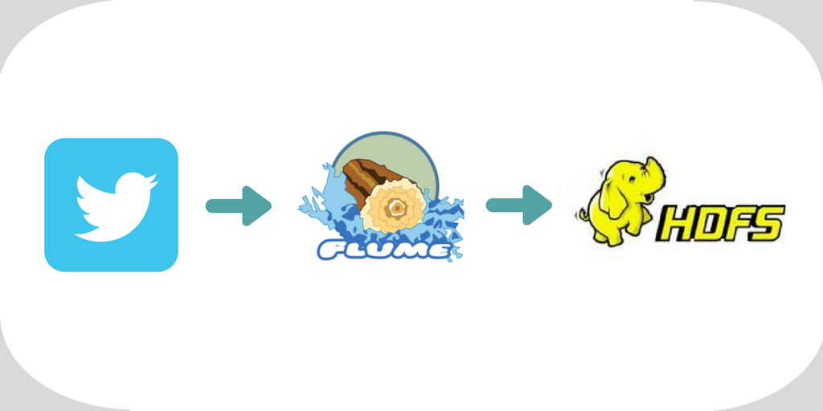
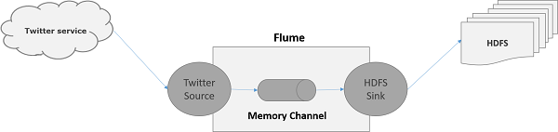
Process of Tweets stored on Hadoop Cluster

Slide 5
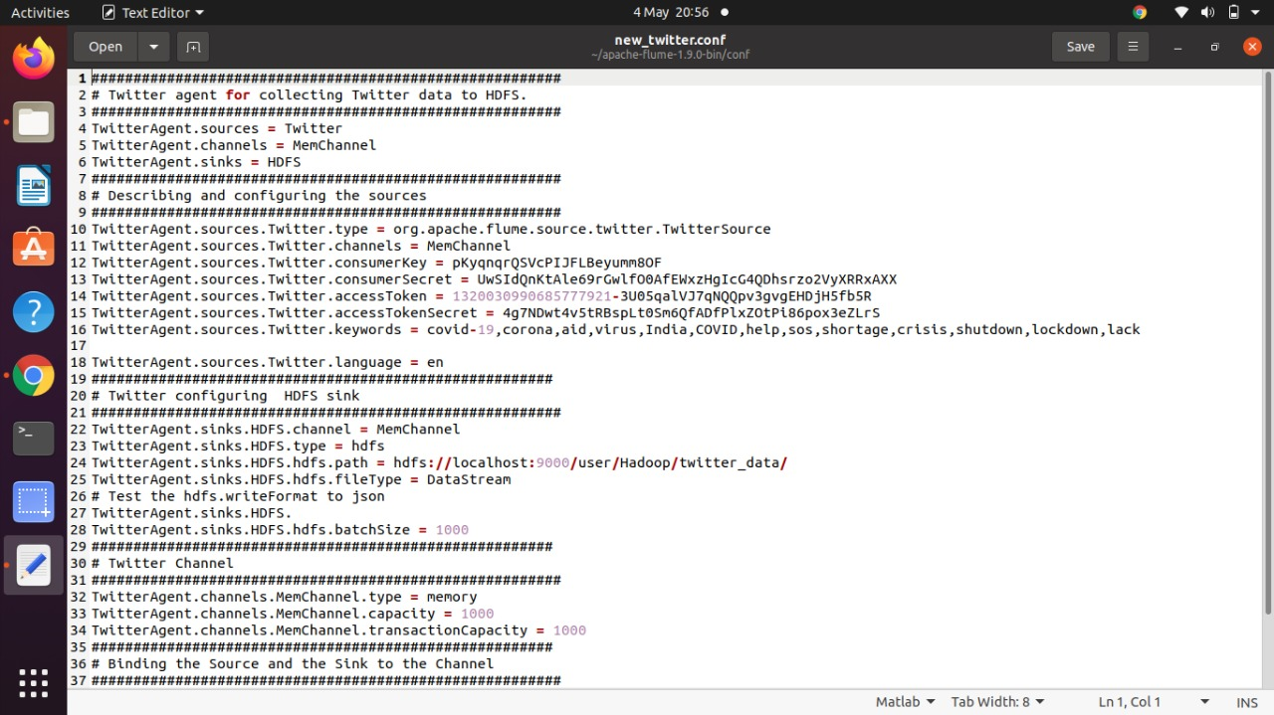
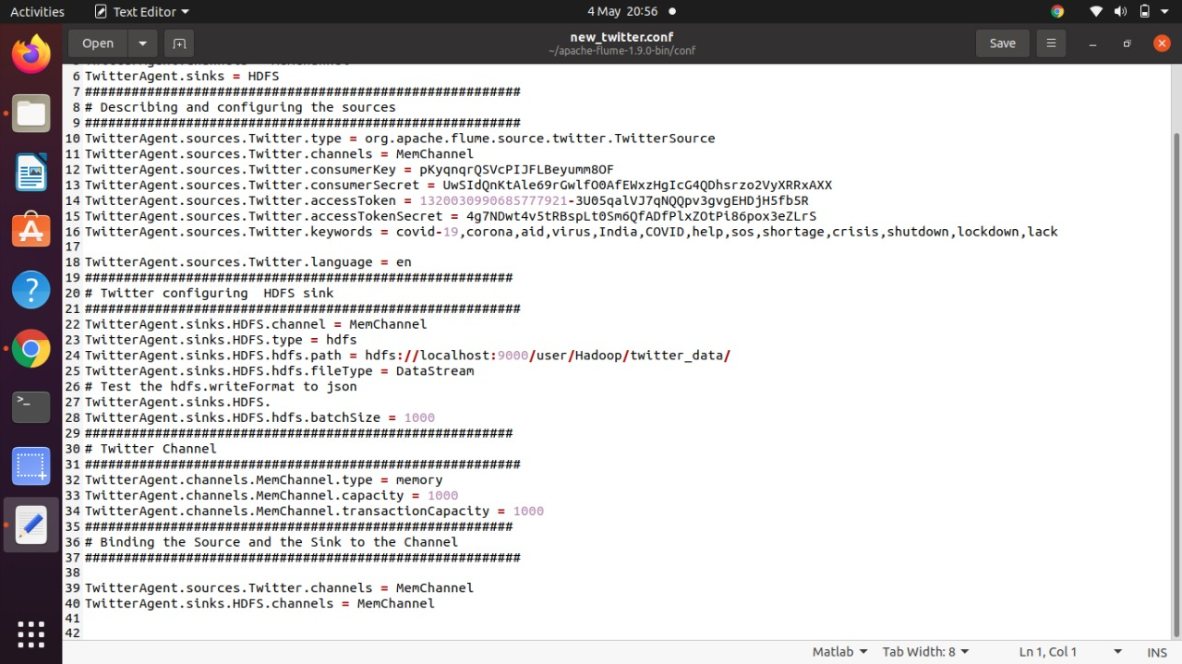
Twitter Config File
The flume agent has 3 components: source, sink, and channel.
Source: It accepts the data from the incoming streamline and stores the data in the channel.
Channel: In general, the reading speed is faster than the writing speed. Channel acts as the local storage(buffer) or temporary storage between the source of data and persistent data in the HDFS.
Sink: Collects the data from the channel and commits or writes the data in the HDFS permanently.

Slide 6
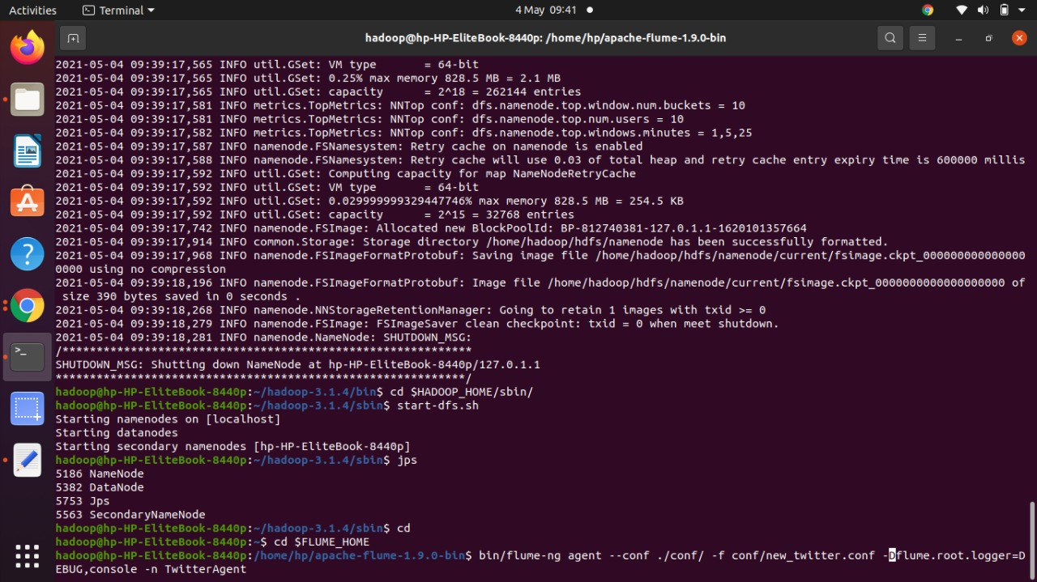
Starting Hadoop and calling flume agent

Slide 7
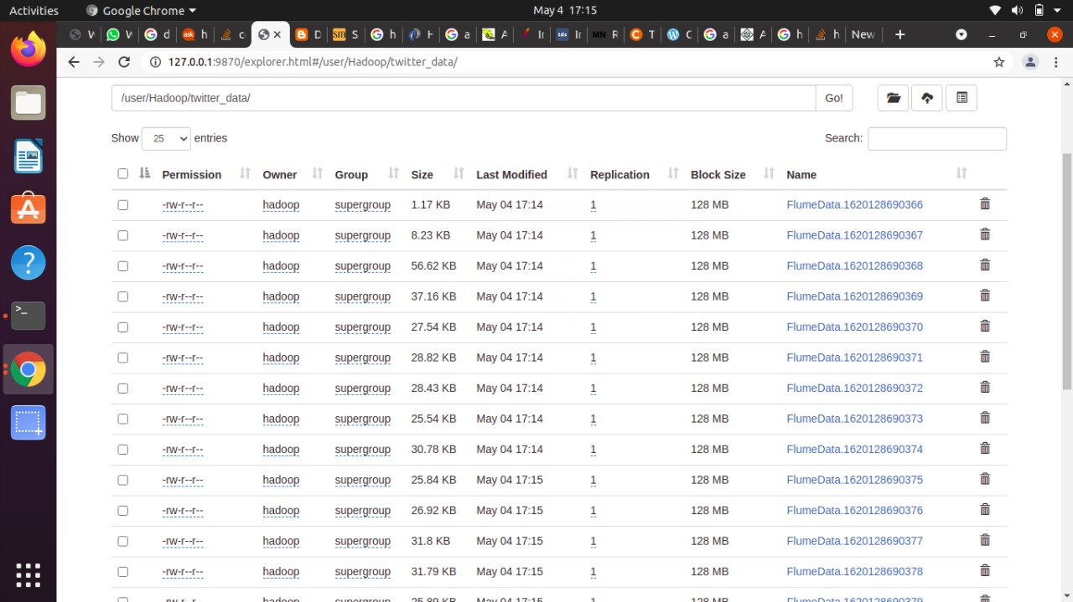
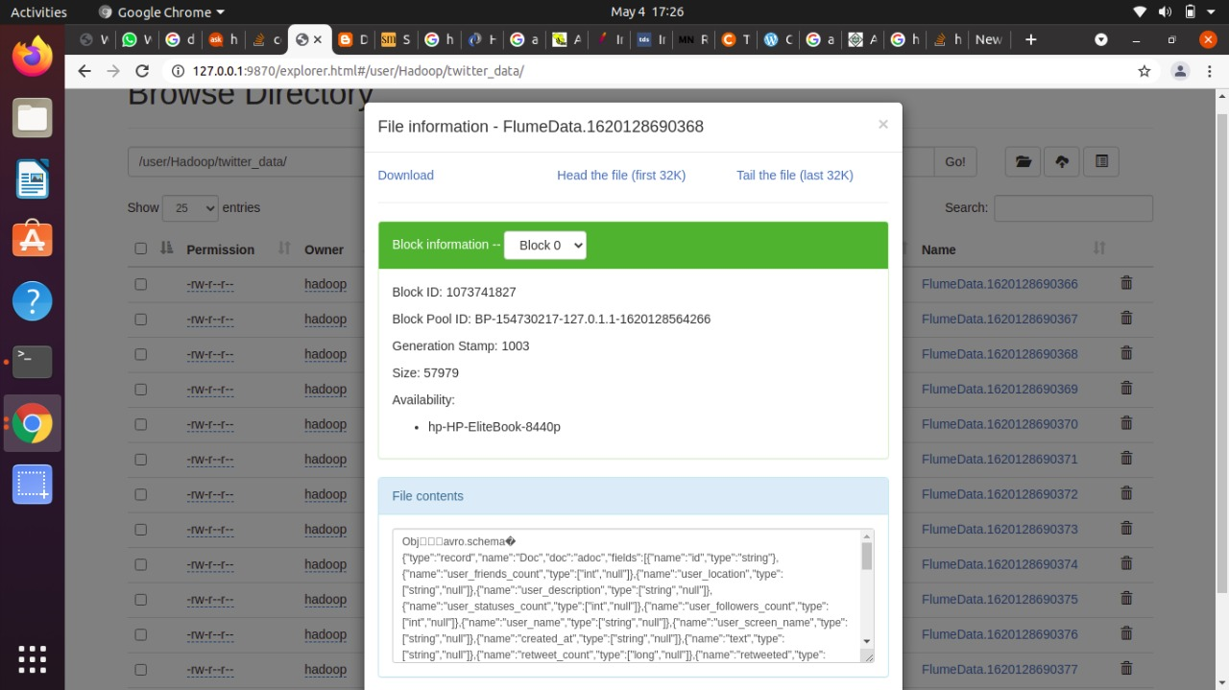
Tweets stored in Avro format using Flume on Hadoop Cluster

Slide 8
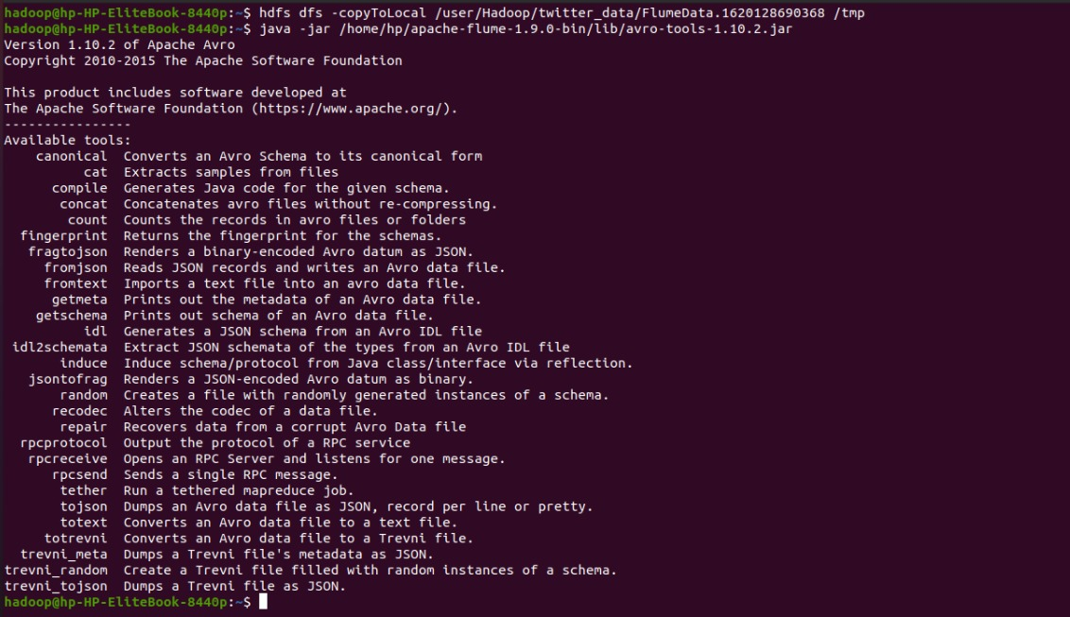
Storing Data generated using flume agent in a folder and Avro initialization

Slide 9
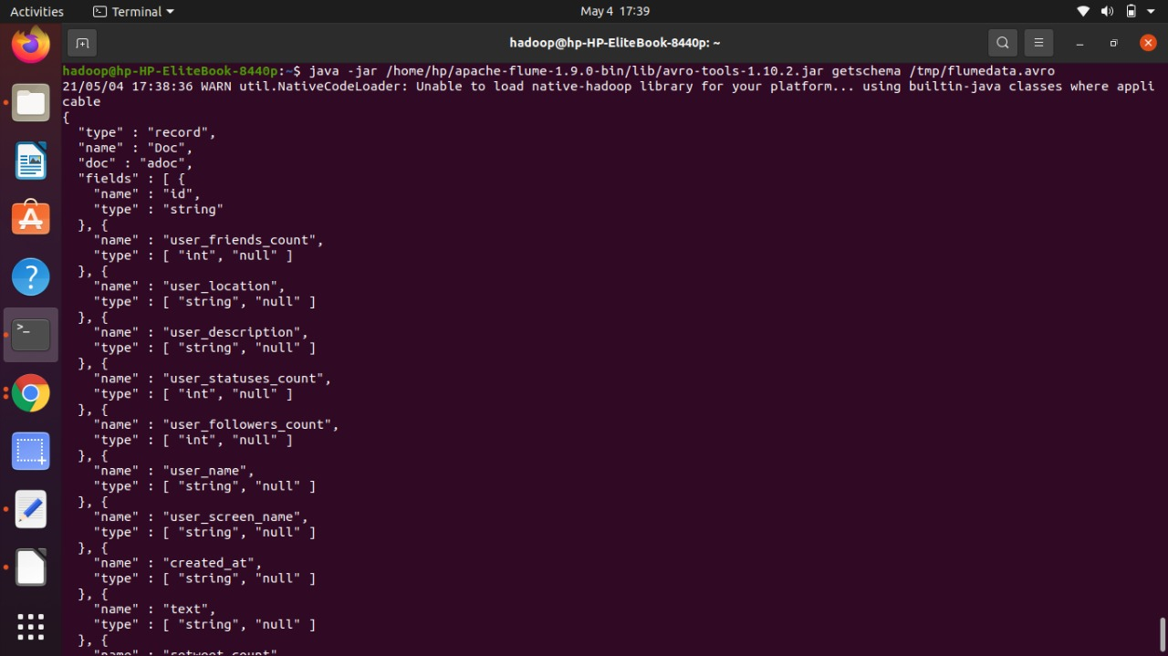
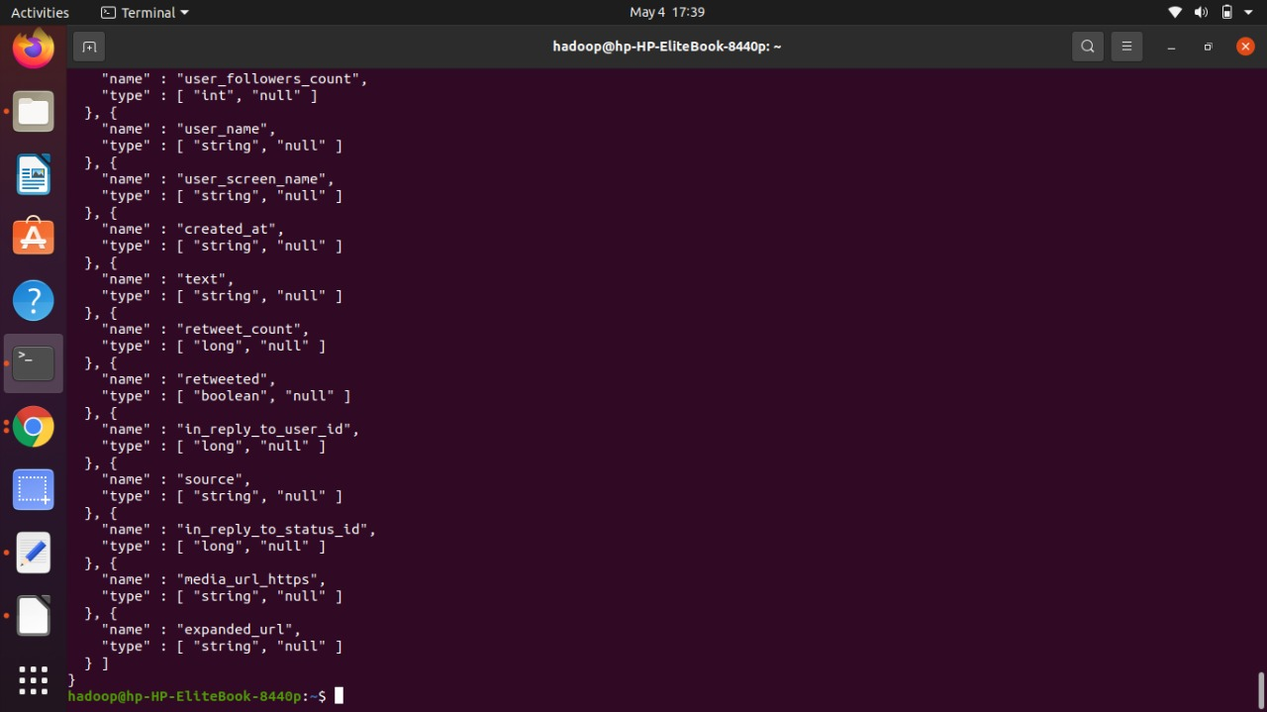
Getting Schema of Data Generated in Avro Format

Slide 10
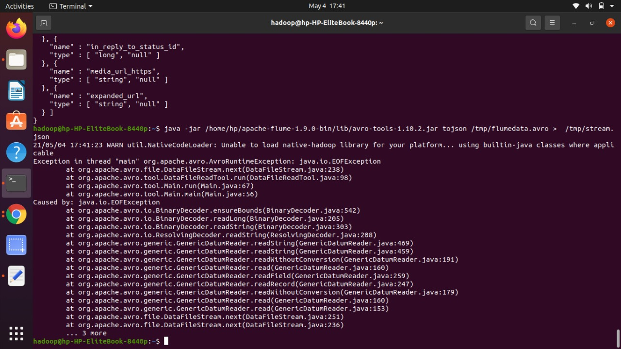
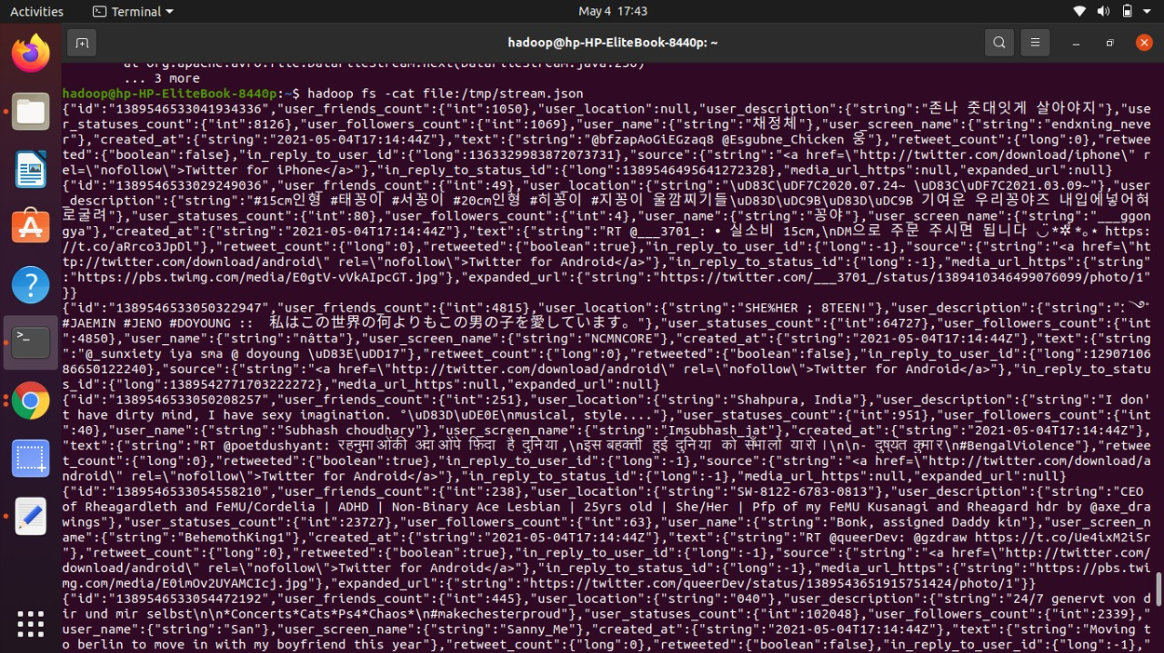
Converting Avro to JSON Data format

Slide 11
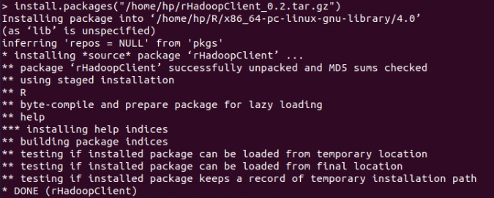
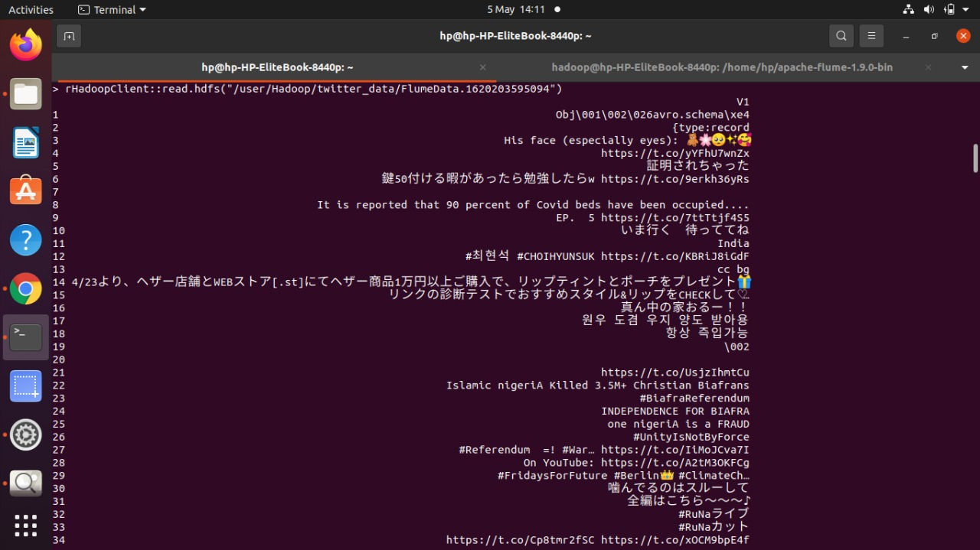
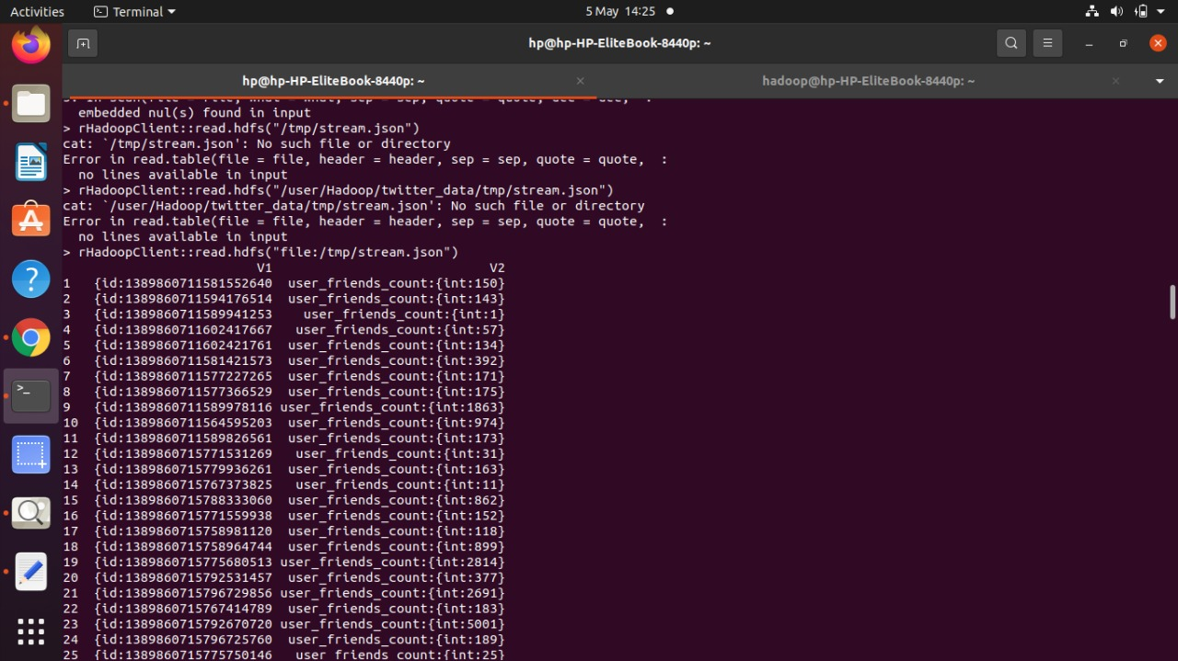
rHadoop
Avro data format read
JSON Format data read

Slide 12
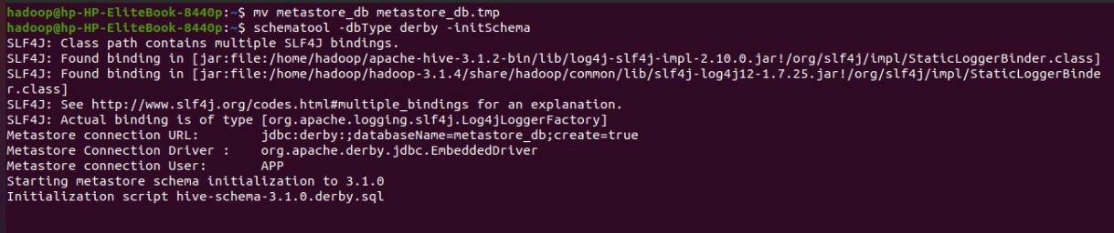
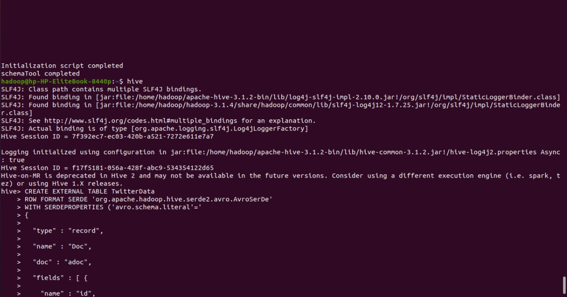
Starting Hive

Slide 13
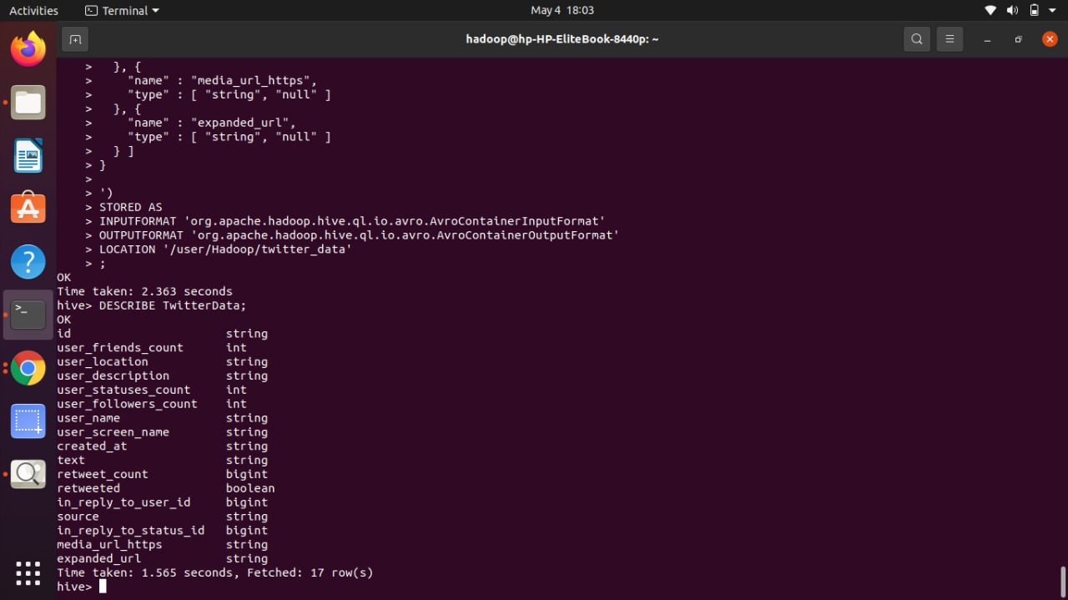
Creating and Showing Table using Twitter(Avro) Data using Hive

Slide 14


Reconnecting with R

Slide 15
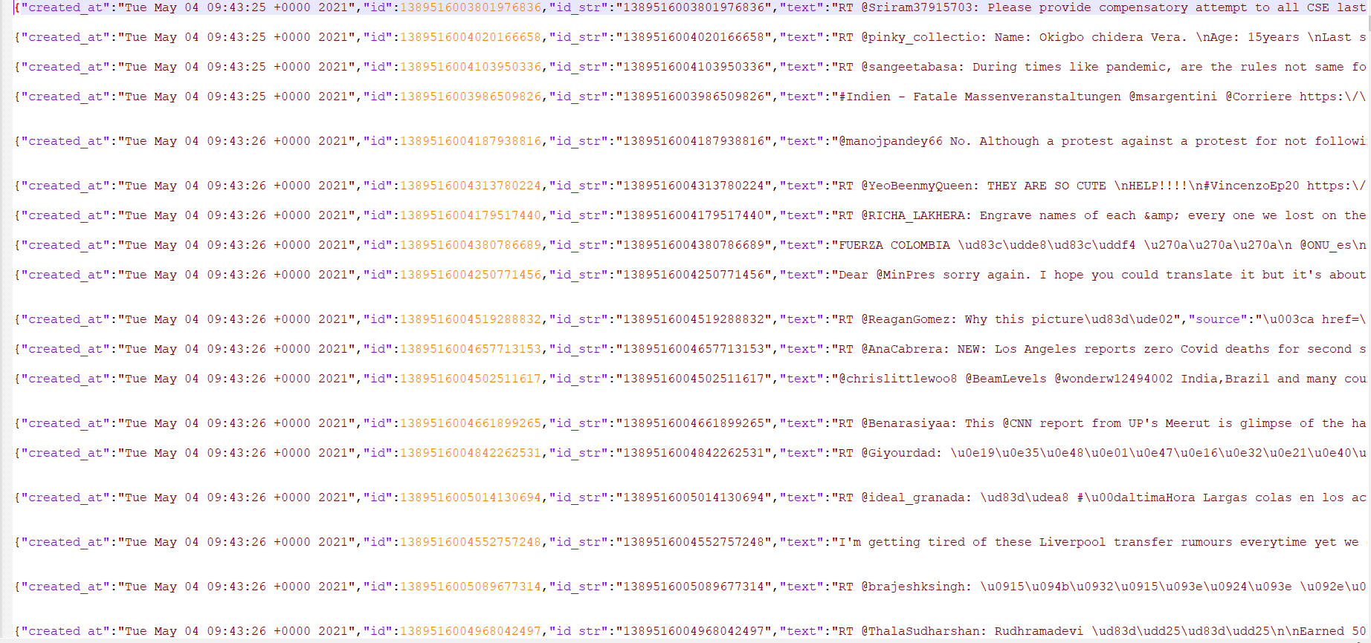
Cleaned JSON file with tweets in English Language

Slide 16
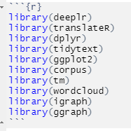
Libraries used for Data Analysis

Slide 17
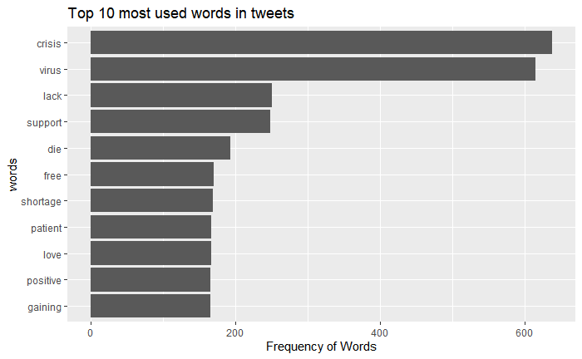
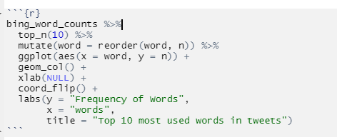

Slide 18
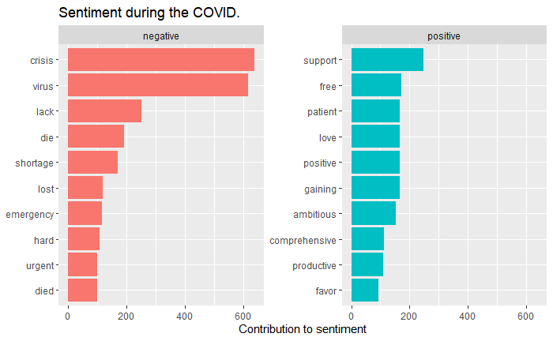

Slide 19
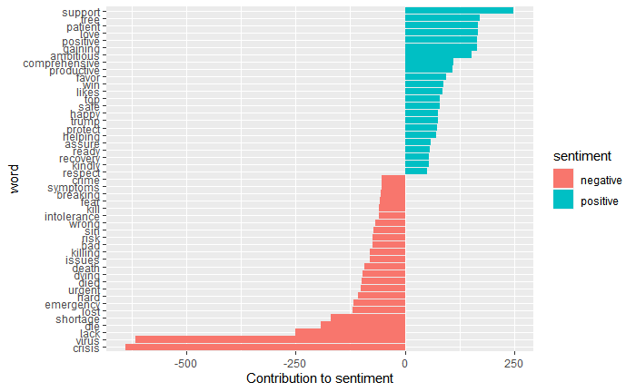

Slide 20

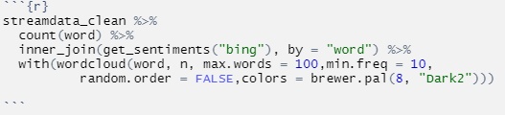

Slide 21
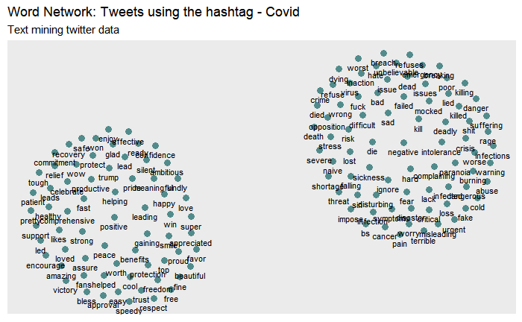

Slide 22

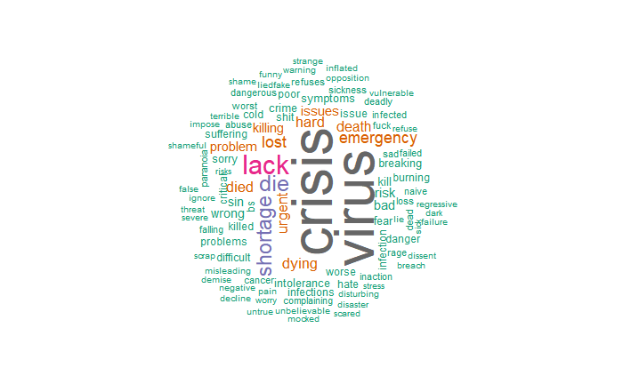

Slide 23
References
https://flume.apache.org/FlumeUserGuide.html
https://www.tutorialspoint.com/apache_flume/fetching_twitter_data.htm
https://towardsdatascience.com/apache-flume-71ed475eee6d
https://www.youtube.com/watch?v=PdY31i25SL0
https://data-flair.training/blogs/apache-hive-installation/
https://stackoverflow.com/questions/11889261/datanode-process-not-running-in-hadoop
http://dbmentors.blogspot.com/2017/06/streaming-twitter-data-using-apache.html
https://medium.com/edureka/apache-flume-tutorial-6f7150210c76
https://www.h2kinfosys.com/blog/apache-flume-tutorial/
https://www.confluent.io/blog/avro-kafka-data/#:~:text=Avro%20has%20a%20JSON%20like,in%20a%20compact%20binary%20form.&text=It%20has%20a%20direct%20mapping,inefficient%20for%20high%2Dvolume%20usage.

Slide 24
11. https://towardsdatascience.com/twitter-sentiment-analysis-and-visualization-using-r-22e1f70f6967
12. https://towardsdatascience.com/twitter-data-visualization-fb4f45b63728
13. https://codeburst.io/sentiment-analysis-of-twitter-data-359fa9f86bd6
14. https://dataaspirant.com/twitter-sentiment-analysis-using-r/
15. https://www.r-bloggers.com/2014/04/twitter-sentiment-analysis-with-r/

Slide 25

Thank You

