Slide 1
Object Oriented Programming Using
Python
Teemu Matilainen teemu.matilainen@savonia.fi

Slide 2
Lecture 2#
You realize what a class is
You are able to define a class
You realize what an object is
You are able to create instances of a class
You realize what an attribute is
You are able to create attributes into a class
You realize what a method is
Classes and objects
In object-oriented programming (OOP), classes and objects are fundamental concepts. They provide a way to structure and organize code in a more modular and reusable manner. Let's explore the concepts of classes and objects in Python.

Slide 3
Classes:
A class is a blueprint or a template (abstract: dog) for creating objects. It defines a set of attributes (data) and methods (functions) that the objects of the class will have. In Python, a class is created using the class keyword.

Slide 4

Simple class:
Now we create a simple skeleton of a class. Class does not do anything… yet.
The provided code indicates to Python that a class called Simple_class is being defined. Although the class currently lacks any functionality, we can still instantiate an object based on it.
Now, consider a program in which two variables, 'name' and 'age,' are added to a Simple_class object. Any variables associated with an object are referred to as its attributes, specifically, data attributes or, at times, instance variables.
These attributes linked to an object can be retrieved through the object

Slide 5
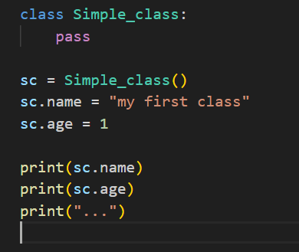

Simple Class continues:
Output:

Slide 6
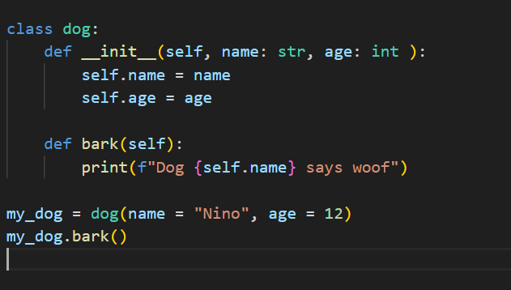
In this example:
Dog is a class with attributes name and age, and a method bark.
The init method is a special method called the constructor, which initializes the object's attributes when an instance is created.
my_dog is an instance (object) of the Dog class.

Slide 7

Create a class cat with the name and age. Cat class has a method Miau and parameter what makes the cat miau as many time as the input argument defines.
Exercise:

Slide 8
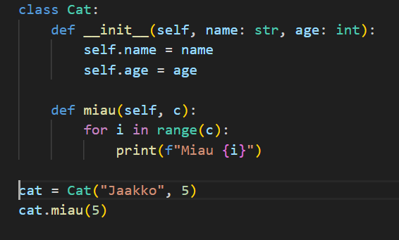
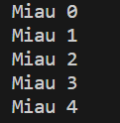
One solution:
Output

Slide 9
Objects:
An object is an instance of a class. It is a concrete realization of the class, with its own unique state (attribute values). Objects can perform actions (methods) defined by the class. In the example above, my_dog is an object of the Dog class.
In Python, an object is an instance of a class, and a class is a blueprint for creating objects. Objects can have associated methods, which are functions that are defined within the class and can operate on the object's attributes.
Methods are essentially functions that are bound to the object and can access and modify its state.

Slide 10
Instantiation:
The process of creating an object from a class is called instantiation. In the example,
my_dog = Dog(name=’Nino', age=3) is an instantiation of the Dog class.
Encapsulation:
Encapsulation is the bundling of data and methods that operate on the data within a single unit, i.e., a class. The attributes and methods of a class are encapsulated within that class, providing a way to control access and modification.
Inheritance:
Inheritance is a mechanism where a new class (subclass or derived class) can inherit attributes and methods from an existing class (base class or parent class). It promotes code reuse and extensibility.
Polymorphism:
Polymorphism allows objects of different classes to be treated as objects of a common base class. It enables flexibility and extensibility in code.
These concepts collectively form the foundation of object-oriented programming and are widely used in Python and many other programming languages.

Slide 11
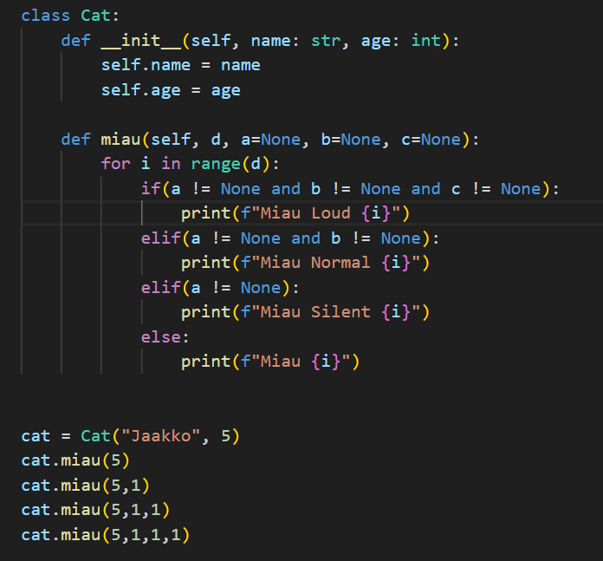
Compile-Time Polymorphism (Static Binding):
Achieved through method overloading and operator overloading.
Python does not support method overloading in the same way as some statically-typed languages like Java or C++, but you can achieve similar behavior using default argument values or variable-length argument lists.
Example of method overloading in Python (using default argument values):

Slide 12
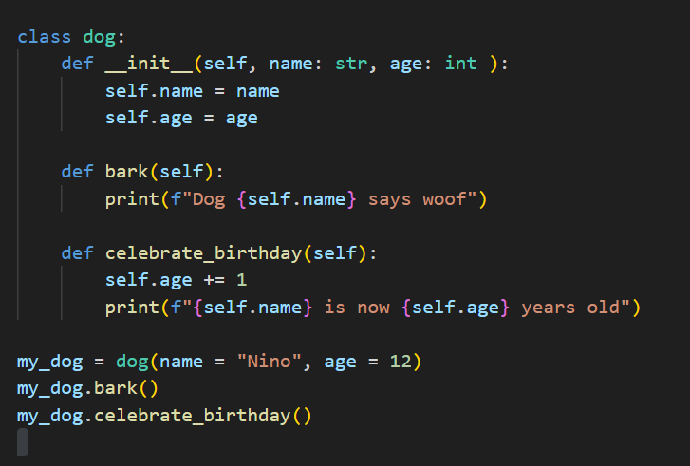
Encapsulation example:
In this example, Dog is a class with two methods: bark and celebrate_birthday. The
init method is a special method called the constructor, which is executed when a new instance of the class is created.
The bark method is a simple method that prints a message using the name
attribute of the Dog object.
The celebrate_birthday method increments the age attribute by 1 and prints a message.

Slide 13
When we create an instance of the Dog class (my_dog), we can call its methods and access its attributes. The methods operate on the object's state, and each method has access to the object's attributes through the self parameter.
Understanding objects and methods is essential in object-oriented programming, as it allows you to model and encapsulate behavior within classes, leading to more organized and modular code.

Slide 14
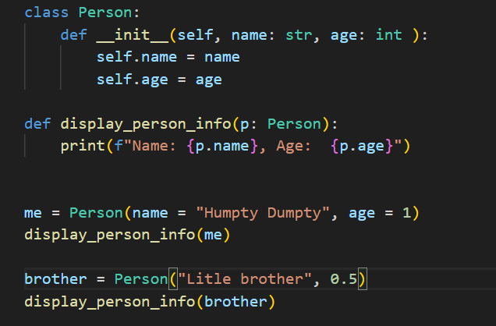

Function to Display Object Information:
Functions that work with objects in Python can interact with the attributes and methods of those objects. Here are some examples of functions that work with objects:

Slide 15
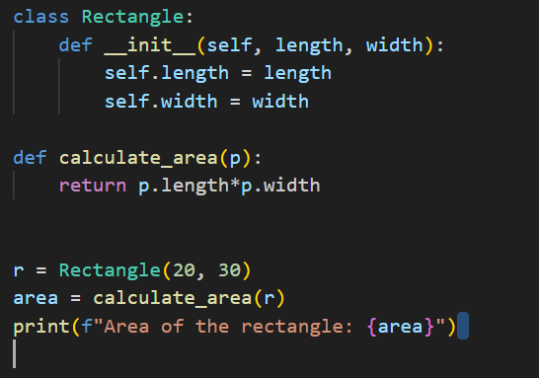
Function to Calculate Area of a Rectangle Object:

Slide 16
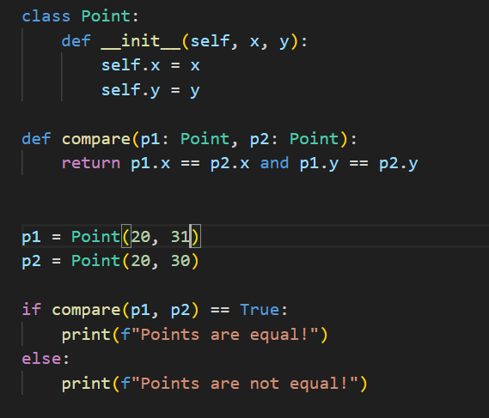
Function to Compare Objects:

Slide 17
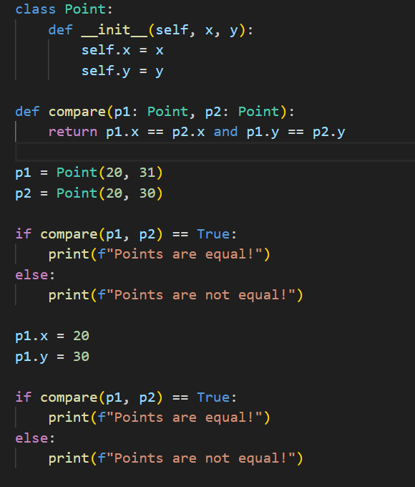
Later in the program you can still change the initial values of the data attributes:

Slide 18
These examples illustrate how functions can take objects as parameters, access their attributes, and invoke their methods to perform various actions. This is a common pattern in object-oriented programming, promoting modularity and code organization.

Slide 19
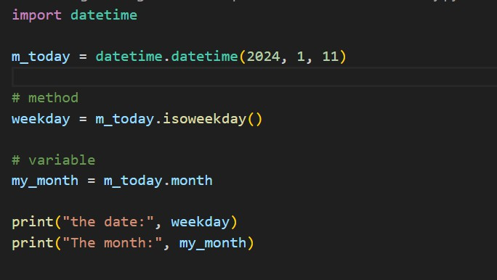
Working with an object of type e.g.
date
you may have noticed that there is a slight
difference between how the variables contained in the object are accessed, as opposed
to how the methods attached to the objects are used:

Slide 20

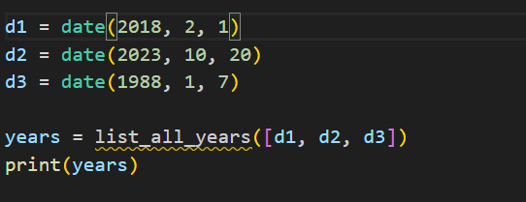
Assignment 3#:
Write a function named list_all_years(dates: list) which takes a list of date type objects as its argument. The function should return a new list, which contains the years in the original list in chronological order, from earliest to latest.
An example of the function in action:

Slide 21
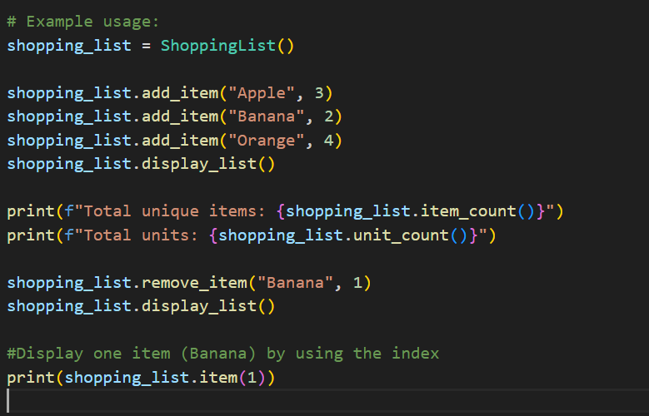
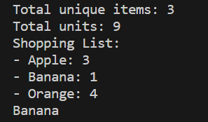
Assignment 4#:
This ShoppingList class has methods for adding items, removing items, getting the count of unique items, getting the total units, and displaying the current shopping list etc.

Slide 22
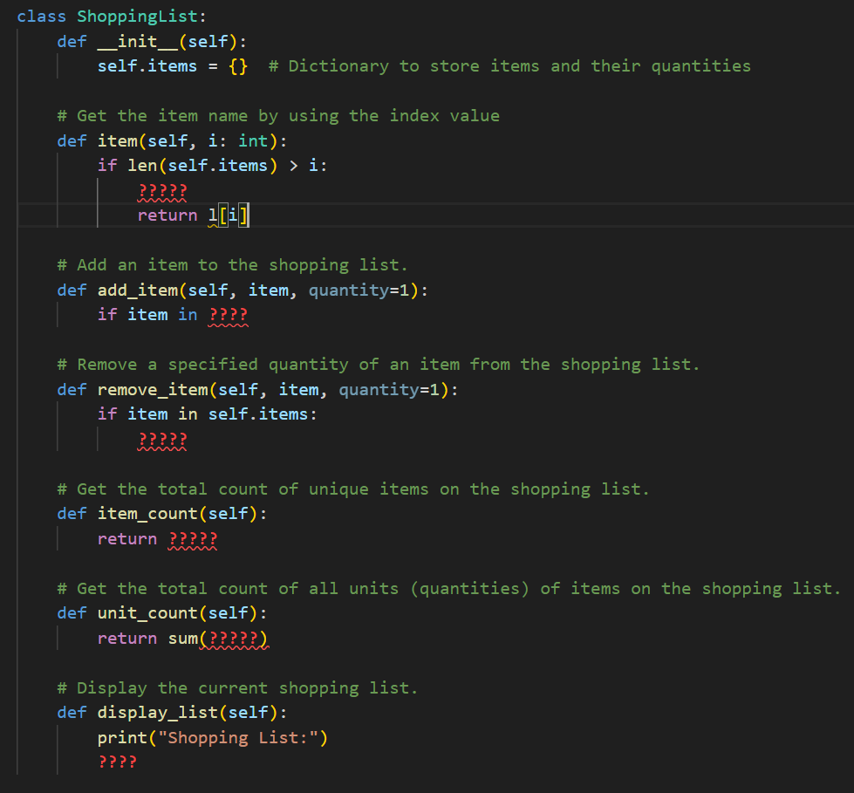
Create a ShoppingList class which has several methods item_count, add_item, unit_count etc.
Here is partially created shopping list class. Fill the gaps…

