Slide 1
Object Oriented Programming Using
Python
Teemu Matilainen teemu.matilainen@savonia.fi

Slide 2
Lecture 3#
You are able to change attributes
Youe are able to call class attributes
You are able to create a dynamic method bound to an instance of a class
You are able to create a static method
You realize what data encapsulation means
You realize what is an accessor (Getter, Setter)
You realize what is an mutator (Getter, Setter)
You realize what a mutator is used for
You realize what an accessor is used for
You realize what access control attributes are
You are able to restrict visibility of attributes
You are able to restrict visibility of methods

Slide 3
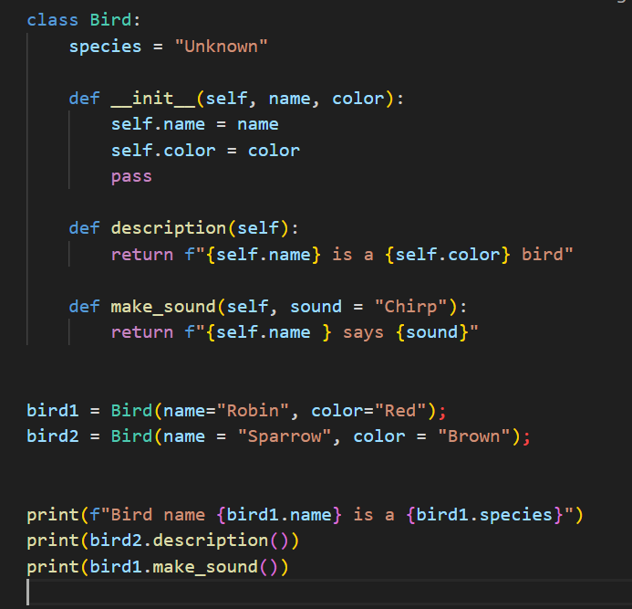
Adding a constructor:
Here's an example of a simple Bird class with the constructor:
In this example:
We define a class named Bird.
The class has a class attribute species.
The init method is used to initialize instance attributes (name and color).
There are two instance methods, description and make_sound.
We create two instances of the Bird class, bird1 and bird2, and then access their attributes and call methods.

Slide 4
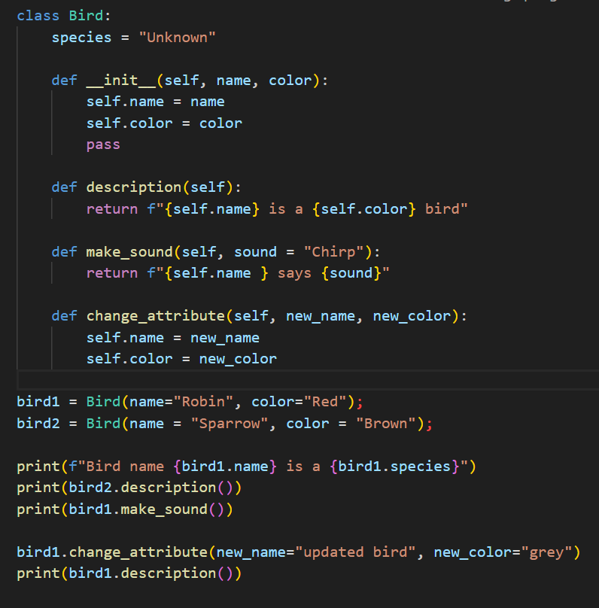
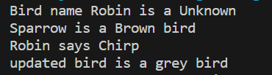
Changing initial values of the data attributes:
You can add a method to the Bird class that allows you to change the initial values of the data attributes:
In this example, I added a change_attributes method to the Bird class, which takes new values for the name and color attributes and updates them accordingly. The example then demonstrates how to use this method to change the attributes of an existing bird_instance.

Slide 5
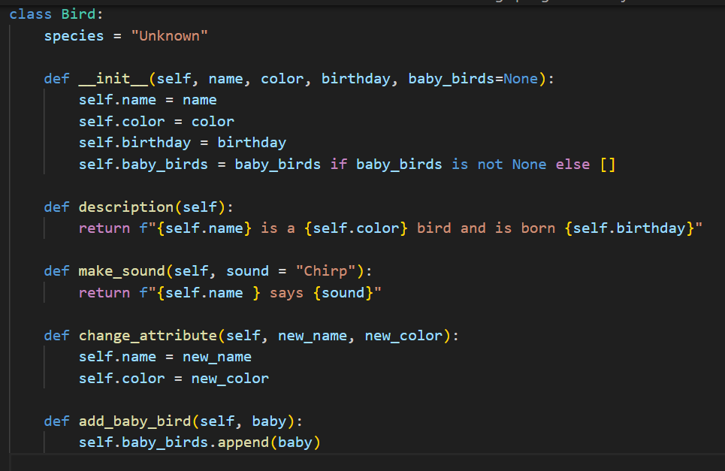
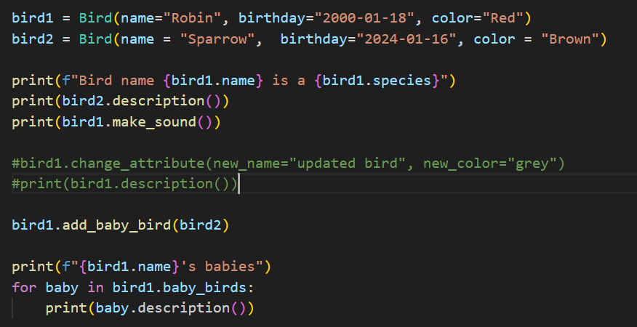
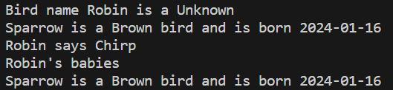
Class using different attribute types:
A Bird class with a birth date and a list of baby birds as parameters in the constructor:

Slide 6




Class attributes
In Python, you can access a class attribute from within the class by using the class name. Class attributes are shared among all instances of the class, and you can reference them using the ClassName.attribute syntax.

Slide 7
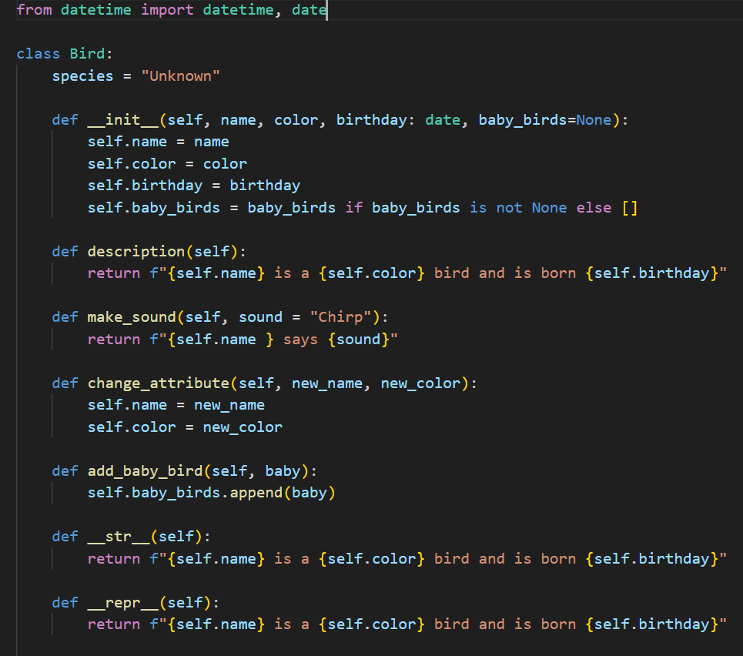
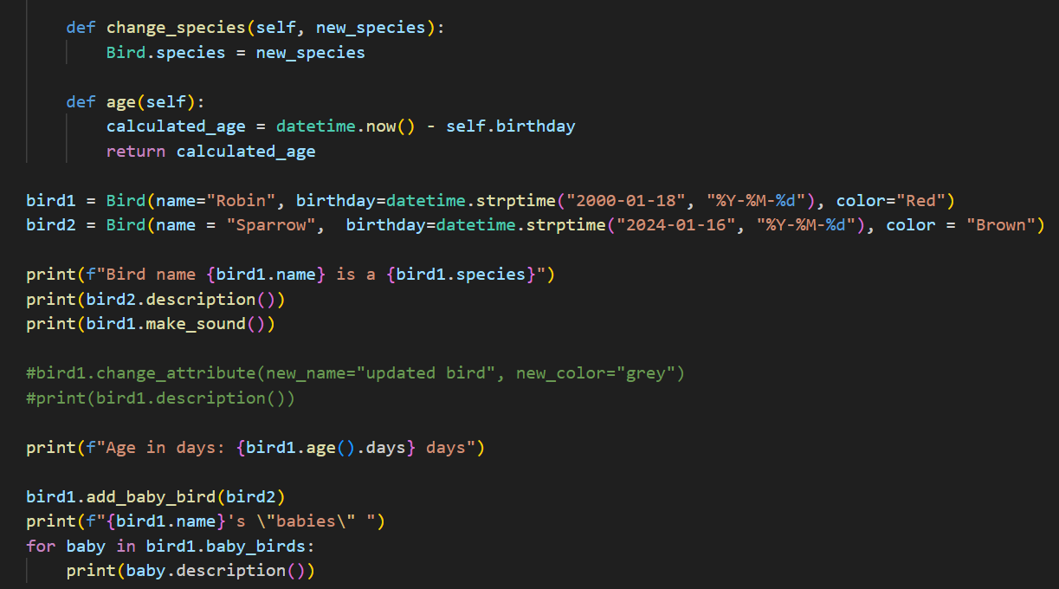
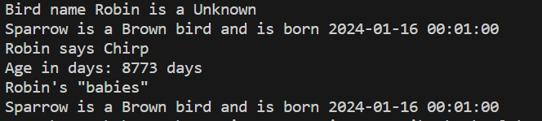
Local variables
In a Python class like Bird, you can use local variables within methods to perform computations or store temporary values

Slide 8
In this:
The Bird class now takes four parameters in the constructor: name, color, birth_date, and baby_birds. The baby_birds parameter is optional and defaults to an empty list if not provided.
The add_baby_bird method is added to add a baby bird to the list of baby birds for a parent bird.
What is the if baby_birds is not None else []??
The if baby_birds is not None else [] part in the constructor is a ternary conditional expression, also known as a ternary operator. It is a concise way to write an if-else statement in a single line. Here's how it works:

Slide 9
baby_birds if baby_birds is not None else [] checks if baby_birds is not None.
If baby_birds is not None, it evaluates to baby_birds.
If baby_birds is None, it evaluates to an empty list[]. So, in the context of the Bird class constructor:
This line sets the baby_birds attribute of the Bird instance. If a value for baby_birds is provided during the object creation (Bird(..., baby_birds=some_value)), it will be used. Otherwise, it defaults to an empty list ([]). This is a way to handle the case where baby_birds might not be provided, ensuring that self.baby_birds is always a list.

Slide 10
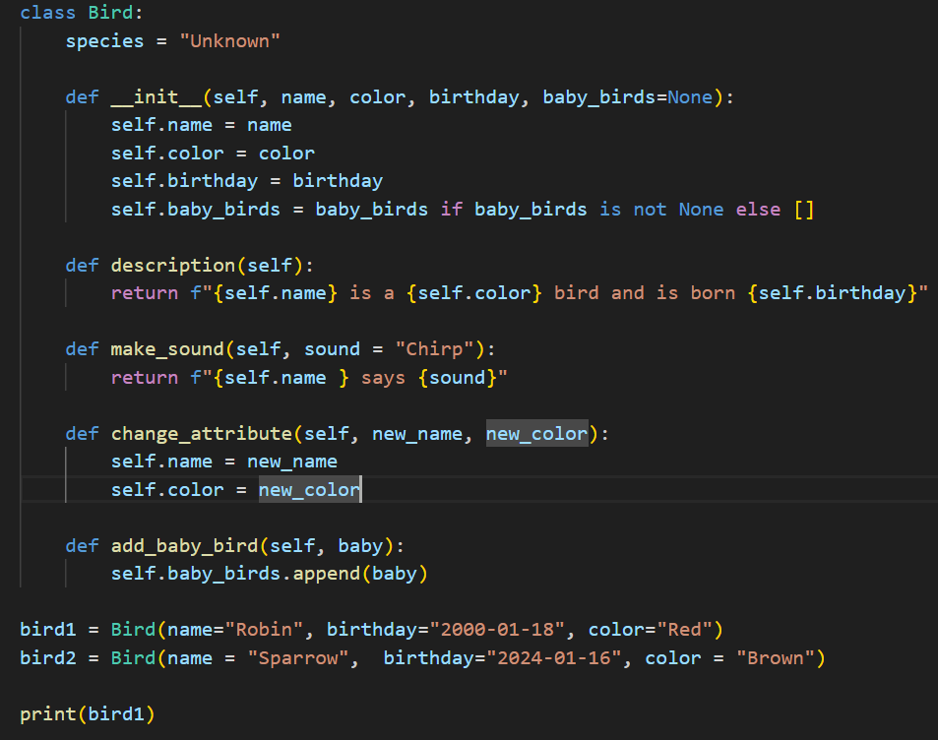
How to print an object?
When you have created a class and defined it by yourself, the default thing would be calling the print command with that object. As you can see it’s not very informative:

Slide 11
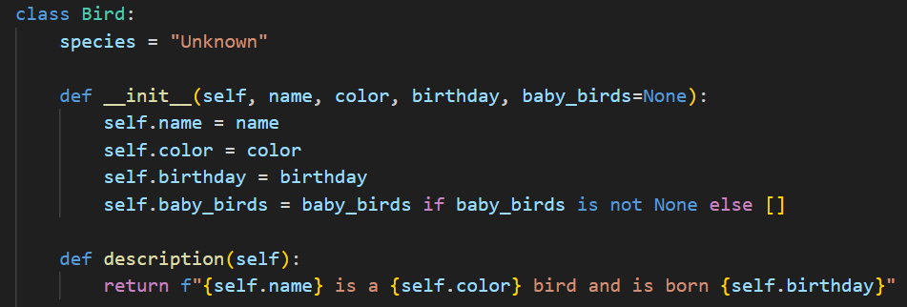
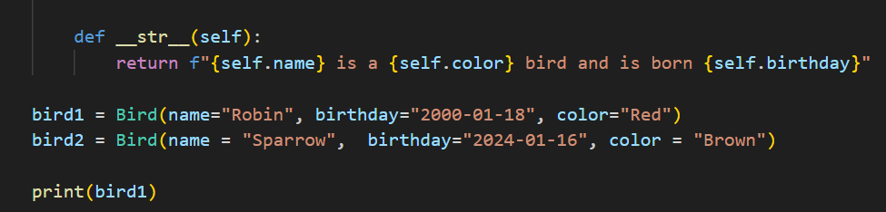

__str__ method
…
If we want to have more control over what is printed out. The easiest way to do this is to use special __str__ method to the class definition. Its purpose is to return a snapshot of the state of the object in string format!!! If the class definition contains a __str__ method, the value returned by the method is the one printed out when the print command is executed.

Slide 12
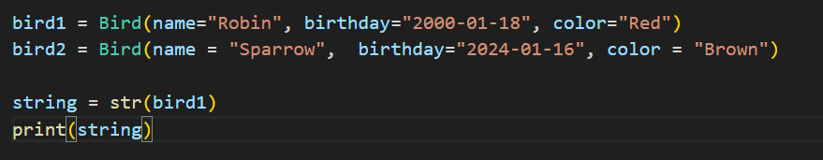
The __str__ method is more often used for formulating a string representation of the object with the str function.

Slide 13
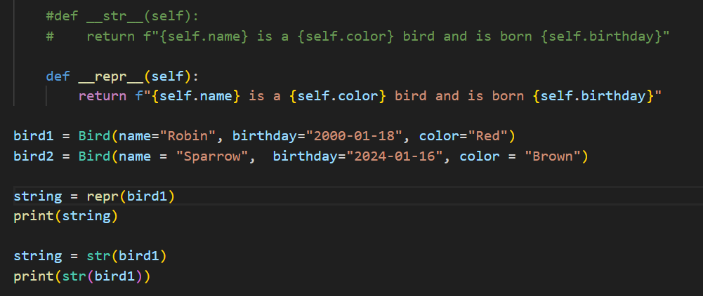

__repr__ method
There more special underscored methods which can be defined for classes. One rather similar is the __repr__ method. Its purpose is to provide a technical representation of the state of the object.
Note: Run the code in a Debugging mode and test the software without __str__ method!!!

Slide 14
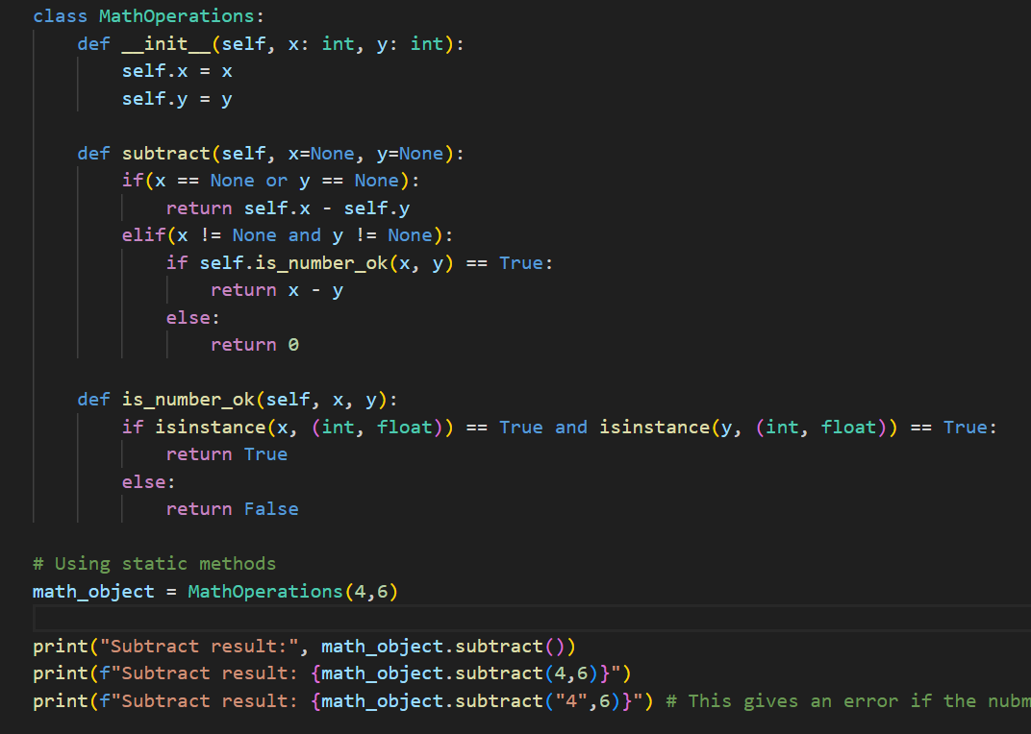
Helper methods
The class definition for MathOperations contains separate validator methods which ascertain that the arguments passed are valid.

Slide 15
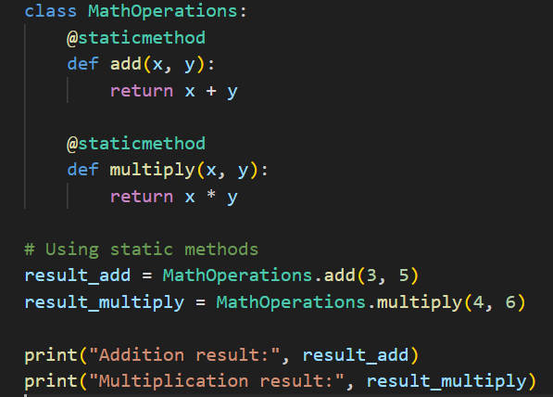
Static methods
Static method is a method that belongs to a class rather than an instance of the class. It is defined using the @staticmethod decorator and does not have access to the instance or its attributes. Static methods are similar to class methods, but they do not receive the class itself as the first parameter.

Slide 16
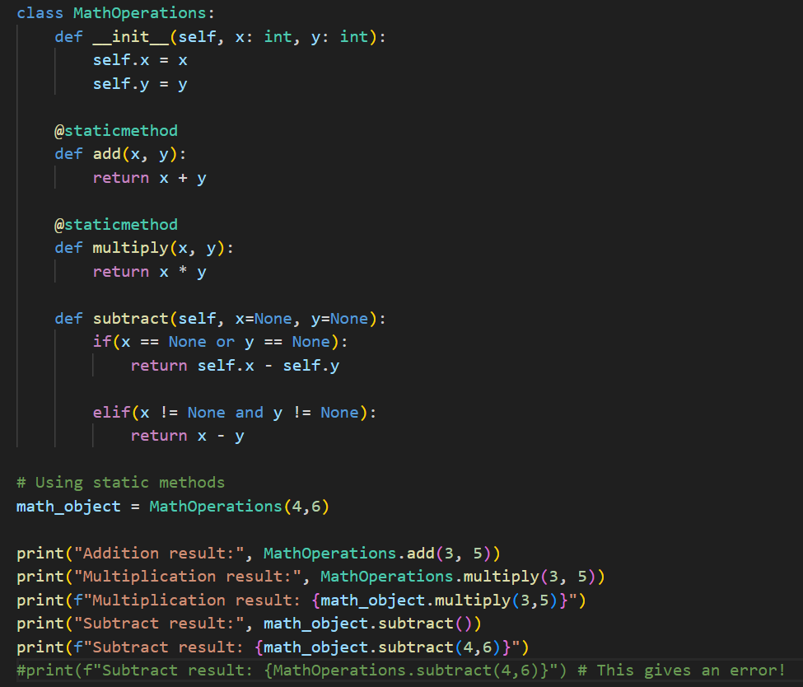
Key characteristics of static methods:
They do not have access to the instance (self) or its attributes.
They do not have access to the class itself (cls) as the first parameter (unlike class methods).
They are defined using the @staticmethod decorator.
They are called on the class rather than an instance of the class.
Static methods are useful when a method is related to the class but does not require access to instance-specific data. They are often used for utility functions that are related to the class but don't involve manipulating instance attributes.
Yetunde

Slide 17
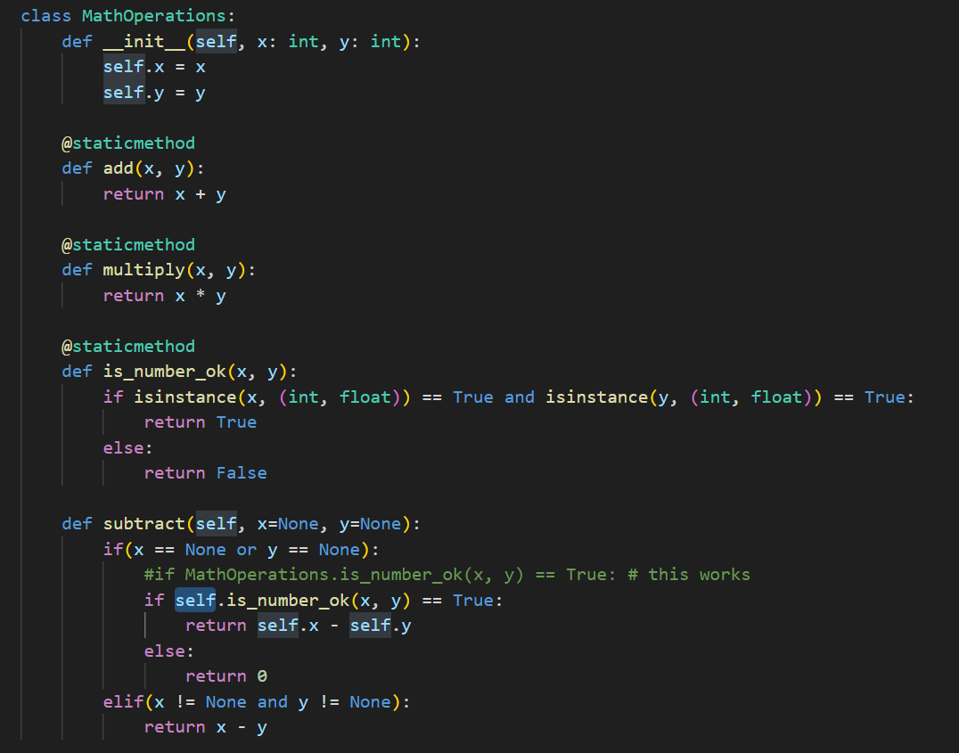

Slide 18
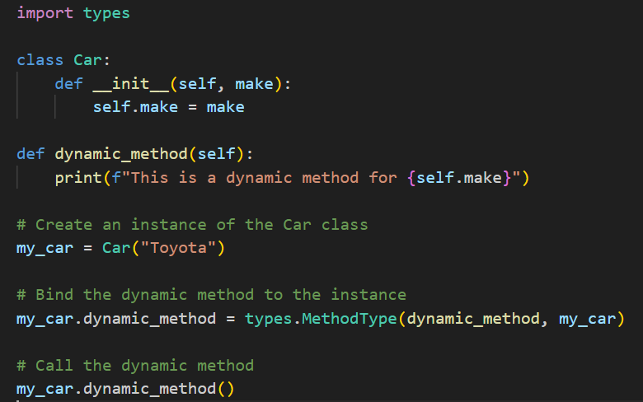
Creating a dynamic method bound to an instance of a class
How to create a dynamic method bound to an instance of a class by using the types module, specifically the types.MethodType class. This allows you to dynamically add a method to an instance of a class at runtime.

Slide 19
Data encapsulation
Data encapsulation is one of the fundamental principles of object-oriented programming (OOP) and refers to the bundling of data (attributes) and methods (functions) that operate on that data into a single unit known as a class. Encapsulation helps in hiding the internal state of an object and restricting direct access to it from outside the class. The primary goals of encapsulation are data protection, code organization, and promoting a clean interface.

Slide 20
Here are key concepts related to data encapsulation:
Attributes (Data Members): These are the variables that store the state of an object. They are typically declared as private or protected within the class to restrict direct access from outside.
Methods (Member Functions): These are functions that operate on the attributes of the class. Methods are used to perform operations, modify the state of the object, or provide information about the object. They are defined within the class and can access the private attributes.
Access Modifiers: In many programming languages (including Python, Java, and C++), access modifiers such as public, private, and protected are used to control the visibility of attributes and methods. For encapsulation, it's common to make attributes private (accessible only within the class) and provide public methods to interact with them.
Getters and Setters: These are methods that are used to access (get) or modify (set) the values of private attributes. By using getters and setters, you can control how the data is accessed and modified, enforcing validation or business rules if needed.

Slide 21
In object-oriented programming, access modifiers determine the visibility of class members (attributes and methods) from outside the class. There are typically three main access modifiers: public, private, and protected. Here's a brief overview of each:
Public:
Members declared as public are accessible from anywhere, both within the class and from external code. There are no restrictions on accessing public members.
Private:
Members declared as private are only accessible from within the same class. External code cannot directly access or modify private members.
Protected:
Members declared as protected are accessible within the same class and its subclasses (derived classes or child classes). External code, which is not a subclass, typically cannot access or modify protected members.

Slide 22
In Python, the access modifiers public, private, and protected are conventions rather than strict rules, as Python is a language that emphasizes readability and simplicity. The convention is to use a single underscore _ to indicate a protected member, and a double underscore __ to indicate a private member.
It's important to note that Python does not enforce strict encapsulation or access control like some other languages. The use of a single underscore (_) is a convention to indicate that a variable or method should be treated as protected, and developers are expected to follow this convention. However, external code can still access protected members if needed. Private members (those with double underscores (__) are name-mangled to make them less accessible from outside the class, but they are not entirely inaccessible.

Slide 23
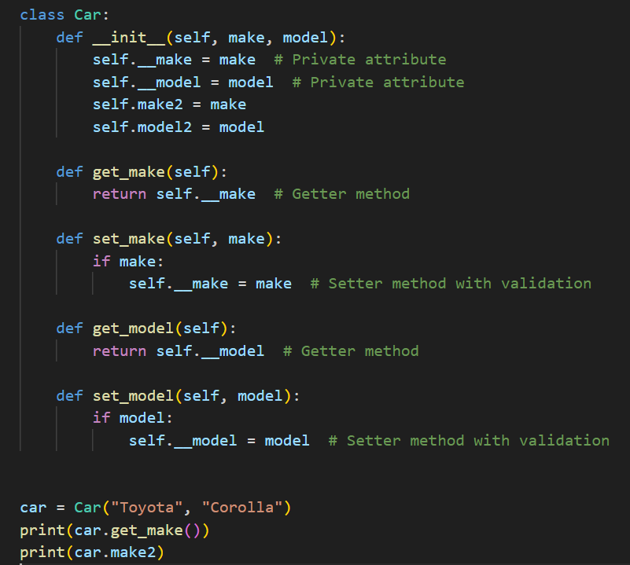

Here's a modified version of the Car class example with private attributes:

Slide 24
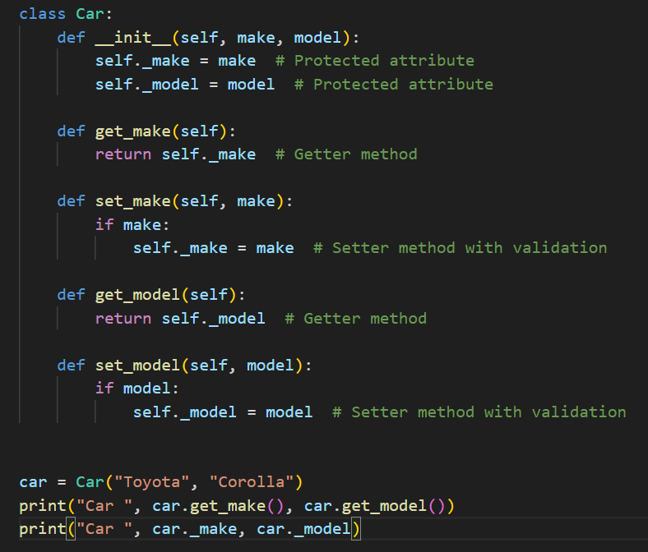

Here's a modified version of the Car class example with protected attributes:

Slide 25
Visibility of methods
It is controlled using the same conventions as attributes. There are no explicit access modifiers like public, private, or protected as in some other programming languages. Instead, Python relies on naming conventions to indicate the intended visibility of methods:
Public Methods:
Methods without any special naming convention are considered public and can be accessed from anywhere.
Example: def public_method(self):
Protected Methods:
Methods intended to be protected are prefixed with a single underscore _.
Example: def _protected_method(self):
Private Methods:
Methods intended to be private are prefixed with a double underscore __.
Example: def __private_method(self):

Slide 26
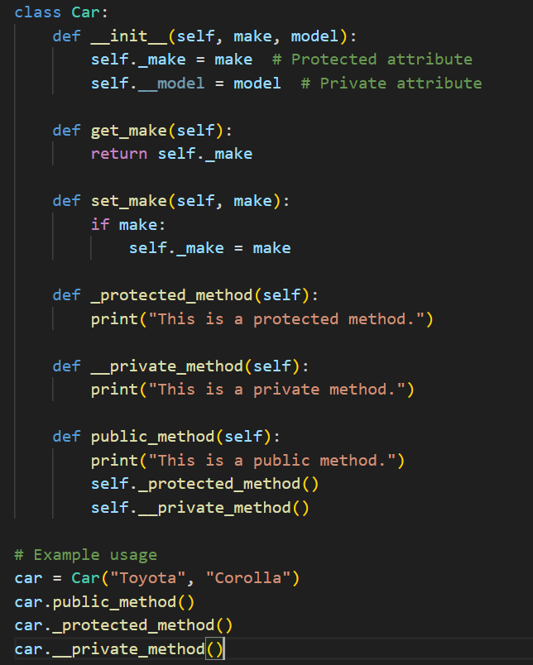

Just like with attributes, these conventions are not enforced by the Python interpreter, and they are more about signaling the intended use of the methods to other developers. It's still possible to call "protected" and "private" methods from outside the class.

Slide 27
The concept of a "mutator" method is not explicitly defined or recognized as a standard term. However, a mutator, in the context of object-oriented programming, is often associated with methods that modify the state of an object. These methods are sometimes referred to as setter methods.
A setter method, or mutator method, is responsible for modifying the value of an attribute. It provides a controlled way to update the internal state of an object. In Python, you can use a setter method to implement mutator functionality.

Slide 28
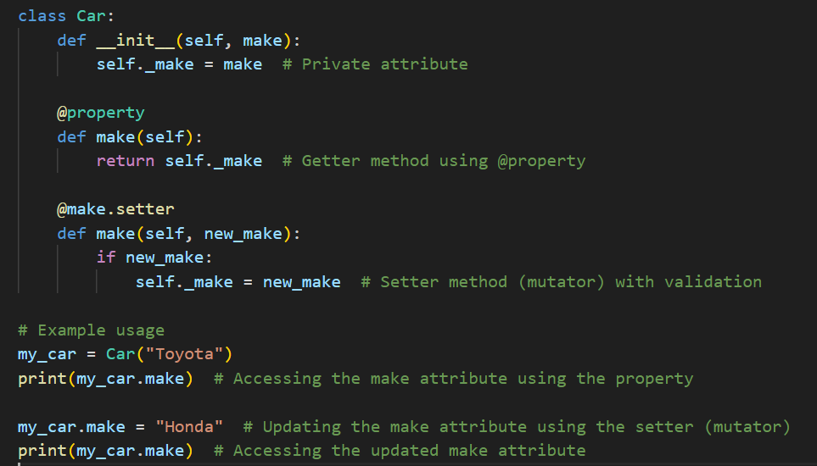

In this example:
The @property decorator is used for the make method, indicating that it is a property (getter).
The @make.setter decorator is used to define a setter method for the make property.
The make property can be accessed and modified like an attribute, providing a clean interface for both getting and setting the attribute value.

Slide 29
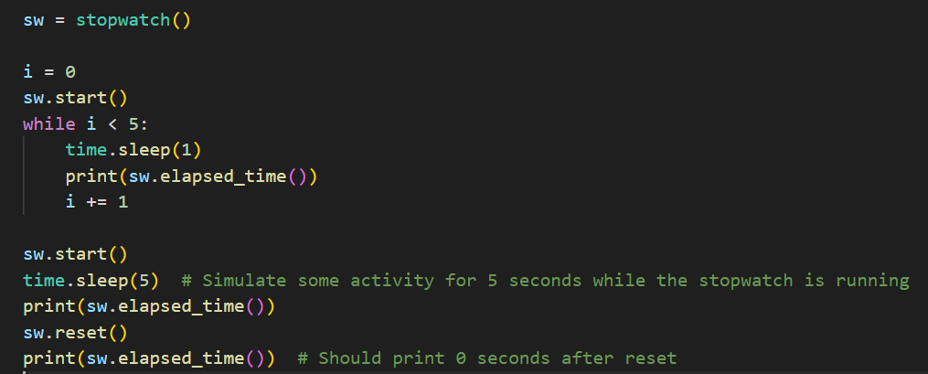
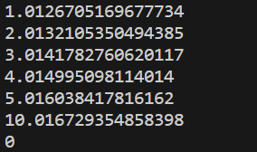
Assignment 5#
Implement a stopwatch class to represent a simple stopwatch that can measure elapsed time. Define all the attributes as a private. Test your code also with static methods!
The class should have the following methods:
__init__(self)
Initializes the stopwatch with an initial state.
start(self)
Starts the stopwatch. If the stopwatch is already running, do nothing.
stop(self)
Stops the stopwatch. If the stopwatch is not running, do nothing.
reset(self)
Resets the stopwatch to its initial state.
elapsed_time(self)
Returns the elapsed time in seconds. If the stopwatch is running, it should return the time elapsed up to the current moment. If the stopwatch is stopped or reset, it should return the total elapsed time.
Output example:

