Slide 1
Object Oriented Programming Using
Python
Teemu Matilainen teemu.matilainen@savonia.fi

Slide 2
Lecture 5#
You realize operator overloading
You realize what are objects as attributes
You understand the use of Class methods

Slide 3
Python Special Functions
Class functions that begin with double underscore __ are called special functions in Python.
Function Description
__init__() initialize the attributes of the object
__str__() returns a string representation of the object
__len__() returns the length of the object
__add__() adds two objects
__call__() call objects of the class like a normal function

Slide 4
Python Special Functions
Similarly, we can overload other operators as well. The special function that we need to implement is tabulated below.
Reference: https://www.programiz.com/python-programming/operator-overloading
Operator Expression Internally
Addition p1 + p2 p1.__add__(p2)
Subtraction p1 - p2 p1.__sub__(p2)
Multiplication p1 * p2 p1.__mul__(p2)
Power p1 ** p2 p1.__pow__(p2)
Division p1 / p2 p1.__truediv__(p2)
Floor Division p1 // p2 p1.__floordiv__(p2)
Remainder (modulo) p1 % p2 p1.__mod__(p2)
Bitwise Left Shift p1 << p2 p1.__lshift__(p2)
Bitwise Right Shift p1 >> p2 p1.__rshift__(p2)
Bitwise AND p1 & p2 p1.__and__(p2)
Bitwise OR p1 | p2 p1.__or__(p2)
Bitwise XOR p1 ^ p2 p1.__xor__(p2)
Bitwise NOT ~p1 p1.__invert__()

Slide 5
Python Special Functions…
Similarly, the special functions that we need to implement, to overload other comparison operators are tabulated below.
Reference: https://www.programiz.com/python-programming/operator-overloading
Operator Expression Internally
Less than p1 < p2 p1.__lt__(p2)
Less than or equal to p1 <= p2 p1.__le__(p2)
Equal to p1 == p2 p1.__eq__(p2)
Not equal to p 1 != p2 p1.__ne__(p2)
Greater than p1 > p2 p1.__gt__(p2)
Greater than or equal to p1 >= p2 p1.__ge__(p2)

Slide 6
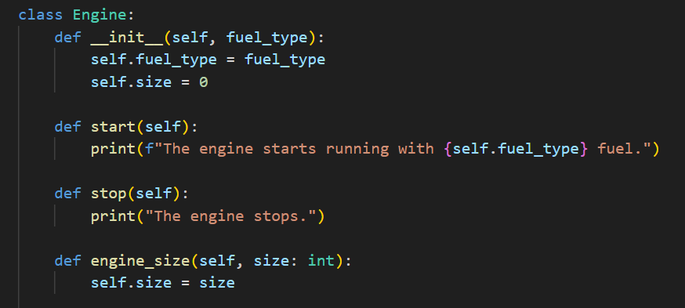
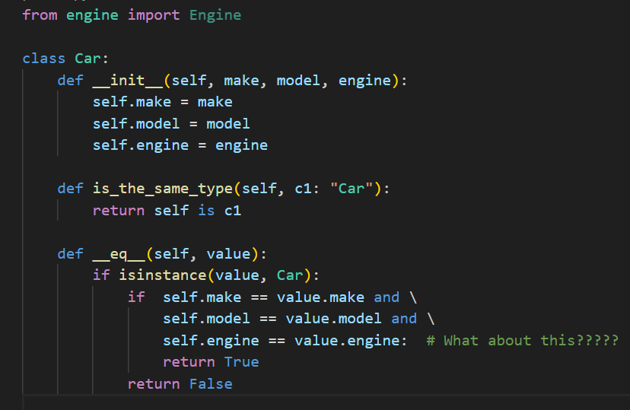
How to implement the operator

Slide 7
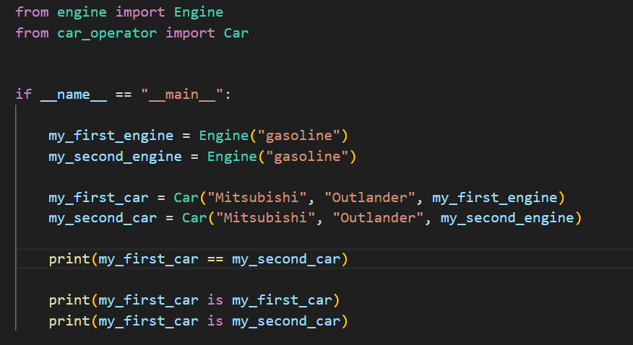

How to implement the operator…

Slide 8
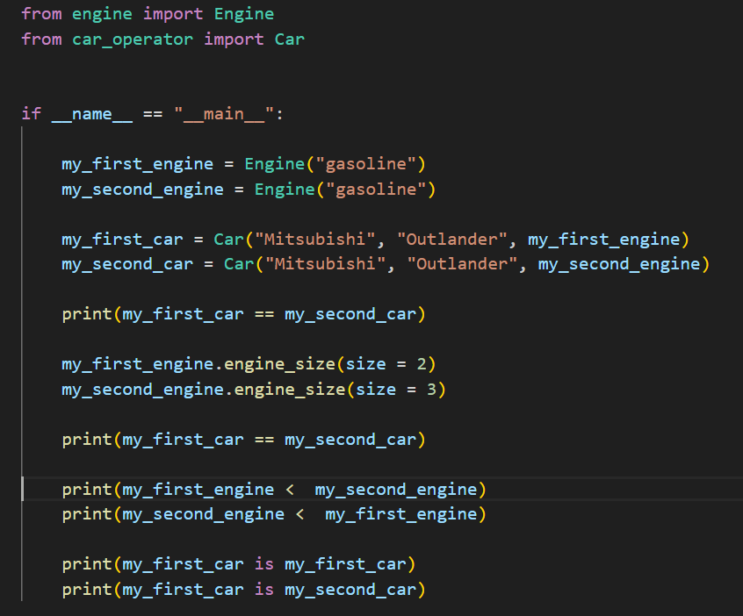

How to implement the operator…

Slide 9
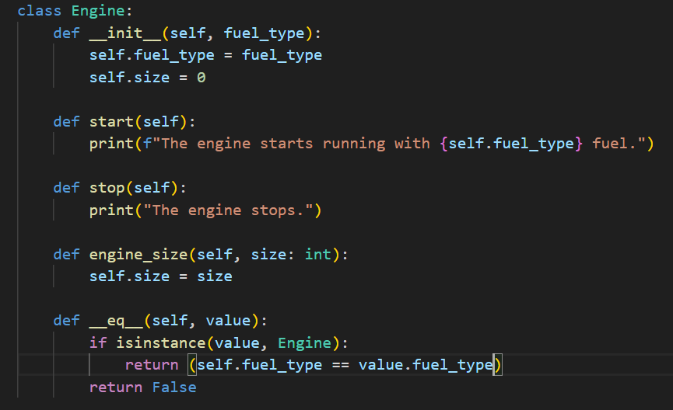
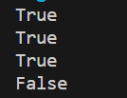
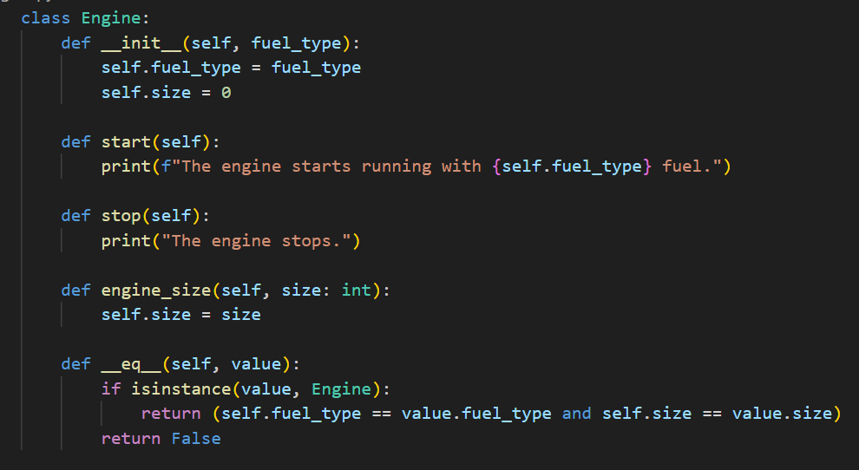
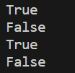
How to implement the operator… Let’s add __eq__ to Engine class.

Slide 10
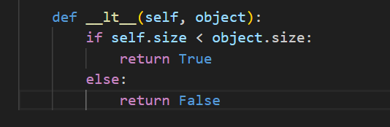
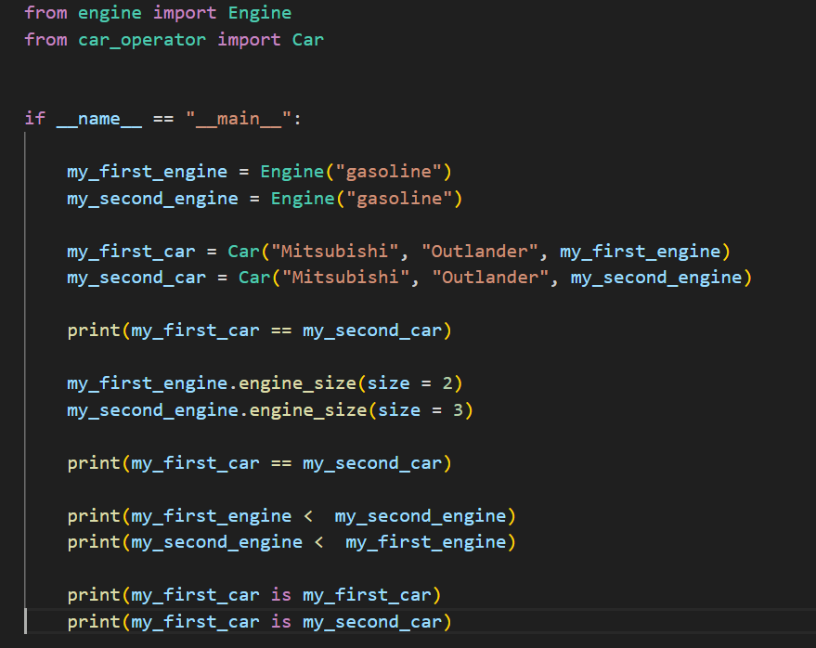
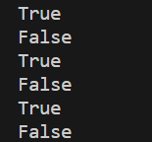
One more operator example…

Slide 11
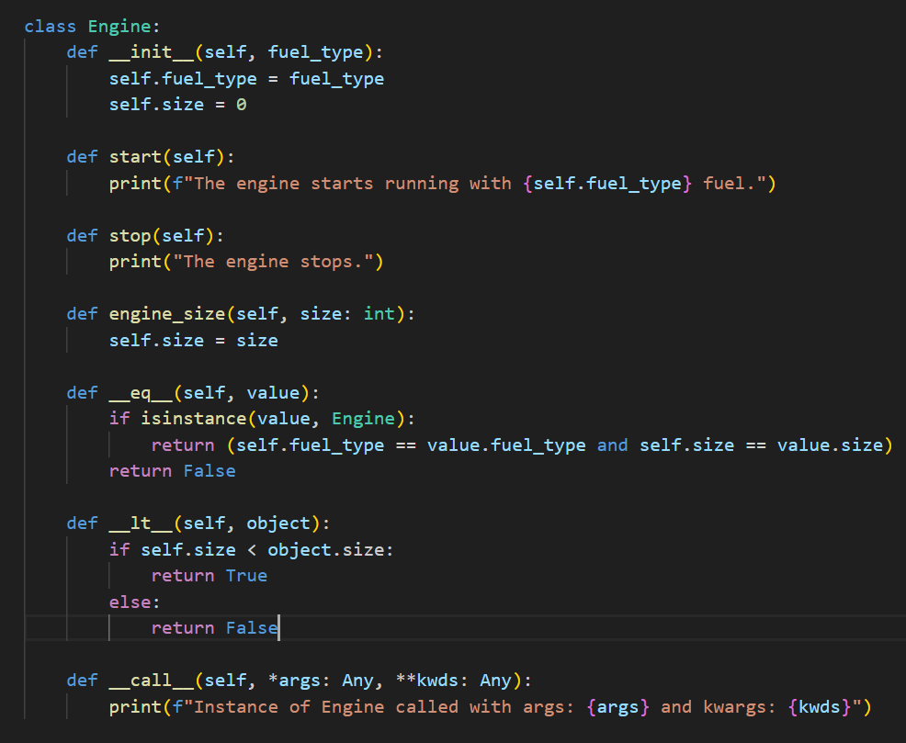
What is a __call__ operator?

Slide 12
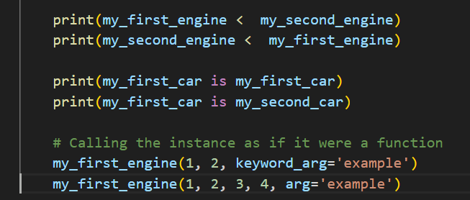
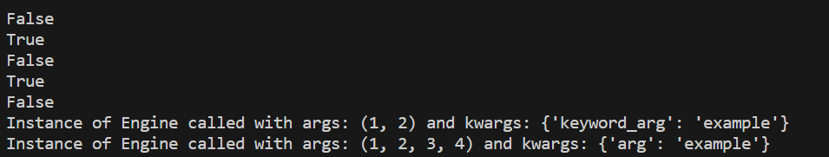
What is a __call__ operator?
This can be useful in situations where you want instances of your class to be callable, providing a more function-like behavior for objects.

Slide 13
Benefits of Operator Overloading:
Operator overloading offers several advantages, including:
Enhanced Code Readability:
It enhances code readability by enabling the utilization of familiar operators, contributing to a more intuitive understanding of the code.
Consistent Object Behavior:
Ensures that instances of a class behave consistently with both built-in types and other user-defined types, promoting a uniform and predictable experience.
Simplified Code Writing:
Streamlines code writing, particularly for intricate data types, making the codebase more straightforward and easier to comprehend.
Code Reusability:
Facilitates code reuse through the implementation of a single operator method, which can be employed for multiple operators, promoting efficiency in development.

Slide 14
Objects as attributes
We've previously explored instances of classes with lists as attributes. Since there are no restrictions preventing us from incorporating mutable objects as attributes in our classes, we can seamlessly employ instances of our own classes as attributes within other classes we've created. In the upcoming examples, we'll introduce the Book, Member, and BorrowedBook classes. The BorrowedBook class utilizes the first two classes. The class definitions are intentionally brief and straightforward to emphasize the practice of utilizing instances of our own classes as attributes.

Slide 15
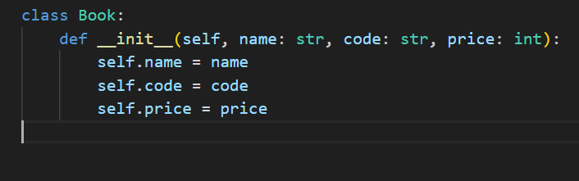
Let’s define the class Book in a file named book.py:

Slide 16
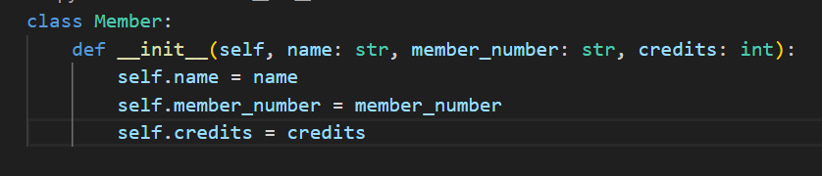
Next, the class Member

Slide 17
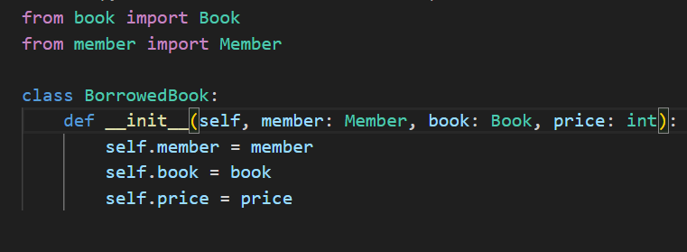
Finally, we create the class BorrowedBook. This class uses the other two classes, they have to be imported before they can be used:

Slide 18
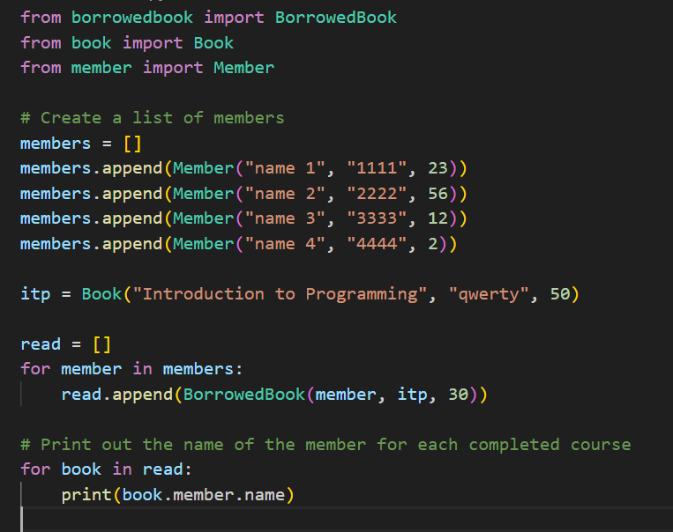
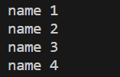
Here is an example of a main function which will add some borrowed books to a list:

Slide 19
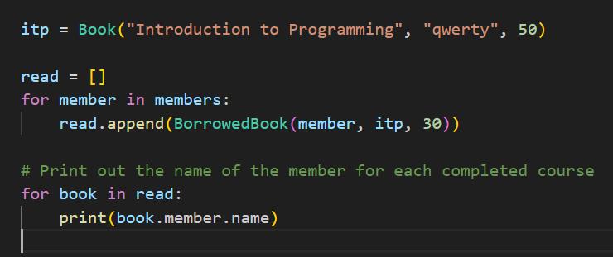
What does these dots mean in a print(book.member.name)? - book is an instance of the class BorrowedBook - member refers to an attribute of the BorrowedBook object, which is an object of type Member - the attribute name in the Member object contains the name of the member

Slide 20
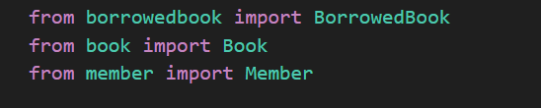
When do we need import statement?
An import statement is only necessary when using code which is defined outside the current file (or Python interpreter session). This includes situations where we want to use something defined in the Python standard library.

Slide 21
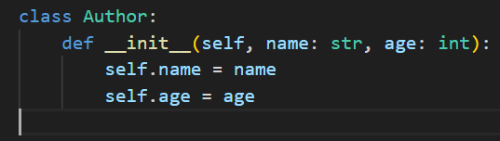
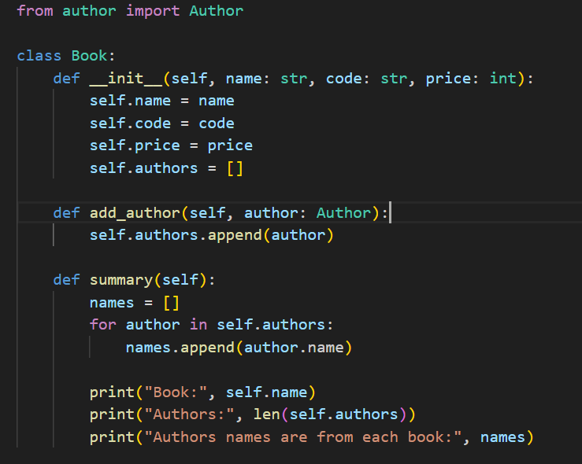
A list of objects as an attribute of an object???
Create an Author class
Now we add new methods to a Book class and then we will use the created Author class

Slide 22
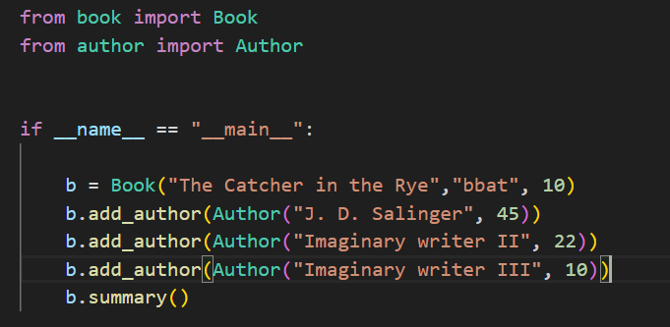
An example of our class in action:

Slide 23
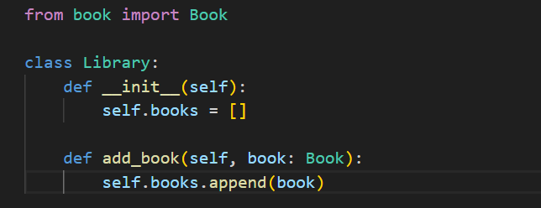
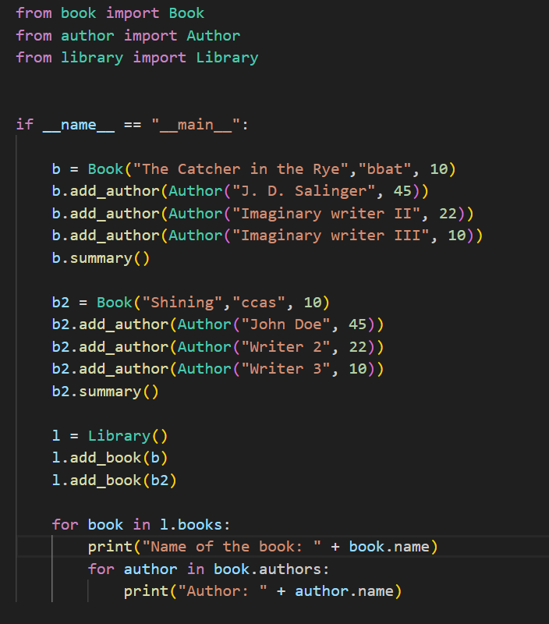
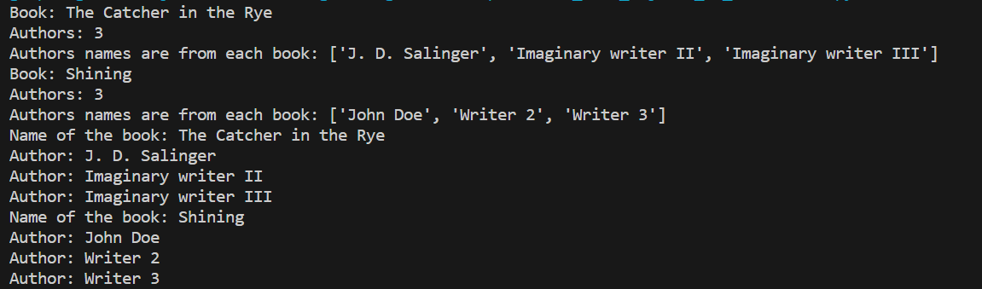
Using nested loops and nested object lists…

Slide 24
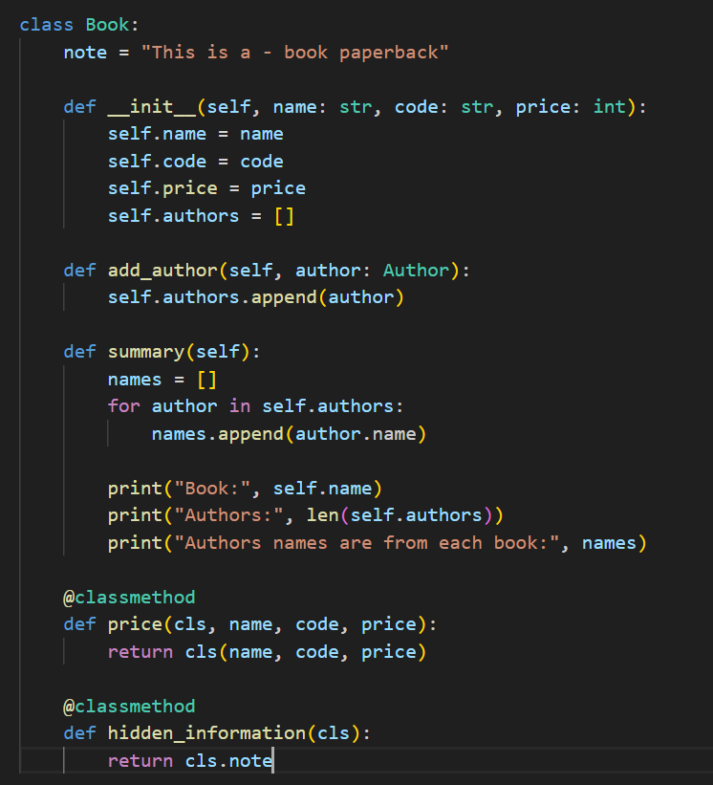

What is Class Method? We know already how to use: - Instance method - Static methods - …and also, Dynamic method A class method is declared using the @classmethod decorator, where the first parameter is consistently named cls. The usage of cls is analogous to the self parameter, with the distinction being that cls references the class itself, while self refers to an instance of the class. Neither parameter needs to be explicitly provided in the argument list when calling the function; Python automatically assigns the appropriate values.

Slide 25
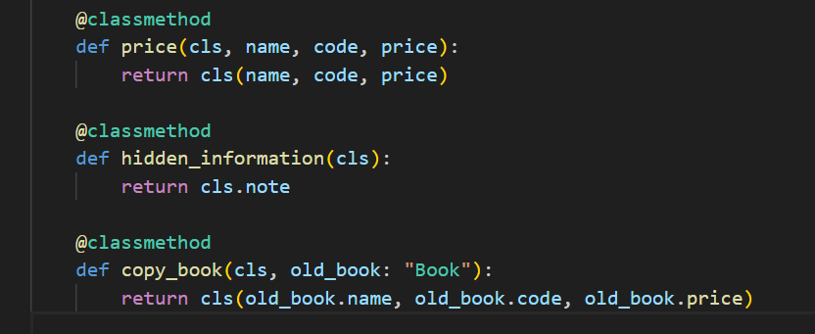
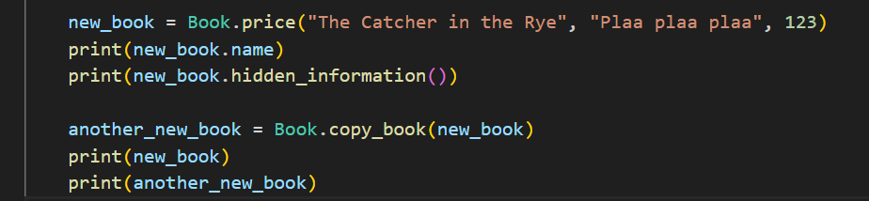

Class Method continues? Copying an object…

