Slide 1
Object Oriented Programming Using
Python
Teemu Matilainen teemu.matilainen@savonia.fi

Slide 2
Lecture 4#
Aggregation
Composition
Objects and references
Objects as arguments to functions
Objects as arguments to methods
Instance of the class as an argument to a method

Slide 3
Lecture 4#
Aggregation
Aggregation is a concept in object-oriented programming (OOP) that represents a "has-a" relationship between two classes. It is a form of association where one class contains an object of another class but does not control the lifecycle of that object. In simpler terms, it denotes a relationship where one class is part of another class.

Slide 4
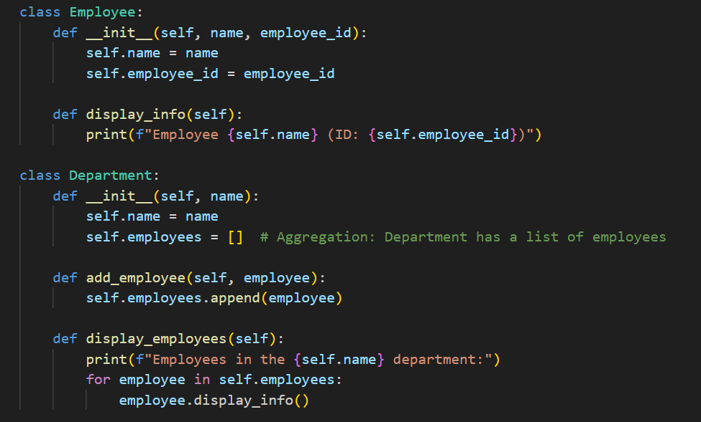
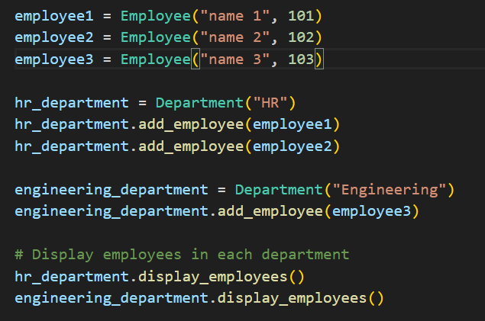
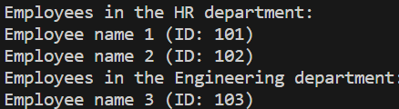
Aggregation
In aggregation, the contained object can exist independently of the containing object. It doesn't imply ownership, and the contained object can be shared among multiple instances of the containing class or even exist outside of it.

Slide 5
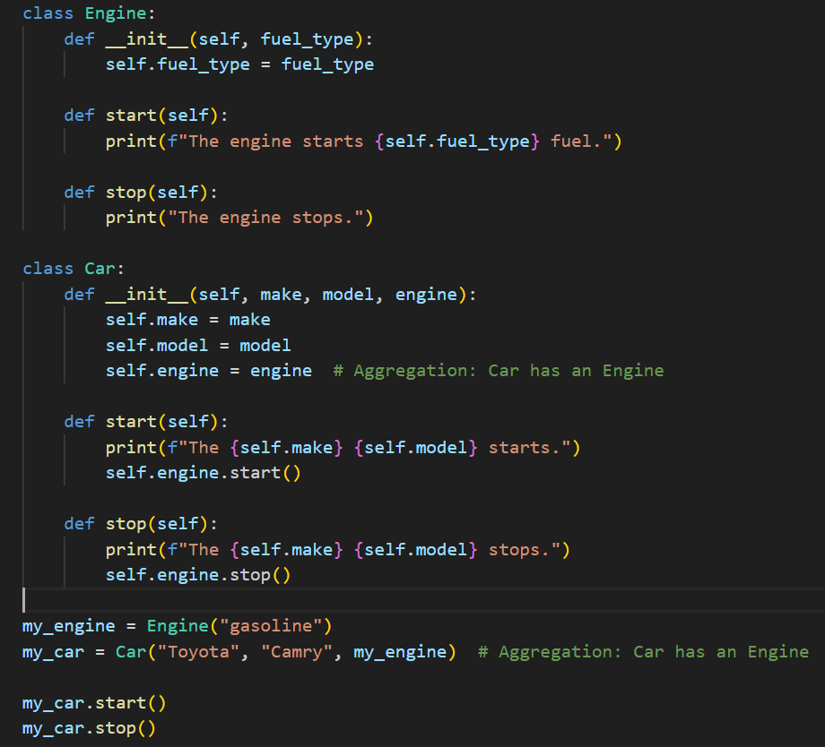

Aggregation (Car)
Aggregation is different from composition, where the contained object is considered a part of the containing object, and its lifecycle is controlled by the containing object. In aggregation, the contained object is more independent and can be shared among multiple objects.

Slide 6
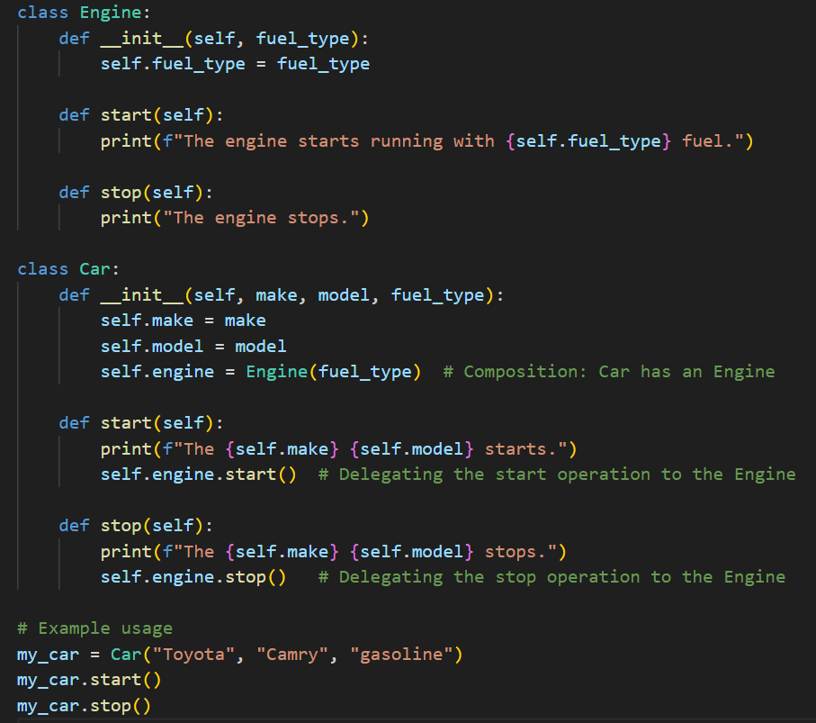

Composition:
When using Composition, the difference is that here we are not creating an object of the Engine inside the Car class, rather than that we are creating an object of the Engine outside and passing it as a parameter of Engine class which yields the same result.

Slide 7
Objects and references
Car 1
Car 2
Cars

Slide 8
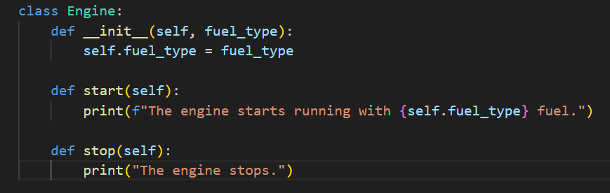
Let’s create a class Engine in its own file

Slide 9
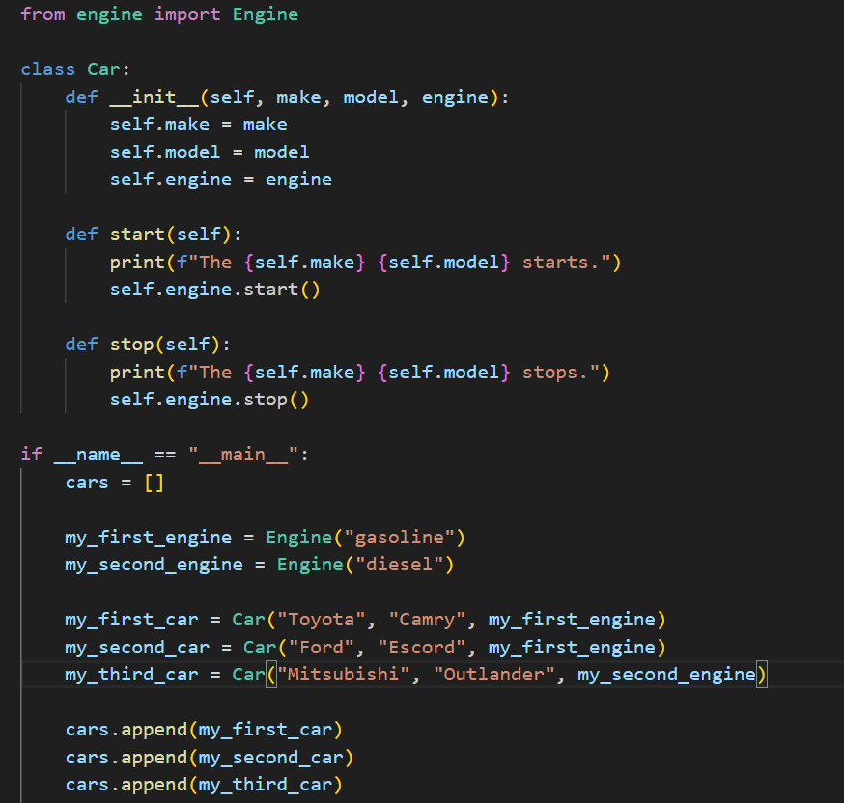
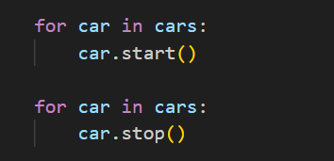
Every value in Python is an object. Any object you create based on a class you've defined yourself works exactly the same as any "regular" Python object. For example, objects can be stored in a list:

Slide 10
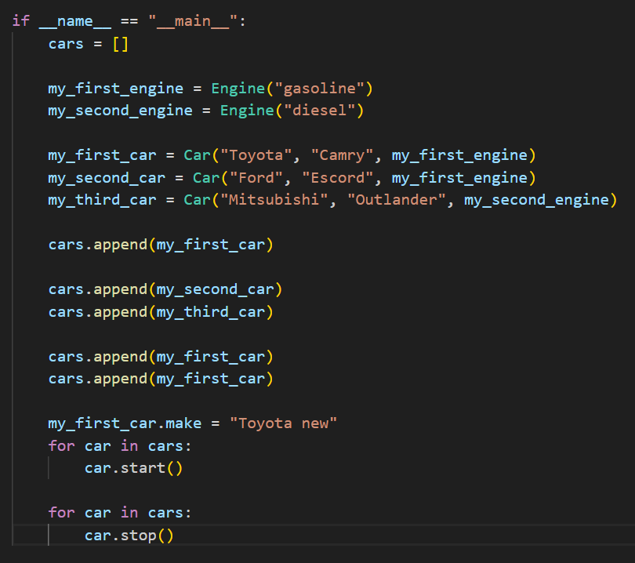
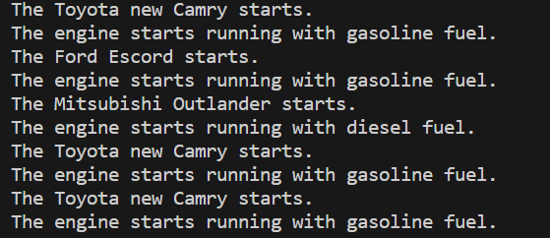
Reference
The references at indexes 0, 3 and 4 in the list refer to the same object. Either one of the references can be used to access the object. The reference at index 1 and 2 refers to a different object, although with seemingly the same contents. Changing the contents of this latter object does not affect the other one.

Slide 11
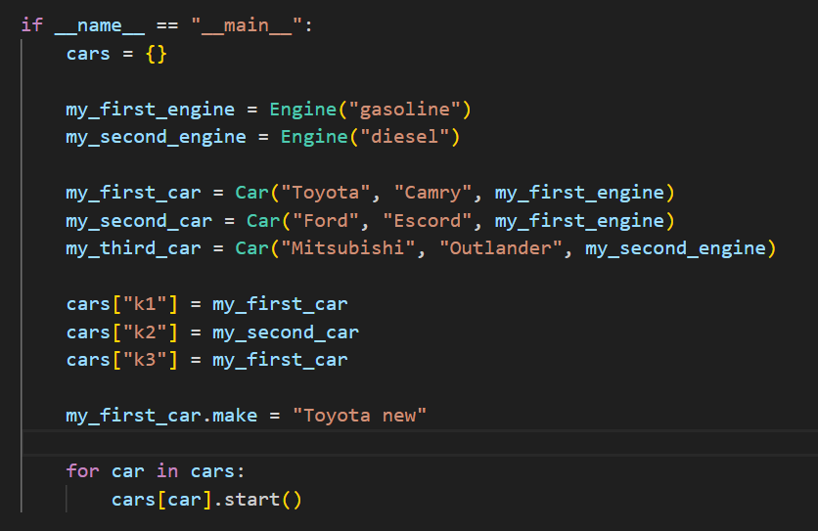
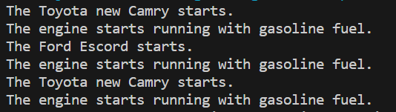
Dictionary usage for Objects:
Let us used dictionary to store the object data structure.

Slide 12
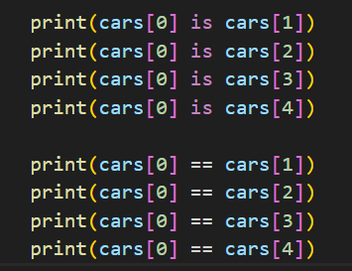
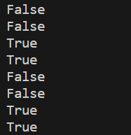
How can we test references?
The operator is been used for checking if the two references refer to the exact same object, while the operator == will tell you if the contents of the objects are the same.

Slide 13
Objects as arguments to functions

Slide 14
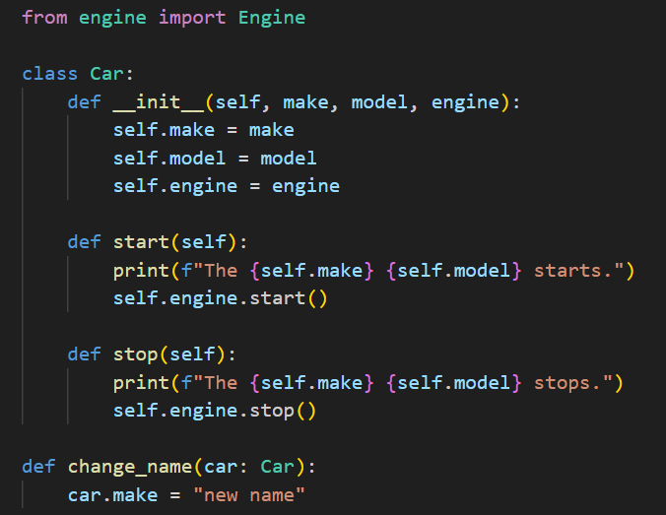


Let's have a look at a simple example where a function receives a reference to an object of type my_first_car as its argument. The function then changes the name of the car. Both the function and the main function calling it access the same object, so the change is apparent in the main function as well.

Slide 15
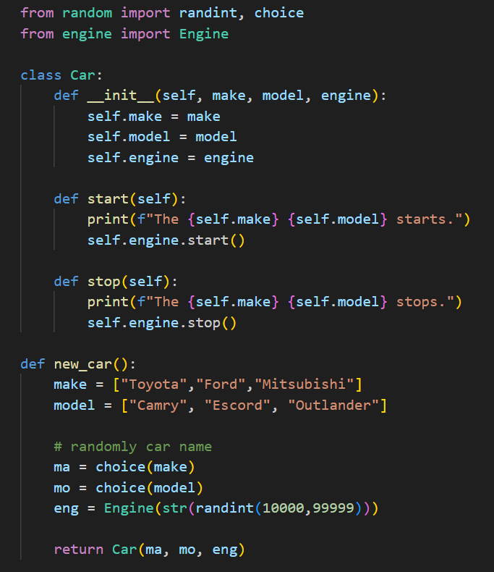
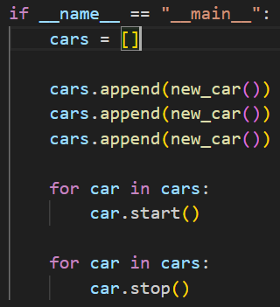
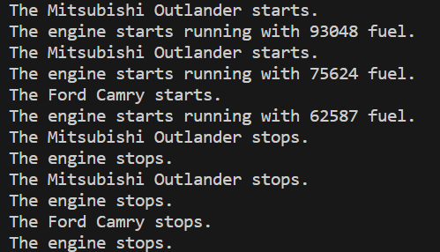
Objects within function
It is also possible to create objects within functions. If a function returns a reference to the newly created object, it is also accessible within the main function!!!!!

Slide 16
Objects as arguments to methods

Slide 17
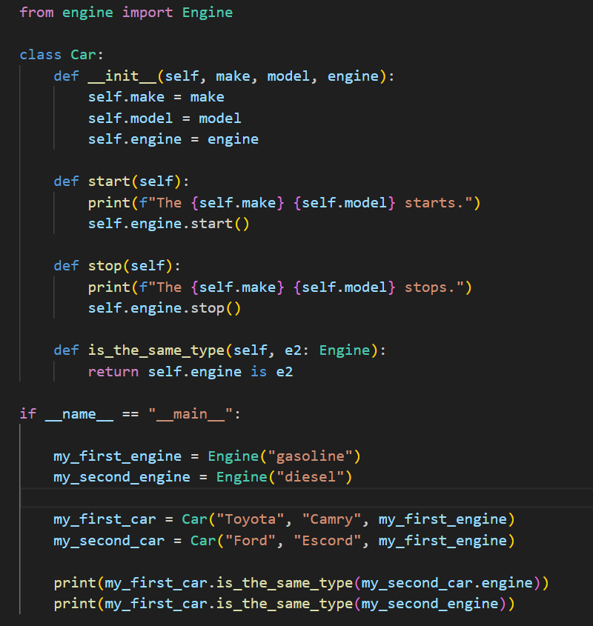

Objects can act as arguments to methods.
Car Class contains a is_the_same method what compares car object and another car object engines (given as an argument)

Slide 18
Instance of the class as an argument to a method

Slide 19
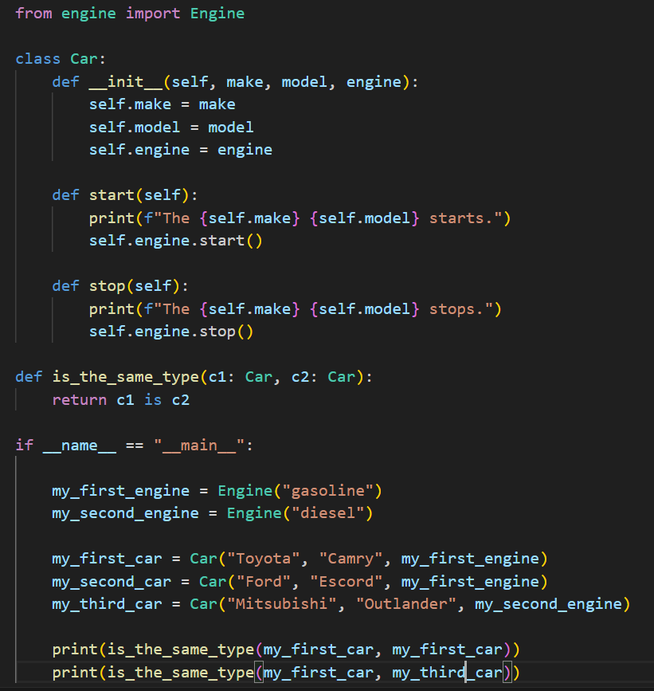

Let's assume we want to write a program which compares car objects. We can write a separate function for this purpose

Slide 20
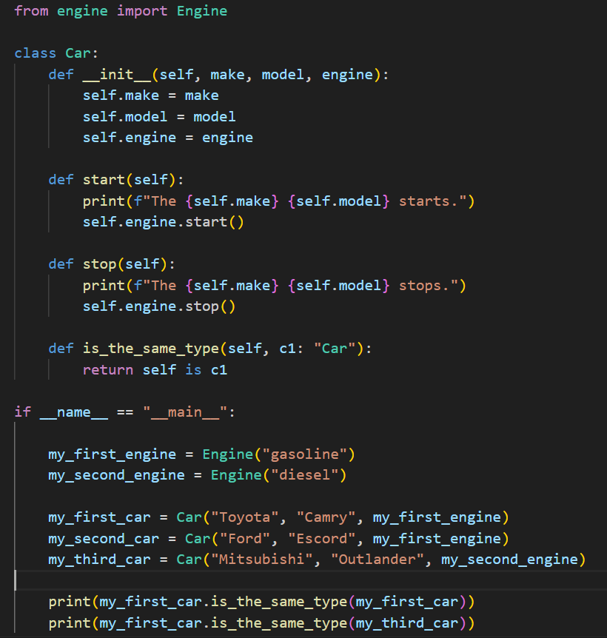
One of the principles of object-oriented programming is to include any functionality which handles objects of a certain type in the class definition, as methods. So instead of a function we could write a method which allows us to compare the car with another car object
Here the car object which the method is called on is referred to as self, while the other car object is c1.
Remember, calling a method differs from calling a function. A method is attached to an object with the quote notation: “Car”

Slide 21
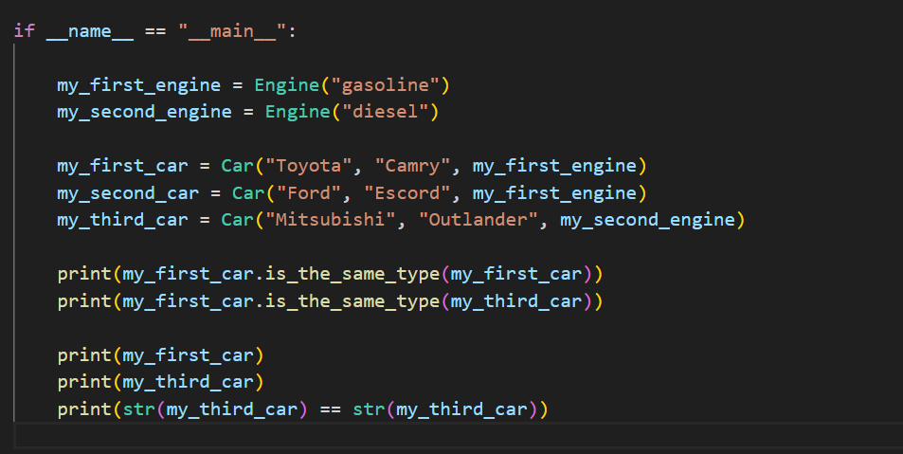
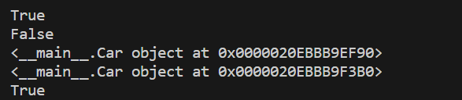
Is there any other way to compare objects?

Slide 22
Assignment 6#
Secret Society with Artifacts
Create a class named Artifact with the following attributes:
name (string): the name of the artifact.
power (string): the power or ability associated with the artifact.
Implement methods within the Artifact class: __init__(self, name, power): A constructor method that initializes the name and power of the artifact.
Create a class named Member with the following attributes:
secret_identity (string): a unique identifier for the member.
name (string): the public name of the member.
access_level (string): the level of access the member has within the society.
artifacts (list): a list to store instances of the Artifact class representing artifacts owned by the member.
Implement methods within the Member class: __init__(self, secret_identity, name, access_level): A constructor method that initializes the secret_identity, name, and access_level of the member. add_artifact(self, artifact): A method that takes an Artifact object as an argument and adds it to the member's list of artifacts.

Slide 23
Create a class named Society with the following attributes: society_name (string): the name of the secret society. members (list): a list to store instances of the Member class representing society members. Implement methods within the Society class: __init__(self, society_name): A constructor method that initializes the society_name and an empty list for members. add_member(self, member): A method that takes a Member object as an argument and adds the member to the society. remove_member(self, member): A method that takes a Member object as an argument and removes the member from the society. print_society_info(self): A method that prints information about the society, including the society name, a list of members, and their associated artifacts.

Slide 24
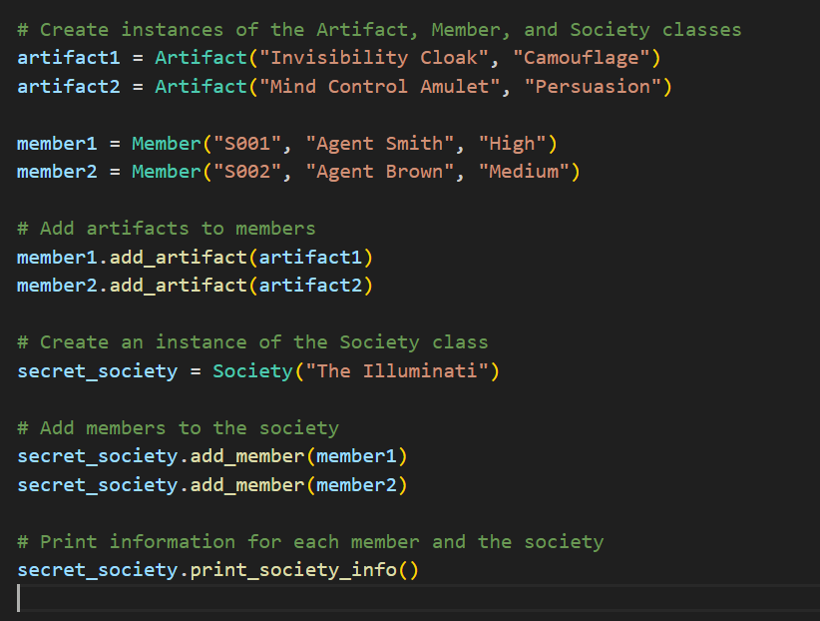
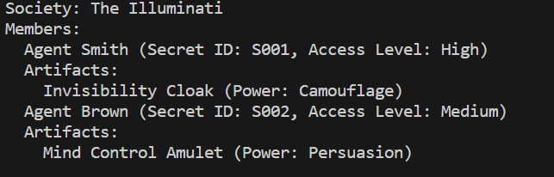
Create instances of the Artifact, Member, and Society classes, add members to the society, associate artifacts with members, and print information for both members and the society
You can copy the test code from here:
# Create instances of the Artifact, Member, and Society classes
artifact1 = Artifact("Invisibility Cloak", "Camouflage")
artifact2 = Artifact("Mind Control Amulet", "Persuasion")
member1 = Member("S001", "Agent Smith", "High")
member2 = Member("S002", "Agent Brown", "Medium")
# Add artifacts to members
member1.add_artifact(artifact1)
member2.add_artifact(artifact2)
# Create an instance of the Society class
secret_society = Society("The Illuminati")
# Add members to the society
secret_society.add_member(member1)
secret_society.add_member(member2)
# Print information for each member and the society
secret_society.print_society_info()

