Slide 1
Object Oriented Programming Using
Python
Teemu Matilainen teemu.matilainen@savonia.fi

Slide 2
Lecture 7#
Inheritance continues…
You understand how to use iterators
You know how to use comprehensions within own classes
You are able to restrict the visibility of inherited attributes in a subclass
You are able to restrict the visibility of inherited methods in a subclass

Slide 3
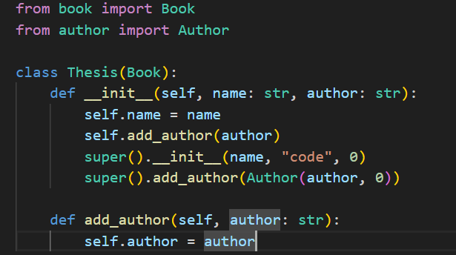
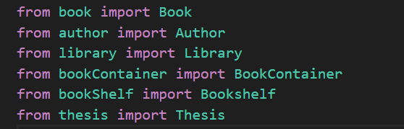
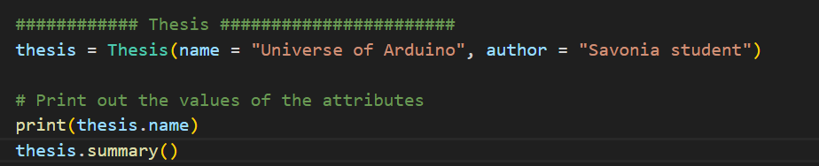
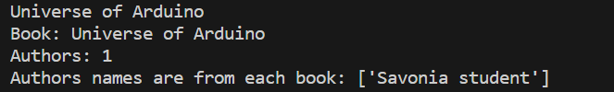
Inheritance … Thesis class… Override…
The constructor within the Thesis class invokes the constructor in the base class Book with the specified arguments for name and author.
In addition, the constructor in the derived class assigns a value to the attribute ‘author’.
Derived class can override method in the base class!

Slide 4
Access modifiers within base class

Slide 5
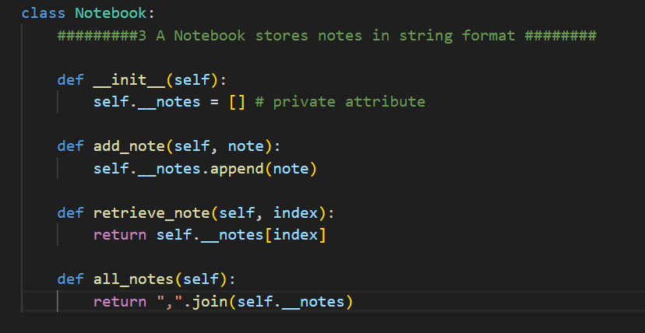
NoteBook with private attributes

Slide 6
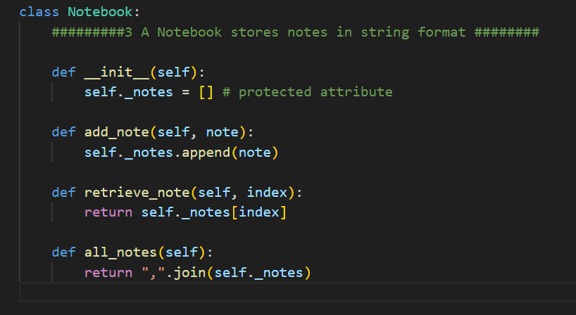
NoteBook with protected attributes

Slide 7
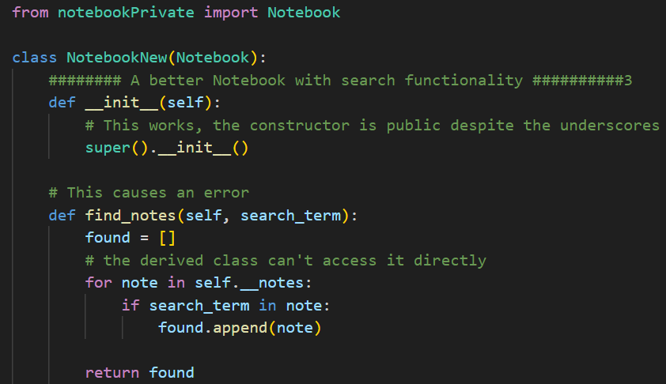
Access modifiers: - Private
If a trait is defined as private in the base class, it is not directly accessible in any derived classes. Let's take a look at an example. In the Notebook class below the notes are stored in a list, and the list attribute is private:

Slide 8
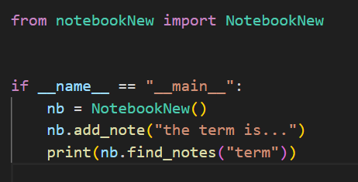
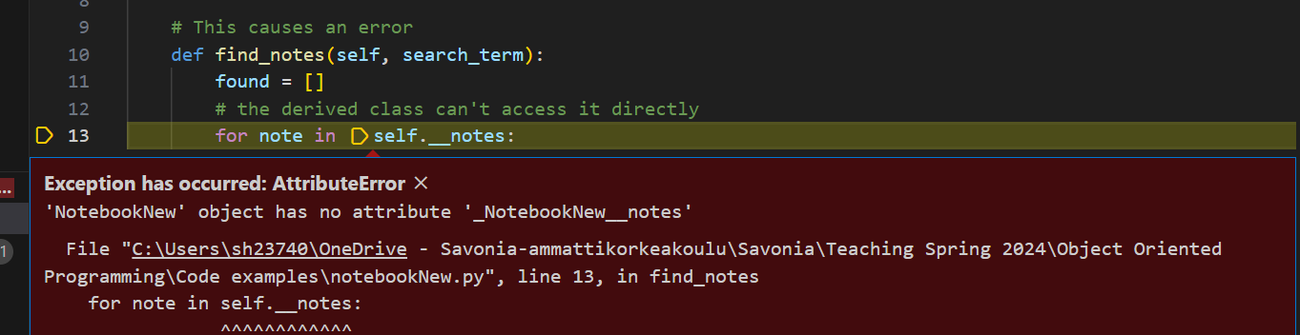
Access modifiers: - Private
If the integrity of the class is key, making the list attribute notes private makes sense. The class provides the client with suitable methods for adding and browsing notes, after all. This approach becomes problematic if we define a new class NotebookPro, which inherits the Notebook class. The private list attribute is not accessible to the client, but neither is it accessible to the derived classes. If we try to access it, as in the find_notes method below, we get an error:

Slide 9
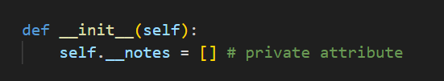
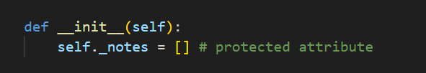
Access modifiers: - Private - Protected
Many object oriented programming languages have a feature, usually a special keyword, for protecting traits. This means that a trait should be hidden from the clients of the class, but kept accessible to its subclasses. Python in general abhors keywords, so no such feature is directly available in Python. Instead, there is a convention of marking protected traits in a certain way.

Slide 10
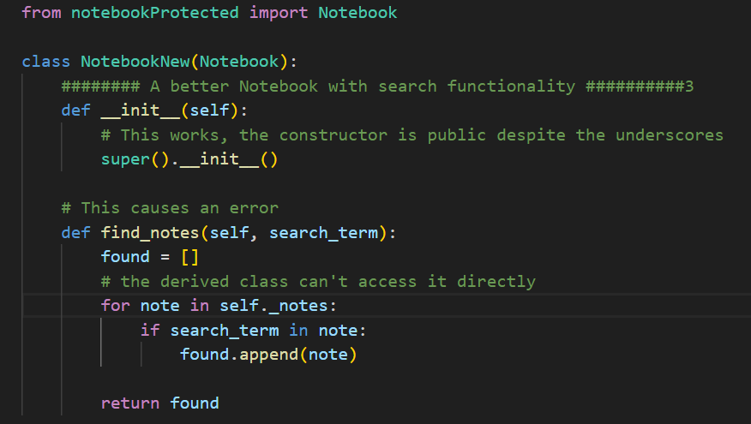
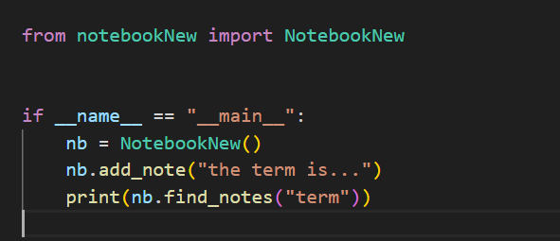
Access modifiers: - Protected

Slide 11
Access modifiers: Table
Below we have a table for the visibility of attributes with different access modifiers:
Access modifier Example Visible to client Visible to derived class
Public self.name yes yes
Protected self._name no yes
Private self.__name no no

Slide 12
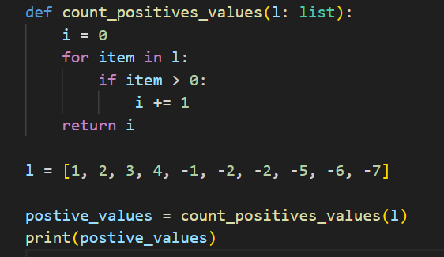
Iteration?
We use for statement to iterate through different data structures, objects and collections of items. A typical use:

Slide 13
Creating custom iterable classes is achievable as well. This becomes beneficial when the primary function of the class revolves around managing a group of items. For instance, the Bookshelf class demonstrated earlier would be well-suited for this, allowing a for loop to conveniently navigate through the books on the shelf. A similar scenario applies to a student register, where the ability to iterate through the collection of students would be advantageous.
One more operator example and Iteration
To enable a class to be iterable, it is necessary to implement the iterator methods __iter__ and __next__. We will delve into the details of these methods in the upcoming example.

Slide 14
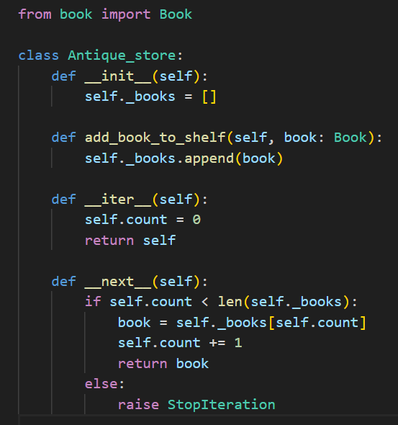
One more operator example and Iteration

Slide 15
The __iter__ method initializes the iteration variable or variables. In this context, a simple counter containing the index of the current item in the list is sufficient. Additionally, the __next__ method is also required, responsible for returning the next item in the iterator. In the aforementioned example, this method returns the item at index n from the list within the Antique_store object, while also incrementing the iterator variable.
Upon traversing all objects, the __next__ method triggers the StopIteration exception. While the process is akin to raising other exceptions, Python automatically handles this particular exception. Its purpose is to notify the code invoking the iterator (e.g., a for loop) that the iteration has concluded.
One more operator example and Iteration

Slide 16
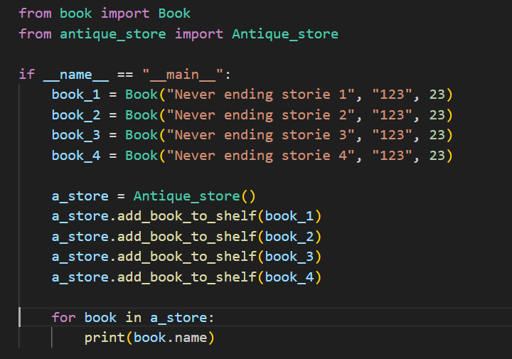
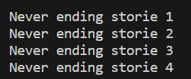
One more operator example and Iteration

Slide 17
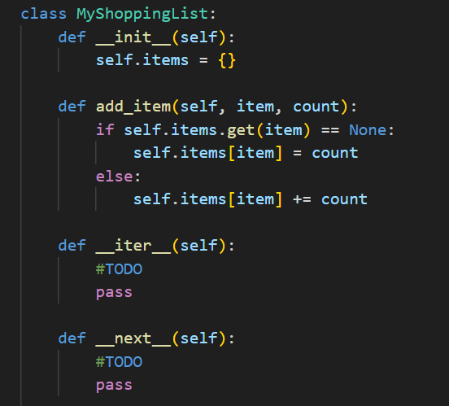
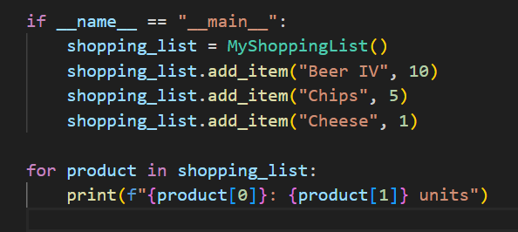

Exercise
Create a MyShoppingList class and adjust the class so that it is iterable and can thus be used as follows:

Slide 18
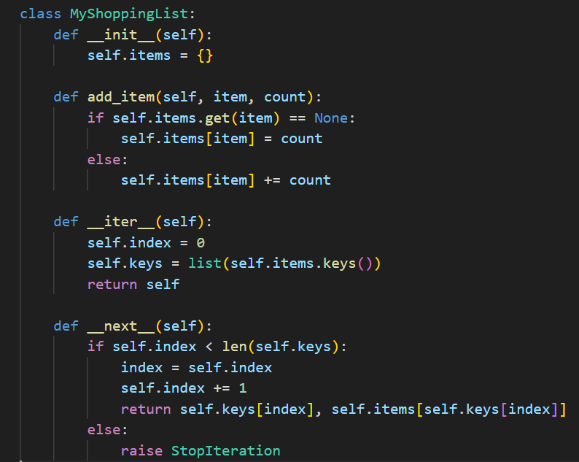
Exercise…
Create a MyShoppingList class and adjust the class so that it is iterable and can thus be used as follows:

Slide 19
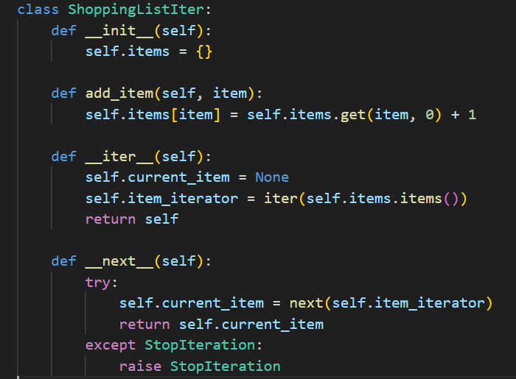
Exercise…
Create a MyShoppingList class and adjust the class so that it is iterable and can thus be used as follows:

Slide 20
iter()
The iter() function is used to obtain an iterator from an object that implements the iteration protocol.
If the object has a __iter__() method, the iter() function calls this method to get the iterator.
If the object doesn't have a __iter__() method but has a __getitem__() method, iter() creates an iterator that accesses elements using integer indices.
If neither method is present, iter() raises a TypeError.
next()
The next() function is used to retrieve the next item from an iterator.
It takes an iterator as its first argument and an optional default value as its second argument.
If the iterator has more items, next() returns the next item; otherwise, it raises a StopIteration exception if no default value is provided.
If a default value is provided, next() returns the default value when the iterator is exhausted.

Slide 21
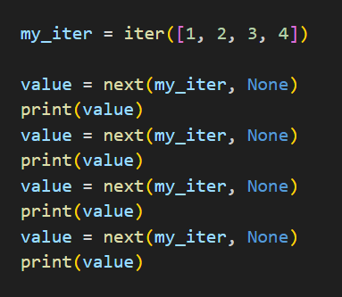
Simple Iteration

