Slide 1
Object Oriented Programming Using
Python
Teemu Matilainen teemu.matilainen@savonia.fi

Slide 2
Lecture 8#
You know how to use comprehensions within own classes
You realize what exceptions are
You realize how exceptions are used
You are able to catch an exception
You are able to throw an exception
You are able to design an exception class of your own

Slide 3
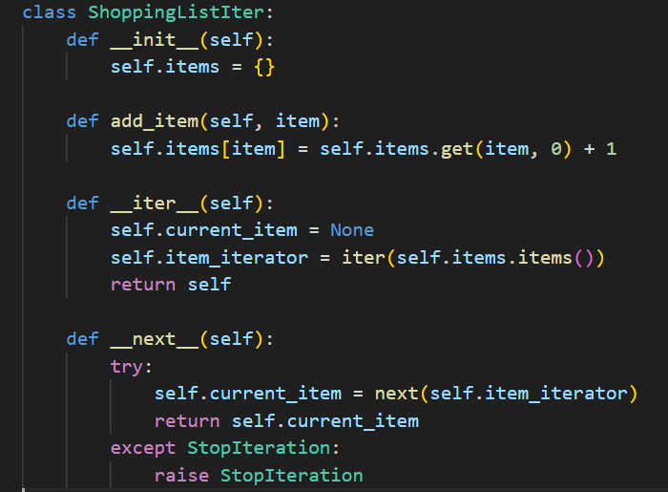
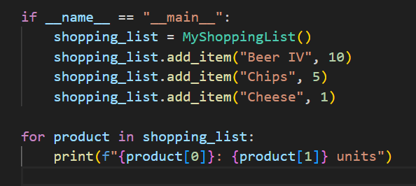
Exercise…
Create a MyShoppingList class and adjust the class so that it is iterable and can thus be used as follows:

Slide 4
iter()
The iter() function is used to obtain an iterator from an object that implements the iteration protocol.
If the object has a __iter__() method, the iter() function calls this method to get the iterator.
If the object doesn't have a __iter__() method but has a __getitem__() method, iter() creates an iterator that accesses elements using integer indices.
If neither method is present, iter() raises a TypeError.
next()
The next() function is used to retrieve the next item from an iterator.
It takes an iterator as its first argument and an optional default value as its second argument.
If the iterator has more items, next() returns the next item; otherwise, it raises a StopIteration exception if no default value is provided.
If a default value is provided, next() returns the default value when the iterator is exhausted.

Slide 5
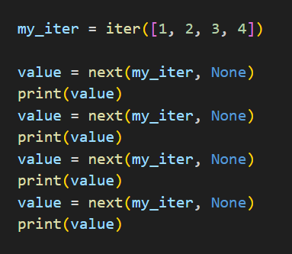
Simple Iteration

Slide 6
Another more 'pythonic' approach to creating lists from existing ones is through the use of list comprehensions. The concept involves condensing onto a single line both the operation applied to each item in the list and the assignment of the results to a new list.

Slide 7
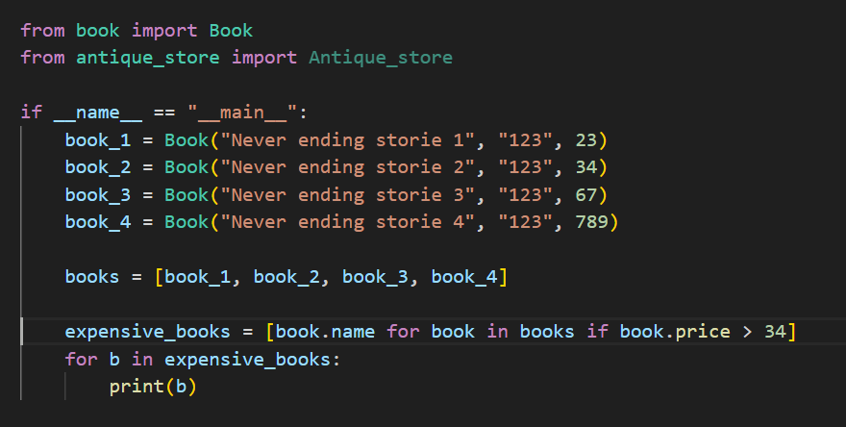
Comprehensions
With
Own classes
Comprehensions can prove valuable in handling or creating instances of custom classes, as demonstrated in the upcoming examples.

Slide 8
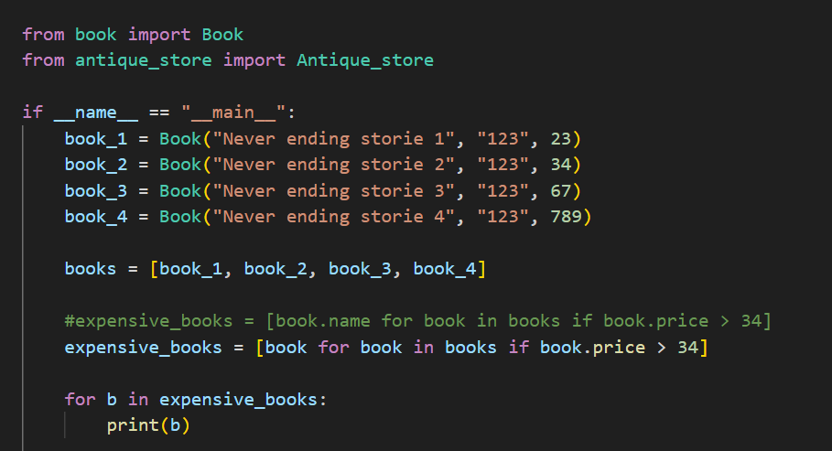

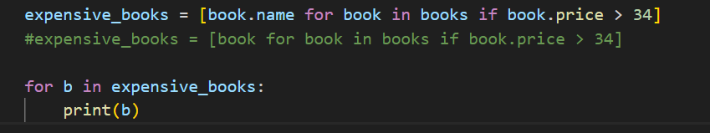

Comprehensions
With
Own classes

Slide 9
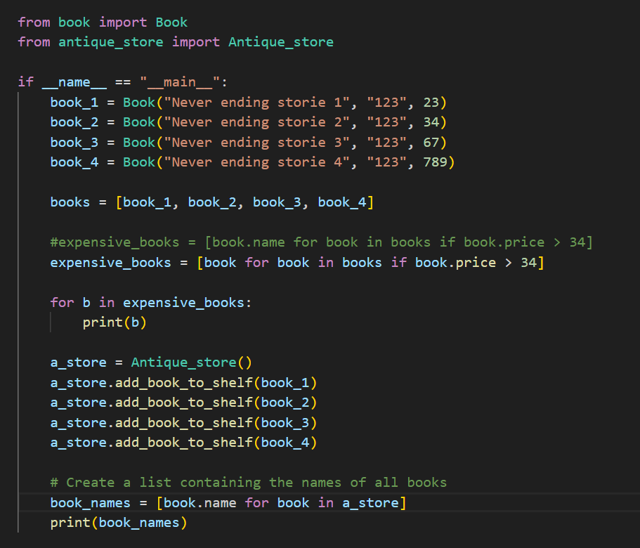
Comprehensions
With
Own classes

Slide 10
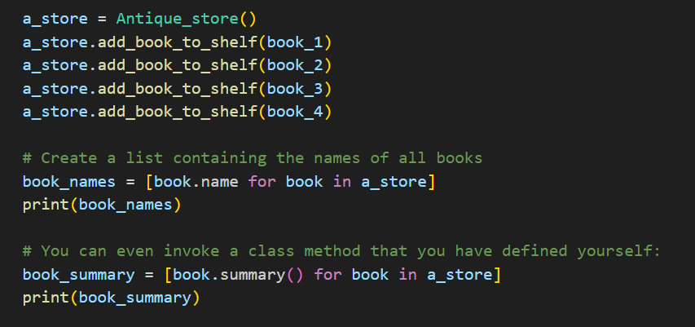
Comprehension and class methods…
In reality, the expression used within the list comprehension statement can be any valid Python expression. You can even invoke a class method that you have defined yourself:

Slide 11
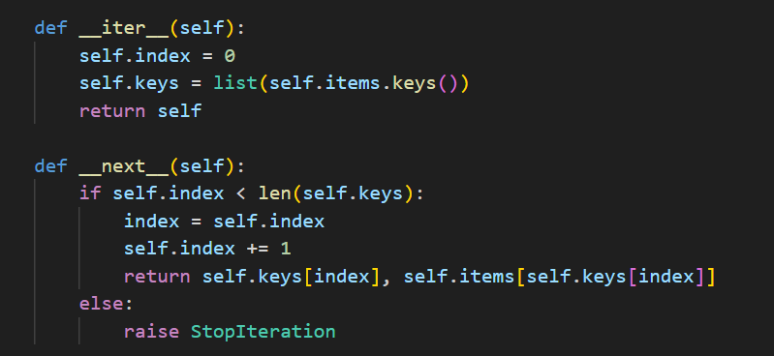
Comprehension for Shopping list

Slide 12
Exception handling
Exception handling is a crucial aspect of Python programming. It allows you to gracefully handle errors and unexpected situations that may occur during the execution of your code. Python provides a mechanism to catch and deal with exceptions using the try, except, finally, and else blocks.

Slide 13


Exception handling
Its July 20, 1969, Apollo 11 mission was close to touchdown on the moon. Neil Amstrong, Buzz Aldrin, and Michel Collins checking last-minute preparation for landing. Over their, onboard computer something started flashing it was Error 1201 followed by error 1202. Human beings first landing on the moon is jeopardized by two computer errors…

Slide 14
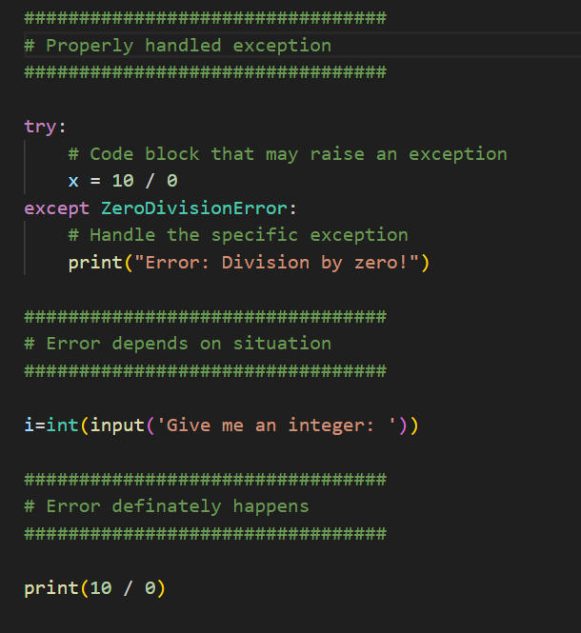
Here's a basic example of exception handling in Python:

Slide 15

Exceptions?
What are exceptions?
• Exceptions are mechanism to handle runtime errors
• For example, user gives string ’one’ when asked an integer
⇒ Conversion throws an exception
⇒ If the exception is not handled correct, the software crashes
Basics of Programming: Janne Koponen

Slide 16
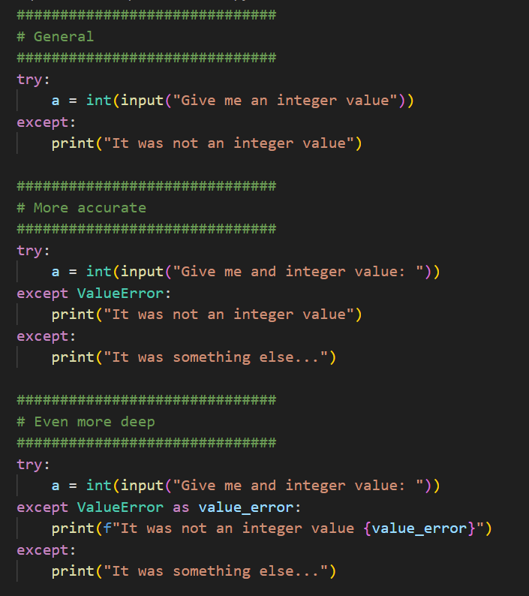
Catching Exceptions continues
You can also catch multiple exceptions and handle them
Basics of Programming: Janne Koponen

Slide 17
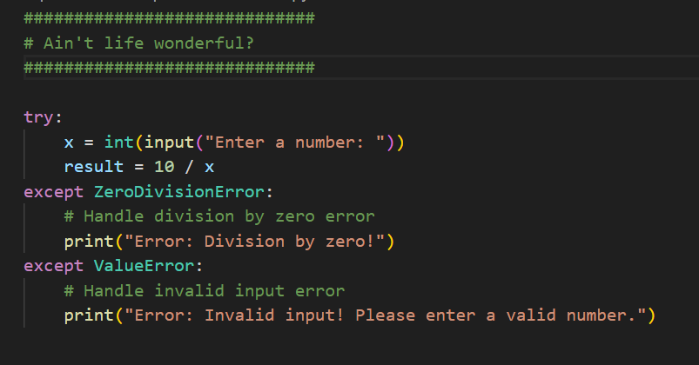
Catching Exceptions. Ain’t life wonderful?
You can also catch multiple exceptions and handle them differently…

Slide 18
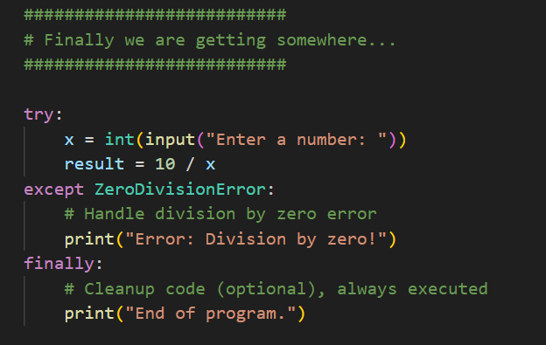
Catching Exceptions. Finally we are getting somewhere… Or are we?
You can use the finally block to execute cleanup code regardless of whether an exception occurs!

Slide 19
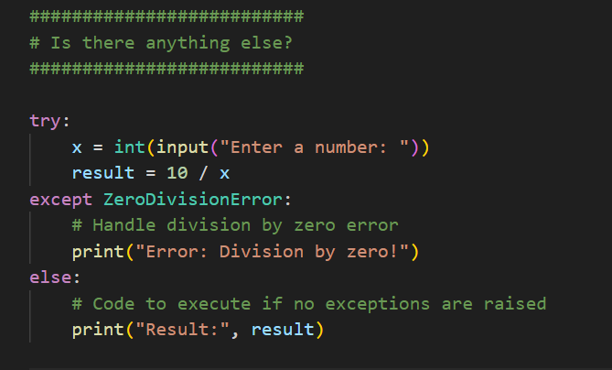
Catching Exceptions. Is there anything else?
Else block can be used to execute code if no exceptions are raised:

Slide 20
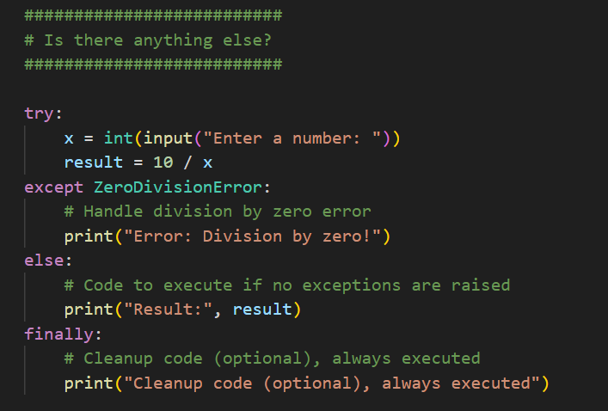
Catching Exceptions. Else & Finally
Else + Finally

Slide 21
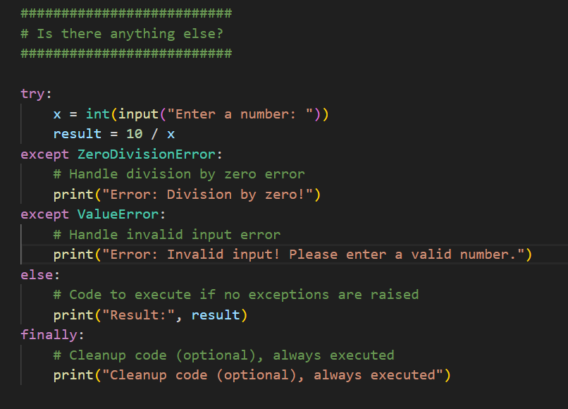
Catching Exceptions. All together!!

Slide 22
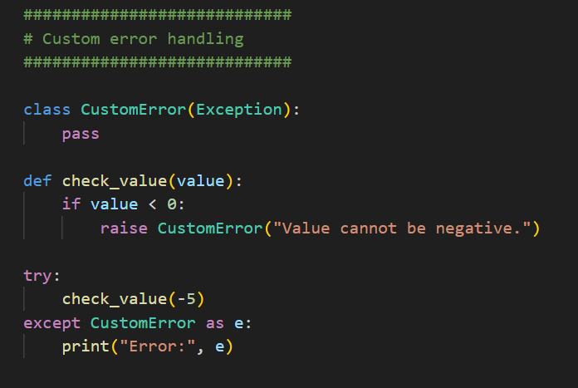
Raising Custom errors
To create your own custom exceptions in Python, you can subclass the built-in Exception class or any other built-in exception class. This allows you to define specific types of errors that are relevant to your application.

Slide 23
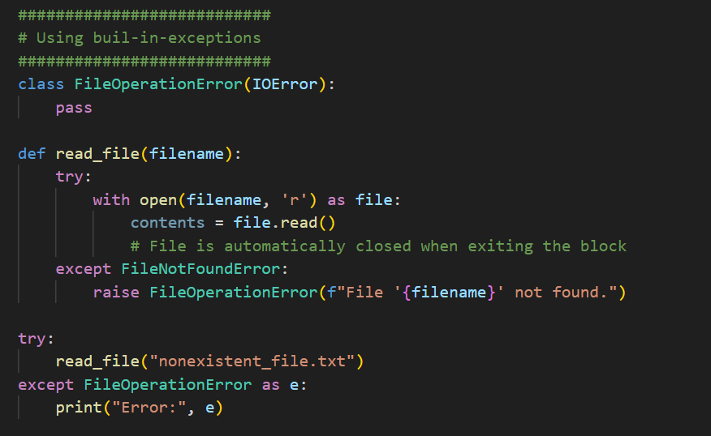
Raising Custom errors continues…
You can create more specific custom exceptions by subclassing other built-in exceptions if your custom exception represents a specific type of error. For example, if your custom exception is related to file operations, you might subclass IOError.
The with statement ensures that the context management methods __enter__() and __exit__() of the object are properly called, regardless of whether the block of code inside the with statement raises an exception or not. This is commonly used for acquiring and releasing resources in a clean and predictable manner.
When working with files, using the with statement ensures that the file is properly closed after its use, even if an exception occurs!

Slide 24
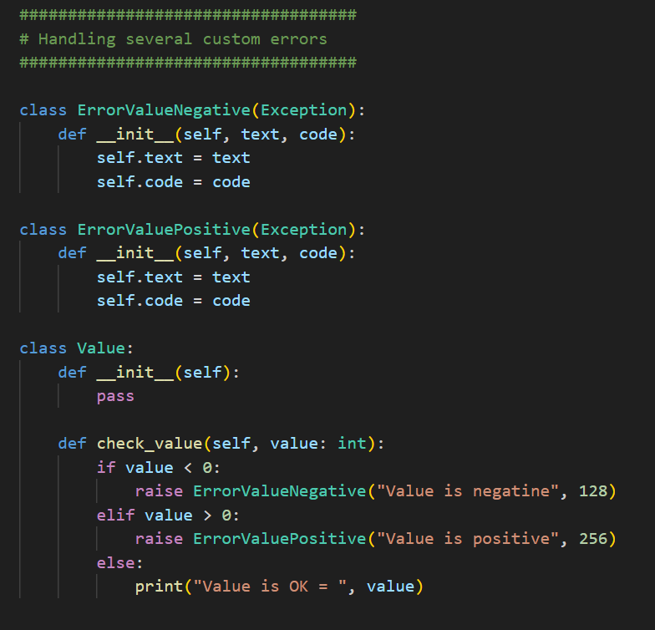
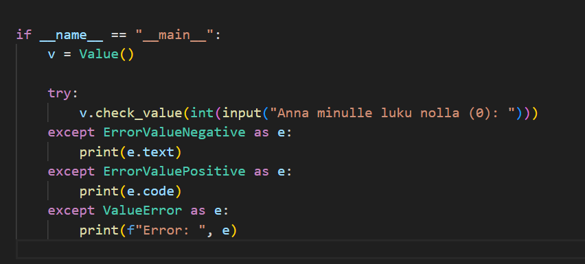
Raising Custom errors continues…
You can define your custom error class constructor attributes…

Slide 25
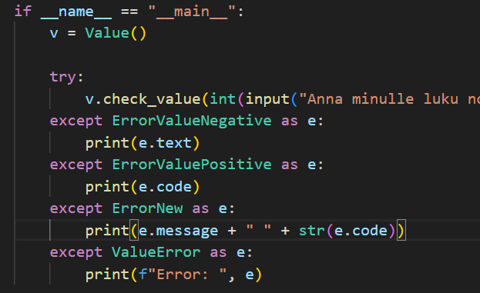
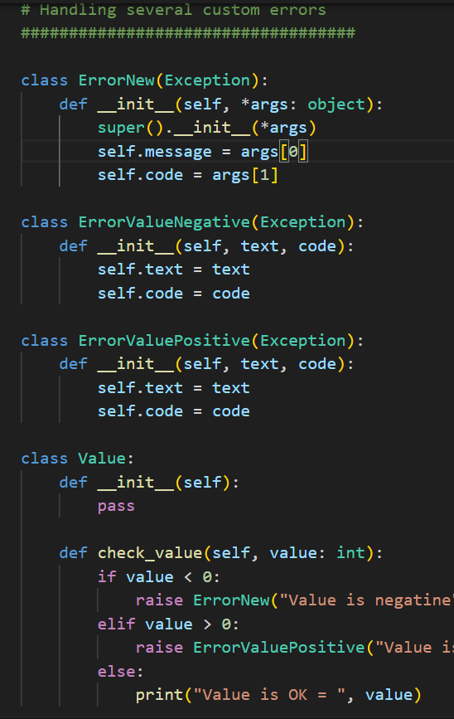
Raising Custom errors…
In Python, when you subclass a built-in class like Exception to create a custom exception class, it's generally a good practice to call the __init__ method of the superclass (the class you're inheriting from) within your custom exception class's __init__ method. This ensures that any initialization logic defined in the superclass is executed, which can be important for proper exception handling.

Slide 26
Assignment:
Create a program (class AreaCalculator) that calculates the area of geometric shapes.
The program should have “exception” classes: ShapeError as the base exception class, and two subclasses, NegativeDimensionError and InvalidShapeError.
ShapeError: Base exception class representing errors related to shape calculations.
NegativeDimensionError: Subclass of ShapeError, raised when the dimensions (length, width, etc.) provided to calculate the area are negative.
InvalidShapeError: Subclass of ShapeError, raised when an invalid shape type is provided for calculation.
The program should include methods for calculating the area of rectangles and circles. Handle exceptions appropriately for negative dimensions and invalid shape types.
AreaCalculator has class methods:
rectangle_area(self, length, width)
circle_area(self, radius)
calculate_area(self, shape_type, *args):

Slide 27
