Slide 1
Object Oriented Programming Using
Python
Teemu Matilainen teemu.matilainen@savonia.fi

Slide 2
Lecture 6#
You realize what inheritance is about
You are able to inherit a class
You are able to override a method in a subclass

Slide 3
What inheritance is about? How to inherit a class?

Slide 4
Tailoring Classes for Specific Needs… There are instances when you've already created a class, but later find the need for unique characteristics in certain instances, rather than all. Alternatively, you might notice that you've defined two closely related classes with only slight distinctions. As programmers, our goal is to minimize repetition while ensuring clarity and readability. How can we address varying implementations of inherently similar objects in such cases?

Slide 5
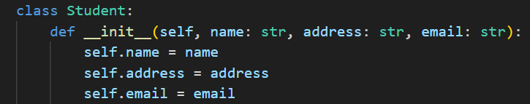
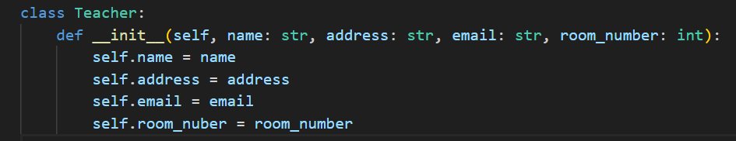
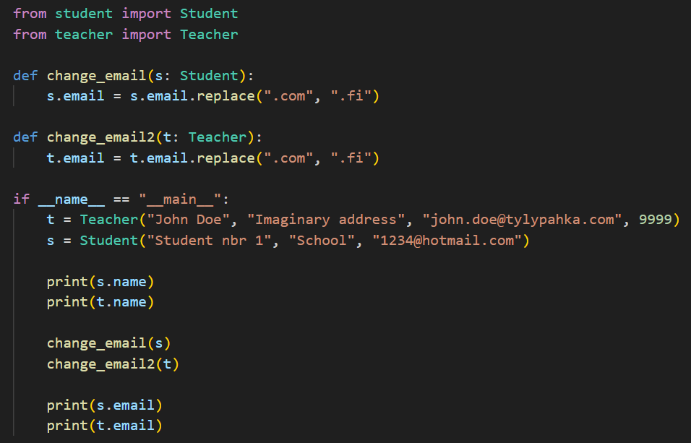

Example: If we want to change the email address, we must write two different functions…

Slide 6
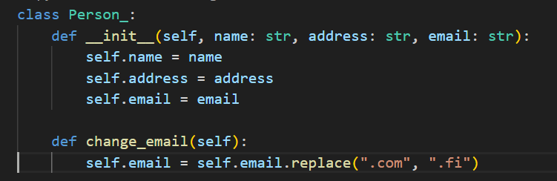
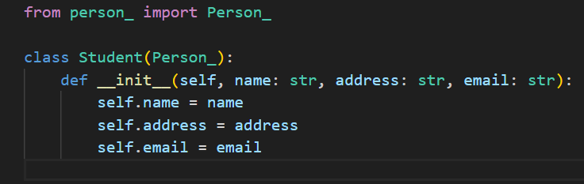
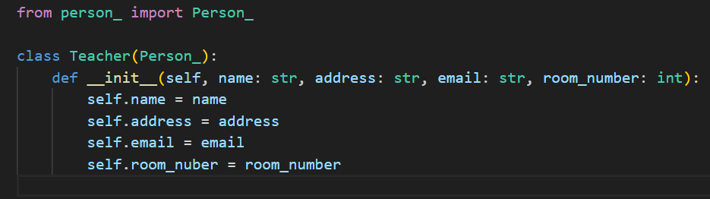
Inheritance:

Slide 7
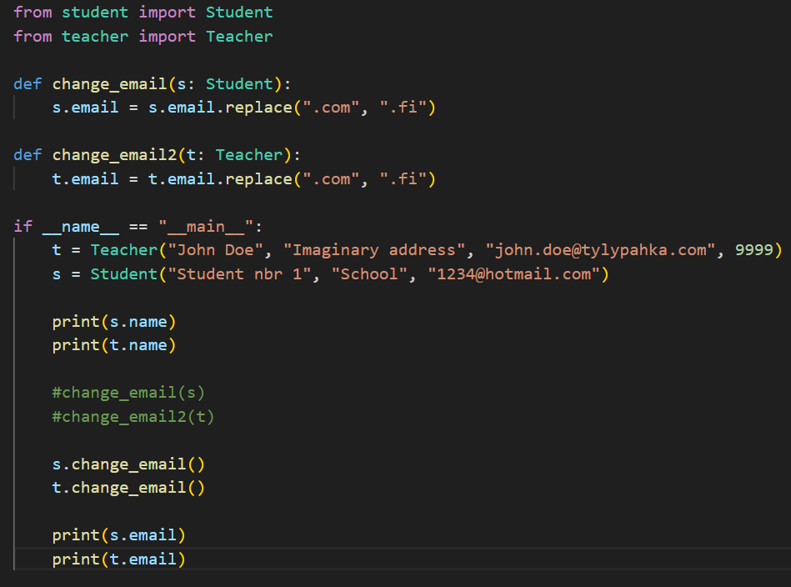
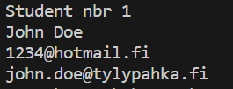
Using the inherited class change_email call

Slide 8
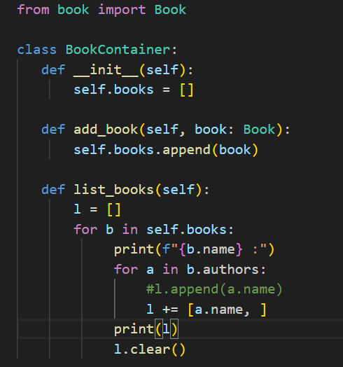
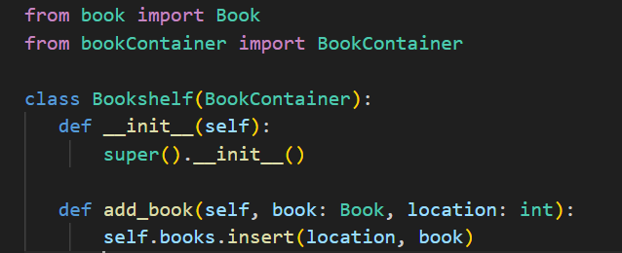
BookContainer & BookShelf – Method overriding
In the Bookshelf class, there is a method named add_book. The base class BookContainer also defines a method with the same name. This phenomenon is known as method overriding. When a derived class has a method sharing the same name as the one in the base class, the version in the derived class takes precedence and replaces the original method when working with instances of the derived class.
In the example, the concept is that when adding a new book to a BookContainer, it is always placed at the top. However, with a Bookshelf, you have the flexibility to specify the location yourself. The list books method functions identically for both classes, as there is no overridden method in the derived class.

Slide 9
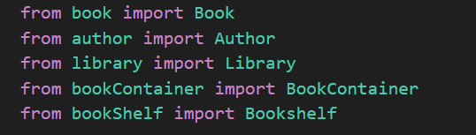
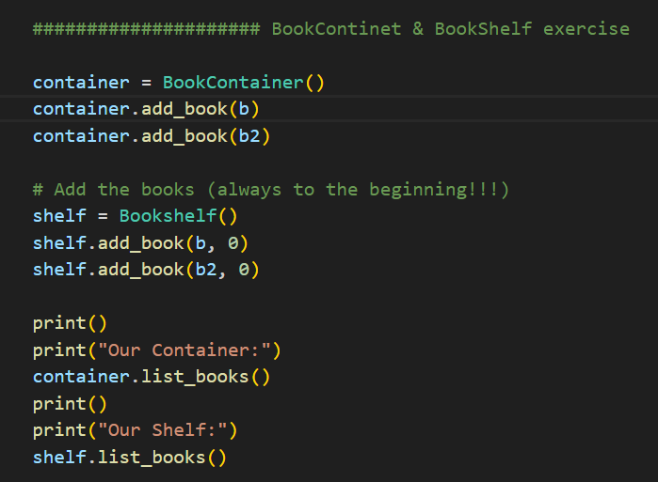
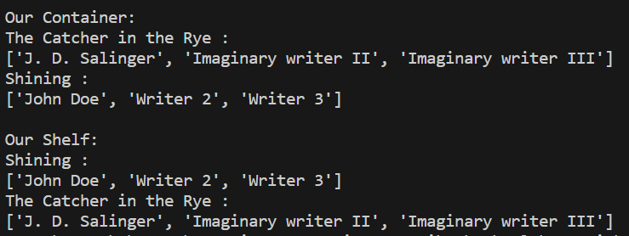
BookContainer & BookShelf in action!!
The Bookshelf class also has access to the list of books method. Through inheritance the method is a member of all the classes derived from the BookContainer class!!!!

Slide 10
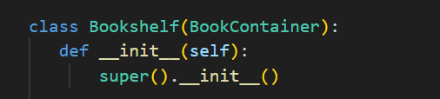
Inheritance and the scope of these properties
A derived class inherits all properties from the base class. Properties are accessible from the derived class, unless they have been defined as private in the base class (with two underscores before the name of the properties).
As the attributes of a Bookshelf are identical to a BookContainer, there was no need to rewrite the constructor of Bookshelf. We simply called the constructor of the base class:
All the properties in the base class can be accessed from the derived class with the function super(). The self argument is left out from the method call, as Python adds it automatically.
What if the attributes are not identical: can we still use the base class constructor in some way?

Slide 11
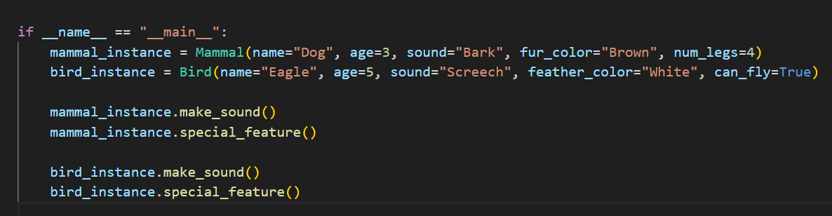

Exercise: Inheritance
Create a Base Class: Animal
Create Subclasses: Mammal and Bird

Slide 12
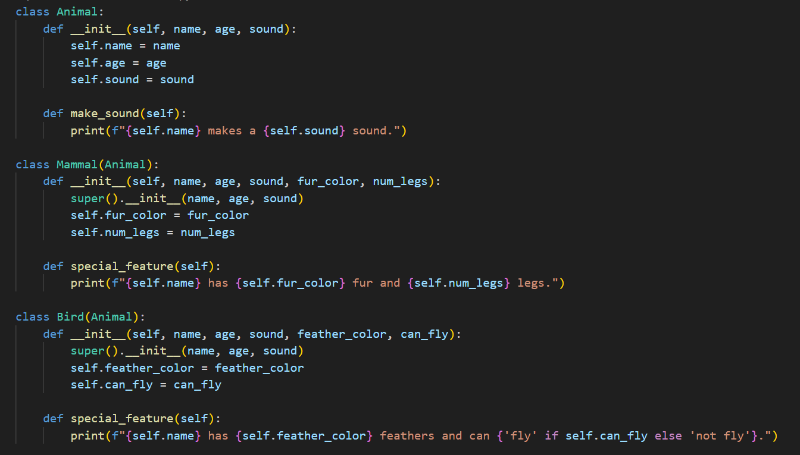
Exercise: Inheritance…

