Slide 1
Create Job
Web Server
Img Files
Selected Profile
Commands
Print,Stop,Cancel
Pause,Resume
Job Creator
Print Engine
Job File
Gcode File
All img Files
LCD
Print Data Dir
Screen Generator
Projector
Motors
Motion Controller
Log Manager

Slide 2
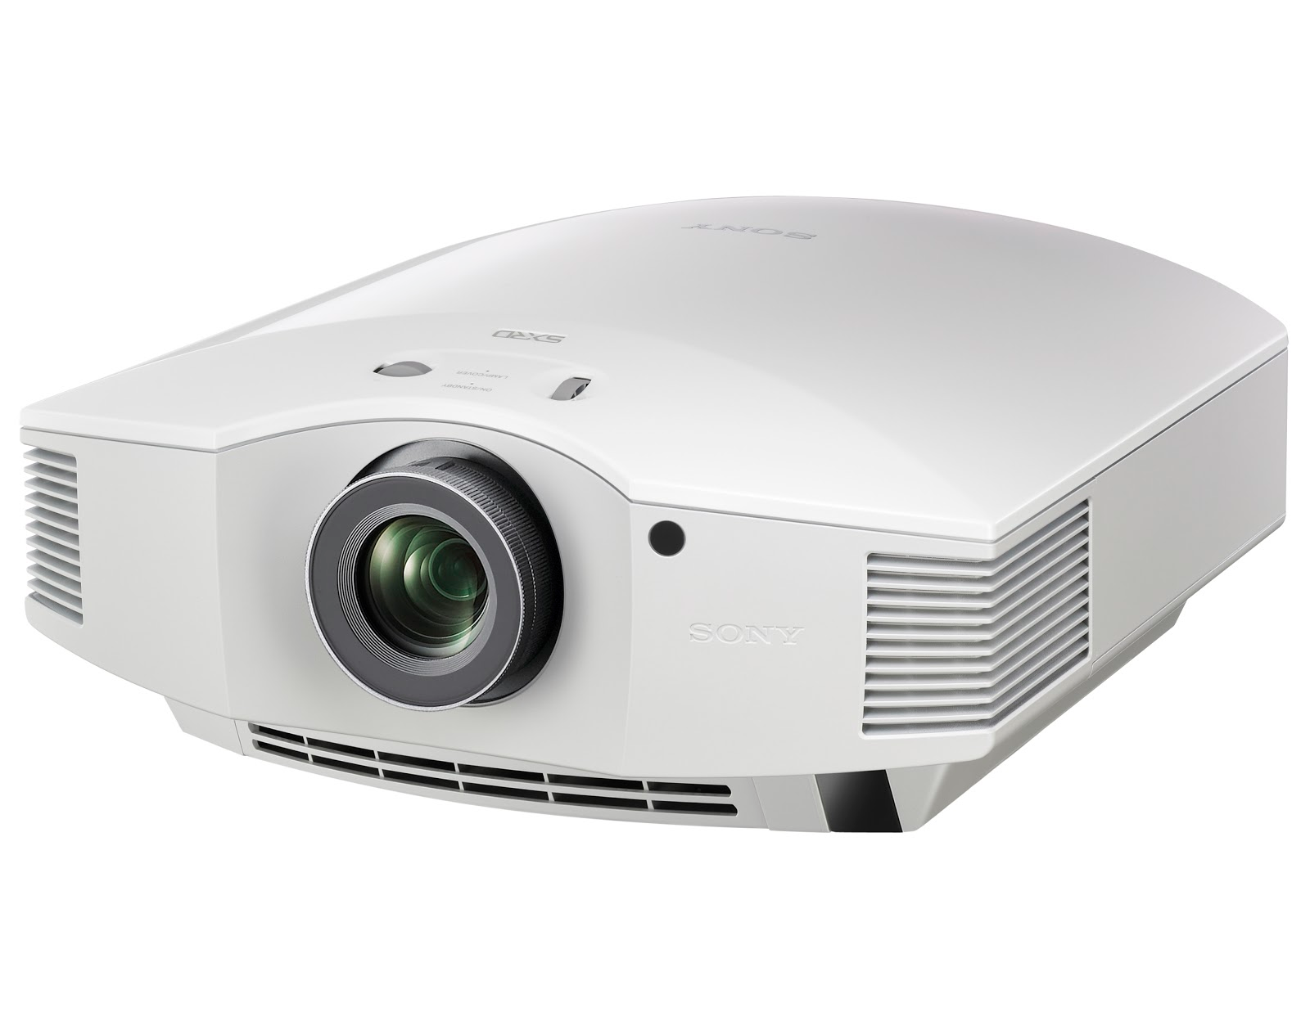
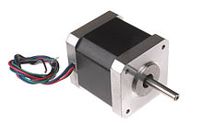
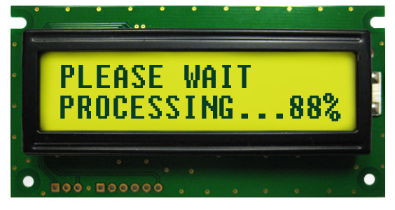
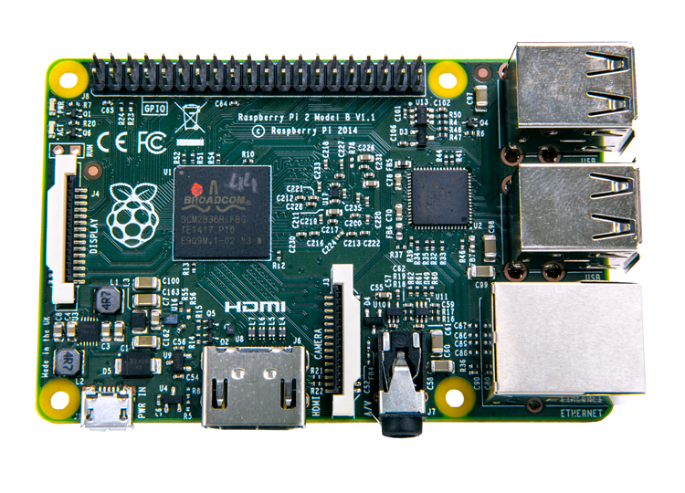
Print Manager
Create Job
File Upload
Materials
Printer Settings
Views
printDataDir
Img Files
Meterial Jsons
Settings Json
Model
Job Creator
Controller
Looper
Motion
Lcd Driver
Logger
Physical

