Slide 1
3D Printing of Body Parts
Riley Englin

Slide 2
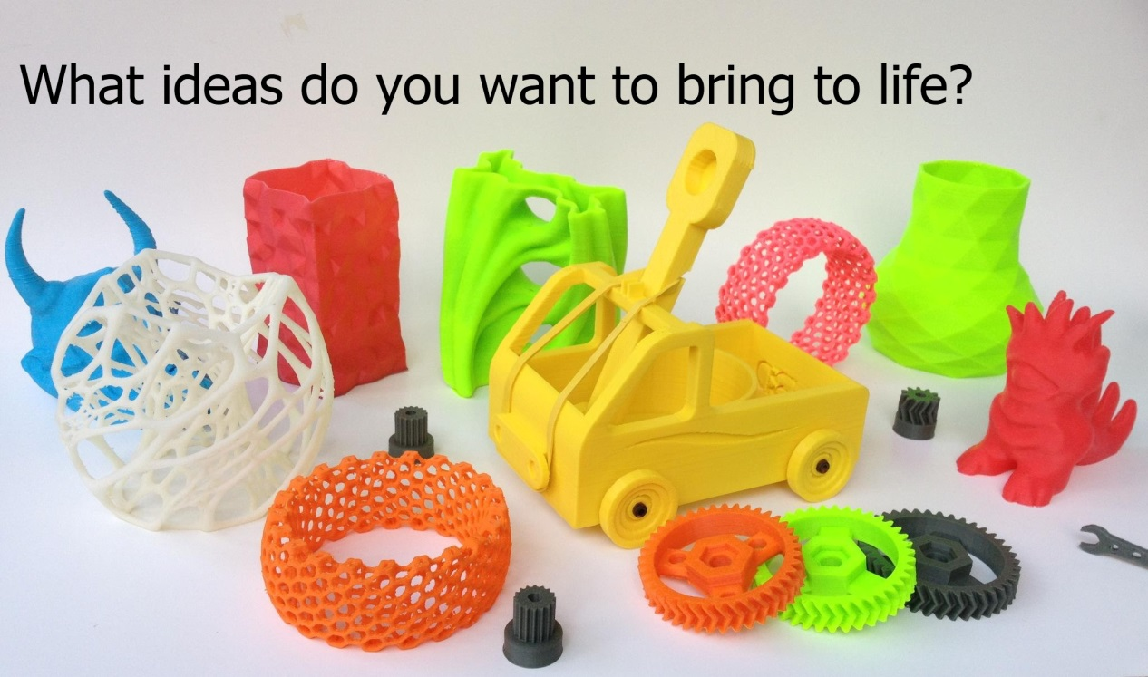
3D Printing
Computer-created digital models create real-world objects
Produced everything from jewelry to toys to food

Slide 3
How It Works
Digital Model
CAD, Modeling Software, Download Designs
Virtual blue print
Divides object into digital cross-sections
Print object layer by layer
.STL file
Standard Tessellation Language
3D polygons so printer can easily digest info

Slide 4
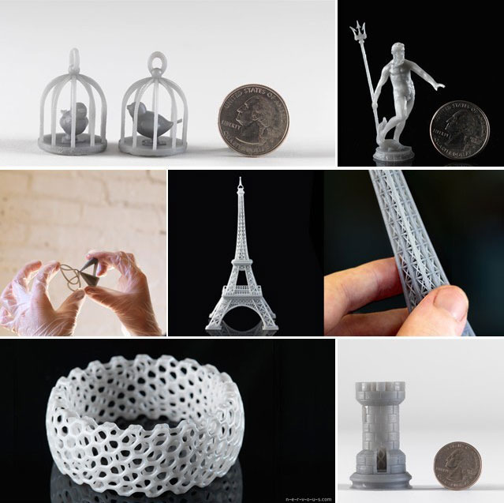
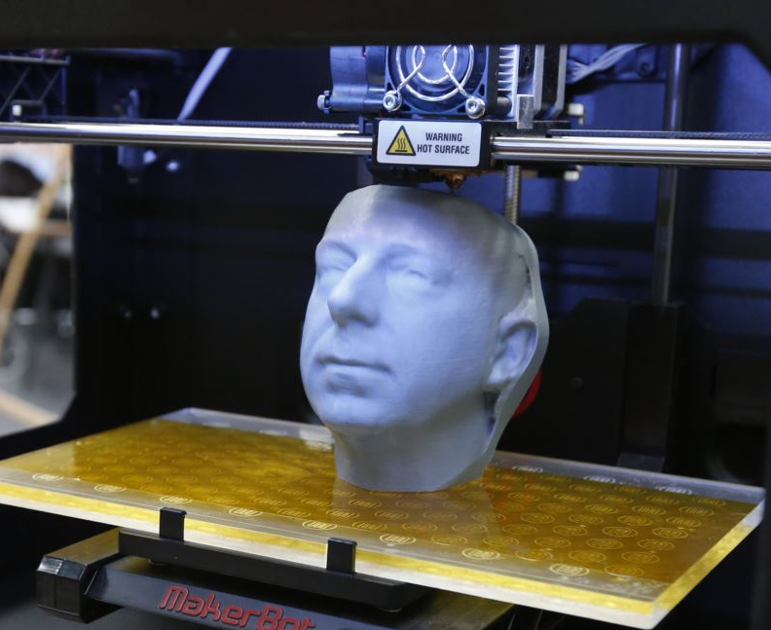
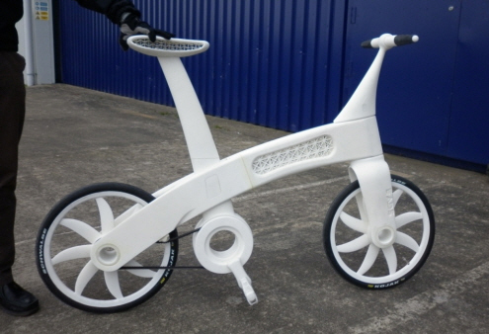

Slide 5
Body Parts
Scientists harvest human cells from biopsies or stem cells, then allow them to multiply in a petri dish
Result (“biological ink”) is fed into a 3D printer
programmed to arrange different cell types, along with other materials, into a precise 3D shape
Doctors hope that 3D printed cells will integrate with existing tissues

Slide 6
Organovo
CA company has printed strips of human liver tissue in its labs
4 X 4 X 1 mm strips
45 min to print, 2 days to grow and mature
Models can survive for about 40 days
Built models of human kidneys, bone, cartilage, muscle, blood vessels and lung tissue

Slide 7
Future Practice and Use
Bioprinting allows for placing cells in right places when building tissues
Could be ready to begin use in next 5 years
Need approval from the US Food and Drug Association
Could take up to a decade
Ethical issues?
Acceptance?
Notes:
Playing with God?
Only the rich can afford?

Slide 8
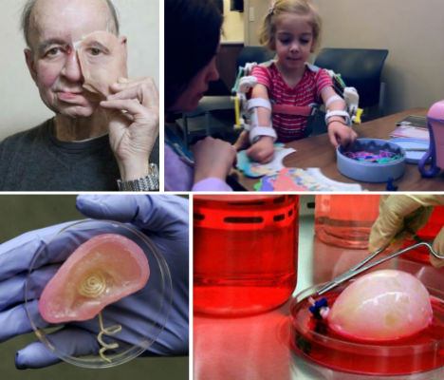
Notes:
This incredible 3D-printed bionic ear was made using an off-the-shelf 3D printer, combining human cartilage with an antennae. And get this: it hears better than a real human ear. The fully-functioning organ represents yet another intriguing possibility for augmenting the bodies of the deaf or those born without ears.
3D printing has made it possible for doctors to give a little girl with a genetic condition that will eventually render her arms useless a measure of self-reliance. Ekso Bionics created a light exoskeletontailored to two-year-old Emma’s body that gives her the use of her arms.
3D printing gave a man ravaged by cancer his face back in the form of an incredibly life-like prosthetic. Eric Molger lost almost the entire left half of his face to a tennis-ball-sized tumor, but doctors used CT and facial scans of the right side of his face to create digital blueprints for the prosthetic. The implant specialist behind this revolutionary medical miracle hopes to develop techniques that would allow 3D printing of similar body parts in silicone
Believe it or not, fully-functioning organs are possible, as well. Researchers have already successfully created a bladder. The organ is made by scanning the patient’s existing organ, printing a new one with bio-compatible materials, and seeding the result with tissues from the patient. This raises the possibility of ‘growing’ organs rather than relying on scarce transplants to save lives.

