Slide 1
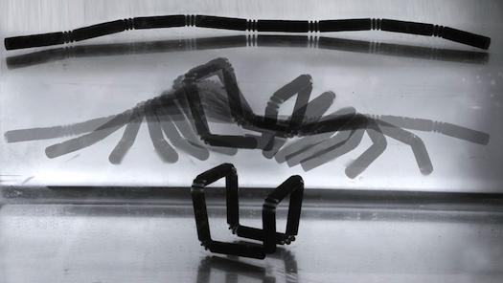
4D Printing
Peter Griffin

Slide 2
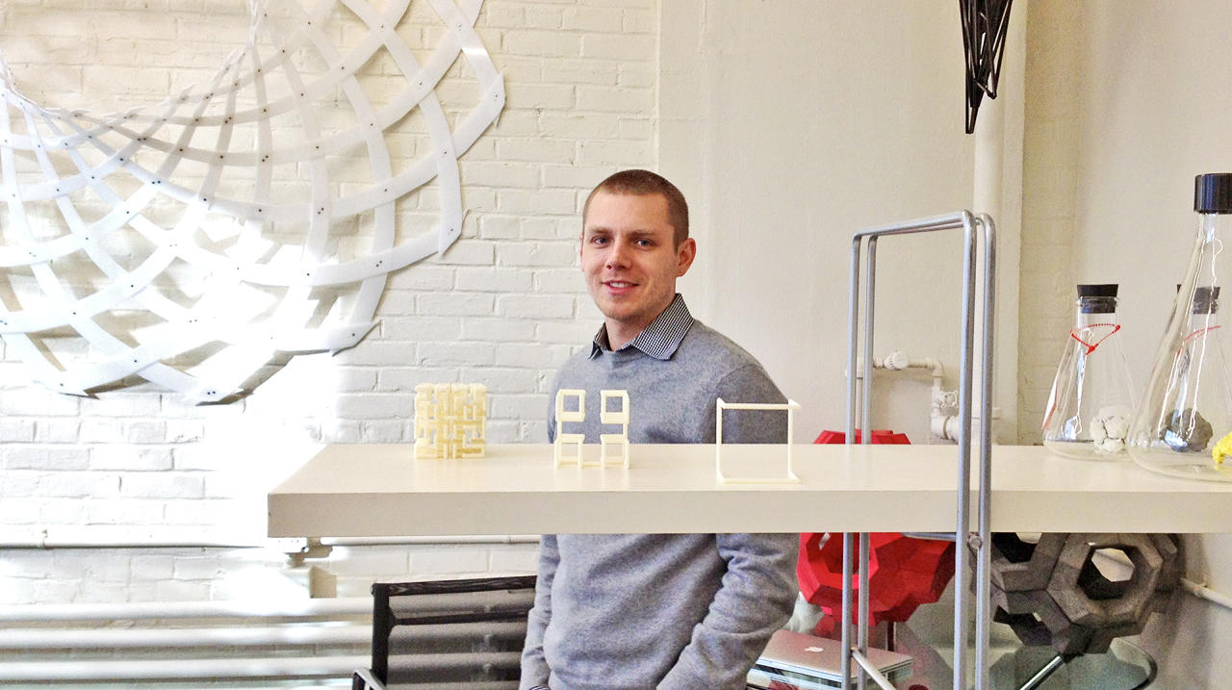
Introduction
Skylar Tibbets
MIT Self Assembly Lab
Stratasys

Slide 3
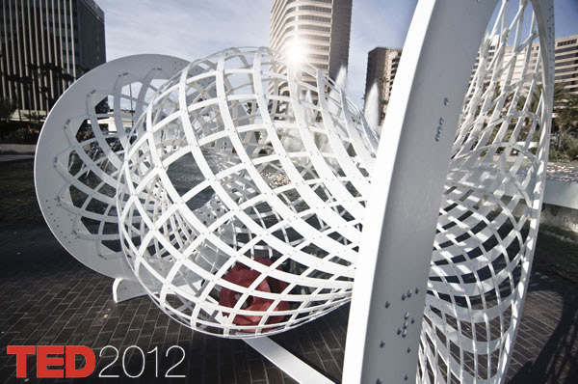
See it in action
Self Folding Cube

Slide 4
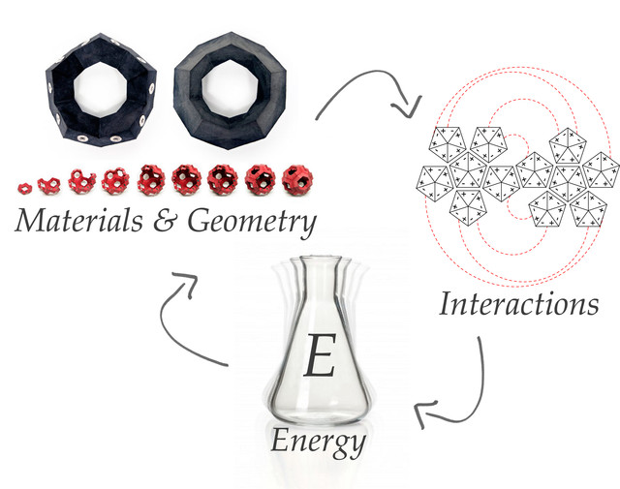
Material
Stratasys proprietary water absorbent plastic
150% size increase when immersed in water

Slide 5
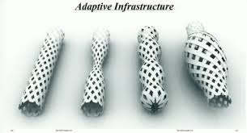
Future Implications
Other energy sources for modification
One possible use is pipes that contract and expand due to environmental factors

Slide 6
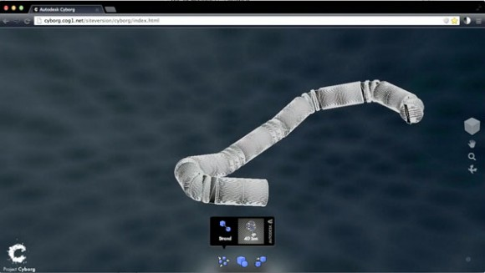
How it relates to this class
Autodesk Cyborg modeling
Testing materials for different energy sources

