Slide 1
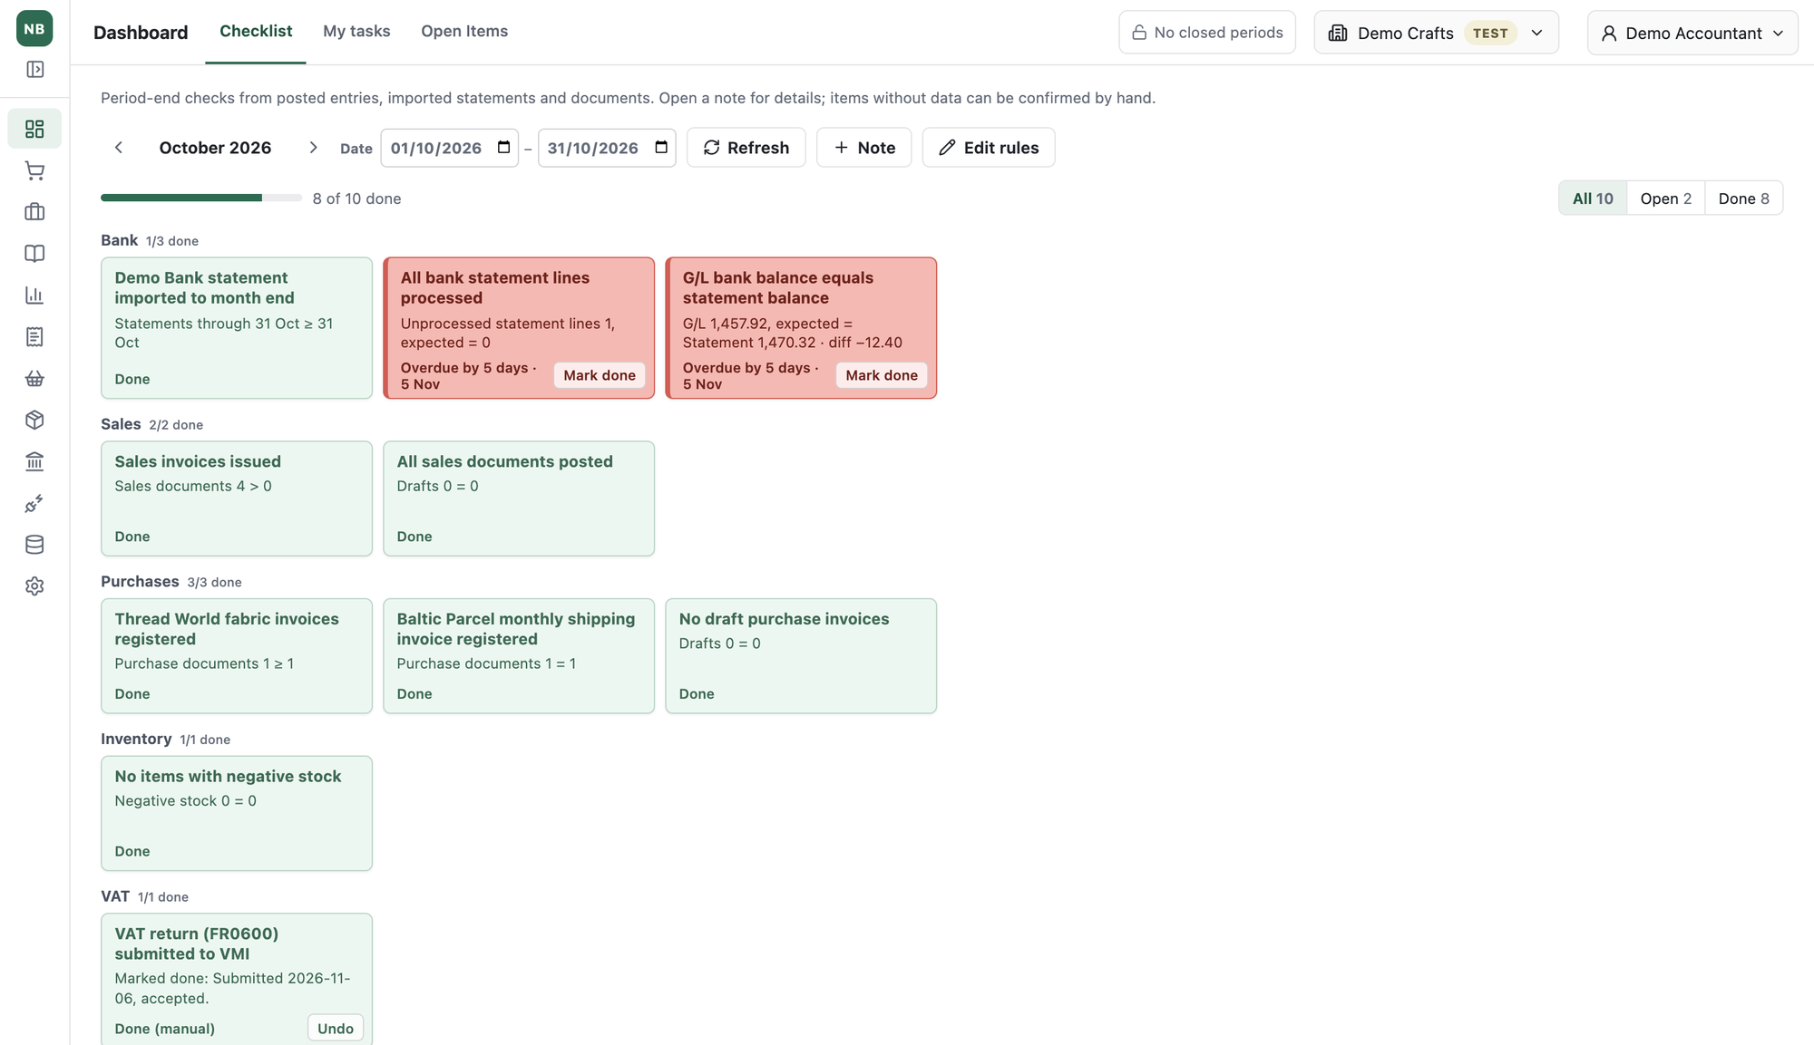
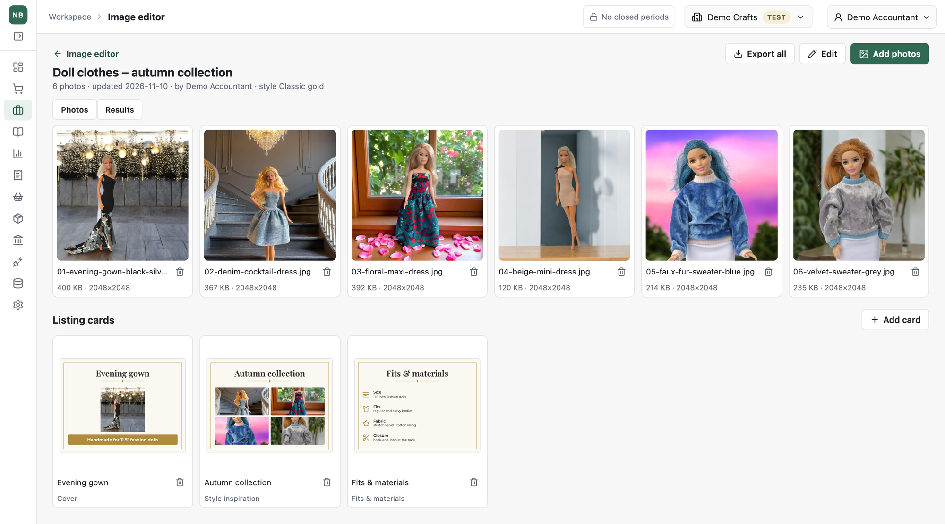
Neringa Bateikienė
Personal product portfolio
NB Accounting
Product content studio
Career CRM
Applications I define, direct and test, built with AI coding tools
github.com/neringabateikiene

Slide 2
What I do in these projects
AI tools write most of the code. I decide what is built and whether it is right.
1
2
3
4
5
Define the problem
Set the rules
Direct the build
Test with real work
Protect the data
Map my own working process: steps, records and data relationships.
States, business rules, exceptions and acceptance criteria. No accounting values in code.
Small reviewed changes, priorities and choices between design options.
Daily use, investigate mismatches, turn each finding into a rule and a test.
Separate data per organisation, role-based access, only fictional data in public.

Slide 3
NB Accounting
E-commerce bookkeeping built around rules, checklists and clear next actions
Marketplace orders, payments, purchase invoices and bank statements in one workflow, with explicit review and posting steps.
Import and stage
Review the draft
Post the document
Check and report
Etsy, WooCommerce, Faire, Amazon, PayPal, Stripe, bank
Mappings, VAT treatment, duplicates
Accounting and period rules
Checklist, VAT, OSS, i.SAF
My contribution: the import-review-post workflow, the checklist rule model and the VAT, OSS and i.SAF reporting rules. Every accounting value comes from settings and mappings, not code.

Slide 4
A check explains its result
One unprocessed bank line → two open checks
Eight of ten checks are done.
The G/L bank balance is 1,457.92 and the statement says 1,470.32: a 12.40 difference.
Each card shows the compared values, not just a red flag.
Rules are configured, not coded: two functions, an operator, a tolerance, a deadline.
Demonstration organisation with fictional data

Slide 5
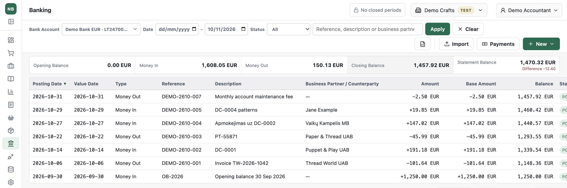
Rules that protect the result
Closed periods
Payment files
No accounting constants
Posting into a closed period must fail.
A bank export must satisfy its schema.
Another company or year may differ.
Drafts can block closing. Only the latest closed period can be reopened, with its own permission.
pain.001 files get amount and field checks, then validation against the XSD.
Accounts, VAT codes and rates with validity dates, series, countries and carriers are all settings.
The bank register shows the same 12.40 gap: statement 1,470.32 against 1,457.92 posted. The open line still has to be matched.

Slide 6
Product content studio
Listing photos, sewing guides and shop texts for a handmade doll-clothes shop
Photo sets
Cut-out, light, size and listing cards in one style
Sewing guides
Sections and steps, DOCX and PDF export
Listing texts
One text per shop, within each channel’s limits
Pattern Tracer
Paper pattern photos to vector pieces

Slide 7
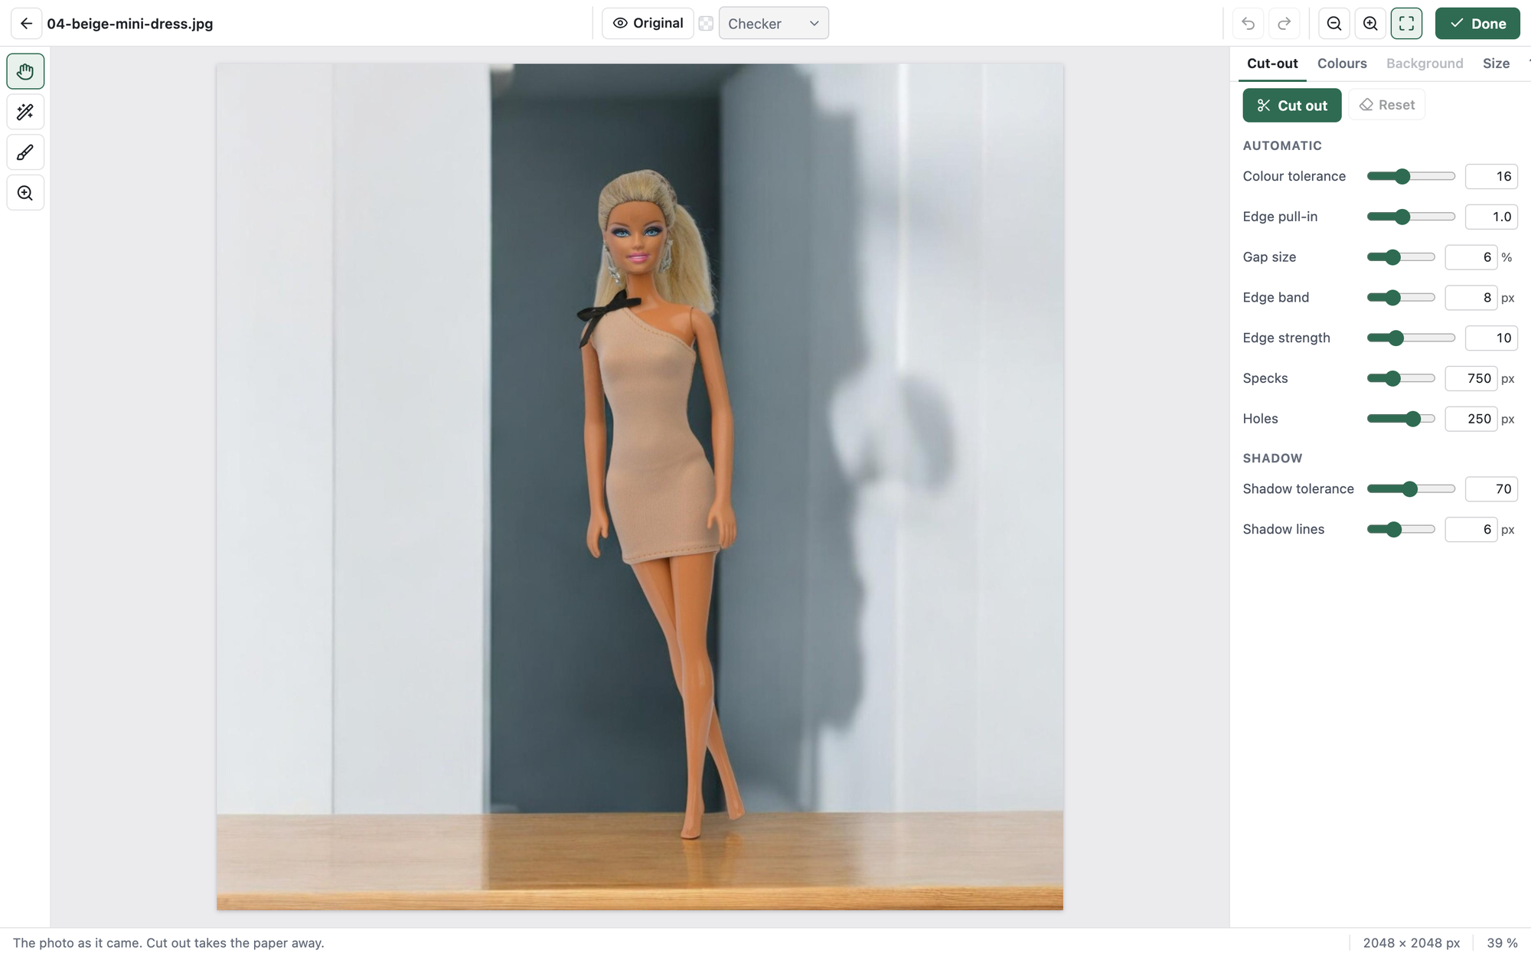
A decision I can explain
No generative AI in the product content
Why it matters
Buyers must get what the photo shows.
How it works
Background removal by colour and edge rules, every setting visible; hand corrections outrank later recalculation.
Acceptance
Uploads with an AI-generator mark are refused; exports carry no metadata.

Slide 8
Career CRM
A personal job search workspace
Job opportunities, applications and interview history connected in one workflow.
Discover jobs
Check and organise
Track the application
Record the outcome
AI search, Sheets imports, URL checks
Normalised URLs, duplicate checks, A–D priority
Events, dates and status rules
Manual closing with a preview
My contribution: the application, advertisement and event model, and the status rules that keep history consistent.

Slide 9
AI proposes, I review
Nothing changes the record until I have checked it
Email
AI event proposal
Review and edit
Validate and save
Why it matters
Acceptance example
Uncertainty stays visible
A suggested interpretation should not silently alter the application history.
An interview-rescheduling email must not create a second interview stage.
A working link does not prove the vacancy is open; unknown stays unknown.

Slide 10
What these projects demonstrate
Capability | Evidence
User needs and priorities | Three applications shaped by work I do myself
Business rules | VAT, OSS and i.SAF rules, checklist rules, status rules
AI-assisted development | Written plans, small reviewed changes, independent review, tests
Quality and acceptance | Posting controls, failure cases, daily use against real records
Responsible data | Organisation isolation, roles, no generative AI in product content
Personal applications under active development · github.com/neringabateikiene

