Slide 1

PhishX
AI-Driven Threat Intelligence & Scam Prevention Ecosystem
PhishX
Unified Scam & Phishing Protection Platform
Team: CipherStorm
Track: Security

Slide 2


In Today’s Hyperconnected World,
CyberCriminals are Evolving Faster than Users can Adapt.
1
2
3
People fall for lookalike URLs, fake UPI requests, and SMS-based loan/offer scams daily.
Most users lack awareness or delay responses, causing financial loss, identity theft, and data compromise.
Existing security tools are often complex, non-integrated, or platform-limited (e.g., only for browsers or desktops).
95% of cybersecurity breaches are caused by human error.
Over 60% of frauds in India happen through phishing SMS or UPI links.
Every 39 seconds, there's an attempt to steal sensitive user information online.

Slide 3
Features
Existing Apps
PhishX
Real-Time Phishing URL Protection
❌ Limited to browser-only extensions in apps like Norton and Avast.
❌ No real-time network-wide protection.
✅ AI-powered URL scanner detects phishing/malicious links.
✅ Works in real-time across mobile, browser, and network.
SMS Fraud Detection (NLP)
❌️ Basic spam detection (e.g., Truecaller).
❌ No advanced fraud message classification or financial scam detection.
✅ NLP-based analysis of incoming SMS.
✅ Detects fake UPI, loan fraud, phishing messages.
Raspberry Pi Network Layer Protection
❌No apps offer IoT-based phishing protection.
❌ Cannot block phishing links at router level before reaching device.
✅ Raspberry Pi acts as a network-level firewall.
✅ Intercepts all traffic and filters phishing URLs using OpenPhish API.

Slide 4
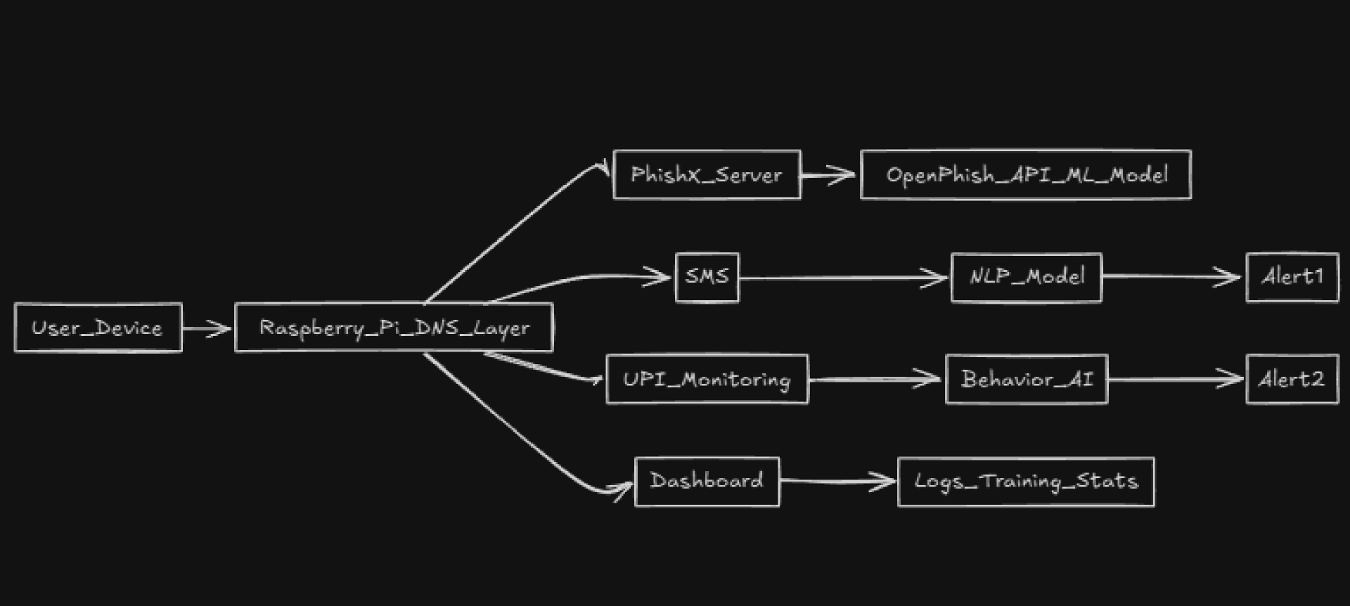
How PhishX Works ?

Slide 5






Technical Stack
Frontend: NextJS, Tailwind CSS
Backend: OpenPhish API, AdGuard API
Mobile App: Kotlin & Jetpack Compose
URL Classifier: Python+ OpenPhish API + Domain Reputation Scoring
SMS NLP Detection: PyTorch + TF-IDF + Neural Network

