Slide 1
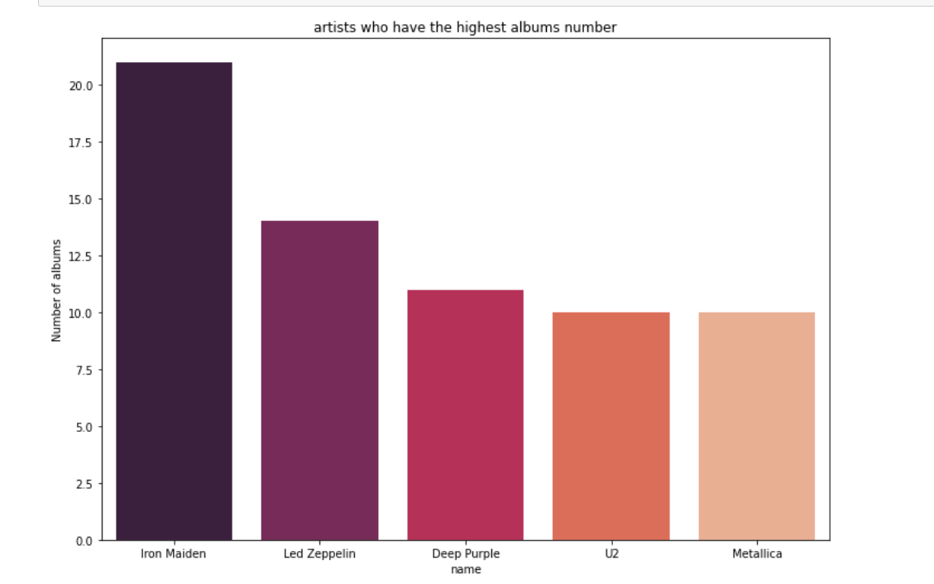
Artists who have the highest albums number in chinook ?
<visualization>
Those are the artists who have the most number of albums in chinook presented by a bar chart

Slide 2
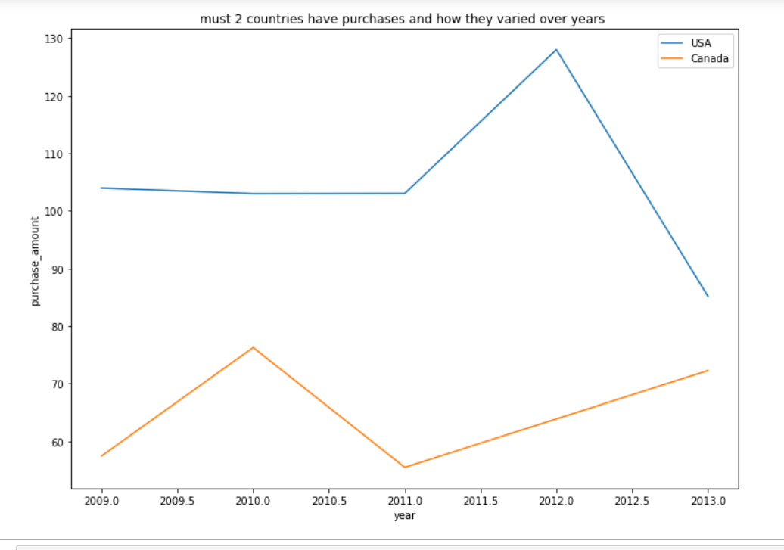
what are two countries have the highest purchase ? and how they performed over years?
<visualization>
Here is a lineplot shows the variation of purchase amount of the highest 2 countries over years

Slide 3
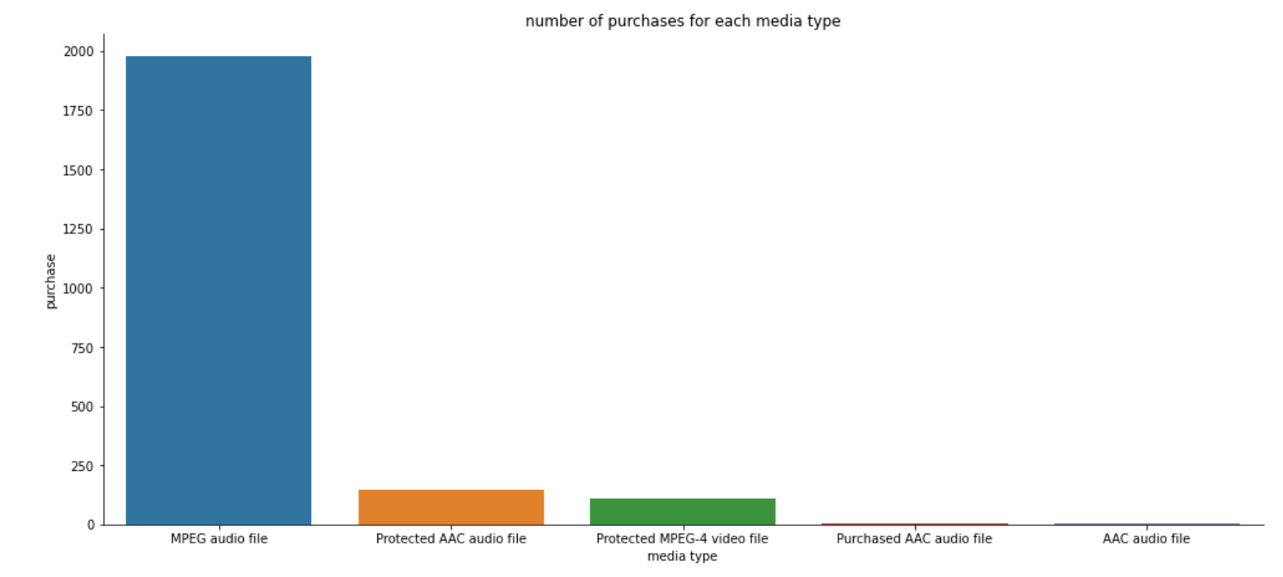
what is the number of purchases for each media type?
<visualization>
The bar chart shows each media type with the shown in the graph MPEG audio file has the highest purchases among other types

Slide 4
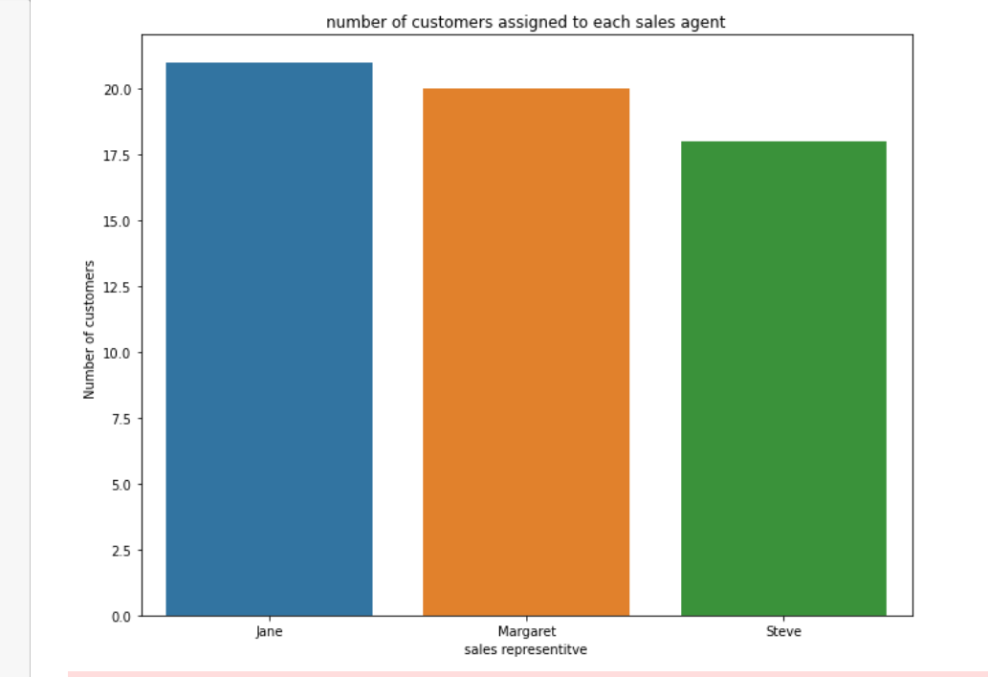
number of customers assigned to each sales representative ?
<visualization>
a bar chart shows each sales representative name with number of assigned customers to this agent

