Slide 1
stylist
A mobile application called stylist
Dr. Tamer Fathy

Slide 2
TEAM members
Hager Shaheen
Nermeen Ayman
Nourhan El-ghazaly
Backend developer
Backend developer
Backend developer
Waleed maher
Waheed Ashraf
Menna Waleed
Flutter developer
Flutter developer
Flutter developer & ui ux
Nourhan Sabry
Flutter developer & ui ux

Slide 3
01
Team members
02
Introduction
03
TABLE OF
CONTENTS
Competitors
04
System design
05
Life cycle
06
Languages and Frame works
07
Tools
08
Features
09
Challenges
10
Upcoming Features
11
Video of our application

Slide 4
Introduction
People before were confused about how to get styled the way they want without seeking the professionalism help or even pay for it.
Fashion was once limited to celebrities
but now everyone has their own style

Slide 5
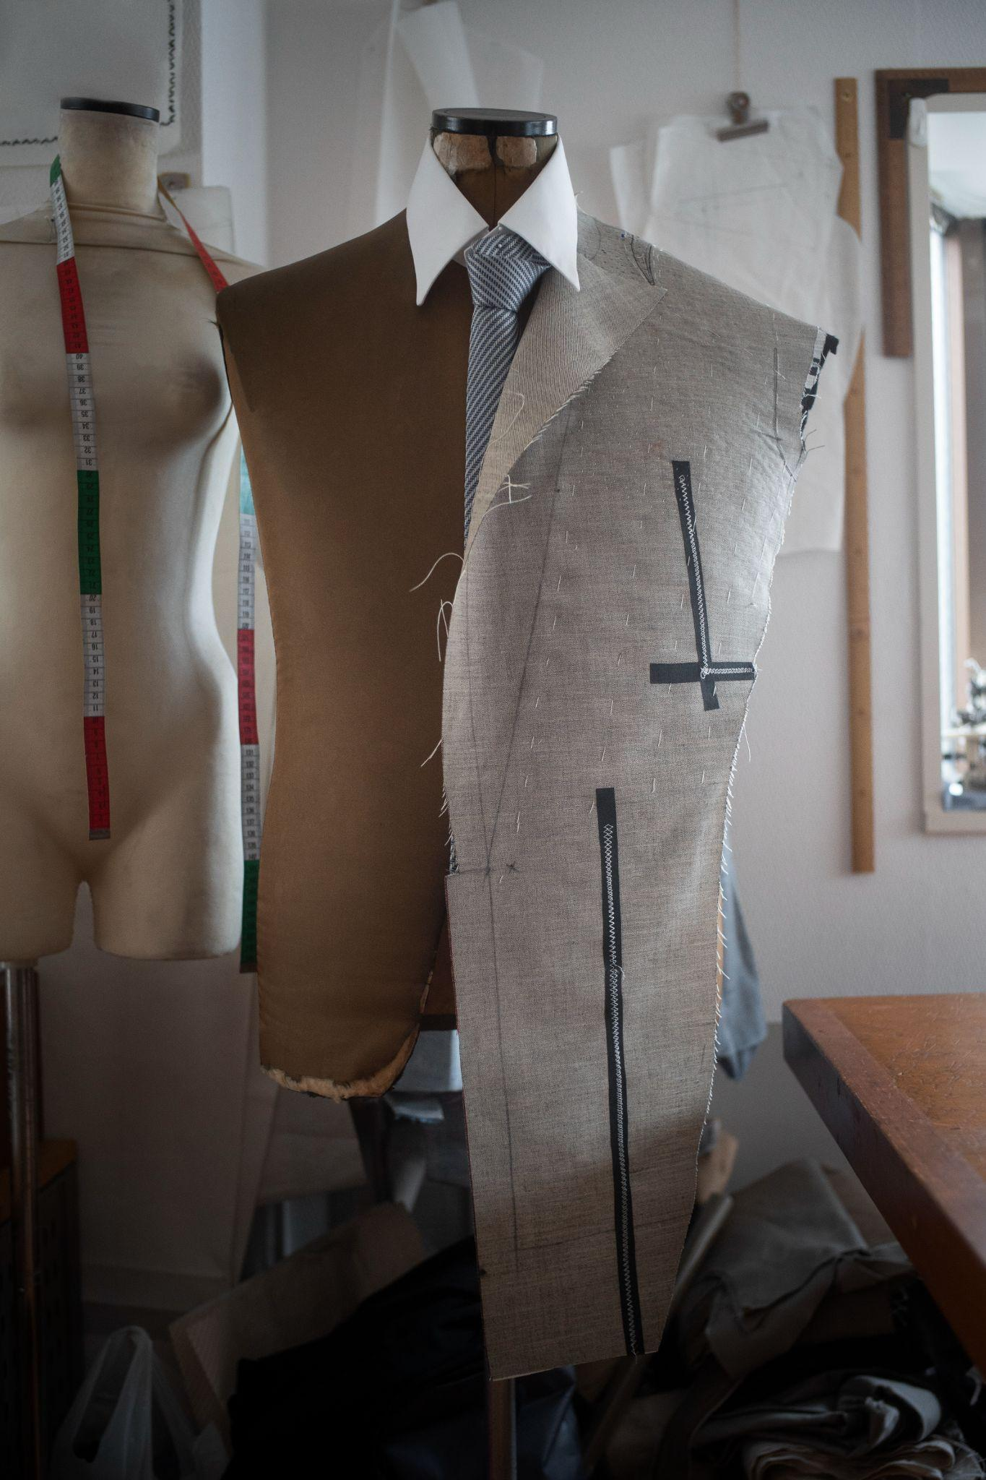
Problem is
s
I want to get dressed well and get that fabulous outfit that i imagined without studying this field for years
The traditional solution was turning to specialists and paying sums of cash without guarantee that you will get what you imagined
or going out that day without complete satisfaction with the outfit
motivation

Slide 6
Stylist
app
So we build this stylist application so users could meet their interests, share opinions about styling easily

Slide 7
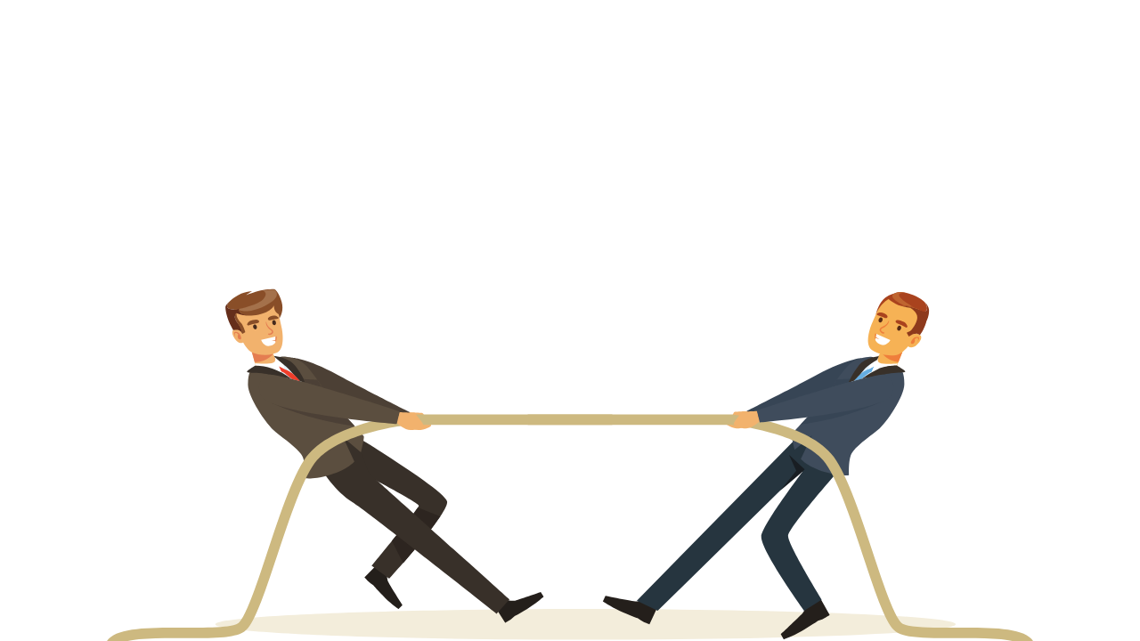
Competitors
We studied applications for the same idea like:
found disadvantages
such as problems with security, not easy to use, not organized enough or only for women.
Stylepedia
Compyne
Dress App

Slide 8
What we provide..
design
Tips
easy to use and organized in comfortable colors for the eye
Inspiring a new style, new forms outside the traditional, letting the users to rate it.
favorites
Interests
favorites
allows users to choose from lists of items, places and aesthetics that match their interests.
Save the posts you liked in a specific place, so that he can return them at any time.
Save the posts you liked in a specific place, so that he can return them at any time.

Slide 9
System Design
Requirements
1 - Upload images from mobile client
2 - Users follow each other
3 - Generate a feed of images
4 – user get notifications
5 – user interactions (comment, Like and Share)

Slide 10
System design
Feed Generation Service
App Server (Read)
Read
Metadata DB
Load Balancer
Cache
Mobile Client
App Server (Write)
File Path
Upload
Object Storage (S3)

Slide 11
Life cycle
1- Planning & Analysis: starts from information gathering and people’s needs to the step of analyzing requirement then, convert it into product correctly to match the SRS.
We used agile method in project management. Starts with:
5- User experience testing: We also tried to test the app by users to see if the app is user friendly.
2- Design: we used adobe xd to make the UI/UX and using sqllite for the database.
4- Testing: we tested our app many times during the implementation, found errors then corrected it.
3- Implementation: we used dart and flutter framework for mobile application and python language as a backend development.

Slide 12
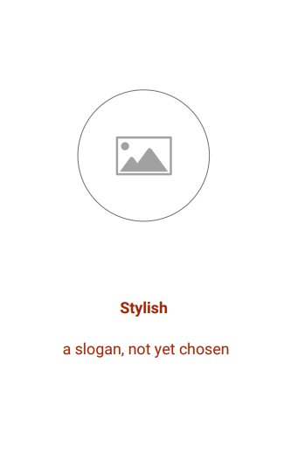

Tools used
Android Studio
Visual Studio Code
PyCharm
Your way to be stylish
Postman
Sourcetree(gitlab)

Slide 13
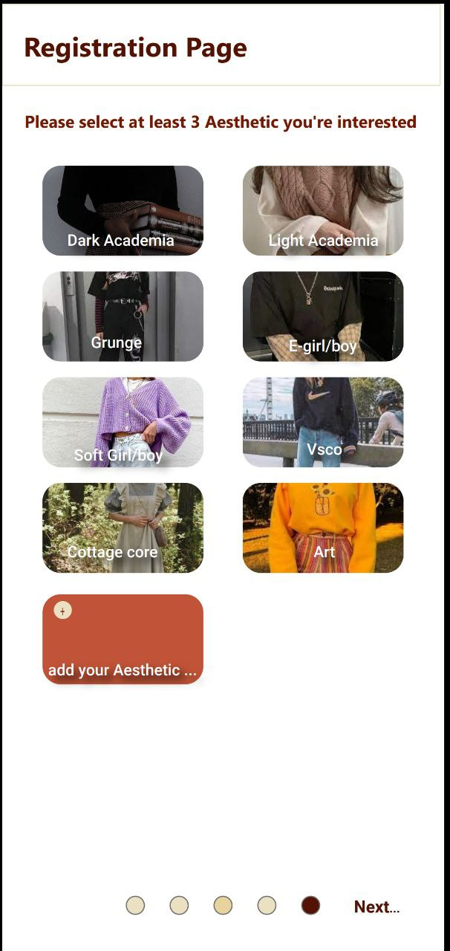
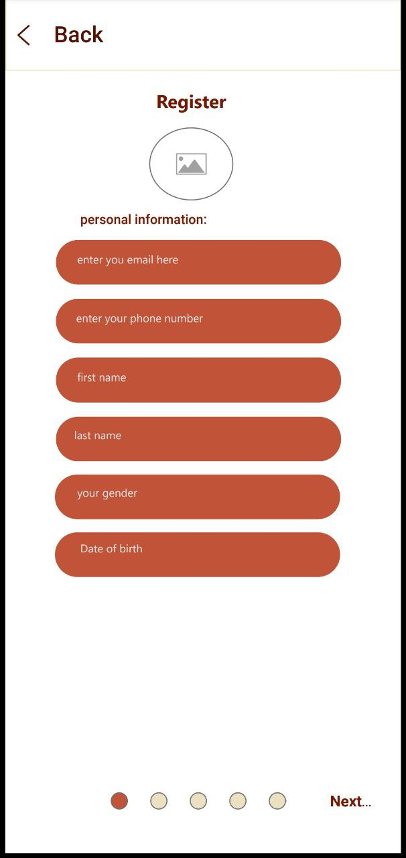
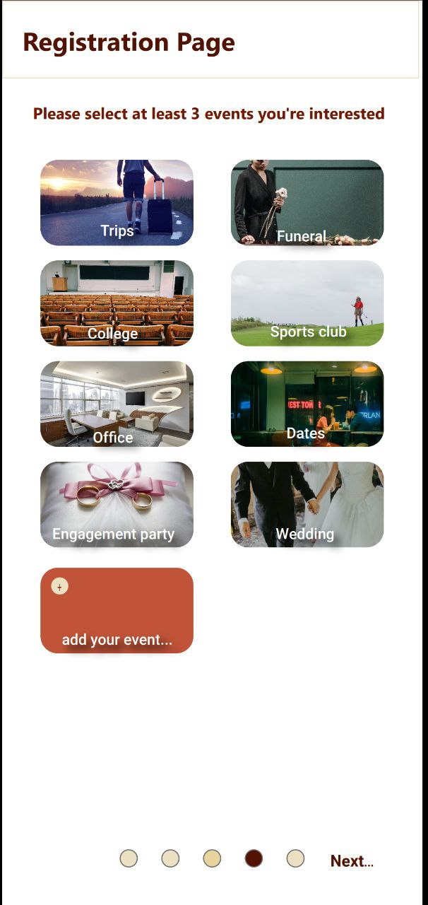
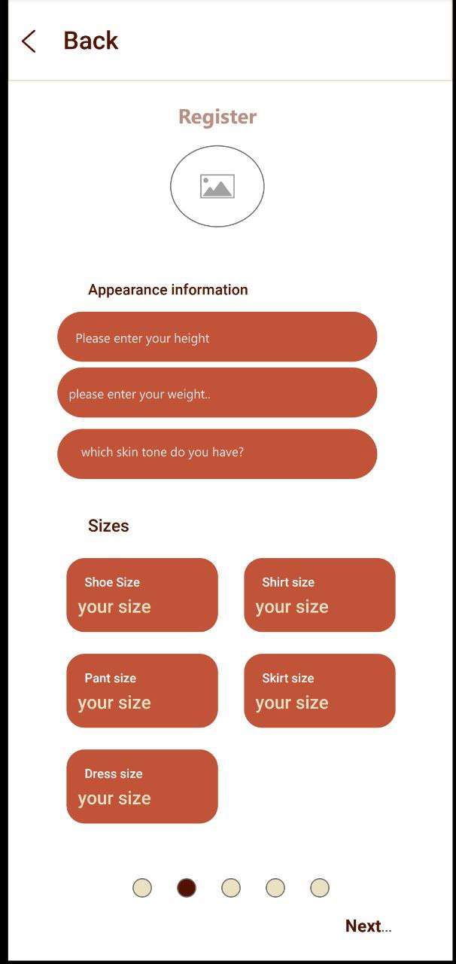
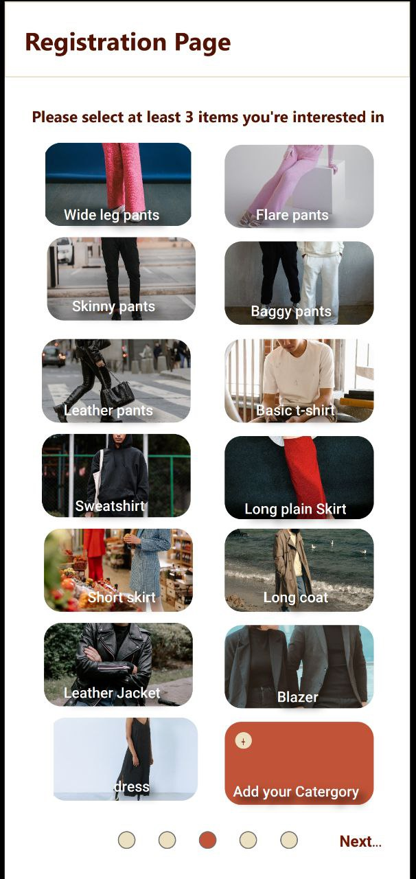

Features
Registration
consists of 5 pages

Slide 14
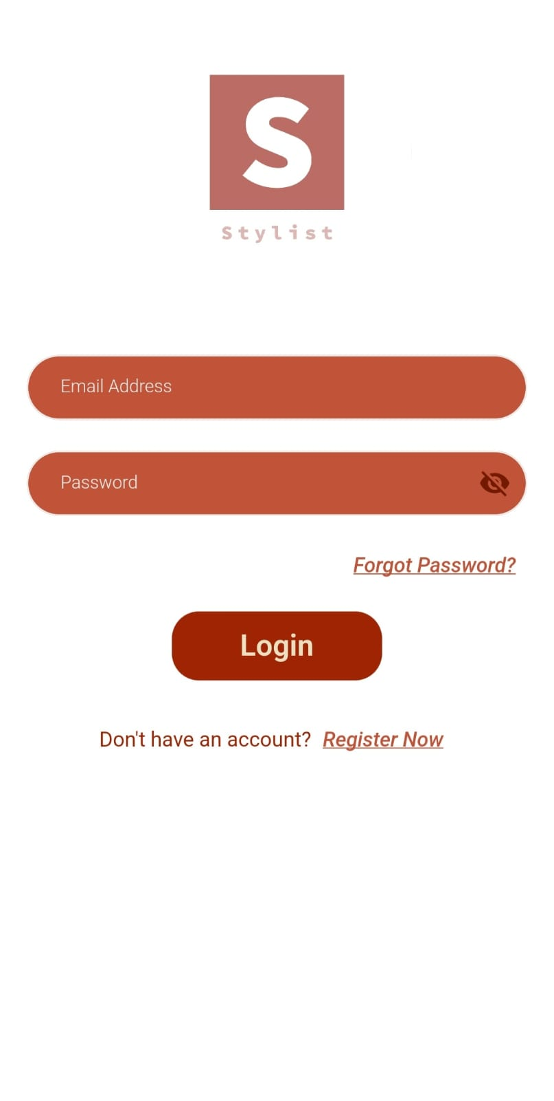
Features….
Login
If you have an account login and move to the home screen
You can go through the app as a guest user but without making any interactions

Slide 15
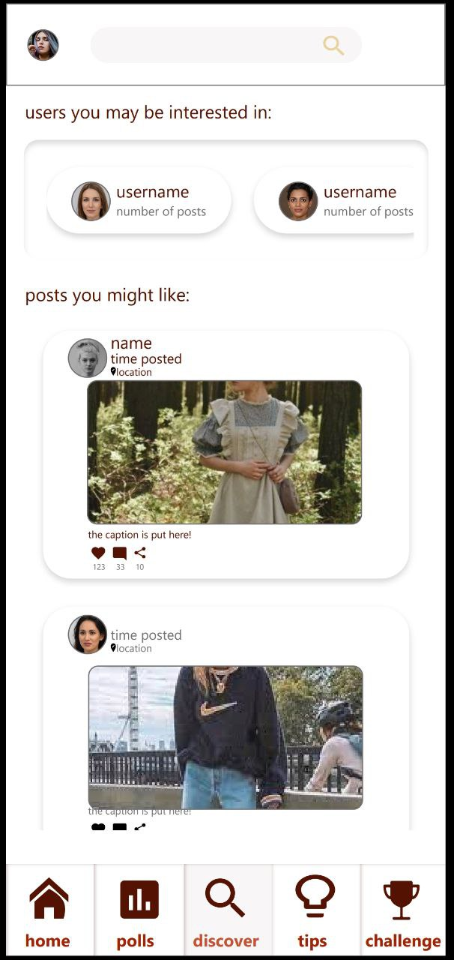
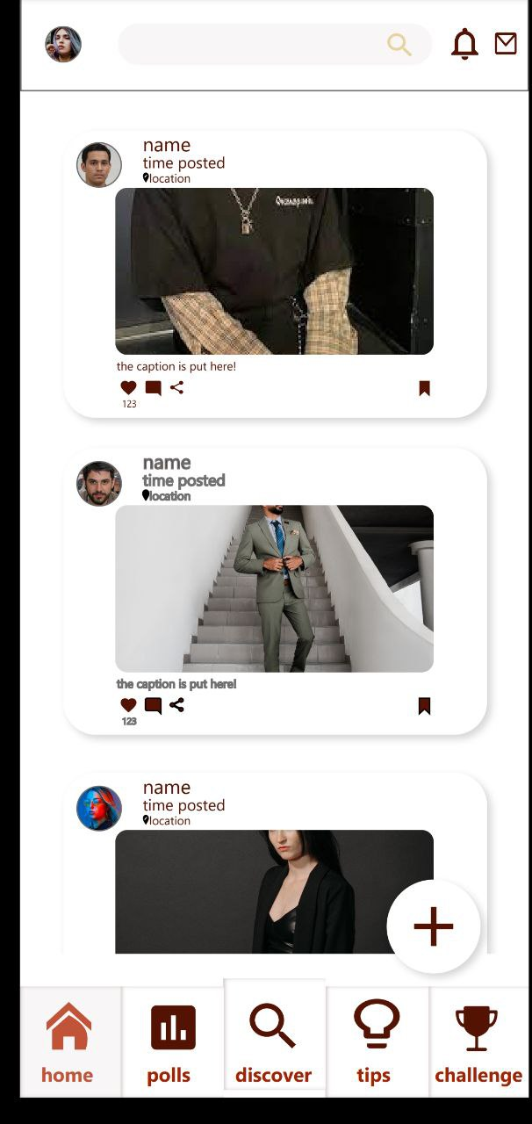
Discover Screen
Home Screen

Slide 16
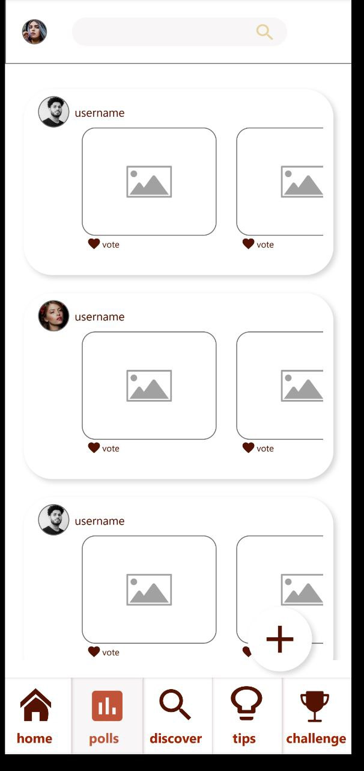
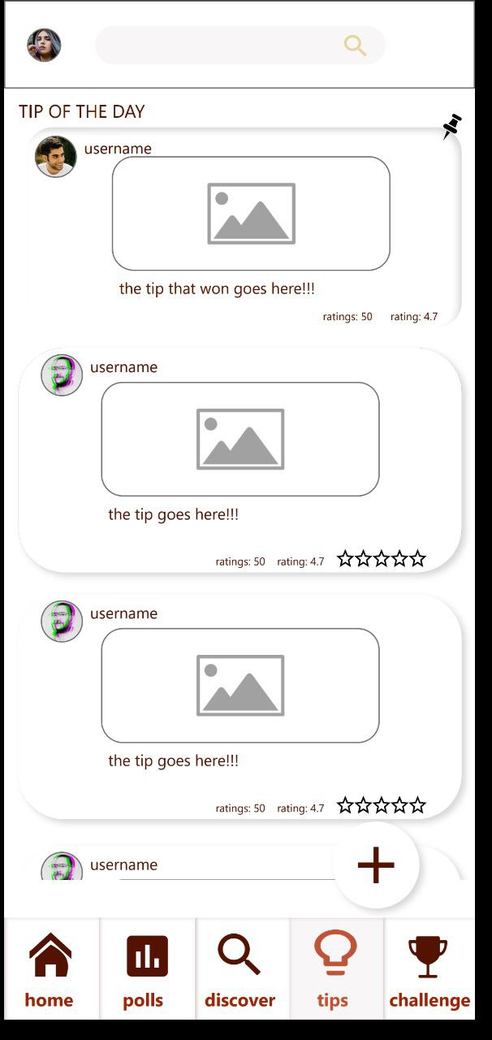
Polls Screen
Tips Screen

Slide 17
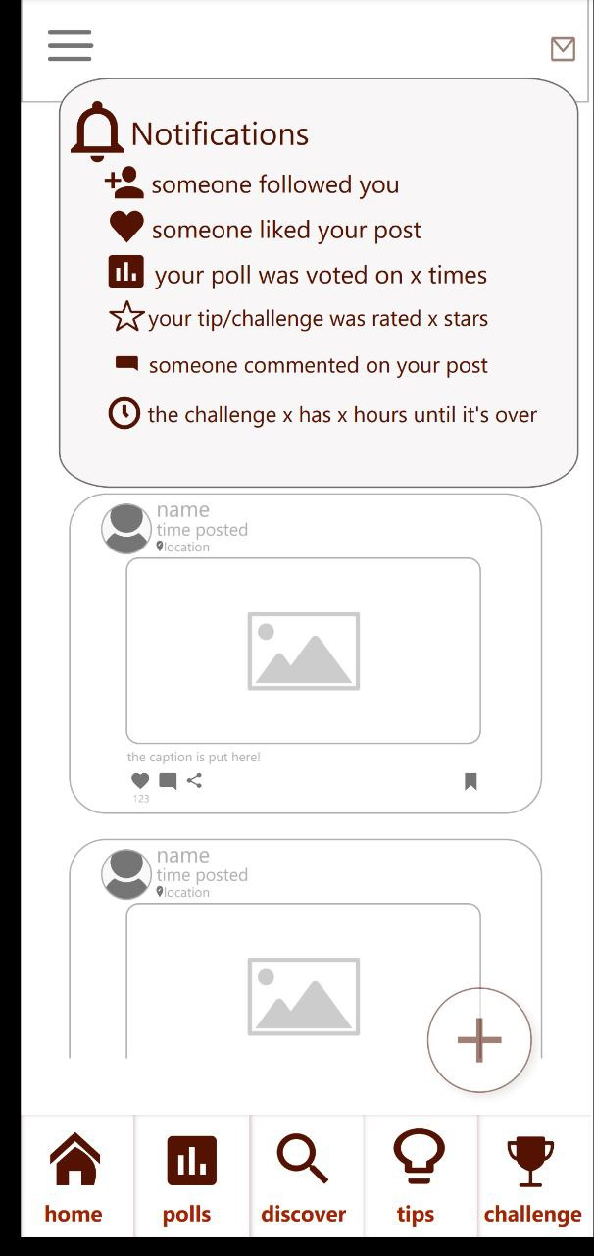
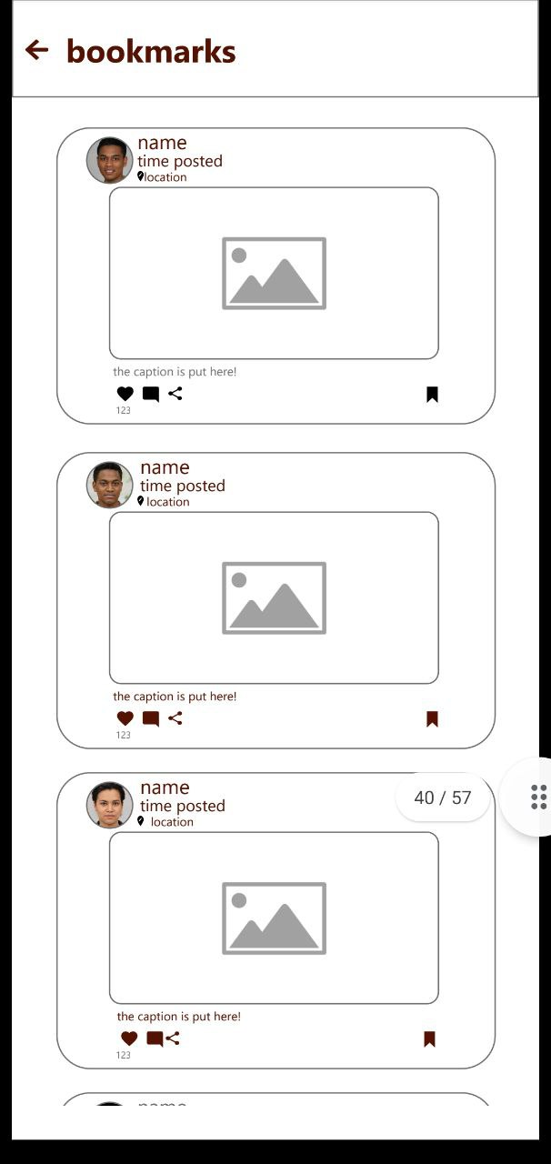
Notifications Screen
Bookmark

Slide 18
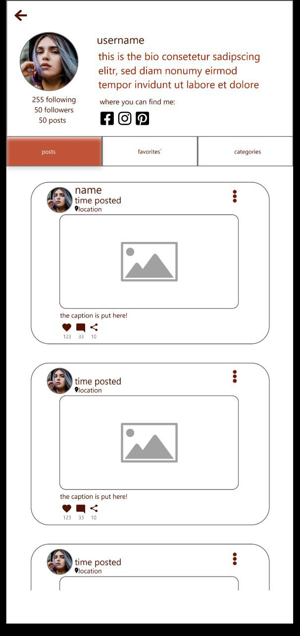
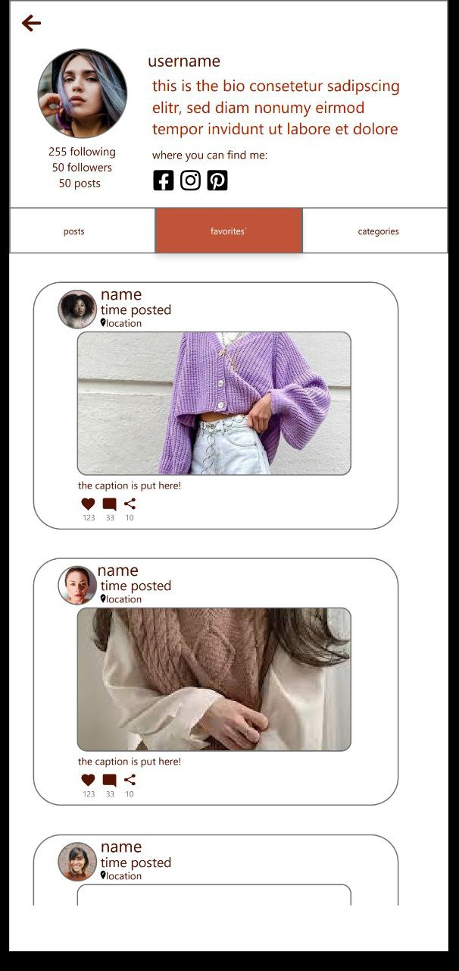
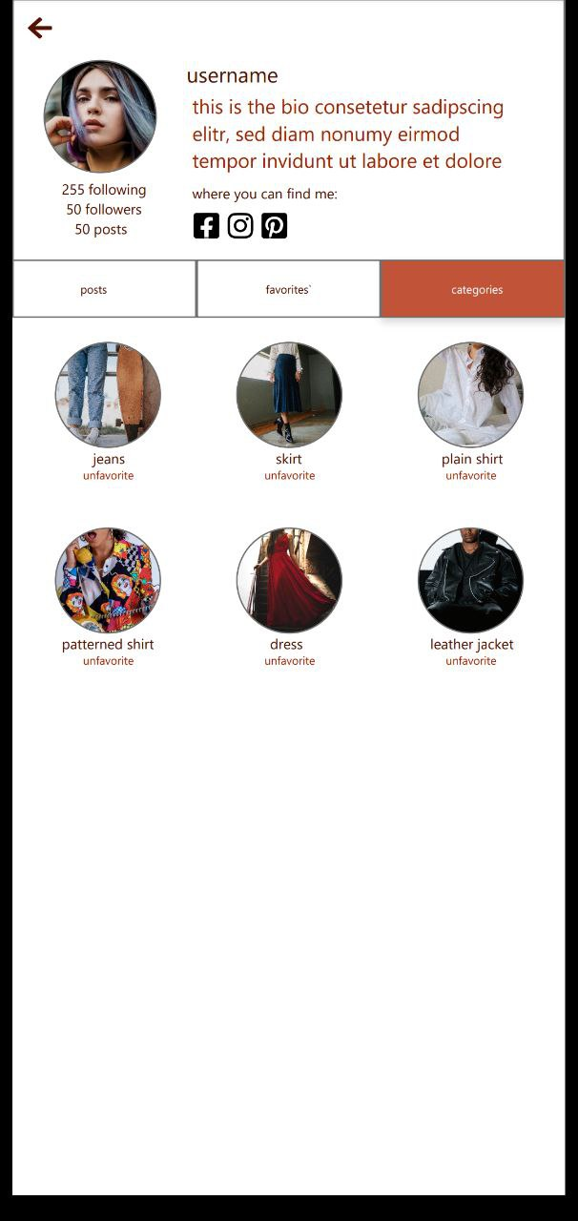
Profile Screen

Slide 19






Challenges
Finding a unique
project idea
finding appropriate UI/UX design
Planning project
with the team
Real-Time updating approach
Writing
Clean code
Completing the application on time

Slide 20
Upcoming Features
Market
where users can sell and buy other user's old or used clothes
what’s next?
challenges
with a variety of challenges themes, users could participate and compete to win the best outfit
Chat room
where users could contact in private with each other

Slide 21
Now we'll leave you with a short video
to let you know our application better

