Slide 1
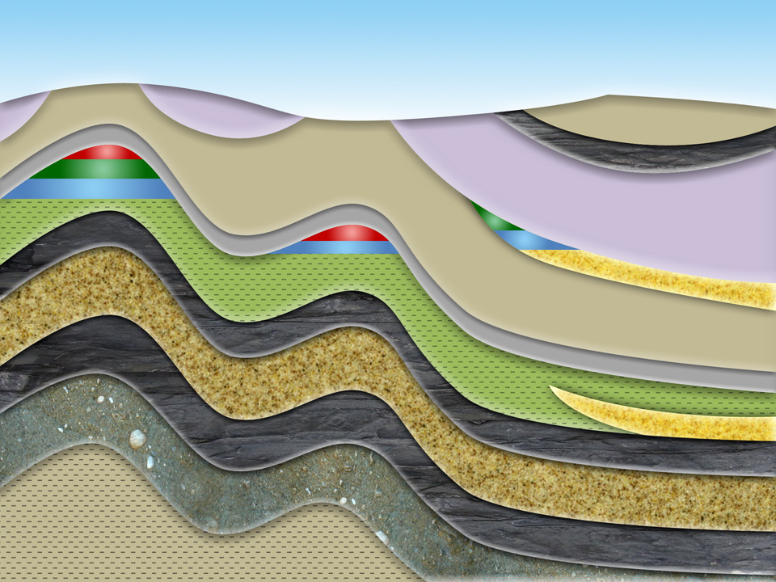





SweetSpot Identification through Machine Learning for Unconventional Plays
Jingnan Xue
Summer 2015

Slide 2
Agenda
 | Task Accomplished
1 | Universal Kriging
2

Slide 3
1.0
Universal Kriging

Slide 4
Data aggregation
For each variable in each core well, we have several measurements. Three methods can be applied to aggregate those measurements:
Mean
Trimmed Mean
Calculated with only the middle 80% of the data
Mean calculated without outliers
IQR=Q3-Q1
Values smaller than Q1-1.5IQR or larger than Q3+1.5IQR are identified as outliers

Slide 5
kriging
For each variable, Kriging can be used to predict its value in any production well based on the values in core wells.
Kriging is a name for Best Linear Unbiased Prediction for spatial statistics
Three Types of Kriging
Simple kriging: when the mean is a known constant
Ordinary kriging: when the mean is an unknown constant
Universal kriging: when the mean is a function of covariates, the default case is a low-order polynomial function of locations. We use universal kriging in this project.

Slide 6

Universal Kriging
One example to show how to apply universal Kriging in R
KrigTmax<-Krig(x=location, Y=Tmax)
Location is an m$×$2 matrix, recording the latitude&longitude of each core well
Tmax is an m$×$1 matrix, recording the aggregated Tmax at each core well
This function produced a Kriging object which is used to do predictions
predic.Tmax<-predict(KrigTmax,location)
KrigTmax is the Kriging object produced before
Location is a n$×$2 matrix, recording the latitude&longitude of each production well
This function produced a n$×$1 matrix, recording the prediction of Tmax at each production well

Slide 8
2.0
Data and workflow

Slide 9
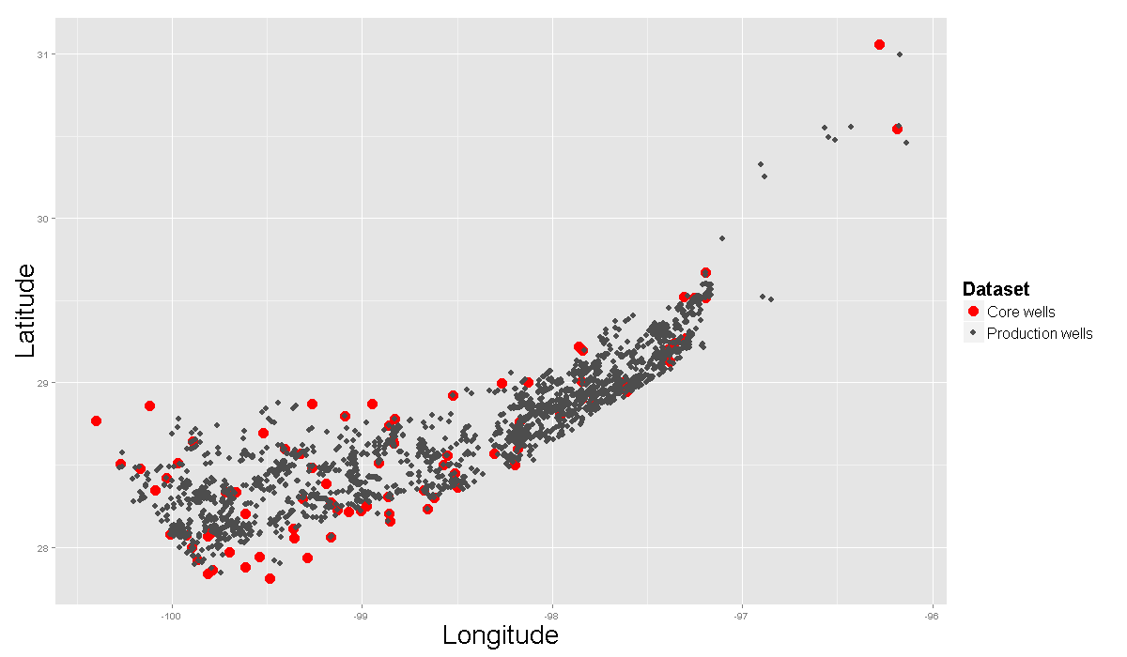
Data (EAGLE FORD)
Oil production & cored wells distribution
2631 oil production wells
81 cored wells

Slide 10
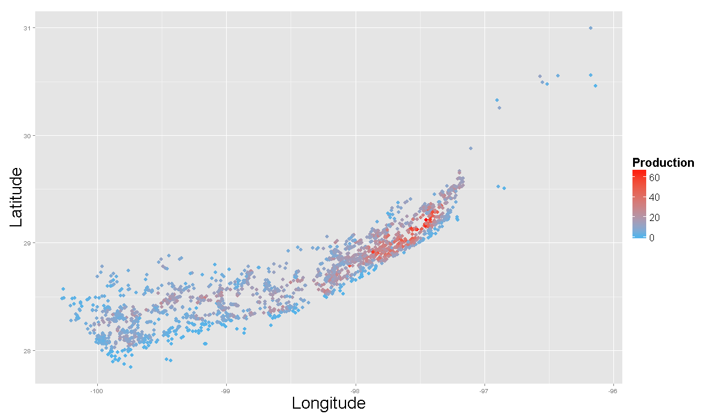
Data (EAGLE FORD)
Production Heat Map

Slide 11
WORKFLOW
Raw Data
Data Integration
Preprocessing/
Outlier Removal
Interpolation
Interpolated Feature Map
Stratigraphy Aggregate
Geological Feature Interpolated Map
Engineering Parameters
Predictive Modeling
Core Analysis Data
Predictive Modeling
1st 12-mo. Production
Well Logs
Normalized 1st 12-Month Production
Predictive Model

Slide 12
3.0
PREDICTIVE MODELING

Slide 13
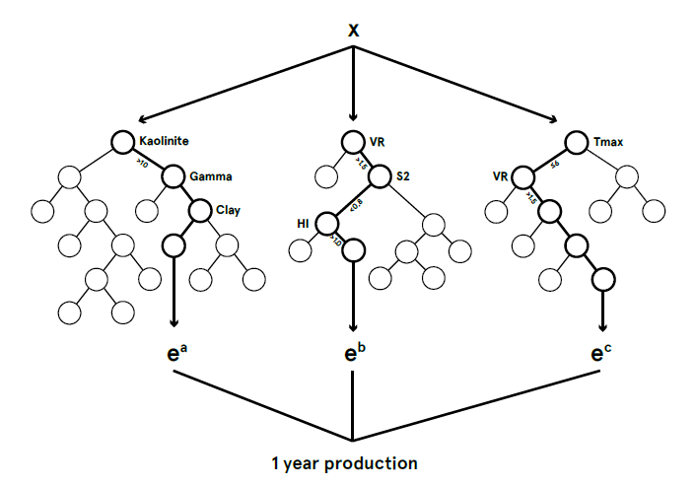
RANDOM FOREST ALGORITHM
Decision trees
Random Forest (ensemble decision trees)
Non-parametric method without any distribution assumptions on x and y
Can handle nonlinear relationships
Provides effective methods for estimating missing data ...
X₁
X₁ < t₁
X₁ ≥ t₁
X₂
X₃
X₂ < t₂
X₂ ≥ t₂
X₃ < t₃
X₃ ≥ t₃
X₄
C₃
C₄
C₅
X₄ < t₄
X₄ ≥ t₄
C₁
C₂
13

Slide 14
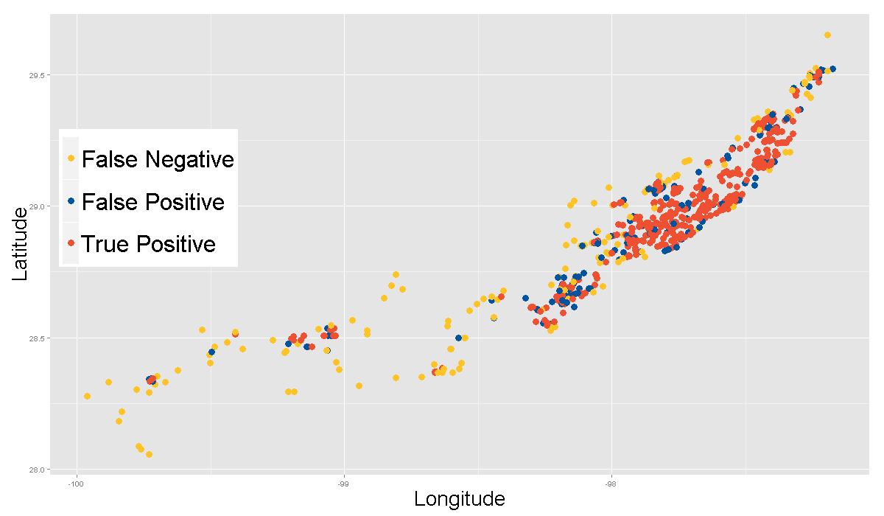
RESULTS (RF 5-Fold Cross-Validation)
Eagle Ford Oil Producer Sweetspots (658 out of 2631)
Top 25% Wells True Production
Top 25% Wells Predicted
Correctly Identified TQ
Random Draw | Rule Based | Kaggle | RF
165 | 201 | 366 | 484
74% Overlap
May 2015
14

Slide 15
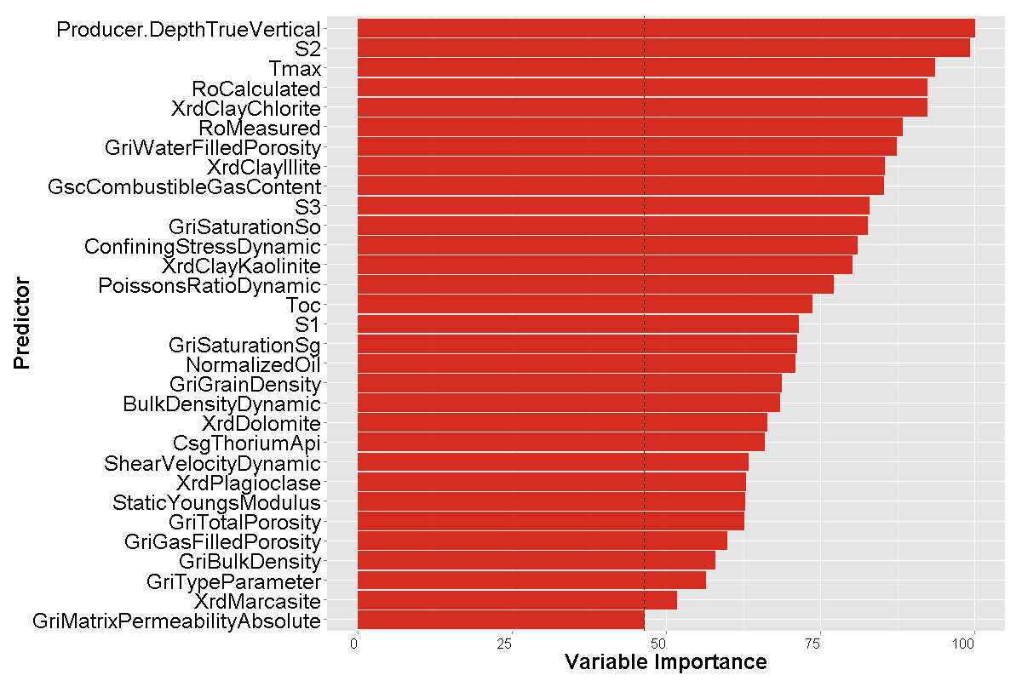
VARIABLE IMPORTANCE
Permutation-based MSE reduction measure normalized by the maximum score.
May 2015
15

Slide 16
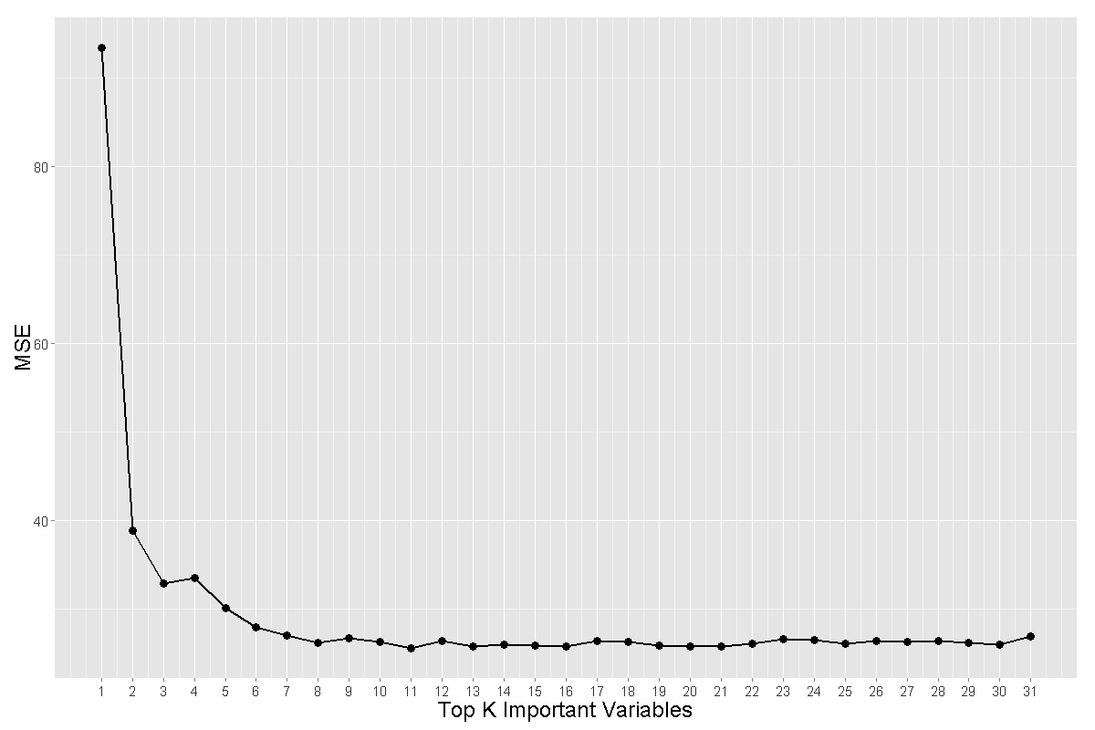
PREDICTION BASED ON TOP K IMPORTANT VARS
Results of 5-fold cross-validation
Top 7 important vars. are good enough to build a predictive model.
Correlation Tmax and Ro Calculated ~ 1, Ro Calculated is removed from the model.
A parsimonious model (6 vars.) achieved similar performance as full model (31 vars.)
{True vertical depth, S2, Tmax, Chlorite in clay(X-ray diffraction), Ro measured, GRI water filled porosity}
May 2015
16

Slide 17
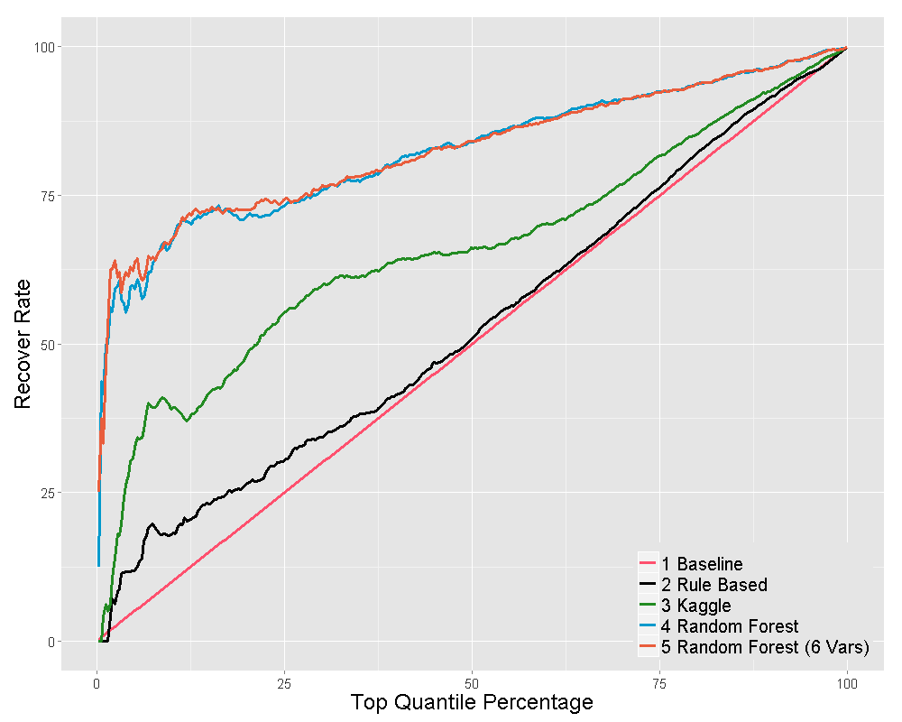
TOP QUANTILE RECOVERY CURVE
Performance Comparison of Different Models
Results of 5-fold Cross-validation
May 2015
17

Slide 18
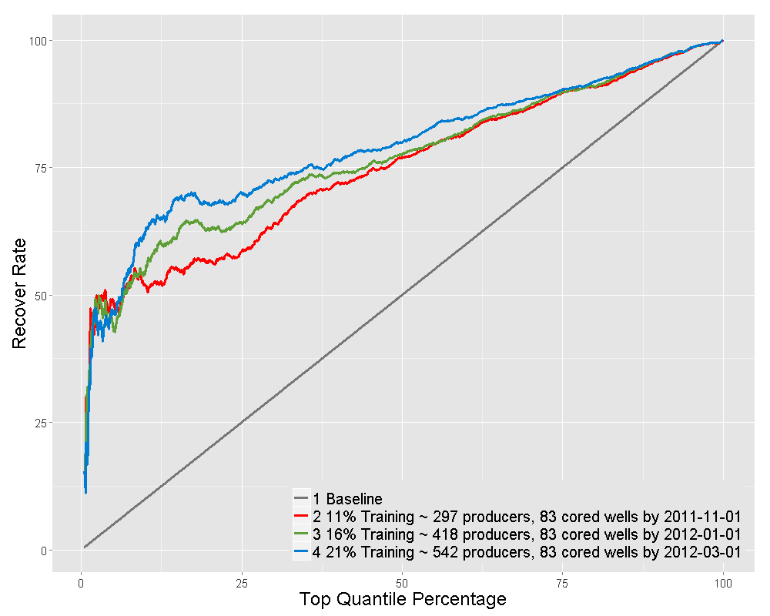
CHRONOLOGICAL STUDY
Performance Comparison By Different Cutoff Date
Total 2631 Producers
2008-04-01 first producer start production
2013-09-01 last producer achieve 12-mon production
Producers with 12-mon production by the cutoff date will be used for training
May 2015
18

Slide 19
Concluding remark
Going forward:
Complete ML/DA modeling and prediction workflow in Q4 2015.
Apply to active assets E&P in 2016 and beyond.
Business Impact
Provide superior guiding technology for new well drilling to reduce cost and improve production.
Furnish quick and better methodology for new asset assessment.

Slide 20
Q & A
20

