Slide 1
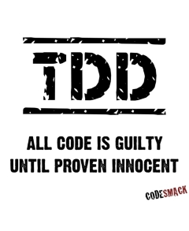
TDD Test Driven Development
Alt.Net DevDays
09.12.2012
Erdem ÖZDEMİR
Nexum Boğaziçi
Senior Analyst Developer
nerobianchi@gmail.com

Slide 2
Contents
What is TDD?
Obstacles And Difficulties
Advantages of TDD
Descriptions Of Concepts
How to TDD?
Resources

Slide 3
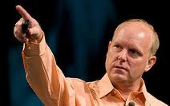
What is TDD?
Found by Kent Beck in
1999 as a component of
Extreme Programming
An advanced technique of
using automated unit tests to drive the design of software and force decoupling of dependencies
At any time to provide feedback that the software is still working.

Slide 4
Obstacles And Difficulties

Slide 5
Obstacles And Difficulties
Education
Hard to Learn
Lack of Practice
Lack of Investment
Time
Slowness of Development
Notes:
Did you stop trying to ride a bicycle when you fell off?

Slide 6
Advantages of TDD

Slide 7
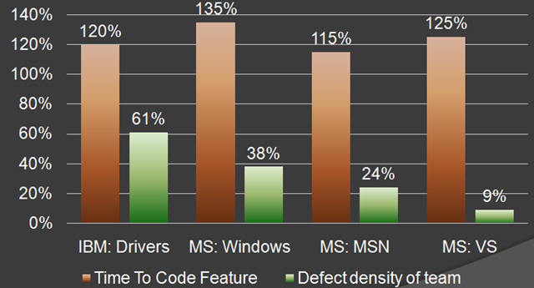
TDD vs non-TDD

Slide 8
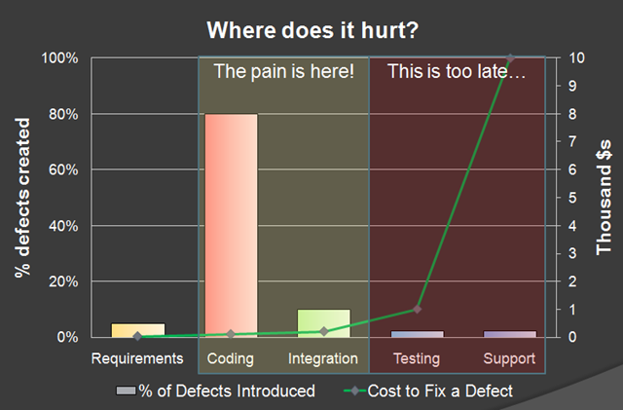
Cost of Defect
Notes:
One can argue that the results doesn’t mean anything, even if a dev team has more defects those defects will be caught during QA and integration testing.
There is a known fact in software development – the longer it takes to find the bug the more it would cost to fix it.

Slide 9
Descriptions Of Concepts

Slide 10
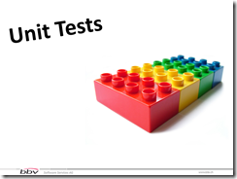
Unit Test
The smallest testable
part of software
A unit is often an entire interface, such as a class, but could be an individual method

Slide 11
Test Case
Test cases are subsets of user stories
As a book service, i should list all books
When there is no book then return an information about non existence
When there exists any books then return them

Slide 12
Integration Test
It talks to the database
It communicates across the network
It touches the file system

Slide 13
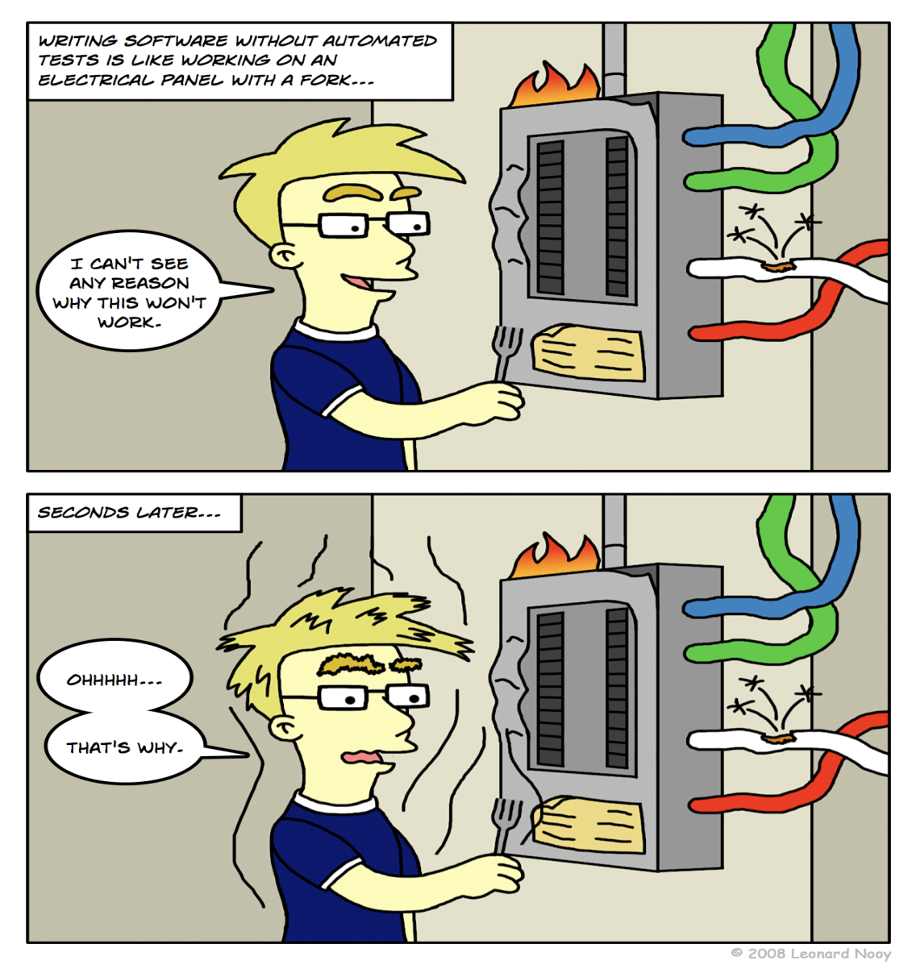
Automated Unit Testing
Control the execution of tests
Automated unit testing framework
During test case execution, the framework logs tests that fail any criterion

Slide 14
Automated Unit Testing Frameworks
NUnit
xUnit.net
MbUnit
MSTest

Slide 15
Goals of Test Automation
Project Goals
Test Writing Goals
Principles of Test Automation
Smells

Slide 16
Project Goals
Tests as Specification
Tests as Documentation
Tests as Safety Net
Defect Localization
Easy to Write/Maintain
Improve Quality
Reduce Risk
Bug Repellent

Slide 17
Test Writing Goals
Fully Automated
Self-Checking
Repeatable Test
Robust Test
Simple Test
Expressive Tests
Separation of Concerns
Do No Harm
Notes:
Repeatable Test:they can be run multiple times with the same result.
Robust Test:Verify One Condition per Test
Separation of Concerns:Keep Test Logic Out of Production Code)
Do No Harm:Keep Test Logic Out of Production Code). Test double
Expressive Tests:Don’t repeat yourself. Creation Methods

Slide 18
Principles of Test Automation
Write the Tests First
Isolate the SUT
Don’t Modify the SUT
Minimize Test Overlap
Communicate Intent
Use the Front Door First
Verify One Condition per Test
Test Concerns Separately
Keep Tests Independent
Minimize Untestable Code
Keep Test Logic Out of Production
Ensure Commensurate Effort and Responsibility

Slide 19
Smells
Conditional Test Logic
Obscure Tests
Slow Tests
Assertion Roulette

Slide 20
How to TDD?

Slide 21
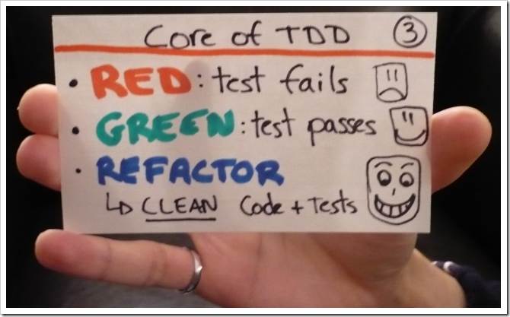
Motto
RED – The developer writes a failing test essentially capturing the requirements
in a test

Slide 22
Motto
GREEN – The developer implements the business functionality, writing just enough code to pass the test

Slide 23
Motto
REFACTOR – The developer refines and improves the code without adding new functionality

Slide 24
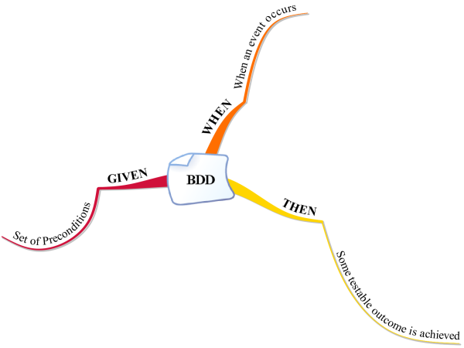
Naming Convention
ClassNameTests.cs
MethodName_SystemUnderTestScenerio_ExpectedBehaviour
method_name_when_system_under_test_scenerio_then_expected_behaviour
for_ClassName
MethodName.cs
when_system_under_test_scenerio_then_expected_behaviour

Slide 25
Fixture
Everything we need in place
to exercise the SUT
Name conflicts
NUnit : Testcase Class

Slide 26
Fixture Ingridents
Setup
Exercise
Verify
Teardown
Arrange
Act
Assert

Slide 27
Runners
Manual
Testdriven.Net
Visual Studio
Resharper
Auto
NCrunch
Mighty Moose

Slide 28
Principles
YAGNI (You Ain’t Gonna Need It)
DDSTTCPW (Do The Simplest Thing That Can Possibly Work)
KISS (Keep It Stupid Simple)
Testable Design
Fine Grained Components
Loosely Coupling
High Cohesion
SOLID

Slide 29
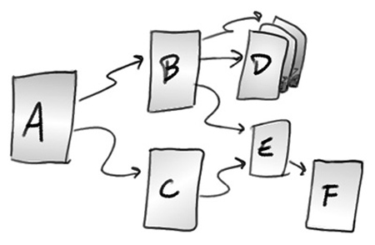
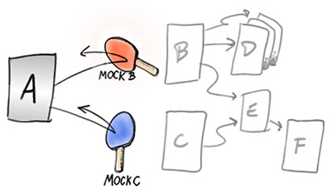
Test Double

Slide 30
Test Double
Stub
Deals with Result
Mock
Deals with Behaviour

Slide 31
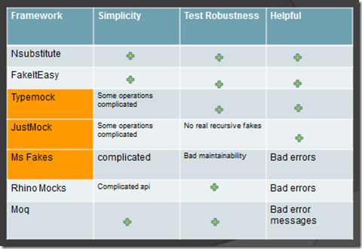
Test Double Libraries
Notes:
http://osherove.com/blog/2012/10/14/the-three-values-of-a-good-isolation-framework.html

Slide 32

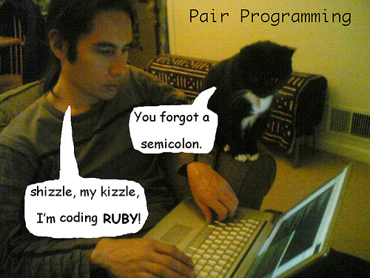
How To Get Better
Coding Kata
Pair Programming

Slide 33
Libraries
AutoFixture
Fluent Assertion
NDbUnit

Slide 34
Resources

Slide 35
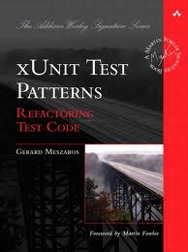
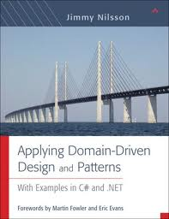
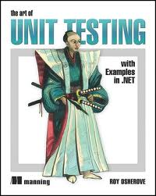
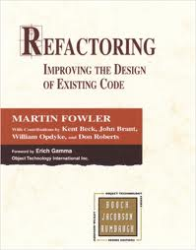
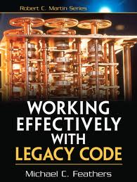
Books

Slide 36
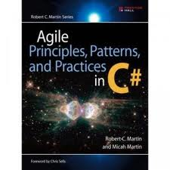
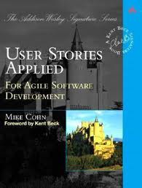
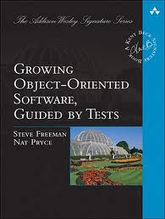
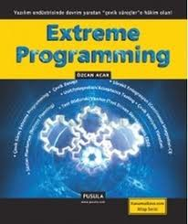
Additional Books

Slide 37
Blogs
Mark Seemann
http://blog.ploeh.dk
Roy Osherove
http://osherove.com/
James Grenning
http://www.renaissancesoftware.net/blog/
Özcan Acar
http://ozcanacar.com/

Slide 38
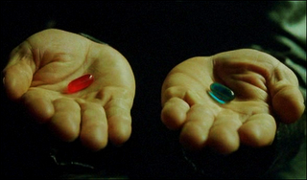
Are You Ready to TDD?

