Slide 1
CR-Honeynet: A learning & decoy based Sustenance Mechanism Against Jamming Attack in CRN
Suman Bhunia, Shamik Sengupta, Felisa Vazquez-Abad

Slide 2
Outline
Introduction
Motivation
Some Related Work
Proposed Model
Algorithms
Performance Evaluation
Conclusion and Future Work

Slide 3
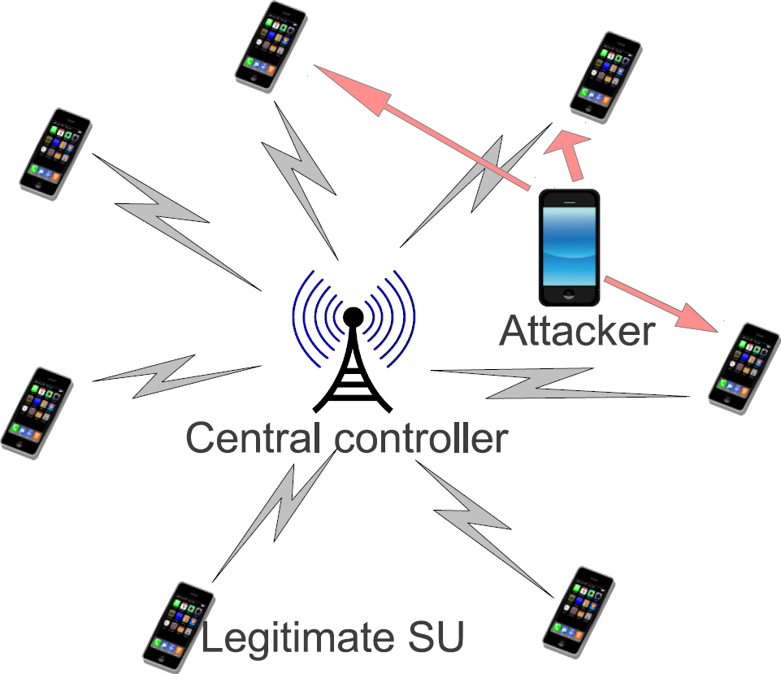
Cognitive Radio Network (CRN)
allows secondary user (SU) to use a spectrum when primary user (PU) is absent
SUs sense for free channels in sensing period and can transmit on a channel on transmission period.
all SUs are synchronous for this cognitive cycle.

Slide 4
Aim of the paper
The “open” philosophy of the cognitive radio paradigm makes CRN susceptible to Jamming based DoS attacks.
Intelligent attacker determines highest impacting communication by observing certain transmission characteristics
We propose CR-Honeynet, a honeynet based defense mechanism where the CRN passively learns the strategy of the attacker using stochastic learning, and then place an active decoy namely honeynode to entice the attacker for jamming the honeynode transmission.

Slide 5
Outline
Introduction
Motivation
Some Related Work
Proposed Model
Algorithms
Performance Evaluation
Conclusion and Future Work

Slide 6
Jamming based DoS attack
wireless medium is vulnerable to jamming based denial of service attack.
PU protection mechanism well defined.
SUs are left vulnerable
Attacker emits jamming signal to create high interference
Advancement in SDR and DSA makes it even easier

Slide 7
Jamming attack example
PSD of normal data
communication
PSD of narrow band
jamming signal

Slide 8
Outline
Introduction
Motivation
Some Related Work
Proposed Model
Algorithms
Performance Evaluation
Conclusion and Future Work

Slide 9
Detection of Jamming
Noise in wireless medium makes detection of jamming critical.
Difficult to correctly detect jamming based on a single system parameter [5].
Solutions:
[13] classified spectrum usage anomaly detection data fusion algorithms
A cross layer detection mechanism to map jammed region has been proposed in [14]

Slide 10
Defense Against Jamming
Channel Surfing
Migrate to a channel upon detection of jamming [9]
Proactive frequency hopping [15]
Spatial Retreat
Mobile nodes relocate themselves physically [16]
Mapping Jammed Region
Multi-hop and intensely populated CRN
Avoid jammed links [17]
Spread Spectrum
low bandwidth data stream uses higher bandwidth channel
Honeypot
single channel honeypot based channel surfing has been proposed [8]
upon detection of attack, the network switches its channel

Slide 11
Outline
Introduction
Motivation
Some Related Work
Proposed Model
Algorithms
Performance Evaluation
Conclusion and Future Work

Slide 12
Model for attackers
We consider three types of attacker
Targets a particular channel.
Targets specific SU transmission characteristic(s).
Randomly targets channel with active SU transmission.
Type I and III causes less harm on a CRN as it does not search for the best communication
From CRN’s point of view, targeted transmission characteristic space of an attacker can be obtained by two methods
manually by domain experts
automatic learning from data obtained over time

Slide 13

CRN Assumptions
SUs scan for free channels in the sensing period
Central Controller assigns channel to each SU
SUs use this channel for data transmission in Transmission period
SUs cannot switch its channel during the transmission period
Upon being attacked, all data packets transmitted by the SU are lost

Slide 14
Difference from Honeypot
Honeypot is a security resource, value lies in being probed, attacked or compromised.
used as a camouflaging security tool
lure the attacker giving them a false sense of satisfaction
retrieve valuable information about the attacker
In wireless medium, hard to get attacker’s signature
Intelligent Attacker choose target with certain criteria
highest transmission power, highest data rate, modulation scheme, packet inter arrival time, quality of route with end-to-end acknowledgments, etc [5], [7].
CR-Honeynet aims to exploit this fact
Honeynode acts to lure the attacker by adapting suitable transmission characteristics

Slide 15
CR-Honeynet Defense mechanism
Assigns the role of honeynode to a SU at the beginning of each transmission period
Honeynode doesn’t transmit its packets, instead, it queues all its incoming packets and transmits garbage data packets
Transmission characteristics of Honeynode lure the attacker
Some attacks happen on legitimate SUs due to
Attacker’s strategy change
Error in sensing

Slide 16
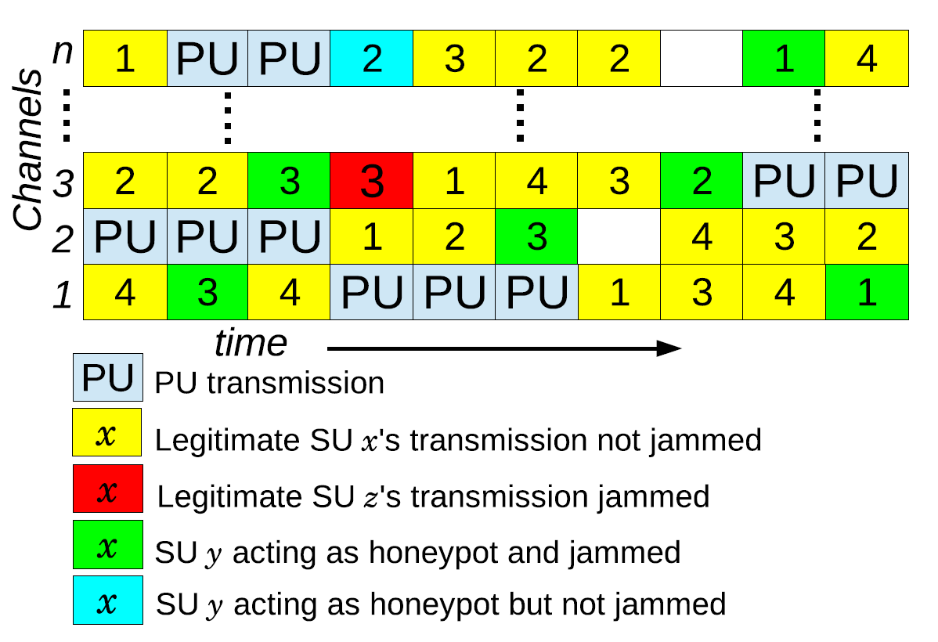
Channel Allocation by Central Controller

Slide 17
Honeynode strategies
Attacker type | Honeynet strategies
Type-I | vulnerable channel will be assigned to the honeynode
Type-II | actual target property should be learned and used as a lure for the honeynode.
Type-III | special honeynode strategy that delays all but the honeynode’s transmissions in order to reduce the number of vulnerable channels to 1

Slide 18
Benefits of Honeynet
Attractiveness of Honeynet (ξ):
The probability that the honeynode transmission is attacked, conditional on observing a jamming attack.
Honeynode allocation results in more delay as well as packet drop
With probability (1- ξ), legitimate SUs are attacked
The threshold, lowest attractiveness of the honeynet (ξ ∗ ) is the value where the net gain is zero
Compromise Delay and Packet loss

Slide 19

Stochastic Model
Let p₁ denote the probability of attacking the communication with the target characteristics
Let d be the target transmission characteristics space
We define
Let α ∈ (0, 1) be a confidence level for statistical significance. Lower the value of α, higher the confidence level.

Slide 20

Learning Attacker’s type
During the learning phase, the d different lures for type-II attacks are assigned to d different communications among the available ones with uniform probability and counts number of attacks on them.
The number of tests (n₀) to check for type I is thus typically very small. For example, if α = 0.001, d = 2 then n₀ = 7, for α = 0.005 and d = 6, n₀ = 4.
If all attack happens on one channel then the attacker is of type-I.

Slide 21

Learning Attacker’s strategy for Type-II
Let α ∈ (0, 1) be a confidence level for statistical signifi cance. Then under the base model we can calculate the sample size required to ensure a probability of correct selection of at least 1 − α:
N* (θ∗ , d) denotes the number of slots required to observe before deciding type-II attacker strategies
With d = 4 and ξ∗ = 0.6, the probability of correct selection after N* = 15 samples is 0.985.

Slide 22
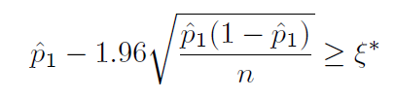
Learning target transmission characteristics
After observing for N* (θ∗,d) slots, we declare having learned that the strategy is of type II and we identify the lure if
From this time onwards, we use the honeynode with that lure and start the monitoring phase.
If the equation does not hold, attacker is of type-III
use the special honeynode allocation
delay all other SUs

Slide 23
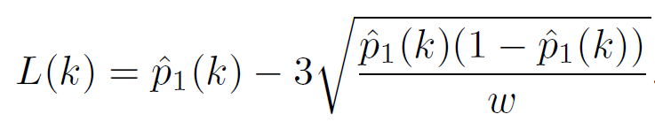
Regime change detection: monitoring phase
After learning period, honeynode is deplyed and honeynet keeps monitoring the attack counts
If type-I attacker, then honeynet restarts learning phase upon detection of attack on a different channel
If type-II attacker, honeynet uses sliding window averages to test for regime changes.
Given a window of size w, let ξ ̃_{w}(k) be the estimate of p₁ for k time slots.
L(k) is calculated as
As soon as ξ ̃_{w}(k)< L(k), the honeynet declares a change of regime and restarts the learning phase

Slide 24
Outline
Introduction
Motivation
Some Related Work
Proposed Model
Algorithms
Performance Evaluation
Conclusion and Future Work

Slide 25
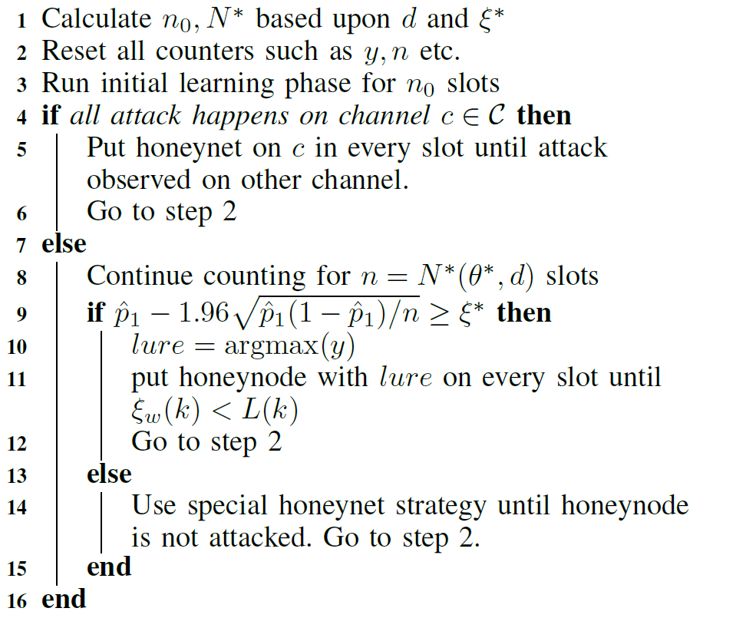
Algorithm for Honeynet

Slide 26
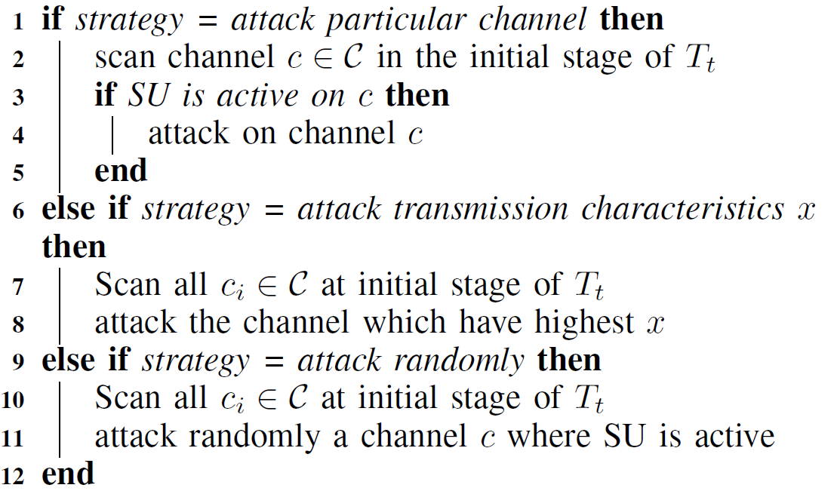
Algorithm for Attacker

Slide 27
Outline
Introduction
Motivation
Some Related Work
Proposed Model
Algorithms
Performance Evaluation
Conclusion and Future Work

Slide 28
Simulator
Coded tick based simulator
20 SUs and 1 attacker
The CR-Honeynet dedicates 1 SU as honeynode in each slot.
All SUs generate packets in accordance with Poisson process
Packet transmission time: uniform distribution of 0.1 - 1.7 ms.
Sensing Period: 50 ms, Transmission Period: 950 ms
Attacker has target transmission characteristics (d) space as 4
attractiveness threshold (ξ ∗ ) is considered as 0.6.
Type-I learning horizon (n₀) is calculated as 5
Type-II learning horizon (N*) is calculated as15
Simulation time : 5,000,000 ms
Warm-up time: 100,000 ms

Slide 29
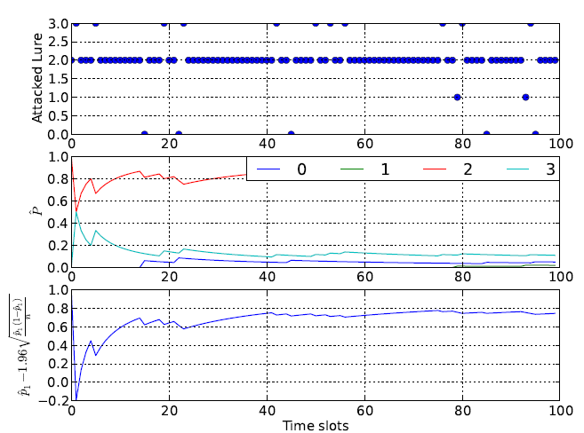

Example of Learning
attacker with type II strategy is aiming for lure 2
Lure 2 is actually attacked with a probability 0.8.
The actual attacks on the various lures are shown on the upper subplot.
The middle subplot depicts Pˆ for the different lures
The third subplot provides CI =

Slide 30
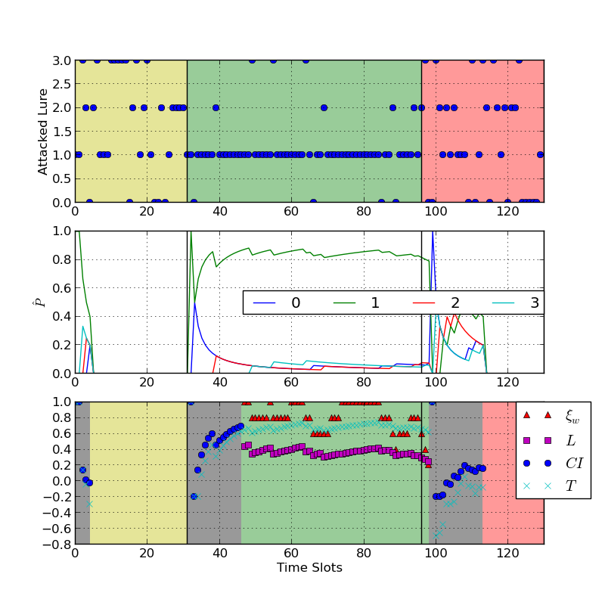
Honeynet Learning phase corresponding to attacker’s strategy change from I to II and then to III
Yellow, green and red colors indicate type-I, type-II and type-III attacking strategies respectively.
4 types of lure
Middle subplots give honeynet’s observation of pˆ
honeynet learns the change of strategy of attacker dynamically within 2 time slots

Slide 31
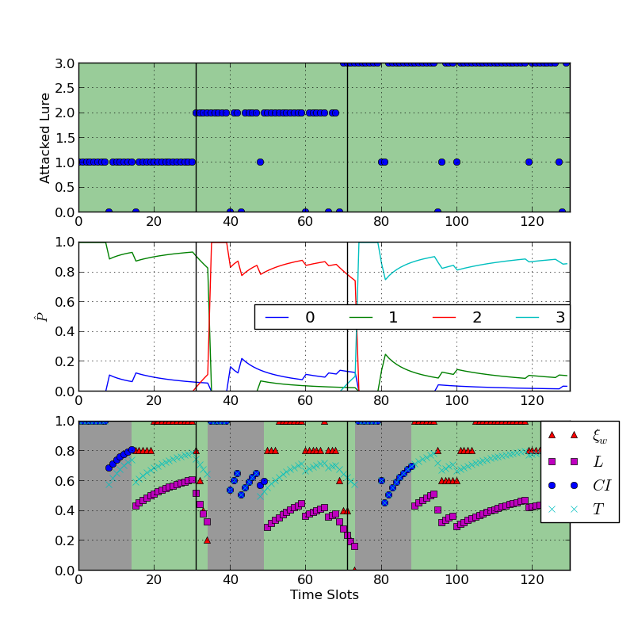
Honeynet Learning phase corresponding to attacker of type II and attacker is changing its target
Attacker targeted SU transmission characteristics dynamically.
For the first phase, attacker aims characteristics 1and then 2 and then 3.
honeynet detect attack strategy change after 3 iteration in the first case and after 2 iterations in the second one.

Slide 32
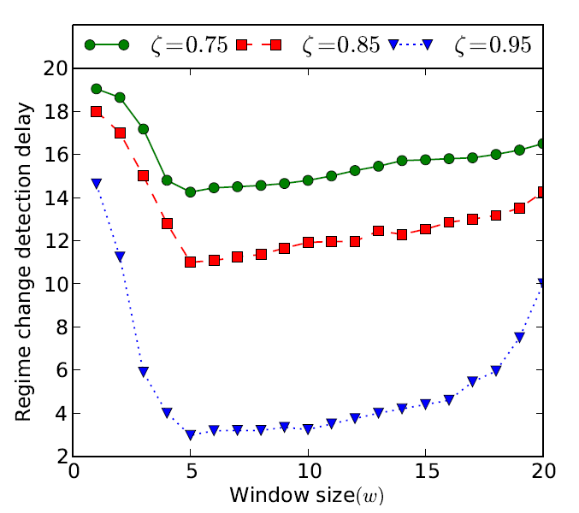
Regime change detection delay for type II attacker
attacker of type-II strategy is attacking a particular lure with probability ζ
the simulation is run for 100,000 slots
attacker is changing its targeted transmission characteristics randomly with mean interval of 100 steps.
window size w = 5 provide optimal result

Slide 33
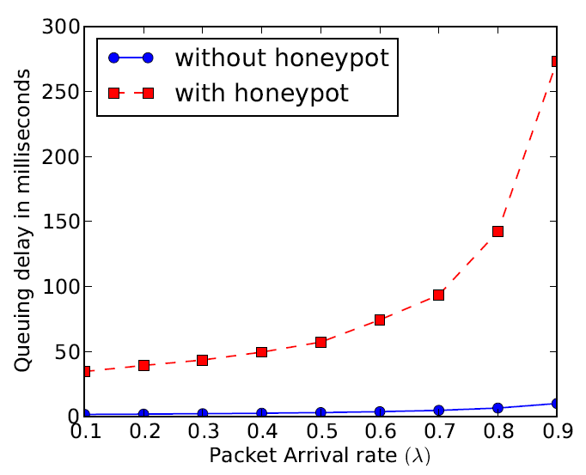
Overall system performance
Event Driven Simulation
20 SUs with ξ = 0.8.
for all values of λ, with CR-Honeynet the average packet dropping probability is 0.01,
Without honeynet results packet dropping probability of 0.05 .
Better packet delivery ratio is achieved at the cost of higher packet delay.

Slide 34
Outline
Introduction
Motivation
Some Related Work
Proposed Model
Algorithms
Performance Evaluation
Conclusion and Future Work

Slide 35
Conclusion and Future Work
Propose CR-Honeynet, a CRN sustenance mechanism to avoid jamming based DoS attack in CRN.
intelligent attacker aims for certain transmission characteristics
CR-honeynet confidently learns attacker’s strategy and dynamically evolve with attacker’s strategy change
Efficiently lures the attacker towards attacking the active decoy
Future Work
Use active lures during learning phase
Multiple attacker
Attacker targeting combination of transmission characteristics

Slide 36
Acknowledgement
This research was supported by NSF CAREER grant CNS #1346600

Slide 37
Thank You!

