Slide 1
Enhancement of Spectrum Utilization in Non-Contiguous DSA with Online Defragmentation
Suman Bhunia, Vahid Behzadan and Shamik Sengupta
Supported by NSF CAREER grant CNS #1346600

Slide 2
Outline
Introduction
Motivation
Some Related Work
Proposed Model
Algorithms
Prototype
Performance Evaluation
Conclusion and Future Work

Slide 3
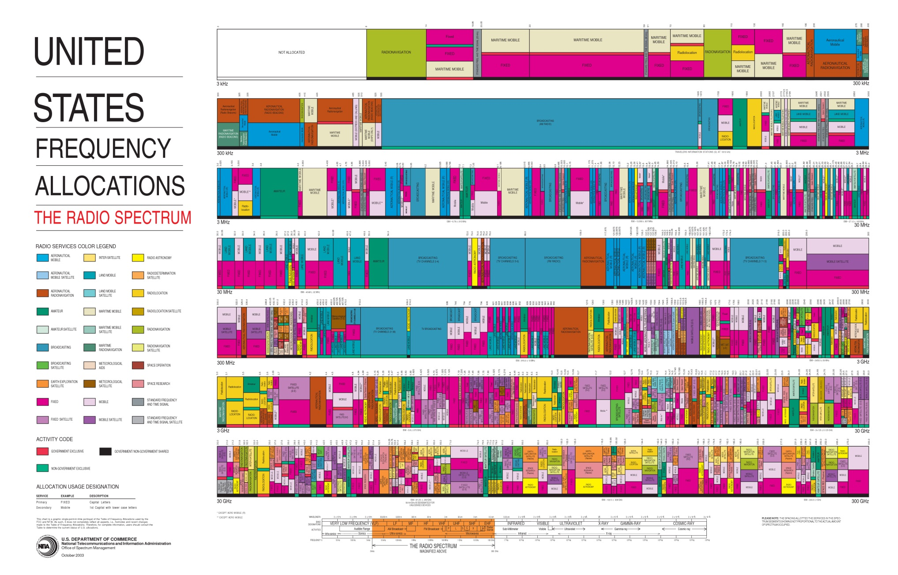
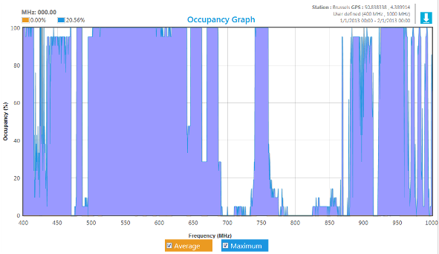
Why Dynamic Spectrum Access?

Slide 4
Non-Contiguous DSA
Dynamic RF environment
Dynamic spectrum requirement
Sometimes single spectrum opportunities are not adequate to support users’ requirements
Allocation of spectrum in the form of non-contiguous blocks

Slide 5
Outline
Introduction
Motivation
Some Related Work
Proposed Model
Algorithms
Prototype
Performance Evaluation
Conclusion and Future Work

Slide 6
NC-DSA
PUs have priority in spectrum acquirement
SUs (red, green and blue) change their spectrum with PU activity
Increases fragments
Overhead due to guard bands (yellow)
Defragmentation minimizes the spectrum wastage

Slide 7
Problem Statement
Sinc type pulses lead to large sidelobes - out of band transmission
Guard bands to protect fragments
Opportunistic NC spectrum allocation increases number of spectrum fragments
Increasing fragments increase spectrum wastage by guard bands
This paper investigates
The cost of wastage due to guard bands
Overhead of coordination in NC DSA
Mitigation techniques
Proposes Online Spectrum Defragmentation as an effective solution to wastage of spectrum due to guard bands.

Slide 8
Outline
Introduction
Motivation
Some Related Work
Proposed Model
Algorithms
Prototype
Performance Evaluation
Conclusion and Future Work

Slide 9
Some related works
Aggregation Aware Spectrum Assignment (AASA) ¹
All users require the same amount of spectrum
Uses first-fit approach for channel assignments
Maximum Satisfactory Algorithm (MSA) ²
users may have different spectrum requirements
Uses best-fit algorithm
Channel Characteristic Aware Spectrum Aggregation algorithm (CCASA) ³
Considers the heterogeneity of data carrying capacity in spectrum
Uses sliding window method
D. Chen, Q. Zhang, and W. Jia, “Aggregation aware spectrum assignment in cognitive ad-hoc networks,” in 3rd International Conference on Cognitive Radio Oriented Wireless Networks and Communications, 2008. CrownCom 2008, pp. 1–6, IEEE, 2008.
F. Huang, W. Wang, H. Luo, G. Yu, and Z. Zhang, “Prediction based spectrum aggregation with hardware limitation in cognitive radio networks,” in IEEE 71st Vehicular Technology Conference (VTC 2010-Spring), 2010, pp. 1–5, IEEE, 2010.
J. Lin, L. Shen, N. Bao, B. Su, Z. Deng, and D. Wang, “Channel characteristic aware spectrum aggregation algorithm in cognitive radio networks,” in IEEE 36th Conference on Local Computer Networks (LCN), 2011, pp. 634–639, IEEE, 2011.

Slide 10
Related Works…
Jello: A MAC Overlay for Dynamic Spectrum Sharing¹
Distributed NC OFDM prototype
Distributed defragmentation triggered by other SU departure
Limited sensing window
Homogenous spectrum
L. Yang, W. Hou, L. Cao, B. Y. Zhao, and H. Zheng, “Supporting demanding wireless applications with frequency-agile radios.,” in Pro- ceedings of the 7th USENIX Conference on Networked Systems Design and Implementation, NSDI 2010, pp. 65–80, 2010.

Slide 11
Outline
Introduction
Motivation
Some Related Work
Proposed Model
Algorithms
Prototype
Performance Evaluation
Conclusion and Future Work

Slide 12
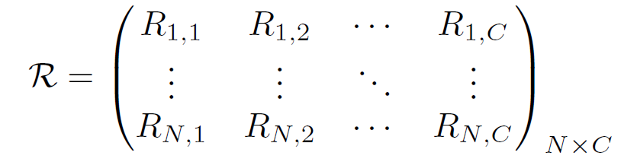
Problem Formulaion
Data Rate matrix
Spectrum assignment matrix:
Define three (N×C) matrices:
Data-subcarrier assignment matrix (D)
Pilot-subcarrier assignment matrix (P)
Guard-subcarrier assignment matrix (G)

Slide 13
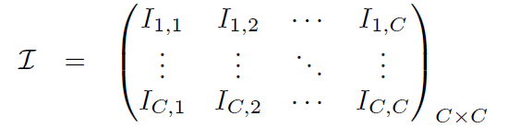
Problem Formulaion…
Throughput achieved:
Cross Channel Interference Matrix:
Constraint for interference:

Slide 14
Optimization Problem
Interference
Demand satisfaction
Prevent overlapping
Transmission BW
Power consumption
Interface limitation

Slide 15
Theorem: The throughput maximization problem is NP-hard even if there is no PU present.
Assume
No cross channel interference
Each subcarrier provides same data rate
SUs have different data rate demand
An SU can be allocated with spectrum iff its demand is met
The goal is to maximize total throughput of the system
reduction of the 0-1 knap sack problem

Slide 16
Outline
Introduction
Motivation
Some Related Work
Proposed Model
Algorithms
Prototype
Performance Evaluation
Conclusion and Future Work

Slide 17
Centralized Spectrum Allocation
Central controller supervises the spectrum allocation
Uses dedicated out-of-band common control channel (CCC)
SUs periodically sense the spectrum and send the spectrum usage map to the controller
SU also notifies the controller of its throughput requirements
Controller has two states:
Steady state
Arrangement state

Slide 18
Centralized Spectrum Allocation

Slide 19
Distributed Method

Slide 20
Semi Centralized Method

Slide 21
Outline
Introduction
Motivation
Some Related Work
Proposed Model
Algorithms
Prototype
Performance Evaluation
Conclusion and Future Work

Slide 22
Prototype Schema
GNURadio controlled USRP
200 KHz band
256 subcarriers of 781.25 Hz
minimum of 28 subcarriers
Filtering and windowing – degrade OFDM signal, not agile enough
Unutilized subcarriers are required as guard bands

Slide 23
Spectrum Usage
NC spectrum allocation of A:
Received Signal
NC spectrum allocation of B :

Slide 24
Outline
Introduction
Motivation
Some Related Work
Proposed Model
Algorithms
Prototype
Performance Evaluation
Conclusion and Future Work

Slide 25
Simulation Parameters

Slide 26
Simulation Results
Throughput obtained for the network
compare with CCASA
CCSA does not consider the waste of spectrum
throughput increases linearly until a saturation point

Slide 27

Simulation Results
Spectral efficiency for centralized method
$\frac{no. of allocated data subcarriers}{no. of allocated subcarriers}$

Slide 28
Simulation Results
Throughput achieved for the entire network
Significantly better performance in comparison with Jello
With high no. of nodes, the throughput of decentralized method decreases

Slide 29
Outline
Introduction
Motivation
Some Related Work
Proposed Model
Algorithms
Prototype
Performance Evaluation
Conclusion and Future Work

Slide 30
Conclusion
Online Defragmentation is proposed as a method of increasing spectrum utilization
Efficiency of this method was investigated in three different network scenarios:
Infrastructure
Distributed
Semi-centralized.
proof-of-concept prototype
Regardless of scenario, defragmentation provides better performance

Slide 31
Future Works
Complete implementation of the proposed algorithms in testbed
Optimization of guard bandwidth
Heterogeneity of subcarriers
Adaptive defragmentation based on spatial considerations

Slide 32
Thank You!

Slide 33
Appendix

