Slide 1
Distributed Adaptive Beam Nulling to Mitigate Jamming in 3D UAV Mesh Networks
Suman Bhunia and Shamik Sengupta

Slide 2
Outline
Introduction
Motivation
Some Related Work
Proposed Model
Performance Evaluation
Conclusion and Future Work

Slide 3
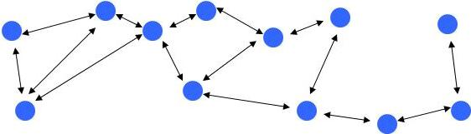
Multi hop ad hoc networks
Ad hoc: Collection of nodes communicating with each other independent of a central infrastructure.
Multihop: Data traverses through multiple nodes
Applications include sensor networks, vehicular networks, emergency radio networks in disaster zones, tactical mobile networks, and UAV communications

Slide 4
Jamming based DoS attack
Wireless medium is vulnerable to jamming based denial of service attack.
Attacker emits jamming signal to create high interference
Jamming a subset of nodes in multihop networks is sufficient for maximal disruption
Disruption of omnidirectional radios completely disables the node

Slide 5
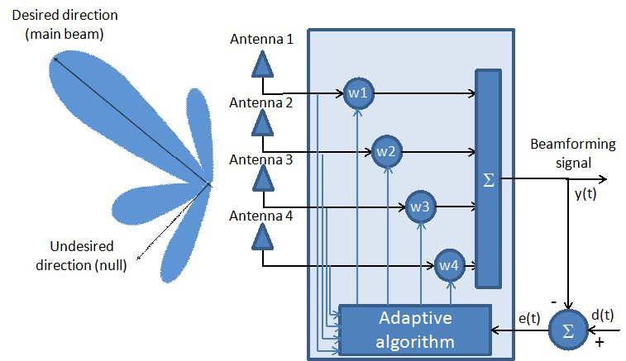
Adaptive Beamforming
Spatial filtering of Tx/Rx
Adjust the influence of signals received by different array element via controlling the weights of signal streams
Adaptive Nulling
Weights chosen to suppress signals arriving from certain directions
Filtering sources of interference
Direction of Arrival (DoA):
Signal arrives at elements in different times
Estimation of DoA based on time(phase) difference between elements

Slide 6
Outline
Introduction
Motivation
Some Related Work
Proposed Model
Performance Evaluation
Conclusion and Future Work

Slide 7
Advantage of ANA against jamming
Before jamming
Shortest path routing
A − B − C − D
After jamming
Omnidirectional
E, B, C deactivated
Avoid entire jammed region
A − F − G − H − I − D
ANA
Null jammer’s direction
A − B − E − C − D
Nodes retain connectivity

Slide 8
Aims and Objectives
Study adaptive beam nulling as a mitigation technique against jamming
Mobile multihop ad hoc network
Mobile jammer
Develop distributed framework
Nodes determine beamnull individually
Dynamic control of beamnull direction and width based on jammer’s mobility
Investigate survivability of links and connectivity of network

Slide 9
Outline
Introduction
Motivation
Some Related Work
Proposed Model
Performance Evaluation
Conclusion and Future Work

Slide 10
Defense Against Jamming
Channel Surfing
Migrate to a channel upon detection of jamming
Proactive frequency hopping
Spatial Retreat
Mobile nodes relocate themselves physically
Mapping Jammed Region
Multi-hop and intensely populated network
Avoid jammed links
Spread Spectrum
low bandwidth data stream uses higher bandwidth channel
Honeypot
single channel honeypot based channel surfing has been proposed
upon detection of attack, the network switches its channel

Slide 11
Outline
Introduction
Motivation
Some Related Work
Proposed Model
Performance Evaluation
Conclusion and Future Work

Slide 12
System assumptions
Mobile jammer
Jamming signal is distinctly recognizable
Nodes monitor DoA of jammer (gr-DoA by Ettus research)
Nodes equipped with antenna arrays and beamforming controllers
Ideal beamformers – 0 gain for nulled regions
Operation time for beamnulling is negligible
DoA estimation and communication occur asynchronously
Periodic sensing between communications
Link failure between 2 nodes occurs when:
2 nodes fall into the jammed region
One node falls within the beamnull of another
Mac and upper layers not affected
Jammed nodes assumed to be out of range

Slide 13
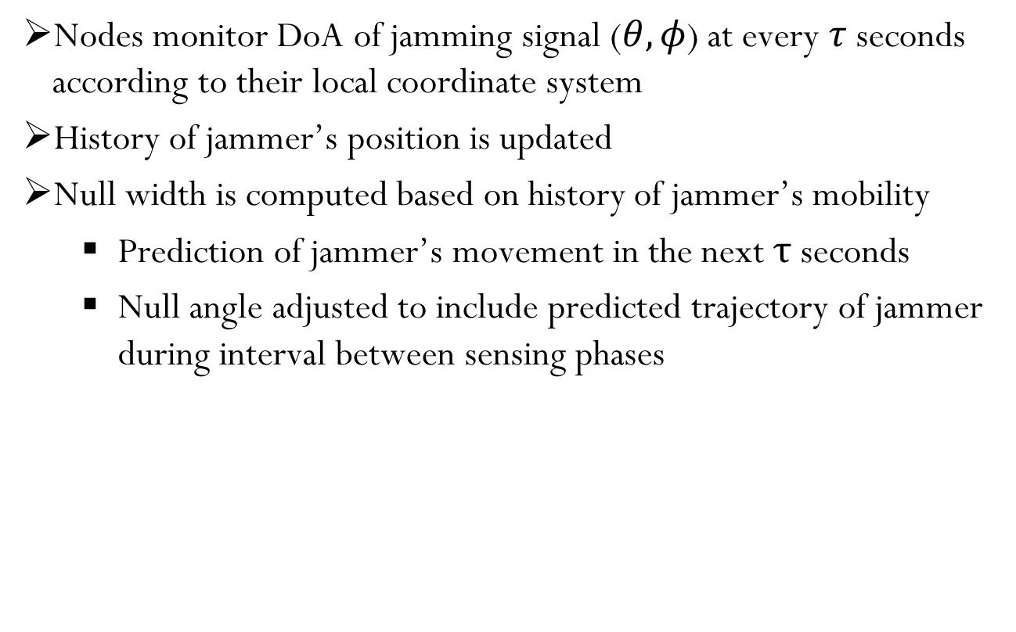
Methodology
Nodes monitor DoA of jamming signal ($θ,φ$) at every $τ$seconds according to their local coordinate system
History of jammer’s position is updated
Null width is computed based on history of jammer’s mobility
Prediction of jammer’s movement in the next τ seconds
Null angle adjusted to include predicted trajectory of jammer during interval between sensing phases

Slide 14
Methodology

Slide 15
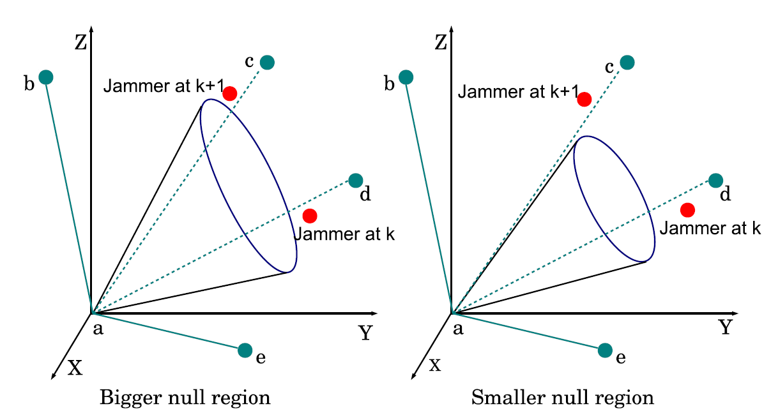
Wide vs. Narrow Nulling

Slide 16
Tracking movement of jammer

Slide 17
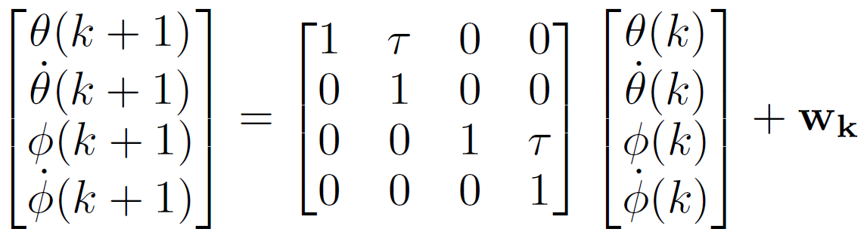
Tracking movement of jammer …
Characteristics equations:
Observed positions

Slide 18
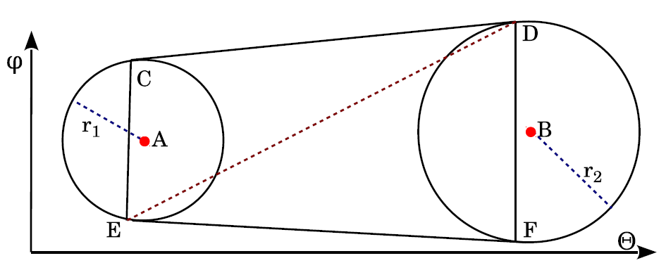
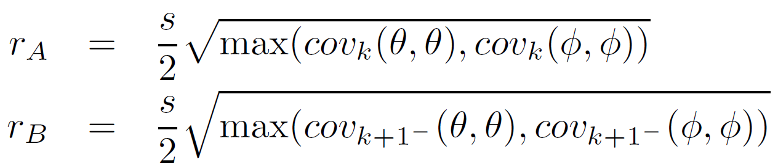
Constructing Beam null
Center of the circles:
Radi of the circles:

Slide 19
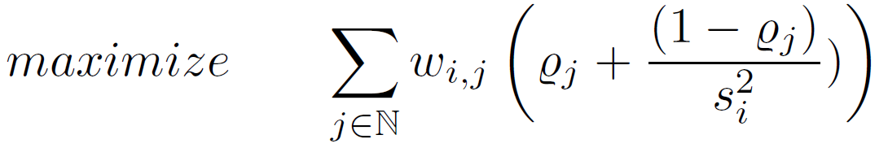
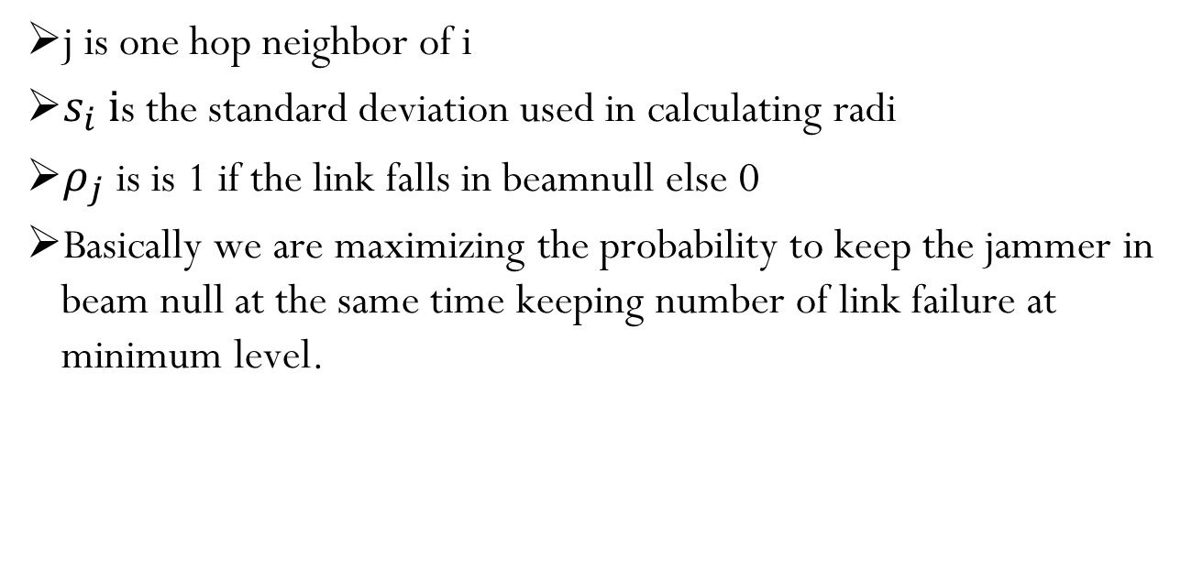
Optimization of beam null
j is one hop neighbor of i
$s_{i} i$s the standard deviation used in calculating radi
$ρ_{j}$is is 1 if the link falls in beamnull else 0
Basically we are maximizing the probability to keep the jammer in beam null at the same time keeping number of link failure at minimum level.

Slide 20
Outline
Introduction
Motivation
Some Related Work
Proposed Model
Performance Evaluation
Conclusion and Future Work

Slide 21
Simulation Parameters

Slide 22
Performance Metrics
Connectivity
is defined as the total number of connected pairs
Average number of active links
A link is the one hop communication between two neighbors
Average number of islands
Number of isolated groups of nodes
For completely connected network, the number of island is 1

Slide 23
Simulation Results

Slide 24
Outline
Introduction
Motivation
Some Related Work
Proposed Model
Performance Evaluation
Conclusion and Future Work

Slide 25
Conclusion and Future Work
Investigated the performance of adaptive beam nulling in multihop ad hoc networks under attack from a moving jammer.
Connectivity of various network topologies with different mobility patterns of the jammer are studied.
Effects of varying inherent errors are observed.
Results demonstrate a significant improvement in survivability of connectivity.
Future work:
Cross-layer optimization

Slide 26
Acknowledgement
This research was supported by NSF CAREER grant CNS #1346600.

Slide 27
Thank You!

