Slide 1
LOS Discovery in 3D for Highly Directional Transceivers
Mahmudur Khan∗, Suman Bhunia ‡, Murat Yuksel ∗, and Shamik Sengupta ‡
∗ Electrical and Computer Engineering, University of Central Florida
‡Computer Science and Engineering, University of Nevada, Reno

Slide 2
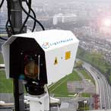
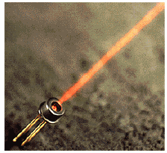
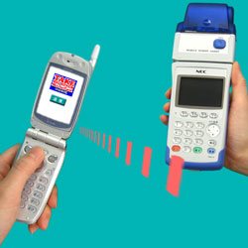

Directional Transceivers
Radiates or receives greater power in specific directions
Radio
High gain antenna
Free-Space-Optical (FSO)
Transmitter (Laser Diodes, LEDs, VCSELs)
Receiver (Photodetector)
Lasers…
VCSELs…
IrDAs…
LEDs…

Slide 3
Advantages
Avoids unwanted interference
Low probability of interception and detection.
Lower probability of jamming
Ideal for military applications
Improves spatial reuse
Higher data transfer rates (10Gbps using FSO)

Slide 4
Difficulties
Requires Line-of-Sight (LOS)
Transmitter and Receiver must be aligned
Any obstruction or poor weather (fog, heavy rain/snow) can increase BER in a bursty manner
Vulnerable against mobility
LOS alignment must be maintained with mobility or sway!

Slide 5
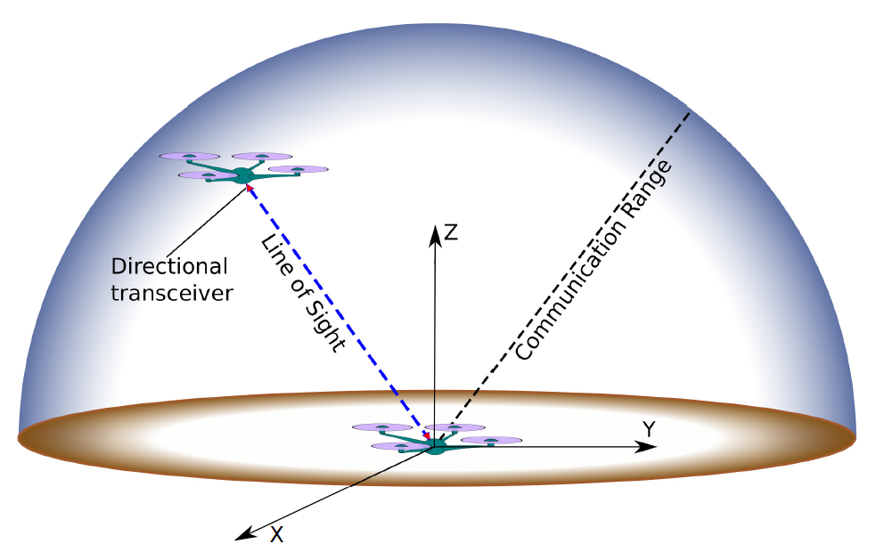
Problem Statement and Assumptions
Two UAVs/ Quadcopters
Observation behind enemy lines
Monitoring disaster area
Hovering in 3D space
GPS-free environment
Supplementary omni-directional
RF channel
Equipped with
A mechanically steerable head/arm
Highly directional transceivers
Half-duplex or full-duplex mode of communication

Slide 6
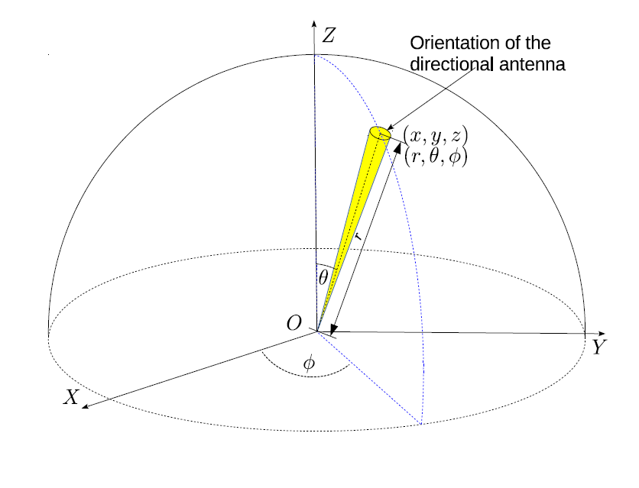
LOS Discovery in 3D
Directional transceiver orientation
r = √(x²+y²+z²)
θ = arccos(z/r)
Φ = arctan (y/x)

Slide 7
LOS Discovery in 3D
Two stages of neighbor discovery
Initialization
3D scanning

Slide 8
LOS Discovery in 3D
Initialization
Use omni-directional RF
Determine existence of neighbor
No GPS, location information not shared
Agrees on starting time of 3D scanning
Agrees on angular speed, ω (rad/s or deg/s)

Slide 9
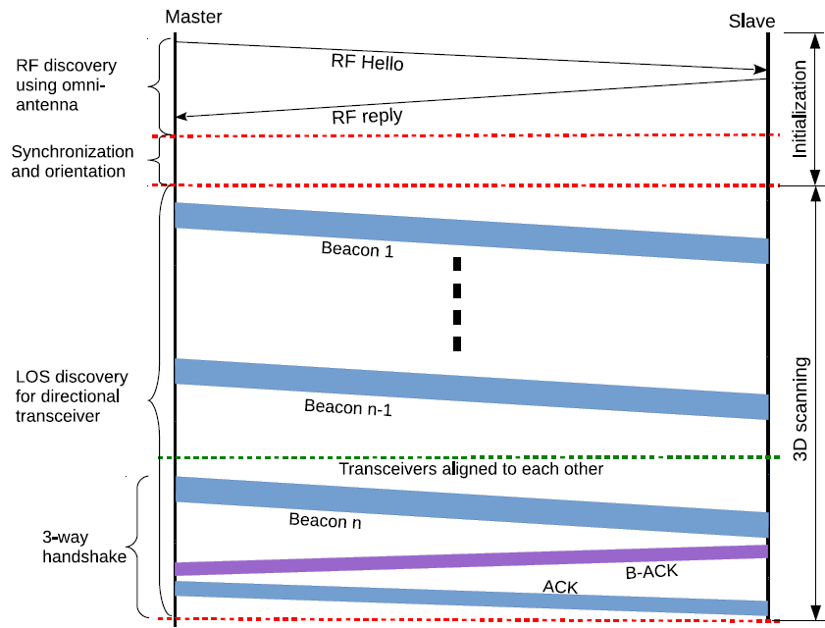
LOS Discovery in 3D
3D scanning

Slide 10
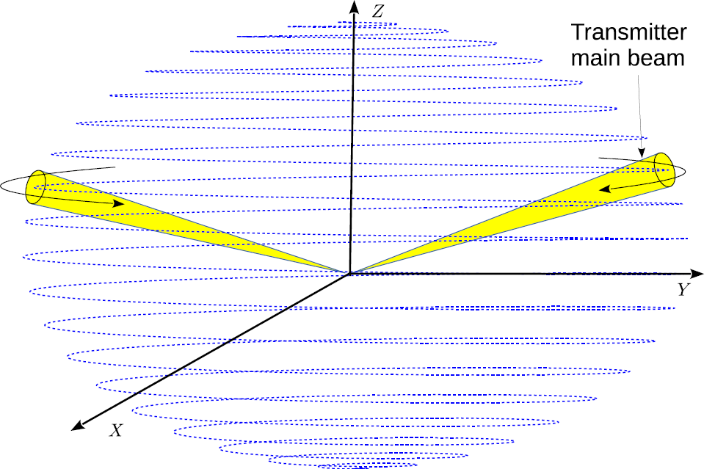
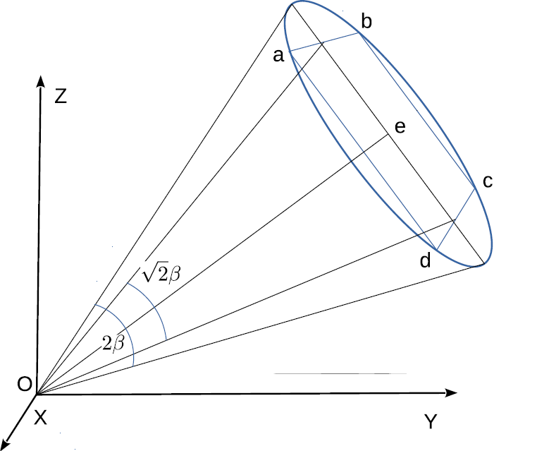
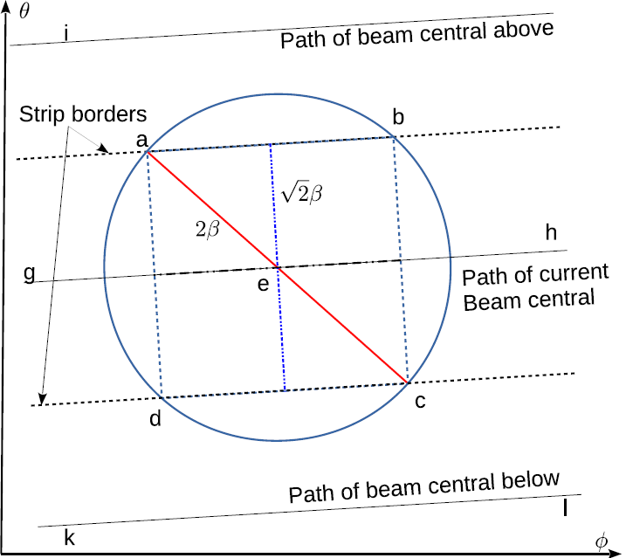
LOS Discovery in 3D
Rotational Speed
ω ≤ β/√2τ
τ = t_{tran} + 3*t_{prop} + 2*_{tproc}

Slide 11
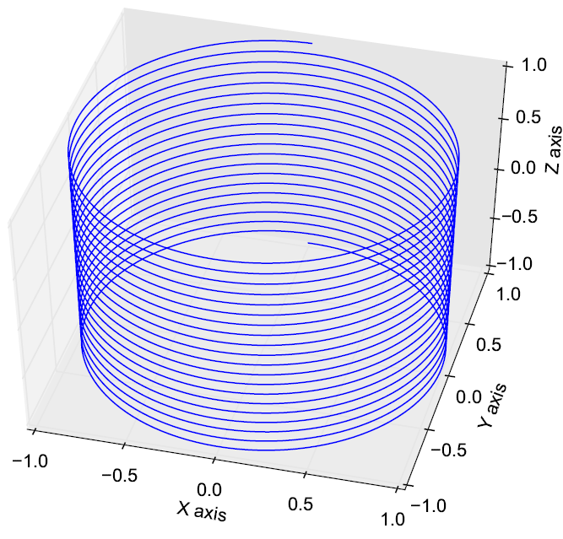
LOS Discovery in 3D
Modified Helix

Slide 12
LOS Discovery in 3D
Modified Helix

Slide 13
Simulations and Results
MATLAB
Nodes at random positions
Divergence angle, β (3º, 5º, 7.5º, 12º)
Angular speed, ω (30rpm – 1200rpm)
50,000 runs for each (β, ω) pair

Slide 14
Simulations and Results
Neighbor discovery time reduces with increase in θ
Larger divegence angle
Smaller discovery time

Slide 15
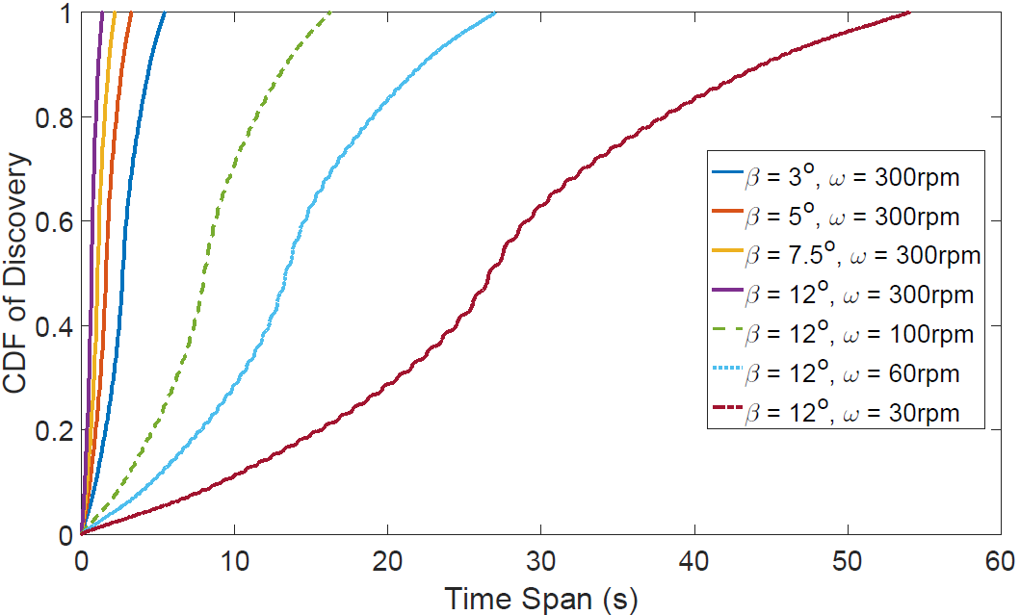
Simulations and Results
Neighbor discovery time reduces with increase in ω
Larger divegence angle
Faster rotation
Smaller discovery time

Slide 16
Simulations and Results
Neighbor discovery time reduces with increase in β and ω (where, ω = β/√2τ)
Larger β and faster ω
Faster LOS discovery

Slide 17
Future Work
Develop neighbor discovery algorithm for:
Mobile nodes
Multiple neighbors
Develop prototype and perform real test-bed experiments.

Slide 18
Thank You!

Slide 19
Questions?

